Slide 1

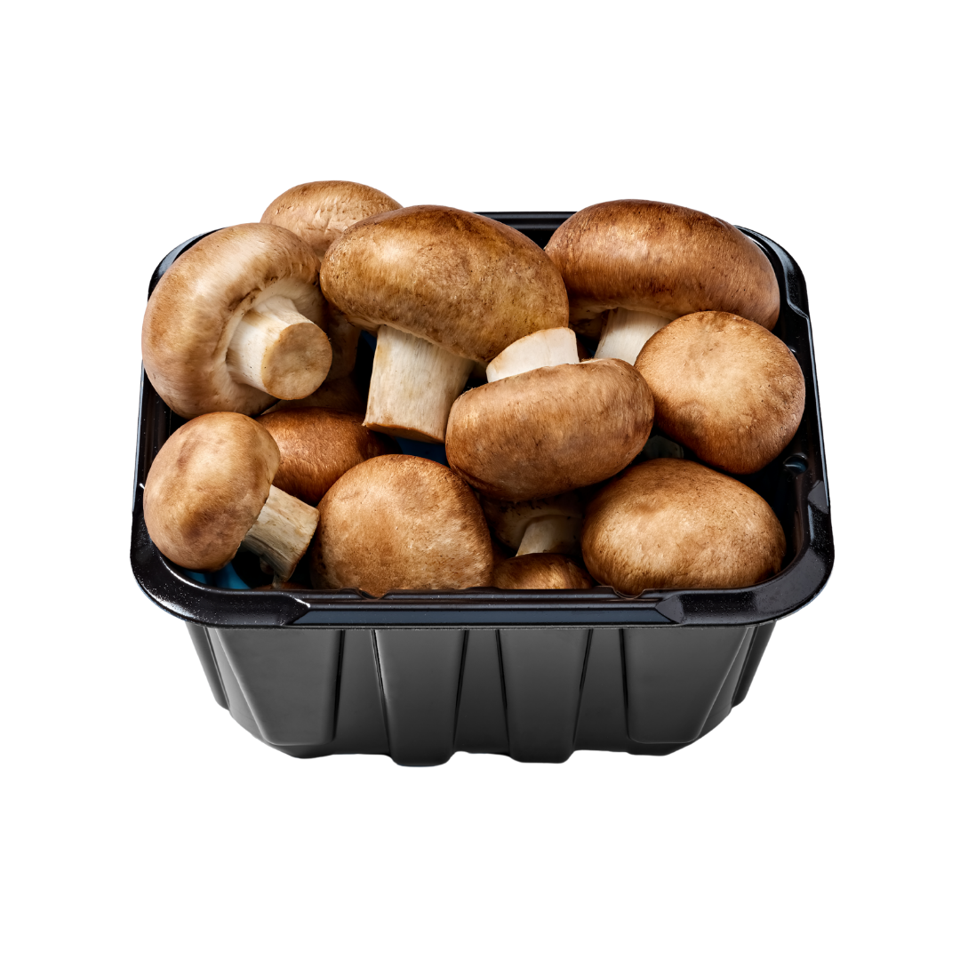

Q4 2025 through Q3 2026
Fresh Mushroom
Purchase Dynamics
An in-depth look at fresh mushroom trips, purchase size and household penetration
Based on Circana, All outlets for the 52 w.e. 10/4/2026 • Released October 2026
mushroomcouncil.org

Slide 2

Mushroom Household Penetration at Retail
During the 52 weeks ending October 4, 2026, 46.3% of U.S. households purchased fresh mushrooms at retail.
This is down substantially from 50.4% household penetration in 2021.
Household penetration remains the main driver of the decrease in volume sales seen these past few years, with a full percentage point decline over the past year. This may improve toward the end of the year as the July Cyclospora iceberg lettuce recall caused vastly different shopping patterns in the third quarter of 2026.
Please note mushrooms sold as part of kebobs or mixed vegetable kits are not included in these numbers.
Farmers’ markets, specialty stores, Asian stores and restaurant foodservice are also not accounted for in this study.
A look by mushroom type shows the following:
White mushrooms have the highest household penetration (33.2%) but also the most erosion (-1.5 percentage points) year-over-year.
This is likely due to light mushroom consumers, who tend to purchase white mushrooms, dropping out of the category.
Crimini/baby bella mushrooms have the second-highest penetration -24.1%, but engagement started to drop, down 0.9 points YOY.
While many consumers purchase both white and crimini mushrooms -33.2% + 24.1% > 46.3%, each also seem to have their unique audiences. This provides a potential opportunity for crossover sales.
Year | % HH Buying
2021 | 50.4%
2022 | 49.1%
2023 | 48.3%
2024 | 47.9%
2025 | 47.1%
Q1 ’26 | 47.0%
Q2 ’26 | 46.4%
Q3 ‘26 | 46.3%
Product | Share of U.S. households purchasing 1+ times/year | Change in households purchasing vs. last year | Change in households purchasing vs. 2 years ago
Produce department | 99.1% | +0.1 | +0.1%
Fresh vegetables | 97.9% | 0.0 | 0.0%
Fresh cooking vegetables | 89.1% | -0.2 | -0.8%
Fresh mushrooms | 46.3% | -1.0 | -2.2%
White mushrooms | 33.2% | -1.5 | -2.4%
Crimini/brown mushrooms | 24.1% | -0.9 | -0.8%
Portabella mushrooms | 7.7% | -0.4 | -1.0%
Random weight mushrooms | 5.6% | -0.8 | -1.4%
Shiitake mushrooms | 2.7% | 0.0 | 0.0%
All other mushrooms | 0.9% | 0.0 | 0.0%
Mixed mushrooms | 0.9% | -0.1 | -0.3%
Oyster mushrooms | 0.5% | -0.1 | -0.2%
Chanterelle mushrooms | 0.2% | -- | --
Source: Circana, Integrated Fresh Household Panel, All Outlets, 52 weeks ending 10/4/2026

Slide 3
Mushroom Trips per Buyer at Retail
Year | Annual trips per buyer
2022 | 7.9x
2023 | 7.7x
2024 | 7.8x
2025 | 7.6x
Q1 ‘26 | 7.5x
Q2 ‘26 | 7.4x
Q3 ‘26 | 7.2x
Consumers continue to purchase fresh mushrooms an average of 7.2 times per year.
The average is starting to trend closer to seven than eight purchases per year.
While the trip frequency had been trending down, the deceleration intensified compared to the past few measurements. This is likely related to the widespread impact of the Cyclospora iceberg lettuce recall that led to changed shopping patterns across most commodities.
Because of the small base 7.2 trips, the 0.4 decrease in trips year over year equates to a loss of 4.9%.
White mushrooms were purchased the most frequently, but trips declined by 3.0%, with similar or even larger declines for baby bellas, portabellas and random weight mushrooms.
Crimini/brown mushrooms, that had enjoyed trip stability for a number of years, also posted a reduction in trips by 3.1%.
Most specialty mushrooms were purchased just once or twice a year, though did enjoy trip growth.
Product | Trips per buyer per year | Change in trips per buyer vs. last year | Percentage change in trips per buyer vs. Last year | Change in trips per buyer vs. 2 YA | Percentage change in trips per buyer vs. 2YA
Produce department | 83.4x | -0.5 | -0.6% | +1.2 | +1.4%
Fresh vegetables | 56.3x | -0.3 | -0.5% | -0.2 | -0.4%
Fresh cooking vegetables | 21.2x | -0.1 | -0.5% | -0.1 | -0.3%
Fresh mushrooms | 7.2x | -0.4 | -4.9% | -0.5 | -6.1%
White mushrooms | 5.3x | -0.2 | -3.0% | -0.3 | -5.5%
Crimini/brown mushrooms | 4.4x | -0.1 | -3.1% | -0.3 | -5.4%
Portabella mushrooms | 3.3x | -0.2 | -5.3% | -0.0 | -1.3%
Random weight mushrooms | 2.0x | -0.1 | -4.1% | -0.2 | -7.5%
Shiitake mushrooms | 2.8x | -0.2 | -7.5% | -0.5 | -14.5%
All other mushrooms | 2.5x | +0.4 | +16.9% | +0.1 | +4.3%
Mixed mushrooms | 1.9x | +0.1 | +8.2% | +0.3 | +20.3%
Oyster mushrooms | 1.8x | +0.1 | +7.5% | +0.1 | +5.8%
Chanterelle mushrooms | 1.8x | +0.1 | +7.5% | -- | --
Source: Circana, Integrated Fresh Household Panel, all outlets, 52 weeks ending 10/4/2026

Slide 4
Mushroom Dollars per Trip at Retail
Unlike other grocery categories, fresh mushroom prices have been relatively stable for several years.
On average, consumers spent $3.29 when buying mushrooms.
This is up five cents from the 2025 average and within cents of the 2022 through 2024 averages — highlighting the lack of inflation in fresh mushrooms and the produce department in general.
The mushroom average of $3.29 was slightly higher than the average across all cooking vegetables, which was $3.20.
The average trip amount was highest for chanterelle, followed by shiitake and mixed mushroom packages.
The average ring for crimini mushrooms was also higher than that of white mushrooms, at $3.70 versus $2.93.
Year | Dollars per trip
2022 | $3.26
2023 | $3.29
2024 | $3.28
2025 | $3.24
Q1 ‘26 | $3.27
Q2 ‘26 | $3.29
Q3 ‘26 | $3.29
Product | Dollars per trip | Dollars per trip change vs YA | Percentage change dollars per trip vs. YA | Dollars per trip change vs. 2YA | Percentage change dollars per trip vs. 2YA
Produce department | $9.39 | +$0.04 | +0.4% | +$0.15 | +1.6%
Fresh vegetables | $6.64 | +$0.05 | +0.8% | +$0.06 | +0.9%
Fresh cooking vegetables | $3.20 | +$0.03 | +0.9% | +$0.02 | +0.7%
Fresh mushrooms | $3.29 | +$0.06 | +1.7% | -$0.01 | -0.3%
White mushrooms | $2.93 | +$0.04 | +1.3% | +$0.02 | +0.8%
Crimini/brown mushrooms | $3.70 | +$0.10 | +2.9% | $0.00 | +0.1%
Portabella mushrooms | $2.93 | +$0.04 | +1.2% | -$0.11 | -3.6%
Random weight mushrooms | $2.96 | -$0.01 | -0.3% | -$0.05 | -1.6%
Shiitake mushrooms | $6.58 | +$0.35 | +5.7% | +$0.44 | +7.1%
All other mushrooms | $4.77 | -$0.49 | -9.3% | -$0.20 | -4.1%
Mixed mushrooms | $4.69 | +$0.36 | +8.3% | +$0.19 | +4.2%
Oyster mushrooms | $4.72 | -$1.11 | -19.1% | -$0.56 | -10.7%
Chanterelle mushrooms | $12.99 | -$1.03 | -7.4% | -- | --
Source: Circana, Integrated Fresh Household Panel, all outlets, 52 weeks ending 10/4/2026

Slide 5
Mushroom Units per Trip at Retail
Year | Units per trip
2022 | 1.1
2023 | 1.1
2024 | 1.2
2025 | 1.2
Q1 ’26 | 1.2
Q2 ’26 | 1.2
Q3 ‘26 | 1.2
Virtually all consumers purchase just one package of mushroom per trip.
This has been the case for many years, despite the rise of buy-one, get-one promotions.
Because the units per trip are so low, even the smallest of changes result in much larger percentage changes, that in reality are essentially meaningless.
Given the decline in the number of trips and the unchanged number of packages per trip over the past few years, promotions and tactics geared at upsizing consumers to larger pack sizes appear to be the most meaningful way to grow sales.
Product | Unit sales per trip | Unit sales per trip change vs YA | Unit sales per trip % change vs YA | Unit sales per trip change vs 2 YA | Unit sales per trip % change vs 2 YA
Produce department | 3.1 | -0.0 | -1.3% | -0.1 | -1.8%
Fresh vegetables | 2.4 | -0.0 | -1.8% | -0.1 | -2.2%
Fresh cooking vegetables | 1.3 | -0.0 | -0.2% | -0.0 | -0.4%
Fresh mushrooms | 1.2 | 0.0 | 0.5% | -0.0 | -0.1%
White mushrooms | 1.2 | 0.0 | 1.1% | 0.0 | 1.2%
Crimini/brown mushrooms | 1.1 | 0.0 | 0.4% | -0.0 | -0.3%
Portabella mushrooms | 1.3 | 0.0 | 0.7% | -0.0 | -0.4%
Random weight mushrooms | 1.1 | -0.0 | -0.7% | -0.0 | -0.8%
Shiitake mushrooms | 1.2 | 0.0 | 0.9% | 0.0 | 1.0%
All other mushrooms | 1.3 | +0.1 | 7.0% | -0.0 | -0.6%
Mixed mushrooms | 1.2 | -0.0 | -2.4% | -0.0 | -0.9%
Oyster mushrooms | 1.2 | -0.2 | -13.1% | -0.1 | -9.5%
Chanterelle mushrooms | 1.1 | -0.0 | -0.9% | -- | --
Source: Circana, Integrated Fresh Household Panel, all outlets, 52 weeks ending 10/4/2026

Slide 6
Mushroom Annual Spend per Buyer at Retail
Year | Dollars per buyer per year
2022 | $25.63
2023 | $25.42
2024 | $25.56
2025 | $24.59
Q1 ‘26 | $24.39
Q2 ‘26 | $24.28
Q3 ‘26 | $23.87
The 46.3% of U.S. households who purchased fresh mushrooms at retail in the past year spent an average of $23.87.
This is down 81 cents year over year, but down nearly two dollars compared to 2022.
Deflation prompted a decrease in the average spend per buyer for total produce and a small $1 increase for fresh vegetables.
Compared with two years ago, produce spending increased by $23, while mushroom spending decreased by $1.64.
The average annual per household spend for crimini mushrooms exceeded that of white mushrooms, at $16.45 versus $15.53.
This is due to a higher price per pound, while trips and household penetration are no longer that far behind those of white mushrooms.
Shiitake, though purchased by a very small share, have the highest annual spend, at $18.38. This is down $0.43 year-over-year due to a decline in trips.
Mixed mushroom packages reached an average per household spend of $9.05.
Product | Dollars per buyer | Dollars per buyer change vs YA | Dollars per buyer % change vs YA | Dollars per buyer change vs 2 YA | Dollars per buyer % change vs 2 YA
Produce department | $782.87 | -$1.13 | -0.1% | $23.06 | +3.0%
Fresh vegetables | $374.10 | $1.02 | +0.3% | $1.71 | +0.5%
Fresh cooking vegetables | $67.83 | $0.28 | +0.4% | $0.28 | +0.4%
Fresh mushrooms | $23.87 | -$0.81 | -3.3% | -$1.64 | -6.4%
White mushrooms | $15.53 | -$0.27 | -1.7% | -$0.77 | -4.7%
Crimini/brown mushrooms | $16.45 | -$0.05 | -0.3% | -$0.92 | -5.3%
Portabella mushrooms | $9.64 | -$0.41 | -4.1% | -$0.49 | -4.9%
Random weight mushrooms | $5.77 | -$0.26 | -4.3% | -$0.57 | -9.0%
Shiitake mushrooms | $18.38 | -$0.43 | -2.3% | -$1.70 | -8.5%
All other mushrooms | $11.80 | $0.67 | +6.0% | -$0.00 | 0.0%
Mixed mushrooms | $9.05 | $1.33 | +17.2% | $1.83 | +25.3%
Oyster mushrooms | $8.59 | -$1.29 | -13.1% | -$0.50 | -5.5%
Source: Circana, Integrated Fresh Household Panel, all outlets, 52 weeks ending 10/4/2026

Slide 7


Questions?
For more information, contact the Mushroom Council: info@mushroomcouncil.org.

