Slide 1


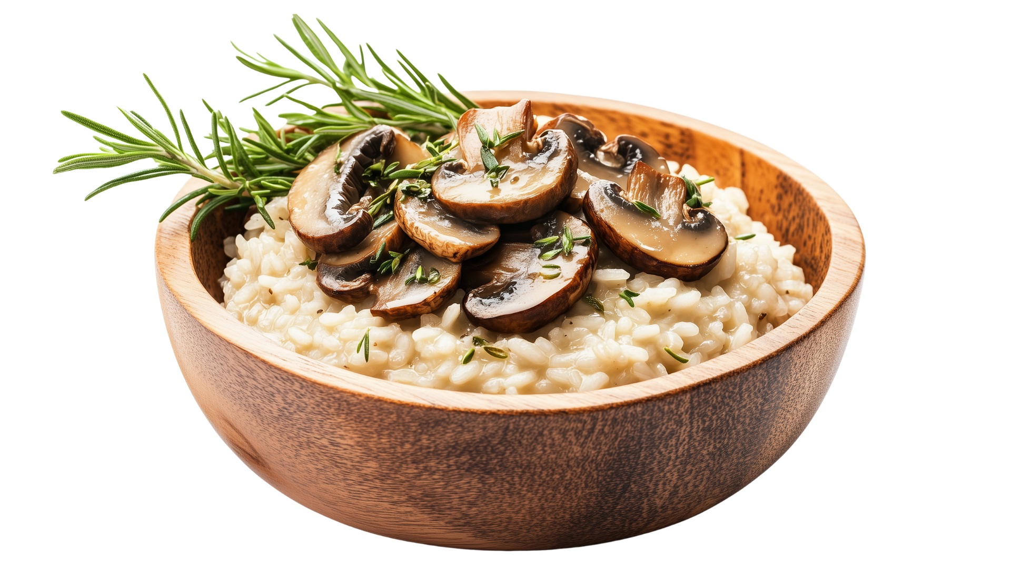
Q2 2025 through Q1 2026
Fresh Mushroom
Purchase Dynamics
An in-depth look at fresh mushroom trips, purchase size and household penetration
Based on Circana, All outlets for the 52 w.e. 3/22/2026 • Released April 2026
mushroomcouncil.org

Slide 2

Mushroom Household Penetration at Retail
During the 52 weeks ending March 22, 2026, 47% of U.S. households purchased fresh mushrooms at retail.
In comparison, 50.4% of households bought fresh mushrooms at retail at least once a year in 2021.
Household penetration remains the main driver of the decrease in volume sales seen these past few years.
Between the second quarter of 2025 and the first quarter of 2026, household penetration dropped 0.6 points to 47.0%
Please note mushrooms sold as part of kebobs or mixed vegetable kits are not included in these numbers.
Farmers’ markets, specialty stores, Asian stores and restaurant foodservice are also not accounted for in this study.
A look by mushroom type shows the following:
White mushrooms have the highest household penetration (34.4%) but also the most erosion (-1.1 percentage points year-over-year).
This is likely due to light mushroom consumers, who tend to purchase white mushrooms, dropping out of the category.
Crimini/baby bella mushrooms have the second-highest and stable household penetration.
While many consumers purchase both white and crimini mushrooms (34.1% + 24.7% > 47.0%), each also seem to have their unique audiences. This provides a potential opportunity for crossover sales.
Year | % HH Buying
2021 | 50.4%
2022 | 49.1%
2023 | 48.3%
2024 | 47.9%
2025 | 47.1%
Q1 ‘26 | 47.0%
Product | Share of U.S. households purchasing 1+ times/year | Change in households purchasing vs. last year | Change in households purchasing vs. 2 years ago
Produce department | 99.1% | +0.1% | 0.0%
Fresh vegetables | 97.8% | +0.1% | 0.0%
Fresh cooking vegetables | 89.3% | -0.4% | -0.6%
Fresh mushrooms | 47.0% | -0.6% | -2.0%
White mushrooms | 34.1% | -1.1% | -2.2%
Crimini/brown mushrooms | 24.7% | 0.0% | -0.3%
Portabella mushrooms | 7.9% | -0.2% | -1.1%
Random weight mushrooms | 6.2% | -0.9% | -1.4%
Shiitake mushrooms | 2.9% | +0.2% | 0.0%
Mixed mushrooms | 1.0% | 0.0% | 0.0%
All other mushrooms | 1.0% | +0.2% | +0.3%
Oyster mushrooms | 0.5% | -0.1% | 0.0%
Chanterelle mushrooms | 0.3% | +0.1% | --
Source: Circana, Integrated Fresh Household Panel, All Outlets, 52 weeks ending 3/22/2026

Slide 3
Mushroom Trips per Buyer at Retail
Consumers continue to purchase fresh mushrooms an average of seven to eight times per year.
The average number of trips across light, medium and heavy buyers was 7.5, virtually unchanged from 7.6 in 2025.
This is also very similar to the trip average seen between 2022 and 2025.
Because of the small base (7.6 trips), the 0.3 decrease in trips equates to a loss of 4.3%.
White mushrooms were purchased the most frequently, but trips declined by 3.9%. This is the largest decrease across all commonly purchased types. Shiitake and chanterelle mushrooms also had substantial declines, but have much lower penetration.
Crimini/brown mushrooms, that had enjoyed trip stability for a number of years, also lost a little ground.
Most specialty mushrooms were purchased just once or twice a year.
Year | Annual trips per buyer
2022 | 7.9
2023 | 7.7
2024 | 7.8
2025 | 7.6
Q1 ‘26 | 7.5
Product | Trips per buyer per year | Change in trips per buyer vs. last year | Percentage change in trips per buyer vs. Last year | Change in trips per buyer vs. 2 YA | Percentage change in trips per buyer vs. 2YA
Produce department | 86.4x | 1.8 | +2.1% | +4.5 | +5.5%
Fresh vegetables | 57.5x | 0.1 | +0.1% | +1.5 | +2.8%
Fresh cooking vegetables | 21.7x | 0.0 | -0.2% | +0.7 | +3.1%
Fresh mushrooms | 7.5x | -0.3 | -4.3% | -0.3 | -3.6%
White mushrooms | 5.4x | -0.2 | -3.9% | -0.2 | -4.0%
Crimini/brown mushrooms | 4.6x | -0.2 | -3.5% | -0.1 | -2.2%
Portabella fresh mushrooms | 3.4x | -0.1 | -4.0% | +0.1 | +1.6%
Random weight mushrooms | 2.0x | 0.0 | -1.9% | -0.1 | -3.5%
Shiitake mushrooms | 2.9x | -0.3 | -9.3% | -0.3 | -9.8%
Mixed mushrooms | 2.0x | -0.2 | -8.5% | -0.4 | -15.5%
All other mushrooms | 1.9x | +0.1 | +4.7% | 0.0 | -0.8%
Oyster mushrooms | 2.0x | +0.3 | +14.5% | +0.3 | +18.3%
Chanterelle mushrooms | 1.6x | -0.6 | -28.6% | --- | --
Source: Circana, Integrated Fresh Household Panel, all outlets, 52 weeks ending 3/22/2026

Slide 4
Mushroom Dollars per Trip at Retail
Unlike other grocery categories, fresh mushroom prices have been relatively stable for several years.
On average, consumers spent $3.27 when buying mushrooms.
This is up three cents from the 2025 average and within cents of the 2022 through 2024 averages — highlighting the lack of inflation in fresh mushrooms and the produce department in general.
The mushroom average of $3.27 was slightly higher than the average across all cooking vegetables, which was $3.16.
The average trip amount was highest for chanterelle, followed by shiitake and mixed mushroom packages.
The average ring for crimini mushrooms was also higher than that of white mushrooms, at $3.64.
Year | Dollars per trip
2022 | $3.26
2023 | $3.29
2024 | $3.28
2025 | $3.24
Q1 ‘26 | $3.27
Product | Dollars per trip | Dollars per trip change vs YA | Percentage change dollars per trip vs. YA | Dollars per trip change vs. 2YA | Percentage change dollars per trip vs. 2YA
Produce department | $9.14 | $0.03 | +0.4% | $0.07 | 0.8%
Fresh vegetables | $6.37 | -$0.01 | -0.2% | -$0.06 | -1.0%
Fresh cooking vegetables | $3.16 | -$0.01 | -0.4% | $0.01 | 0.3%
Fresh mushrooms | $3.27 | $0.02 | +0.5% | -$0.02 | -0.5%
White mushrooms | $2.92 | $0.02 | +0.7% | $0.03 | 0.9%
Crimini/brown mushrooms | $3.64 | $0.03 | +1.0% | -$0.07 | -1.8%
Portabella mushrooms | $2.96 | -$0.04 | -1.4% | -$0.09 | -3.1%
Random weight mushrooms | $2.99 | $0.01 | +0.4% | $0.03 | 1.0%
Shiitake mushrooms | $6.07 | -$0.01 | -0.1% | $0.01 | 0.1%
Mixed mushrooms | $5.60 | -$0.28 | -4.8% | $0.08 | 1.5%
All other mushrooms | $4.37 | -$0.18 | -3.9% | -$0.47 | -9.8%
Oyster mushrooms | $4.96 | -$0.94 | -16.0% | -$0.70 | -12.3%
Chanterelle mushrooms | $13.13 | -$1.55 | -10.5% | -- | --
Source: Circana, Integrated Fresh Household Panel, all outlets, 52 weeks ending 3/22/2026

Slide 5
Mushroom Units per Trip at Retail
Virtually all consumers purchase just one package of mushroom per trip.
This has been the case for many years, despite the rise of buy-one, get-one promotions.
In this light, promotions and tactics geared at upsizing consumers to larger pack sizes appear to be the most meaningful way to grow sales given that the number of trips and the number of packages per trip are virtually unchanged over the past few years.
Year | Units per trip
2022 | 1.1
2023 | 1.1
2024 | 1.2
2025 | 1.2
Q1 ‘26 | 1.2
Product | Unit sales per trip | Unit sales per trip change vs YA | Unit sales per trip % change vs YA | Unit sales per trip change vs 2 YA | Unit sales per trip % change vs 2 YA
Produce department | 3.1 | 0.0 | -0.8% | 0.0 | -1.3%
Fresh vegetables | 2.4 | 0.0 | -1.1% | 0.0 | -2.0%
Fresh cooking vegetables | 1.3 | 0.0 | -0.1% | 0.0 | -0.8%
Fresh mushrooms | 1.2 | 0.0 | 0.5% | 0.0 | -0.4%
White mushrooms | 1.2 | 0.0 | 1.1% | 0.0 | +0.4%
Crimini/brown mushrooms | 1.1 | 0.0 | 0.3% | 0.0 | +0.2%
Portabella mushrooms | 1.3 | 0.0 | 1.1% | 0.0 | -0.8%
Random weight mushrooms | 1.1 | 0.0 | 0.2% | 0.0) | -0.1%
Shiitake mushrooms | 1.1 | 0.0 | -2.1% | 0.0) | -3.6%
Mixed mushrooms | 1.2 | 0.0 | 1.2% | 0.0 | 3.0%
All other mushrooms | 1.3 | +0.1 | -4.5% | -0.1 | -6.6%
Oyster mushrooms | 1.3 | +0.1 | -5.1% | -0.1 | -9.3%
Chanterelle mushrooms | 1.1 | 0.0 | -1.4% | -- | --
Source: Circana, Integrated Fresh Household Panel, all outlets, 52 weeks ending 3/22/2026

Slide 6
Mushroom Annual Spend per Buyer at Retail
Combining the trends in household penetration, trips and purchase size results in U.S. consumers spending $24.39 on fresh mushrooms in the past year.
This is about a dollar less than in 2023 and 2024, and twenty cents less than the 2025 average.
In contrast, total produce spending increased by $19, with all gains being fruit-driven.
Total vegetable spending was down $0.42 year-over-year on a per household basis.
The average annual per household spend for crimini mushrooms exceeded that of white mushrooms, at $16.56 versus $15.73.
This is due to a higher price per pound, while trips and household penetration are no longer that far behind those of white mushrooms.
Shiitake, though purchased by a very small share, have the highest annual spend, at $17.59. This is down $1.83 year-over-year due to a decline in trips.
Mixed mushroom packages reached an average per household spend of $11.45.
Year | Dollars per buyer per year
2022 | $25.63
2023 | $25.42
2024 | $25.56
2025 | $24.59
Q1 ‘26 | $24.39
Product | Dollars per buyer | Dollars per buyer change vs YA | Dollars per buyer % change vs YA | Dollars per buyer change vs 2 YA | Dollars per buyer % change vs 2 YA
Produce department | $789.32 | $18.96 | +2.5% | $47.32 | +6.4%
Fresh vegetables | $366.29 | -$0.42 | -0.1% | $6.43 | +1.8%
Fresh cooking vegetables | $68.71 | -$0.39 | -0.6% | $2.26 | +3.4%
Fresh mushrooms | $24.39 | -$0.97 | -3.8% | ($1.03) | -4.0%
White fresh mushrooms | $15.73 | -$0.53 | -3.2% | ($0.51) | -3.2%
Crimini/brown fresh mushrooms | $16.56 | -$0.44 | -2.6% | ($0.68) | -3.9%
Portabella fresh mushrooms | $10.01 | -$0.56 | -5.3% | ($0.16) | -1.6%
Random weight fresh mushrooms | $6.09 | -$0.09 | -1.4% | ($0.16) | -2.5%
Shiitake fresh mushrooms | $17.59 | -$1.83 | -9.4% | ($1.89) | -9.7%
Mixed fresh mushrooms | $11.14 | -$1.64 | -12.8% | ($1.86) | -14.3%
All other fresh mushrooms | $8.10 | +$0.05 | +0.7% | ($0.95) | -10.5%
Oyster fresh mushrooms | $9.97 | -$0.40 | -3.9% | $0.36 | +3.8%
Source: Circana, Integrated Fresh Household Panel, all outlets, 52 weeks ending 3/22/2026

Slide 7


Questions?
For more information, contact the Mushroom Council: info@mushroomcouncil.org.

