Slide 1
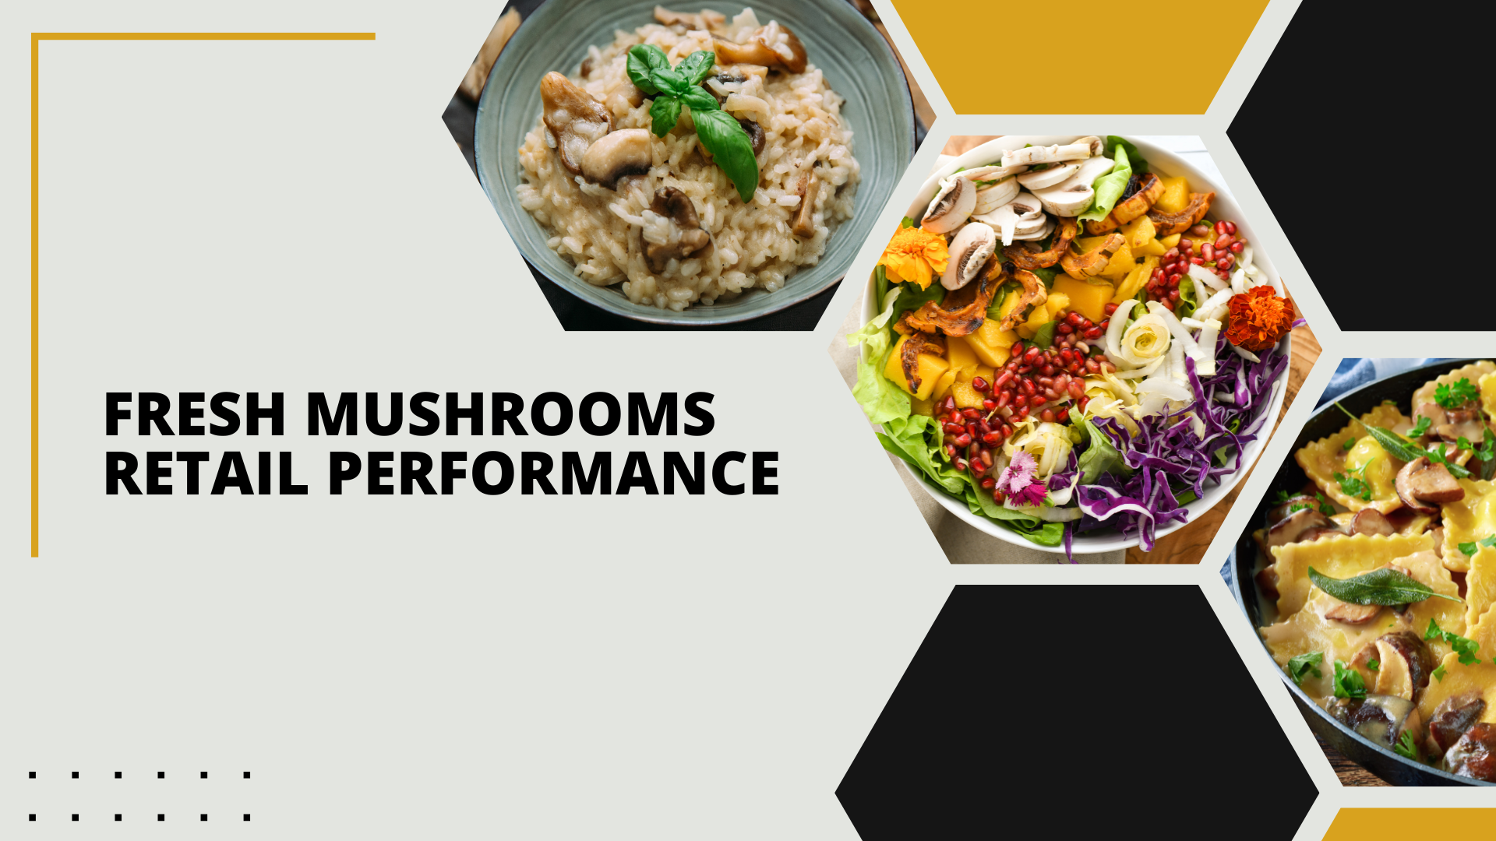

Period ending
April 20, 2025

Slide 2
Methodology
The report covers the four weeks ending April 20, 2025 with week endings:
  March 30, 2025
  April 6, 2025
  April 13, 2025
  April 20, 2025
Dollar references are the retail value, volume is reflected in pounds and units (packages)
Package size, organic, fixed/random weight and value-added now all reflect the MULO+ expanded marketplace
For questions, contact Anne-Marie Roerink, at aroerink@210analytics.com
Source: Circana, Integrated Fresh, MULO+, 4 weeks ending 4/20/2025

Slide 3
Four-year dollar sales trend
Dollar sales continued to contract in the latest quad-week period
Source: Circana, Integrated Fresh, MULO+, 4 weeks and 52 w.e. 4/20/2025 versus same periods the past four years

Slide 4
Four-year unit sales trend
Unit sales have declined by about 60 million packages compared to three years ago
Source: Circana, Integrated Fresh, MULO+, 4 weeks and 52 w.e. ending 4/20/2025 versus same periods the past four years

Slide 5
Four-year volume (pound) sales trend
Pound sales have fallen by about 38 million compared to three years ago
Source: Circana, Integrated Fresh, MULO+, 4 weeks and 52 w.e. ending 4/20/2025 versus same periods the past four years

Slide 6
Mushroom contribution to the department/category
The mushroom share of fresh produce and total vegetables averages 3%-4%
4 weeks Mushroom $ share | Share of total produce | Share of total vegetables
3YA | 1.8% | 3.7%
2YA | 1.8% | 3.6%
YA | 1.7% | 3.4%
4 w.e. 4/20/2025 | 1.5% | 3.3%
52 weeks Mushroom $ share | Share of total produce | Share of total vegetables
3YA | 1.6% | 3.4%
2YA | 1.7% | 3.5%
YA | 1.8% | 3.7%
52 w.e. 4/20/2025 | 1.9% | 3.9%
Source: Circana, Integrated Fresh, MULO+, 4 weeks and 52 w.e. ending 4/20/2025

Slide 7
Mushrooms price per unit
On a per unit basis, vegetable and mushroom prices decreased in the quad week
4 weeks Average price/unit | Total produce | Total vegetables | Mushrooms
3YA | $2.70 | $2.35 | $2.89
2YA | $2.70 | $2.41 | $2.98
YA | $2.75 | $2.44 | $3.01
4 w.e. 4/20/2025 | $2.77 | +0.9% | $2.41 | -1.4% | $2.98 | -1.0%
Source: Circana, Integrated Fresh, MULO+, YTD weeks ending 4/20/2025

Slide 8
Mushroom price per volume (pound)
On a per pound basis, total produce, vegetables and mushrooms became less expensive for the consumer
4 weeks Average price/pound | Total produce | Total vegetables | Mushrooms
3YA | $1.88 | $1.95 | $4.37
2YA | $1.88 | $1.99 | $4.45
YA | $1.92 | $2.01 | $4.49
4 w.e. 4/20/2025 | $1.91 | -0.3% | $1.98 | -1.3% | $4.44 | -1.1%
Source: Circana, Integrated Fresh, MULO+, YTD weeks ending 4/20/2025

Slide 9
Price per volume by quarter/month
The quad-week price per volume was the lowest since Q2 2022
Source: Circana, Integrated Fresh, MULO+, 2019-w.e. 4/20/2025

Slide 10
Price by type
4 w.e.4/20/2025 | Price per unit | % change vs. YA
Total mushrooms | $2.98 | -1.0%
White mushrooms | $2.63 | -0.5%
Crimini mushrooms | $3.38 | -1.4%
Portabella mushrooms | $2.69 | -3.9%
Specialty mushrooms | $5.55 | +0.6%
4 w.e. 4/20/2025 | Price per volume | % change vs. YA
Total mushrooms | $4.44 | -1.1%
White mushrooms | $3.94 | -1.0%
Crimini mushrooms | $4.52 | -0.8%
Portabella mushrooms | $5.22 | -3.2%
Specialty mushrooms | $14.39 | +1.8%
Specialty mushrooms include mixed packages, shiitake, oyster, enoki, chanterelle, morel, wood ear, porcini, black forest, lion’s mane and other
Source: Circana, Integrated Fresh, MULO+, 4 w.e. 4/20/2025

Slide 11

Mushroom dollar, unit, volume sales
The quad-week was impacted by the much later timing of Easter in 2025 vs. 2024
4 w.e. 4/20/2025 dollars
$113.4M
volume (lbs)
25.5M
-5.1%
-4.2%
-4.0%
Dollar
growth vs. YA
Unit
growth vs. YA
Volume
growth vs. YA
-6.7% vs. 3YA
-9.4% vs. 3YA
-8.2% vs. 3YA
Source: Circana, Integrated Fresh, MULO+, 4 weeks ending 4/20/2025

Slide 12
Vegetables and mushroom pound sales vs. YA
Both the vegetable and mushroom trend lines show year-over-year decreases
Source: Circana, Integrated Fresh, MULO+, 2020 -w.e. 4/20/2025

Slide 13
Share of dollars sold on merchandising
Promotional levels increased during the past four weeks but remain well below 20% of total sales
Fresh mushrooms | 4 w.e. 4/20/2025 | Vs. YA | Latest 52 w.e. 4/20/2025 | Vs. YA
Share of dollars sold on promotion | 16.3% | -14.3% | 18.1% | +2.2%
* Any merchandising, including feature, display, feature & display and temporary price reductions
Source: Circana, Integrated Fresh, MULO+, latest 4 w.e. 4/20/2025

Slide 14
Over indexing versus under indexing regions
California and the Western region have above-average shares and growth rates
Use as comparison to understand importance/size of mushrooms
L-4 w.e. 4/20/2025 | Share of veg. lbs | Share of mushroom lbs | lbs sales growth vs. YA
Total US | 100.0% | 100.0% | -4.0%
California | 10.9% | 12.2% | -6.7%
Great Lakes | 14.6% | 15.1% | -0.1%
Mid-South | 13.3% | 11.6% | -4.3%
Northeast | 15.8% | 17.9% | -5.4%
Plains | 7.1% | 6.6% | -0.9%
South Central | 10.4% | 8.3% | -1.3%
Southeast | 15.0% | 14.7% | -7.2%
West | 12.9% | 13.6% | -3.1%
WEST
PLAINS
GREAT LAKES
NORTHEAST
MID SOUTH
CALIFORNIA
SOUTHEAST
SOUTH CENTRAL
= Above-average share vs. veg
= Above-average
performance vs. total US
Source: Circana, Integrated Fresh, MULO+, L52 w.e. 4/20/2025 | Total fresh vegetables and total fresh mushrooms

Slide 15
Performance summary whites, browns and specialty
The later timing of Easter wreaked havoc across all segments, including specialty mushrooms
4 weeks ending 4/20/2025 | Dollars | Dollar share | $ sales vs. YA | $ sales vs. 3YA | Volume (lbs) | Lbs share | Lbs vs. YA | Lbs vs. 3YA
Total fresh mushrooms | $113.4M | 100.0% | -5.1% | -6.7% | 25.5M | 100.0% | -4.0% | -8.2%
White mushrooms | $56.4M | 49.7% | -5.6% | -9.4% | 14.3M | 56.1% | -4.7% | -11.3%
Crimini mushrooms | $40.7M | 35.9% | -3.3% | +1.5% | 9.0M | 35.3% | -2.5% | +0.9%
Portabella mushrooms | $8.8M | 7.8% | -7.2% | -27.6% | 1.7M | 6.6% | -4.1% | -23.9%
Specialty mushrooms | $7.4M | 6.5% | -8.0% | +6.4% | 0.5M | 2.0% | -9.6% | -1.0%
Source: Circana, Integrated Fresh, MULO+, 4 weeks ending 4/20/2025

Slide 16

Other insights
Packaged (fixed weight) versus random weight
Package-size analysis
Organic versus conventional
Value-added versus whole/uncut

Slide 17
Package size analysis
8-ounce packs drove the bulk of sales but 24-ounce packages grew dollar, unit and volume sales in the quad-week despite the Easter timing difference
Package size (per UPC) 52 weeks | Dollars | $ vs. YA | Units | % vs. YA | Volume | lbs vs. YA
8 OZ | $719.0M | -3.3% | 310.7M | -2.3% | 155.4M | -2.3%
16 OZ | $230.9M | -3.2% | 57.2M | -4.3% | 57.2M | -4.3%
24 OZ | $246.4M | +2.9% | 47.8M | +1.6% | 71.8M | +1.6%
Source: Circana, Integrated Fresh, MULO+, 52 weeks ending 4/20/2025

Slide 18
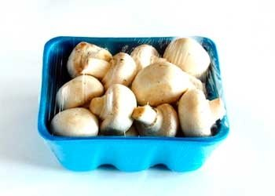
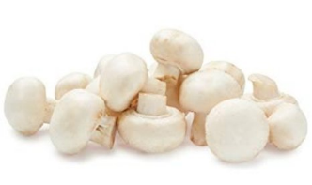
Packaged (fixed weight) versus random weight
Fixed-weight dollar sales outperformed random weight
4 w.e. 4/20/2025 | Share of total mushroom sales and sales growth %
 | Fixed weight | Random weight
Dollar growth | -4.8% | -14.0%
Share of mushroom $ sales | 96.9% | 3.1%
Volume growth | -3.9% | -7.6%
Share of mushroom lbs sales | 97.2% | 2.8%
Source: Circana, Integrated Fresh, MULO+, 4 weeks ending 4/20/2025

Slide 19
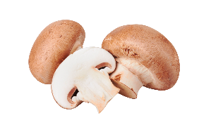
Organic versus conventional mushrooms sales
Organic mushrooms dipped below year-ago levels
4 w.e. 4/20/2025 | Share of total mushroom sales and sales growth %
Market
size
$86.9M
$ growth
-6.3%
Unit growth
-4.7%
Volume
growth
-4.8%
Conventional
Market size
$26.5M
$ growth
-0.8%
Unit growth
-1.2%
Volume
growth
-0.8%
Organic
Source: Circana, Integrated Fresh, MULO+, 4 weeks ending 4/20/2025 compared with year ago

Slide 20
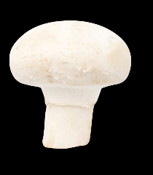

Value added versus whole mushrooms
Whole outperformed value-added mushrooms, though both areas were down
4 w.e. 4/20/2025 | Share of total mushroom sales and sales growth %
Whole
Market
size
$67.5M
$ growth
-3.8%
Unit growth
-3.3%
Volume
growth
-3.1%
Value-
added
Market size
$45.9M
$ growth
-6.9%
Unit growth
-5.3%
Volume
growth
-5.5%
Source: Circana, Integrated Fresh, MULO+, 52 weeks ending 4/20/2025 compared with year ago

