Slide 1
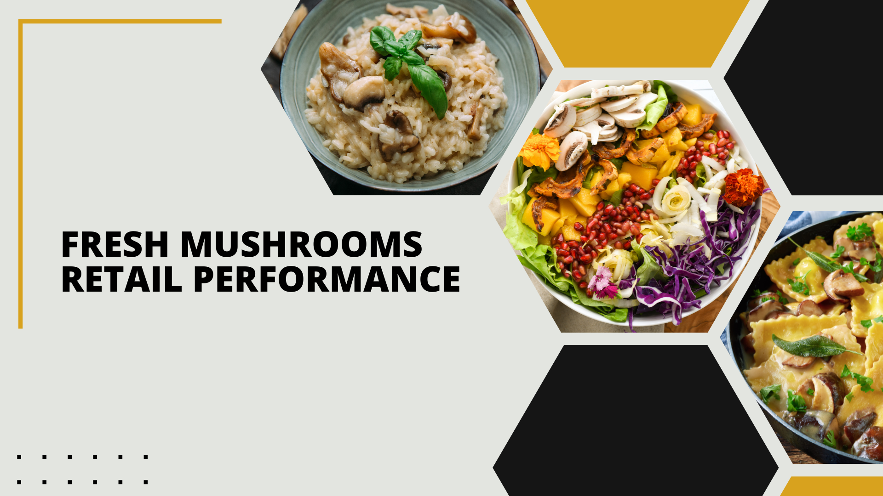

Period ending
March 23, 2025

Slide 2
Methodology
The report covers the four weeks ending February 23, 2025 with week endings:
March 2, 2025
March 9, 2025
March 16, 2025
March 23, 2025
Dollar references are the retail value, volume is reflected in pounds and units (packages)
Package size, organic, fixed/random weight and value-added now all reflect the MULO+ expanded marketplace
For questions, contact Anne-Marie Roerink, at aroerink@210analytics.com
Source: Circana, Integrated Fresh, MULO+, 4 weeks ending 3/23/2025

Slide 3
Four-year dollar sales trend Dollar sales continued to contract in the latest quad-week period
Source: Circana, Integrated Fresh, MULO+, 4 weeks and 52 w.e. 3/23/2025 versus same periods the past four years

Slide 4
Four-year unit sales trend Unit sales have declined by about 63 million packages compared to three years ago
Source: Circana, Integrated Fresh, MULO+, 4 weeks and 52 w.e. ending 3/23/2025 versus same periods the past four years

Slide 5
Four-year volume (pound) sales trend Pound sales have fallen by about 40 million compared to three years ago
Source: Circana, Integrated Fresh, MULO+, 4 weeks and 52 w.e. ending 3/23/2025 versus same periods the past four years

Slide 6
Mushroom contribution to the department/category The mushroom share of fresh produce and total vegetables averages 3%-4%
4 weeks Mushroom $ share | Share of total produce | Share of total vegetables
3YA | 1.9% | 3.9%
2YA | 1.8% | 3.7%
YA | 1.7% | 3.5%
4 w.e. 3/23/2025 | 1.6% | 3.4%
52 weeks Mushroom $ share | Share of total produce | Share of total vegetables
3YA | 1.9% | 3.9%
2YA | 1.8% | 3.7%
YA | 1.7% | 3.6%
52 w.e. 3/23/2025 | 1.6% | 3.4%
Source: Circana, Integrated Fresh, MULO+, 4 weeks and 52 w.e. ending 3/23/2025

Slide 7
Mushrooms price per unit On a per unit basis, vegetable and mushroom prices decreased in the quad week
4 weeks Average price/unit | Total produce | Total vegetables | Mushrooms
3YA | $2.67 | $2.34 | $2.85
2YA | $2.70 | $2.45 | $3.01
YA | $2.76 | $2.47 | $3.00
4 w.e. 3/23/2025 | $2.76 | +0.2% | $2.42 | -2.1% | $2.96 | -1.7%
Source: Circana, Integrated Fresh, MULO+, YTD weeks ending 3/23/2025

Slide 8
Mushroom price per volume (pound) On a per pound basis, total produce, vegetables and mushrooms became less expensive for the consumer
4 weeks Average price/pound | Total produce | Total vegetables | Mushrooms
3YA | $1.87 | $1.92 | $4.30
2YA | $1.89 | $1.99 | $4.52
YA | $1.93 | $2.00 | $4.52
4 w.e. 3/23/2025 | $1.92 | -0.2% | $1.96 | -1.8% | $4.44 | -1.7%
Source: Circana, Integrated Fresh, MULO+, YTD weeks ending 3/23/2025

Slide 9
Price per volume by quarter/month The quad-week price per volume was the lowest since Q2 2022
Source: Circana, Integrated Fresh, MULO+, 2019-w.e. 3/23/2025

Slide 10
Price by type
4 w.e.3/23/2025 | Price per unit | % change vs. YA
Total mushrooms | $2.96 | -1.2%
White mushrooms | $2.61 | -1.2%
Crimini mushrooms | $3.41 | -0.4%
Portabella mushrooms | $2.51 | -5.6%
Specialty mushrooms | $5.56 | +3.1%
4 w.e. 3/23/2025 | Price per volume | % change vs. YA
Total mushrooms | $4.44 | -1.7%
White mushrooms | $3.94 | -1.9%
Crimini mushrooms | $4.53 | -0.7%
Portabella mushrooms | $5.01 | -5.6%
Specialty mushrooms | $14.35 | +2.1%
Specialty mushrooms include mixed packages, shiitake, oyster, enoki, chanterelle, morel, wood ear, porcini, black forest, lion’s mane and other
Source: Circana, Integrated Fresh, MULO+, 4 w.e. 3/23/2025

Slide 11

Mushroom dollar, unit, volume sales The quad-week was impacted by the much later timing of Easter in 2025 vs. 2024
4 w.e. 3/23/2025 dollars
$114M
volume (lbs)
25.7M
-5.6%
-4.5%
-3.9%
Dollar growth vs. YA
Unit
growth vs. YA
Volume growth vs. YA
-7.4% vs. 3YA
-10.9% vs. 3YA
-10.3% vs. 3YA
Source: Circana, Integrated Fresh, MULO+, 4 weeks ending 3/23/2025

Slide 12
Vegetables and mushroom pound sales vs. YA Both the vegetable and mushroom trend lines were affected by the mismatch in Easter dates
Source: Circana, Integrated Fresh, MULO+, 2020 -w.e. 3/23/2025

Slide 13
Share of dollars sold on merchandising Promotional levels increased during the past four weeks but remain well below 20% of total sales
Fresh mushrooms | 4 w.e. 3/23/2025 | Vs. YA | Latest 52 w.e. 3/23/2025 | Vs. YA
Share of dollars sold on promotion | 18.7% | +2.2% | 18.4% | +3.7%
* Any merchandising, including feature, display, feature & display and temporary price reductions
Source: Circana, Integrated Fresh, MULO+, latest 4 w.e. 3/23/2025

Slide 14
Over indexing versus under indexing regions California and the Western region have above-average shares and growth rates
Use as comparison to understand importance/size of mushrooms
L-4 w.e. 3/23/2025 | Share of veg. lbs | Share of mushroom lbs | lbs sales growth vs. YA
Total US | 100.0% | 100.0% | -3.9%
California | 11.0% | 12.6% | -2.8%
Great Lakes | 14.4% | 14.8% | -2.4%
Mid-South | 13.2% | 12.0% | -3.0%
Northeast | 16.2% | 17.0% | -6.3%
Plains | 7.0% | 6.5% | -4.0%
South Central | 10.2% | 7.9% | -2.0%
Southeast | 15.3% | 15.4% | -6.0%
West | 12.6% | 13.8% | -3.2%
WEST
PLAINS
GREAT LAKES
NORTHEAST
MID SOUTH
CALIFORNIA
SOUTHEAST
SOUTH CENTRAL
= Above-average share vs. veg
= Above-average performance vs. total US
Source: Circana, Integrated Fresh, MULO+, L52 w.e. 3/23/2025 | Total fresh vegetables and total fresh mushrooms

Slide 15
Performance summary whites, browns and specialty The later timing of Easter wreaked havoc across all segments, including specialty mushrooms
4 weeks ending 3/23/2025 | Dollars | Dollar share | $ sales vs. YA | $ sales vs. 3YA | Volume (lbs) | Lbs share | Lbs vs. YA | Lbs vs. 3YA
Total fresh mushrooms | $114.1M | 100.0% | -5.6% | -7.4% | 25.7M | 100.0% | -3.9% | -10.3%
White mushrooms | $56.6M | 49.6% | -5.6% | -10.5% | 14.4M | 55.9% | -3.8% | -13.4%
Crimini mushrooms | $41.3M | 36.2% | -5.0% | +0.7% | 9.1M | 35.4% | -4.3% | -2.5%
Portabella mushrooms | $8.4M | 7.4% | -6.2% | -27.4% | 1.7M | 6.6% | -0.6% | -22.7%
Specialty mushrooms | $7.1M | 6.9% | -7.7% | +5.3% | 0.5M | 2.1% | -9.6% | -1.3%
Source: Circana, Integrated Fresh, MULO+, 4 weeks ending 3/23/2025

Slide 16

Other insights
Packaged (fixed weight) versus random weight
Package-size analysis
Organic versus conventional
Value-added versus whole/uncut

Slide 17
Package size analysis 8-ounce packs drove the bulk of sales but 24-ounce packages grew dollar, unit and volume sales in the quad-week despite the Easter timing difference
Package size (per UPC) 52 weeks | Dollars | $ vs. YA | Units | % vs. YA | Volume | lbs vs. YA
8 OZ | $721.2M | -3.1% | 311.1M | -2.3% | 155.5M | -2.3%
16 OZ | $232.3M | -3.4% | 57.5M | -4.8% | 57.5M | -4.8%
24 OZ | $245.8M | +2.7% | 47.8M | +1.7% | 71.7M | +1.7%
Source: Circana, Integrated Fresh, MULO+, 52 weeks ending 3/23/2025

Slide 18
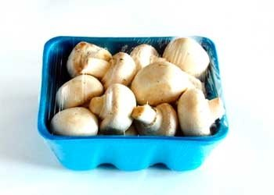
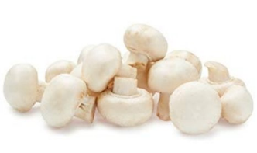
Packaged (fixed weight) versus random weight Fixed-weight dollar sales outperformed random weight
4 w.e. 3/23/2025 | Share of total mushroom sales and sales growth %
 | Fixed weight | Random weight
Dollar growth | -5.2% | -15.5%
Share of mushroom $ sales | 96.9% | 3.1%
Volume growth | -3.8% | -9.1%
Share of mushroom lbs sales | 97.2% | 2.1%
Source: Circana, Integrated Fresh, MULO+, 4 weeks ending 3/23/2025

Slide 19
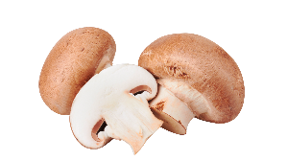
Organic versus conventional mushrooms sales Organic mushrooms increased volume sales with a shift to larger pack sizes
4 w.e. 3/23/2025 | Share of total mushroom sales and sales growth %
Market size
$87.1M
$ growth
-7.3%
Unit growth
-5.1%
Volume growth
-5.2%
Conventional
Market size
$27.0M
$ growth
+0.3%
Unit growth
-0.7%
Volume growth
+1.2%
Organic
Source: Circana, Integrated Fresh, MULO+, 4 weeks ending 3/23/2025 compared with year ago

Slide 20
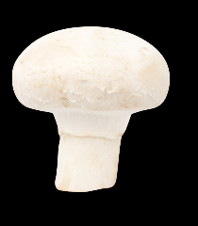

Value added versus whole mushrooms Whole outperformed value-added mushrooms, though both areas were down
4 w.e. 3/23/2025 | Share of total mushroom sales and sales growth %
Whole
Market size
$67.5M
$ growth
-3.5%
Unit growth
-2.6%
Volume growth
-2.2%
Value- added
Market size
$46.6M
$ growth
-8.4%
Unit growth -6.9%
Volume growth
-6.7%
Source: Circana, Integrated Fresh, MULO+, 52 weeks ending 3/23/2025 compared with year ago

