Slide 1
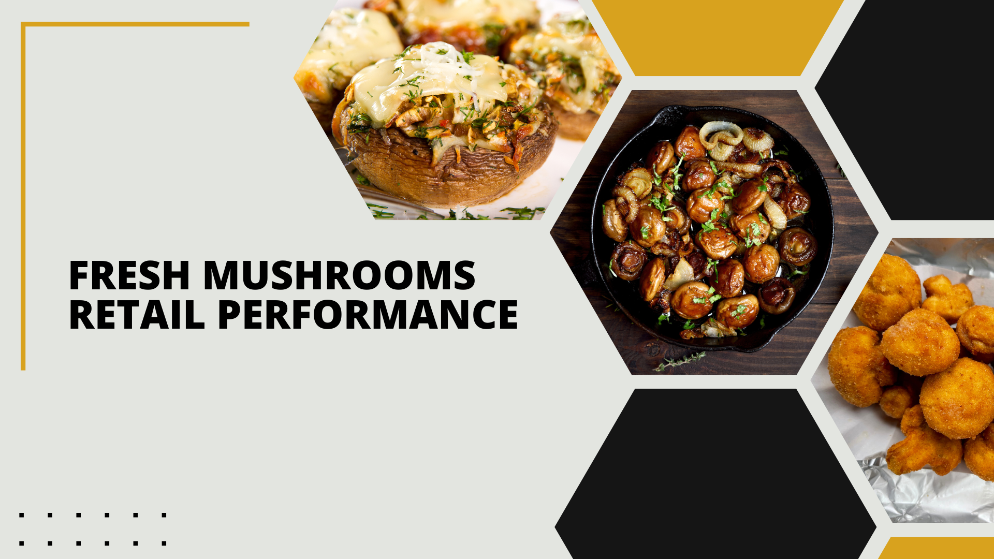

Period ending
February 23, 2025

Slide 2
Methodology
The report covers the four weeks ending February 23, 2025 with week endings:
  February 2, 2025
  February 9, 2025
  February 16, 2025
  February 23, 2025
Dollar references are the retail value, volume is reflected in pounds and units (packages)
Package size, organic, fixed/random weight and value-added now all reflect the MULO+ expanded marketplace
For questions, contact Anne-Marie Roerink, at aroerink@210analytics.com
Source: Circana, Integrated Fresh, MULO+, 4 weeks ending 2/23/2025

Slide 3
Four-year dollar sales trend
Quad-week sales were down almost $10 million from three years ago
Source: Circana, Integrated Fresh, MULO+, 4 weeks and 52 w.e. 2/23/2025 versus same periods the past four years

Slide 4
Four-year unit sales trend
Unit sales have declined by about 64 million packages over the years, but a shift to larger packages have made up some of the lost pounds
Source: Circana, Integrated Fresh, MULO+, 4 weeks and 52 w.e. ending 2/23/2025 versus same periods the past four years

Slide 5
Four-year volume (pound) sales trend
Pound sales have fallen by about 41 million compared to three years ago
Source: Circana, Integrated Fresh, MULO+, 4 weeks and 52 w.e. ending 2/23/2025 versus same periods the past four years

Slide 6
Mushroom contribution to the department/category
The mushroom share of fresh produce and total vegetables averages 3%-4%
4 weeks Mushroom $ share | Share of total produce | Share of total vegetables
3YA | 1.9% | 4.0%
2YA | 1.9% | 3.8%
YA | 1.8% | 3.7%
4 w.e. 2/23/2025 | 1.6% | 3.5%
52 weeks Mushroom $ share | Share of total produce | Share of total vegetables
3YA | 1.9% | 3.9%
2YA | 1.8% | 3.7%
YA | 1.7% | 3.6%
52 w.e. 2/23/2025 | 1.6% | 3.4%
Source: Circana, Integrated Fresh, MULO+, 4 weeks and 52 w.e. ending 2/23/2025

Slide 7
Mushrooms price per unit
On a per unit basis, vegetable and mushroom prices decreased in the quad week
4 weeks Average price/unit | Total produce | Total vegetables | Mushrooms
3YA | $2.67 | $2.31 | $2.87
2YA | $2.74 | $2.48 | $3.03
YA | $2.79 | $2.47 | $3.03
4 w.e. 2/23/2025 | $2.80 | +0.3% | $2.43 | -1.5% | $2.95 | -2.6%
Source: Circana, Integrated Fresh, MULO+, YTD weeks ending 2/23/2025

Slide 8
Mushroom price per volume (pound)
On a per pound basis, total produce, vegetables and mushrooms became less expensive for the consumer
4 weeks Average price/pound | Total produce | Total vegetables | Mushrooms
3YA | $1.90 | $1.92 | $4.32
2YA | $1.96 | $2.06 | $4.54
YA | $1.98 | $2.05 | $4.57
4 w.e. 2/23/2025 | $1.98 | -0.3% | $2.00 | -2.4% | $4.44 | -2.8%
Source: Circana, Integrated Fresh, MULO+, YTD weeks ending 2/23/2025

Slide 9
Price per volume by quarter/month
The quad-week price per volume was the lowest since Q2 2022
Source: Circana, Integrated Fresh, MULO+, 2019-w.e. 2/23/2025

Slide 10
Price by type
4 w.e.2/23/2025 | Price per unit | % change vs. YA
Total mushrooms | $2.95 | -2.6%
White mushrooms | $2.62 | -2.3%
Crimini mushrooms | $3.36 | -2.4%
Portabella mushrooms | $2.51 | -5.3%
Specialty mushrooms | $5.36 | +0.3%
4 w.e. 2/23/2025 | Price per volume | % change vs. YA
Total mushrooms | $4.44 | -2.8%
White mushrooms | $3.94 | -3.1%
Crimini mushrooms | $4.51 | -1.7%
Portabella mushrooms | $5.02 | -5.0%
Specialty mushrooms | $14.20 | +0.4%
Specialty mushrooms include shiitake, oyster, enoki, chanterelle, morel, wood ear, porcini, black forest, lion’s mane and other
Source: Circana, Integrated Fresh, MULO+, 4 w.e. 2/23/2025

Slide 11

Mushroom dollar, unit, volume sales
The quad-week was impacted by the date cut-off and showed larger declines than we have seen in recent months
4 w.e. 2/23/2025 dollars
$118.0M
volume (lbs)
26.6M
-5.3%
-2.7%
-2.6%
Dollar
growth vs. YA
Unit
growth vs. YA
Volume
growth vs. YA
-7.2% vs. 3YA
-9.8% vs. 3YA
-9.7% vs. 3YA
Source: Circana, Integrated Fresh, MULO+, 4 weeks ending 2/23/2025

Slide 12
Vegetables and mushroom pound sales vs. YA
Vegetable growth rates resumed after a flat quad-week 13 performance
Source: Circana, Integrated Fresh, MULO+, 2020 -w.e. 2/23/2025

Slide 13
Share of dollars sold on merchandising
Promotional levels increased during the past four weeks – affecting the price per pound and unit
Fresh mushrooms | 4 w.e. 2/23/2025 | Vs. YA | Latest 52 w.e. 2/23/2025 | Vs. YA
Share of dollars sold on promotion | 17.6% | +5.4% | 18.3% | +4.7%
* Any merchandising, including feature, display, feature & display and temporary price reductions
Source: Circana, Integrated Fresh, MULO+, latest 4 w.e. 2/23/2025

Slide 14
Over indexing versus under indexing regions
Volume grew for the Great Lakes and was close to year ago in the Plains
Use as comparison to understand importance/size of mushrooms
L-4 w.e. 2/23/2025 | Share of veg. lbs | Share of mushroom lbs | lbs sales growth vs. YA
Total US | 100.0% | 100.0% | -2.6%
California | 10.8% | 12.4% | -4.5%
Great Lakes | 14.5% | 15.0% | +0.6%
Mid-South | 13.5% | 12.0% | -2.2%
Northeast | 15.8% | 17.5% | -3.6%
Plains | 7.1% | 6.4% | -0.9%
South Central | 10.4% | 7.6% | -3.0%
Southeast | 15.3% | 15.2% | -4.5%
West | 12.7% | 14.0% | -1.6%
WEST
PLAINS
GREAT LAKES
NORTHEAST
MID SOUTH
CALIFORNIA
SOUTHEAST
SOUTH CENTRAL
= Above-average share vs. veg
= Above-average
performance vs. total US
Source: Circana, Integrated Fresh, MULO+, L52 w.e. 2/23/2025 | Total fresh vegetables and total fresh mushrooms

Slide 15
Performance summary whites, browns and specialty
Whites had the strongest performance this quad week but all varieties lost ground
4 weeks ending 2/23/2025 | Dollars | Dollar share | $ sales vs. YA | $ sales vs. 3YA | Volume (lbs) | Lbs share | Lbs vs. YA | Lbs vs. 3YA
Total fresh mushrooms | $118M | 100.0% | -5.3% | -7.2% | 26.6M | 100.0% | -2.6% | -9.7%
White mushrooms | $58.6M | 49.7% | -4.0% | -10.1% | 14.9M | 55.9% | -0.9% | -12.7%
Crimini mushrooms | $42.4M | 35.9% | -6.5% | -0.1% | 9.4M | 35.4% | -4.9% | -2.6%
Portabella mushrooms | $8.6M | 7.3% | -7.7% | -26.0% | 1.7M | 6.5% | -2.8% | -19.7%
Specialty mushrooms | $7.1M | 6.0% | -4.2% | +6.0% | 0.5M | 1.9% | -4.6% | +0.7%
Source: Circana, Integrated Fresh, MULO+, 4 weeks ending 2/23/2025

Slide 16

Other insights
Packaged (fixed weight) versus random weight
Package-size analysis
Organic versus conventional
Value-added versus whole/uncut

Slide 17
Package size analysis
8-ounce packs drove the bulk of sales but 24-ounce packages grew dollar, unit and volume sales in the quad-week
Package size (per UPC) 52 weeks | Dollars | $ vs. YA | Units | % vs. YA | Volume | lbs vs. YA
8 OZ | $724.4M | -2.8% | 311.7M | -2.2% | 155.8M | -2.2%
16 OZ | $233.8M | -3.5% | 57.9M | -5.1% | 57.9M | -5.1%
24 OZ | $245.1M | +2.3% | 47.7M | +1.7% | 71.6M | +1.7%
Source: Circana, Integrated Fresh, MULO+, 52 weeks ending 2/23/2025

Slide 18
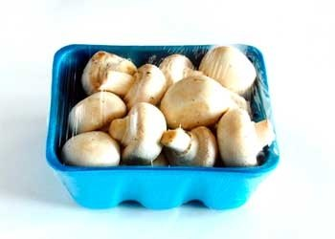
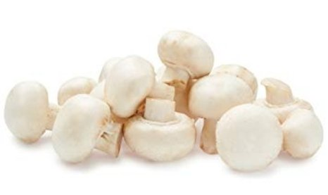
Packaged (fixed weight) versus random weight
Fixed-weight dollar sales outperformed random weight
4 w.e. 2/23/2025 | Share of total mushroom sales and sales growth %
 | Fixed weight | Random weight
Dollar growth | -5.0% | -14.0%
Share of mushroom $ sales | 96.8% | 3.2%
Volume growth | -2.4% | -7.3%
Share of mushroom lbs sales | 97.1% | 2.9%
Source: Circana, Integrated Fresh, MULO+, 4 weeks ending 2/23/2025

Slide 19
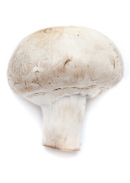
Organic versus conventional mushrooms sales
Organic mushrooms increased volume sales with a shift to larger pack sizes
4 w.e. 2/23/2025 | Share of total mushroom sales and sales growth %
Market
size
$90.3M
$ growth
-7.2%
Unit growth
-3.4%
Volume
growth
-3.9%
Conventional
Market size
$27.7M
$ growth
+1.4%
Unit growth
+1.3%
Volume
growth
+2.8%
Organic
Source: Circana, Integrated Fresh, MULO+, 4 weeks ending 2/23/2025 compared with year ago

Slide 20
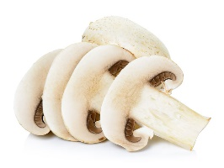
Value added versus whole mushrooms
Whole outperformed value-added mushrooms, though both areas were down
52 w.e. 2/23/2025 | Share of total mushroom sales and sales growth %
Market
size
$885M
$ growth
-1.3%
Unit growth
-1.6%
Volume
growth
-1.8%
Whole
Market size
$621M
$ growth
-3.7%
Unit growth
-4.3%
Volume
growth
-3.3%
Value-added
Source: Circana, Integrated Fresh, MULO+, 52 weeks ending 2/23/2025 compared with year ago

