Slide 1
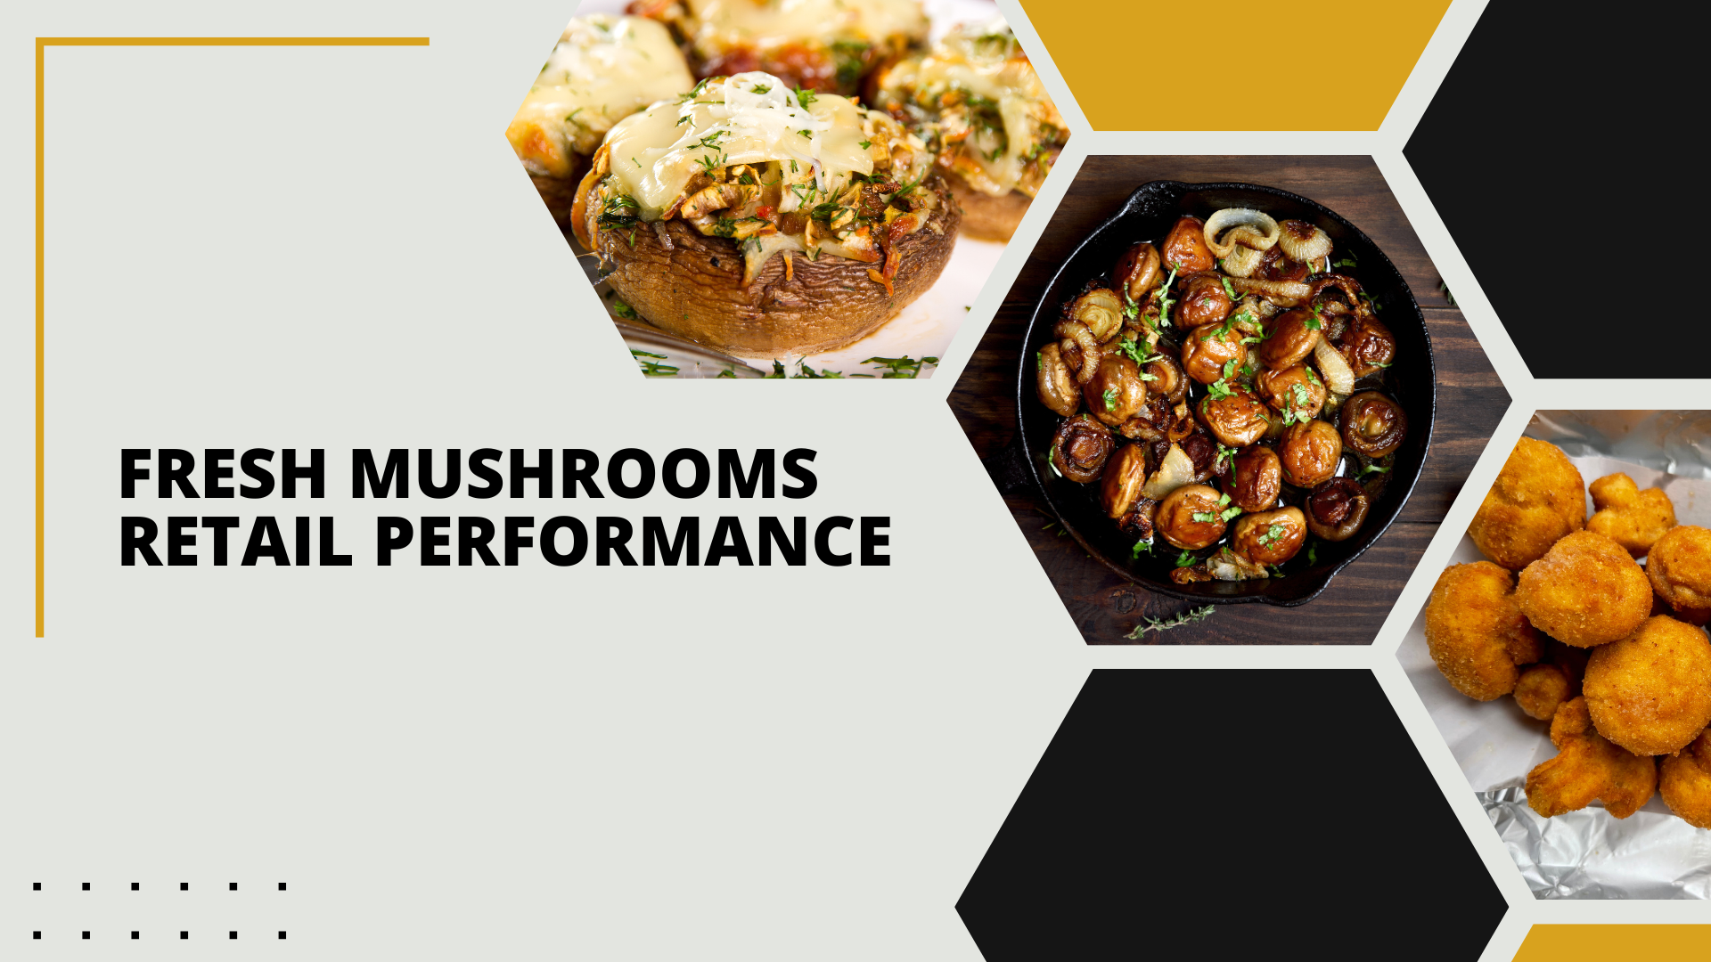

Period ending
January 26, 2025

Slide 2
Methodology
The report covers the four weeks ending January 26, 2025 with week endings:
  January 5, 2025
  January 12, 2025
  January 19, 2025
  January 26, 2025
Please note, during this quad-week, the year-over-year performance is affected by the date cut-off (which is always on a Sunday). In 2023, quad-week 13 ended on 12/31 versus 12/29 in 2024. That means much of the New Year’s food dollar was captured in quad week 13 in 2023, but moved into quad-week 1 for 2025 due to the Wednesday timing of the holiday.
Dollar references are the retail value, volume is reflected in pounds and units (packages)
Package size, organic, fixed/random weight and value-added now all reflect the MULO+ expanded marketplace
For questions, contact Anne-Marie Roerink, at aroerink@210analytics.com
Source: Circana, Integrated Fresh, MULO+, 4 weeks ending 1/26/2025

Slide 3
Four-year dollar sales trend
The greater level of holiday promotions affected the dollar sales negatively in this quad-week period
Source: Circana, Integrated Fresh, MULO+, 4 weeks and 52 w.e. 1/26/2025 versus same periods the past four years

Slide 4
Four-year unit sales trend
Unit sales have declined by about 68 million packages in comparison to four years ago, however, larger pack sizes (16 and 24 ounce) make up some of the difference
Source: Circana, Integrated Fresh, MULO+, 4 weeks and 52 w.e. ending 1/26/2025 versus same periods the past four years

Slide 5
Four-year volume (pound) sales trend
Pound sales were mostly stable in the quad-week with the extra holiday boost
Source: Circana, Integrated Fresh, MULO+, 4 weeks and 52 w.e. ending 1/26/2025 versus same periods the past four years

Slide 6
Mushroom contribution to the department/category
The mushroom share of fresh produce and total vegetables has declined year-over-year
4 weeks Mushroom $ share | Share of total produce | Share of total vegetables
3YA | 2.1% | 4.1%
2YA | 2.0% | 3.9%
YA | 1.9% | 3.8%
4 w.e. 1/26/2025 | 1.7% | 3.6%
52 weeks Mushroom $ share | Share of total produce | Share of total vegetables
3YA | 1.9% | 3.7%
2YA | 1.8% | 4.0%
YA | 1.7% | 3.6%
52 w.e. 1/26/2025 | 1.6% | 3.4%
Source: Circana, Integrated Fresh, MULO+, 4 weeks and 52 w.e. ending 1/26/2025

Slide 7
Mushrooms price per unit
On a per unit basis, total produce experienced a bit of inflation this quad week, driven by fruit. In contrast, mushroom prices decreased
4 weeks Average price/unit | Total produce | Total vegetables | Mushrooms
3YA | $2.61 | $2.29 | $2.89
2YA | $2.73 | $2.49 | $3.02
YA | $2.77 | $2.45 | $3.05
4 w.e. 1/26/2025 | $ 2.79| +0.5% | $2.45 | -0.2% | $2.99 | -2.1%
Source: Circana, Integrated Fresh, MULO+, YTD weeks ending 1/26/2025

Slide 8
Mushroom price per volume (pound)
On a per pound basis, mushrooms were also the exception with a 3.1% year-over-year decrease during the quad-week, versus increases for total produce
4 weeks Average price/pound | Total produce | Total vegetables | Mushrooms
3YA | $1.85 | $1.90 | $4.36
2YA | $1.96 | $2.07 | $4.54
YA | $1.97 | $2.01 | $4.62
4 w.e. 1/26/2025 | $1.98 | +0.9% | $2.01 | -0.1% | $4.48 | -3.1%
Source: Circana, Integrated Fresh, MULO+, YTD weeks ending 1/26/2025

Slide 9
Price per volume by quarter/month
Q4 prices were the lowest of the year, albeit a mere few cents per pound
Source: Circana, Integrated Fresh, MULO+, 2019-w.e. 1/26/2025

Slide 10
Price by type
4 w.e.1/26/2025 | Price per unit | % change vs. YA
Total mushrooms | $2.99 | -2.1%
White mushrooms | $2.63 | -2.6%
Crimini mushrooms | $3.40 | -1.3%
Portabella mushrooms | $2.58 | -3.8%
Specialty mushrooms | $5.58 | +2.4%
4 w.e. 1/26/2025 | Price per volume | % change vs. YA
Total mushrooms | $4.48 | -3.1%
White mushrooms | $3.96 | -4.1%
Crimini mushrooms | $4.55 | -1.3%
Portabella mushrooms | $5.18 | -3.2%
Specialty mushrooms | $14.28 | +0.2%
Specialty mushrooms include shiitake, oyster, enoki, chanterelle, morel, wood ear, porcini, black forest, lion’s mane and other
Source: Circana, Integrated Fresh, MULO+, 4 w.e. 1/26/2025

Slide 11

Mushroom dollar, unit, volume sales
The quad-week was impacted by the date cut-off and showed larger declines than we have seen in recent months
4 w.e. 1/26/2025 dollars
$125.0M
volume (lbs)
27.9M
-4.1%
-2.0%
-1.0%
Dollar
growth vs. YA
Unit
growth vs. YA
Volume
growth vs. YA
-7.1% vs. 3YA
-10.3% vs. 3YA
-9.7% vs. 3YA
Source: Circana, Integrated Fresh, MULO+, 4 weeks ending 1/26/2025

Slide 12
Vegetables and mushroom pound sales vs. YA
Vegetable growth rates resumed after a flat quad-week 13 performance
Source: Circana, Integrated Fresh, MULO+, 2020 -w.e. 1/26/2025

Slide 13
Share of dollars sold on merchandising
Promotional levels increased during the past four weeks, likely due to the end-of-year holiday promotions
Fresh mushrooms | 4 w.e. 1/26/2025 | Vs. YA | Latest 52 w.e. 1/26/2025 | Vs. YA
Share of dollars sold on promotion | 17.6% | +11.7% | 18.3% | +5.2%
* Any merchandising, including feature, display, feature & display and temporary price reductions
Source: Circana, Integrated Fresh, MULO+, latest 4 w.e. 1/26/2025

Slide 14
Over indexing versus under indexing regions
Two regions substantially pulled down volume sales during this quad week, being the Northeast and California.
Use as comparison to understand importance/size of mushrooms
L-4 w.e. 1/26/2025 | Share of veg. lbs | Share of mushroom lbs | lbs sales growth vs. YA
Total US | 100.0% | 100.0% | -1.0%
California | 10.7% | 12.4% | -2.7%
Great Lakes | 14.4% | 14.9% | +0.9%
Mid-South | 13.5% | 12.1% | -0.4%
Northeast | 15.6% | 17.4% | -3.7%
Plains | 7.0% | 6.5% | +1.1%
South Central | 10.9% | 7.5% | -0.5%
Southeast | 15.2% | 15.4% | -0.1%
West | 12.5% | 14.0% | -0.9%
WEST
PLAINS
GREAT LAKES
NORTHEAST
MID SOUTH
CALIFORNIA
SOUTHEAST
SOUTH CENTRAL
= Above-average share vs. veg
= Above-average
performance vs. total US
Source: Circana, Integrated Fresh, MULO+, L52 w.e. 1/26/2025 | Total fresh vegetables and total fresh mushrooms

Slide 15
Performance summary whites, browns and specialty
Where crimini mushrooms have had the better performance, whites did better this quad week, due to light mushroom users coming into the category for the holidays.
4 weeks ending 1/26/2025 | Dollars | Dollar share | $ sales vs. YA | $ sales vs. 3YA | Volume (lbs) | Lbs share | Lbs vs. YA | Lbs vs. 3YA
Total fresh mushrooms | $125.0M | 100.0% | -4.1% | -7.1% | 27.9M | 100.0% | -1.0% | -9.7%
White mushrooms | $61.9M | 49.5% | -2.6% | -9.7% | 15.6M | 56.1% | +1.6% | -12.0%
Crimini mushrooms | $44.9M | 35.9% | -5.0% | -0.2% | 9.9M | 35.4% | -3.7% | -3.2%
Portabella mushrooms | $8.9M | 7.1% | -10.2% | -28.5% | 1.7M | 6.2% | -7.2% | -24.3%
Specialty mushrooms | $7.9M | 6.3% | -2.5% | +9.6% | 0.6M | 2.0% | -2.8% | +3.2%
Source: Circana, Integrated Fresh, MULO+, 4 weeks ending 1/26/2025

Slide 16

Other insights
Packaged (fixed weight) versus random weight
Package-size analysis
Organic versus conventional
Value-added versus whole/uncut

Slide 17
Package size analysis
8-ounce packs drove the bulk of sales but 24-ounce packages have overtaken 16-ounce packages. The 24-ounce had been driving unit and volume growth, but this was also an off period for these large packages
Package size (per UPC) 52 weeks | Dollars | $ vs. YA | Units | % vs. YA | Volume | lbs vs. YA
8 OZ | $55.9M | -4.8% | 24.1M | -1.4% | 12.0M | -1.4%
16 OZ | $18.9M | -6.6% | 4.6M | -8.9% | 4.6M | -8.0%
24 OZ | $21.4M | +0.1% | 4.1M | -1.8% | 6.2M | -1.8%
Source: Circana, Integrated Fresh, MULO+, 4 weeks ending 1/26/2025

Slide 18
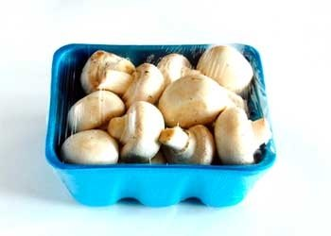
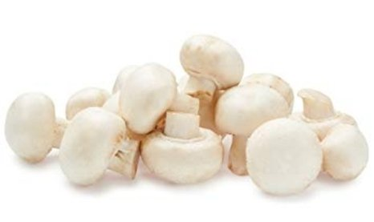
Packaged (fixed weight) versus random weight
Fixed-weight dollar sales outperformed random weight
4 w.e. 1/26/2025 | Share of total mushroom sales and sales growth %
 | Fixed weight | Random weight
Dollar growth | -3.7% | -15.2%
Share of mushroom $ sales | 97.0% | 3.0%
Volume growth | -0.8% | -9.5%
Share of mushroom lbs sales | 97.3% | 2.7%
Source: Circana, Integrated Fresh, MULO+, 4 weeks ending 1/26/2025

Slide 19
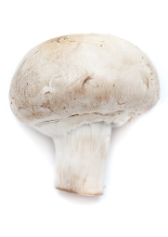
Organic versus conventional mushrooms sales
Organic mushrooms increased volume sales with a shift to larger pack sizes
4 w.e. 1/26/2025 | Share of total mushroom sales and sales growth %
Market
size
$95.8B
$ growth
-5.9%
Unit growth
-2.6%
Volume
growth
-2.5%
Conventional
Market size
$29.2M
$ growth
+2.7%
Unit growth
+1.6%
Volume
growth
+5.2%
Organic
Source: Circana, Integrated Fresh, MULO+, 4 weeks ending 1/26/2025 compared with year ago

Slide 20
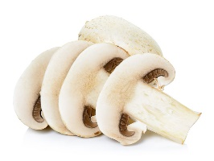
Value added versus whole mushrooms
Whole outperformed value-added mushrooms
52 w.e. 1/26/2025 | Share of total mushroom sales and sales growth %
Market
size
$888M
$ growth
-1.1%
Unit growth
-1.5%
Volume
growth
-1.7%
Whole
Market size
$624M
$ growth
-3.5%
Unit growth
-4.3%
Volume
growth
-3.5%
Value-added
Source: Circana, Integrated Fresh, MULO+, 4 weeks ending 1/26/2025 compared with year ago

