Slide 1
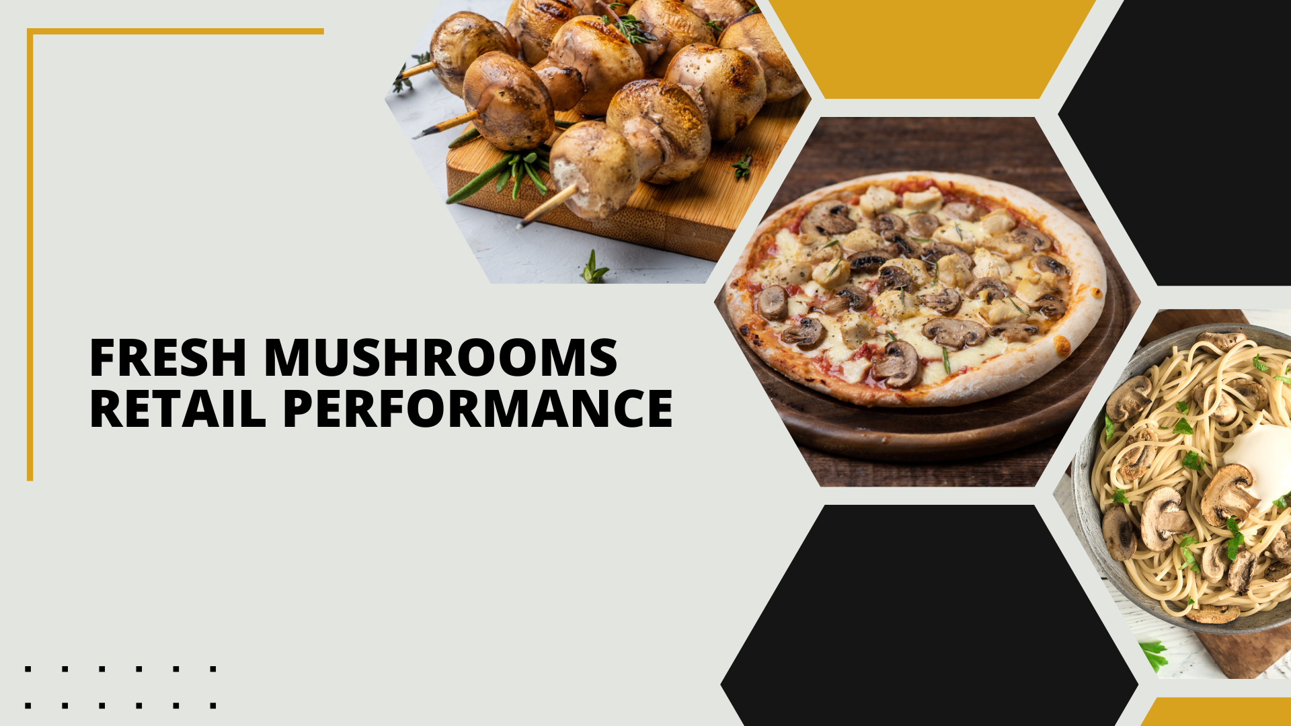

Period ending
September 8, 2024

Slide 2
MULO+ reminder!
Please note that the Mushroom Council has upgraded its contract with Circana to have the largest market coverage available. Depending on the category, market coverage increased 10% to 15%. Our fresh mushroom universe expanded by 14.8% to annual sales of $1.5 billion through the inclusion of food, club, online and other retailers who were not previously included nor projected in the data.
Several of these retailers were ones who gained business during the past few years, changing not only the size of the retail universe measured but also the trajectory. With the added data, mushroom trends more closely follow the overall food and beverage trends with sales levels that remain above the 2019 pre-pandemic baseline. Other trends, such as organic, value-added, seasonal growth and contraction and pack sizes continued to hold up. All historic data points in the spreadsheet and PowerPoint have been upgraded to MULO+.

Slide 3
Methodology
The report covers the four weeks ending September 8, 2024 with week endings:
  August 18, 2024
  August 25, 2024
  September 1, 2024
  September 8, 2024
Dollar references are the retail value, volume is reflected in pounds and units (packages)
Package size, organic, fixed/random weight and value-added now all reflect the MULO+ expanded marketplace
For questions, contact Anne-Marie Roerink, at aroerink@210analytics.com
Source: Circana, Integrated Fresh, MULO+, 4 weeks ending 9/8/2024

Slide 4
Four-year dollar sales trend
Dollar sales are starting to level out in the shorter-term and improving in the full-year view
Source: Circana, Integrated Fresh, MULO+, 4 weeks and 52 w.e. 9/8/2024 versus same periods the past four years

Slide 5
Four-year unit sales trend
Unit sales did see some decline, but shoppers moved to larger pack sizes, resulting in lesser volume declines
Source: Circana, Integrated Fresh, MULO+, 4 weeks and 52 w.e. ending 9/8/2024 versus same periods the past four years

Slide 6
Four-year volume (pound) sales trend
In the quad-week period, pound sales are starting to level out, though still down about 9 million pounds YOY in the 52-week view
Source: Circana, Integrated Fresh, MULO+, 4 weeks and 52 w.e. ending 9/8/2024 versus same periods the past four years

Slide 7
Mushroom contribution to the department and category
The mushroom share of total vegetable sales remained steady in the quad week
4 weeks Mushroom $ share | Share of total produce | Share of total vegetables
3YA | 1.8% | 3.8%
2YA | 1.7% | 3.6%
YA | 1.6% | 3.4%
4 w.e. 9/8/2024 | 1.5% | 3.4%
52 weeks Mushroom $ share | Share of total produce | Share of total vegetables
3YA | 2.0% | 4.1%
2YA | 1.8% | 3.8%
YA | 1.8% | 3.6%
52 w.e. 9/8/2024 | 1.7% | 3.5%
Source: Circana, Integrated Fresh, MULO+, 4 weeks and 52 w.e. ending 9/8/2024

Slide 8
Mushrooms price per unit
On a per unit basis, vegetable prices decreased slightly while mushroom prices saw a 1.3% uptick in the latest four weeks due to the switch to larger packages
4 weeks Average price/unit | Total produce | Total vegetables | Mushrooms
3YA | $2.46 | $2.15 | $2.74
2YA | $2.70 | $2.35 | $2.98
YA | $2.72 | $2.36 | $2.98
4 w.e. 9/8/2024 | $2.73 | +0.4% | $2.35 | -0.7% | $3.02 | +1.3%
Source: Circana, Integrated Fresh, MULO+, YTD weeks ending 9/8/2024

Slide 9
Mushroom price per volume (pound)
On a per pound basis, mushroom prices did decline slightly, at -0.5%
4 weeks Average price/pound | Total produce | Total vegetables | Mushrooms
3YA | $1.62 | $1.83 | $4.17
2YA | $1.79 | $2.01 | $4.53
YA | $1.77 | $2.01 | $4.53
4 w.e. 9/8/2024 | $1.76 | -0.2% | $1.98 | -1.6% | $4.56 | -0.5%
Source: Circana, Integrated Fresh, MULO+, YTD weeks ending 9/8/2024

Slide 10
Price per volume by quarter/month
Prices have been rising over the past few months, matching their highest point during the fourth quarter of 2022
Source: Circana, Integrated Fresh, MULO+, 2019-w.e. 9/8/2024

Slide 11
Price by type
4 w.e.9/8/2024 | Price per unit | % change vs. YA | % change vs. 3YA
Total mushrooms | $3.02 | +1.3% | +10.1%
White mushrooms | $2.64 | +0.8% | +8.8%
Brown mushrooms | $3.36 | +1.4% | +8.9%
Specialty mushrooms | $5.70 | +4.8% | +22.9%
4 w.e. 9/8/2024 | Price per volume | % change vs. YA | % change vs. 3YA
Total mushrooms | $4.56 | +0.5% | +9.2%
White mushrooms | $4.00 | +0.2% | +9.6%
Brown mushrooms | $4.86 | +0.2% | +5.6%
Specialty mushrooms | $14.27 | +1.9% | +12.0%
Brown mushrooms include crimini and portabella
Specialty mushrooms include shiitake, oyster, enoki, chanterelle, morel, wood ear, porcini, black forest, lion’s mane and other
Source: Circana, Integrated Fresh, MULO+, 4 w.e. 9/8/2024

Slide 12

Mushroom dollar, unit, volume sales
Dollar and volume sales are starting to level off, driven by 24-ounce packages
4 w.e. 9/8/2024 dollars
$109.9M
volume (lbs)
24.1M
-0.0%
-1.4%
-0.5%
Dollar
growth vs. YA
Unit
growth vs. YA
Volume
growth vs. YA
-2.5% vs. 2YA
-2.7% vs. 3YA
-4.0% vs. 2YA
-11.7% vs. 3YA
-3.1% vs. 2YA
-10.9% vs. 3YA
Source: Circana, Integrated Fresh, MULO+, 4 weeks ending 9/8/2024

Slide 13
Vegetables and mushroom pound sales vs. YA
Vegetables continue to have a strong 2024 with improving volume numbers for mushrooms
Source: Circana, Integrated Fresh, MULO+, 2020 -w.e. 9/8/2024

Slide 14
Share of dollars sold on merchandising
Promotional levels increased during the past four weeks and year
Fresh mushrooms | 4 w.e. 9/8/2024 | Vs. YA | Latest 52 w.e. 9/8/2024 | Vs. YA
Share of dollars sold on promotion | 17.4% | +9.7% | 17.8% | +11.1%
* Any merchandising, including feature, display, feature & display and temporary price reductions
Source: Circana, Integrated Fresh, MULO+, latest 4 w.e. 9/8/2024

Slide 15
Over indexing versus under indexing regions
In dollars, the Northeast is an above-average seller and had better-than-average growth
Use as comparison to understand importance/size of mushrooms
L-52 w.e. 9/8/2024 | Share of veg. $ | Share of mushrooms $ | $ sales growth vs. YA
Total US | 100.0% | 100.0% | -2.3%
California | 12.1% | 14.0% | -3.6%
Great Lakes | 13.3% | 15.0% | -2.5%
Mid-South | 13.0% | 11.4% | -2.0%
Northeast | 17.6% | 17.6% | -1.1%
Plains | 6.6% | 6.5% | -2.2%
South Central | 8.9% | 6.8% | -4.3%
Southeast | 15.4% | 13.4% | -1.5%
West | 13.1% | 15.4% | -2.1%
WEST
PLAINS
GREAT LAKES
NORTHEAST
MID SOUTH
CALIFORNIA
SOUTHEAST
SOUTH CENTRAL
= Above-average share vs. veg
= Above-average
performance vs. total US
Source: Circana, Integrated Fresh, MULO+, L52 w.e. 9/8/2024 | Total fresh vegetables and total fresh mushrooms

Slide 16
Performance summary whites, browns and specialty
Crimini and specialty mushrooms had the strongest performance in the short and longer term
4 weeks ending 9/8/2024 | Dollars | Dollar share | $ sales vs. YA | $ sales vs. 3YA | Volume (lbs) | Lbs share | Lbs vs. YA | Lbs vs. 3YA
Total fresh mushrooms | $109.9M | 100.0% | -0.0% | -2.7% | 24.1M | 100.0% | -0.5% | -10.9%
White mushrooms | $55.1M | 50.1% | -0.3% | -6.4% | 13.8M | 57.1% | -0.5% | -14.6%
Crimini mushrooms | $38.6M | 35.2% | +0.6% | +8.7% | 8.2M | 34.0% | +0.5% | +0.9%
Portabella mushrooms | $9.3M | 8.5% | -5.5% | -26.4% | 1.6M | 6.8% | -6.9% | -29.2%
Specialty mushrooms | $6.9M | 6.3% | +6.8% | +15.7% | 0.5M | 2.0% | +4.7% | +3.3%
Source: Circana, Integrated Fresh, MULO+, 4 weeks ending 9/8/2024

Slide 17
White button mushrooms dollar performance
Dollars L-52
w.e. 9/8/2024
$755.6M
-3.4% vs. YA
Average price/unit
$2.67
+0.9% vs. YA
Source: Circana, Integrated Fresh, MULO+, 2021 plus 4 weeks ending 9/8/2024

Slide 18
White button mushrooms volume performance
Pounds L-52
w.e. 9/8/2024
187.4M
-4.9% vs YA
Average price/pound
$4.03
+1.5% vs. YA
Source: Circana, Integrated Fresh, MULO+, 2021 plus 4 weeks ending 9/8/2024

Slide 19
Crimini mushrooms dollar performance
Dollars L-52
w.e. 9/8/2024
$545.8M
-1.3% vs. YA
Average price/unit
$3.44
-0.6% vs. YA
Source: Circana, Integrated Fresh, MULO+, 2021 plus 4 weeks ending 9/8/2024

Slide 20
Crimini mushrooms volume performance
Pounds L-52
w.e. 9/8/2024
118.0M
+0.3% vs. YA
Average price/pound
$4.63
-1.6% vs. YA
Source: Circana, Integrated Fresh, MULO+, 2021 plus 4 weeks ending 9/8/2024

Slide 21

Other insights
Packaged (fixed weight) versus random weight
Package-size analysis
Organic versus conventional
Value-added versus whole/uncut

Slide 22
Package size analysis
8-ounce packs drove the bulk of sales but 24-ounce packages have overtaken 16-ounce packages with growth in dollars, units and volume
Package size (per UPC) 52 weeks | Dollars | $ vs. YA | Units | % vs. YA | Volume | lbs vs. YA
8 OZ | $739.5M | -1.6% | 314.5M | -1.5% | 157.3M | -1.5%
16 OZ | $234.9M | -7.3% | 58.5M | -10.3% | 58.5M | -10.3%
24 OZ | $240.7M | +0.5% | 47.4M | +2.4% | 71.1M | +2.4%
Source: Circana, Integrated Fresh, MULO+, 52 weeks ending 9/8/2024

Slide 23
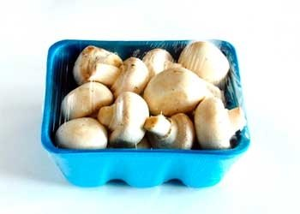
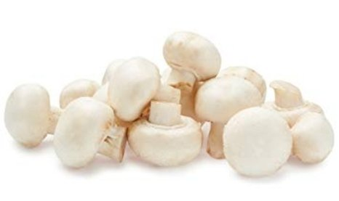
Packaged (fixed weight) versus random weight
Fixed-weight dollar sales increased in the latest quad-week
4 w.e. 9/8/2024 | Share of total mushroom sales and sales growth %
 | Fixed weight | Random weight
Dollar growth | +0.2% | -6.4%
Share of mushroom $ sales | 96.7% | 3.3%
Volume growth | -0.4% | -5.1%
Share of mushroom lbs sales | 97.1% | 2.9%
Source: Circana, Integrated Fresh, MULO+, 4 weeks ending 9/8/2024

Slide 24
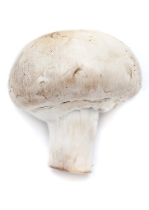
Organic versus conventional mushrooms sales
Organic mushrooms increased volume sales with a shift to larger pack sizes
4 w.e. 9/8/2024 | Share of total mushroom sales and sales growth %
Market
size
$85.1M
$ growth
-1.5%
Unit growth
-2.0%
Volume
growth
-2.1%
Conventional
Market size
$24.8M
$ growth
+5.5%
Unit growth
+2.5%
Volume
growth
+6.2%
Organic
20.3%
of pound sales
Source: Circana, Integrated Fresh, MULO+, 4 weeks ending 9/8/2024 compared with year ago

Slide 25
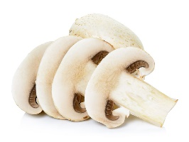
Cut/prepared versus whole mushrooms
Whole and sliced had a very similar performance
4 w.e. 9/8/2024 | Share of total mushroom sales and sales growth %
Market
size
$63.4M
$ growth
+0.1%
Unit growth
-1.8%
Volume
growth
-1.3%
No preparation
Market size
$40.1M
$ growth
-1.4%
Unit growth
-1.1%
Volume
growth
-1.0%
Sliced
Source: Circana, Integrated Fresh, MULO+, 4 weeks ending 9/8/2024 compared with year ago

