Slide 1
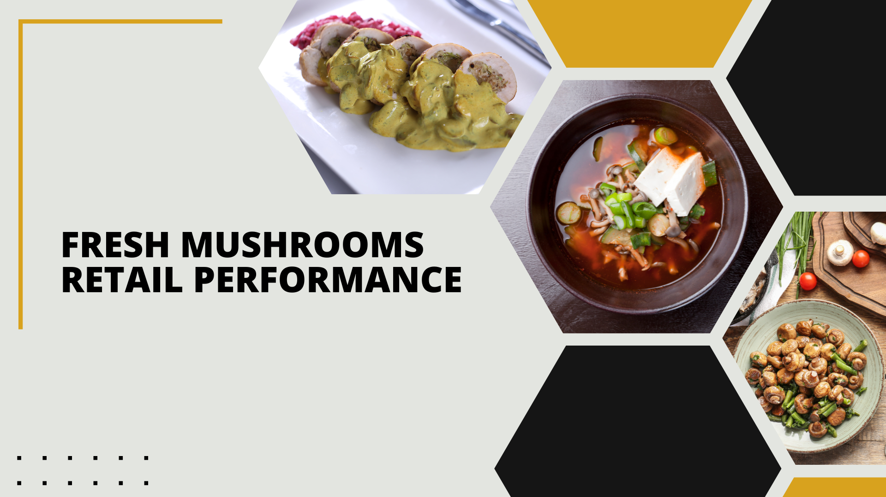

Period ending
June 16, 2024

Slide 2
Methodology
The report covers the four weeks ending June 16, 2024 with week endings:
  May 25, 2024
  June 2, 2024
  June 9, 2024
  June 16, 2024
Dollar references are the retail value, volume is reflected in pounds and units (packages)
Package size, organic, fixed/random weight and value-added reflect the total market
Source: Circana, Integrated Fresh, MULO, 4 weeks ending 6/16/2024

Slide 3
Four-year dollar sales trend
Sales trended below year-ago levels in the shorter- and longer-term views. Sales dipped below the $100K mark for the first time in four years
Source: Circana, Integrated Fresh, MULO, 4 weeks and 52 w.e. 6/16/2024 versus same periods the past four years

Slide 4
Four-year unit sales trend
The shorter- and longer-term unit trends reflect the market pressure with continued declines for both time periods
Source: Circana, Integrated Fresh, MULO, 4 weeks and 52 w.e. ending 6/16/2024 versus same periods the past four years

Slide 5
Four-year volume (pound) sales trend
In the YTD and the quad-week view, pounds continued to trend behind last year’s and prior years’ levels
Source: Circana, Integrated Fresh, MULO, 4 weeks and 52 w.e. ending 6/16/2024 versus same periods the past four years

Slide 6
Mushroom contribution to the department and category
The mushroom share of total produce and vegetables remains below average
4 weeks Mushroom $ share | Share of total produce | Share of total vegetables
3YA | 1.6% | 3.7%
2YA | 1.6% | 3.4%
YA | 1.5% | 3.3%
4 w.e. 6/16/2024 | 1.4% | 3.1 %
52 weeks Mushroom $ share | Share of total produce | Share of total vegetables
3YA | 2.0% | 4.0%
2YA | 1.8% | 3.7%
YA | 1.7% | 3.5%
52 w.e. 6/16/2024 | 1.6% | 3.3%
Source: Circana, Integrated Fresh, MULO, 4 weeks and 52 w.e. ending 6/16/2024

Slide 7
Mushrooms price per unit
On a per unit basis, produce and vegetable prices are decreasing while mushroom prices saw a slight uptick in the latest four weeks
4 weeks Average price/unit | Total produce | Total vegetables | Mushrooms
3YA | $2.41 | $2.02 | $2.59
2YA | $2.61 | $2.21 | $2.81
YA | $2.62 | $2.24 | $2.81
4 w.e. 6/16/2024 | $2.61 | -0.3% | $2.22 | -0.7% | $2.83 | +0.6%
Source: Circana, Integrated Fresh, MULO, YTD weeks ending 6/16/2024

Slide 8
Mushroom price per volume (pound)
On a pound basis, vegetables and mushroom prices rose while total produce and vegetables became less expensive
4 weeks Average price/pound | Total produce | Total vegetables | Mushrooms
3YA | $1.58 | $1.81 | $4.19
2YA | $1.70 | $1.95 | $4.59
YA | $1.77 | $1.99 | $4.58
4 w.e. 6/16/2024 | $ 1.73 | -1.8% | $1.97 | -1.0% | $4.64 | +1.3%
Source: Circana, Integrated Fresh, MULO, YTD weeks ending 6/16/2024

Slide 9
Price per volume by quarter/month
Prices have been rising over the past few months, reaching their highest point since 2018
Source: Circana, Integrated Fresh, MULO, 2018-w.e. 6/16/2024

Slide 10
Price by type
4 w.e.6/16/2024 | Price per unit | % change vs. YA | % change vs. 3YA
Total mushrooms | $2.83 | +0.6% | +9.0%
White mushrooms | $2.56 | +0.9% | +8.7%
Brown mushrooms | $3.07 | +0.1% | +8.6%
Specialty mushrooms | $4.78 | +0.7% | +15.0%
4 w.e. 6/16/2024 | Price per volume | % change vs. YA | % change vs. 3YA
Total mushrooms | $4.64 | +1.3% | +10.7%
White mushrooms | $4.12 | +2.1% | +11.2%
Brown mushrooms | $5.04 | +0.2% | +9.6%
Specialty mushrooms | $13.52 | +0.0% | +10.4%
Brown mushrooms include crimini and portabella
Specialty mushrooms include shiitake, oyster, enoki, chanterelle, morel, wood ear, porcini, black forest, lion’s mane and other
Source: Circana, Integrated Fresh, MULO, 4 w.e. 6/16/2024

Slide 11

Mushroom dollar, unit, volume sales
Declines continue to sit around 3 percentage points of YA levels
4 w.e. 6/16/2024 dollars
$98M
volume (lbs)
21.2M
-3.2%
-3.7%
-4.4%
Dollar
growth vs. YA
Unit
growth vs. YA
Volume
growth vs. YA
-5.0% vs. 2YA
-6.6% vs. 3YA
-5.5% vs. 2YA
-14.3% vs. 3YA
-6.0% vs. 2YA
-15.6% vs. 3YA
Source: Circana, Integrated Fresh, MULO, 4 weeks ending 6/16/2024

Slide 12
Vegetables and mushroom pound sales vs. YA
Vegetables are off to a strong 2024 whereas pound pressure lingers for mushrooms
Source: Circana, Integrated Fresh, MULO, 2019-w.e. 6/16/2024

Slide 13
Share of dollars sold on merchandising
Promotional levels dropped in the latest four weeks
Fresh mushrooms | 4 w.e. 6/16/2024 | Vs. YA | Latest 52 w.e. 6/16/2024 | Vs. YA
Share of dollars sold on promotion | 17.7% | -9.3% | 19.5% | +12.5%
* Any merchandising, including feature, display, feature & display and temporary price reductions
Source: Circana, Integrated Fresh, MULO, YTD through weeks ending 6/16/2024

Slide 14
Over indexing versus under indexing regions
The regional performance pulled closer together with underperforming regions from last year starting to perform better
Use as comparison to understand importance/size of mushrooms
L-52 w.e. 6/16/2024 | Share of veg. $ | Share of mushrooms $ | $ sales growth vs. YA
Total US | 100.0% | 100.0% | -3.2%
California | 10.7% | 11.5% | -4.4%
Great Lakes | 14.2% | 16.4% | -2.1%
Mid-South | 13.3% | 12.0% | -3.6%
Northeast | 18.5% | 18.0% | -3.4%
Plains | 7.0% | 7.0% | -2.1%
South Central | 8.9% | 7.1% | -3.8%
Southeast | 15.0% | 13.7% | -4.0%
West | 12.4% | 14.4% | -2.0%
WEST
PLAINS
GREAT LAKES
NORTHEAST
MID SOUTH
CALIFORNIA
SOUTHEAST
SOUTH CENTRAL
= Above-average share vs. veg
= Above-average
performance vs. total US
Source: Circana, Integrated Fresh, MULO, YTD through 6/16/2024 | Total fresh vegetables and total fresh mushrooms

Slide 15
Performance summary whites, browns and specialty
Crimini mushrooms had the strongest performance in the short and longer term
4 weeks ending 6/16/2024 | Dollars | Dollar share | $ sales vs. YA | $ sales vs. 3YA | Volume (lbs) | Lbs share | Lbs vs. YA | Lbs vs. 3YA
Total fresh mushrooms | $100.3M | 100.0% | -3.1% | -7.5% | 21.9M | 100.0% | -4.9% | -15.6%
White mushrooms | $52.1M | 51.9% | -4.1% | -9.6% | 12.7M | 58.1% | -8.1% | -18.7%
Crimini mushrooms | $33.8M | 33.7% | -1.4% | +5.6% | 7.0M | 32.1% | -0.2% | -4.0%
Portabella mushrooms | $9.2M | 9.2% | -3.5% | -27.9% | 1.8M | 8.1% | -0.2% | -29.1%
Specialty mushrooms | $5.2M | 5.2% | -2.2% | -13.0% | 0.4M | 1.7% | -2.8% | -21.0%
Source: Circana, Integrated Fresh, MULO, 4 weeks ending 6/16/2024

Slide 16
White button mushrooms dollar performance
Dollars L-52
w.e. 6/16/2024
$696M
-3.8% vs. YA
Average price/unit
$2.55
+0.1% vs. YA
Source: Circana, Integrated Fresh, MULO, 2021 plus 4 weeks ending 6/16/2024

Slide 17
White button mushrooms volume performance
Pounds L-52
w.e. 6/16/2024
170.5M
-5.0% vs YA
Average price/pound
$4.08
+1.3% vs. YA
Source: Circana, Integrated Fresh, MULO, 2021 plus 4 weeks ending 6/16/2024

Slide 18
Crimini mushrooms dollar performance
Dollars L-52
w.e. 6/16/2024
$447.3M
-1.4% vs. YA
Average price/unit
$3.16
-0.7% vs. YA
Source: Circana, Integrated Fresh, MULO, 2021 plus 4 weeks ending 6/16/2024

Slide 19
Crimini mushrooms volume performance
Pounds L-52
w.e. 6/16/2024
92.4M
-0.3% vs. YA
Average price/pound
$4.84
-1.2% vs. YA
Source: Circana, Integrated Fresh, MULO, 2021 plus 4 weeks ending 6/16/2024

Slide 20

Other insights
Packaged (fixed weight) versus random weight
Package-size analysis
Organic versus conventional
Value-added versus whole/uncut

Slide 21
Package size analysis
8 and 16 ounces drive the bulk of sales, with 8-ounce packages outperforming 16-ounces in the latest 52 weeks. 24 ounce packages are growing in dollars, units and volume
Package size (per UPC) 52 weeks | Dollars | $ vs. YA | Units | % vs. YA | Volume | lbs vs. YA
8 OZ | $733.7M | -2.2% | 315.5M | -1.0% | 157.M | -1.0%
16 OZ | $226.2M | -8.6% | 57.7M | -12.1% | 57.7M | -12.1%
24 OZ | $79.5M | +0.9% | 18.0M | +3.6% | 27.0M | +3.6%
Source: Circana, Integrated Fresh, MULO, 52 weeks ending 6/16/2024

Slide 22
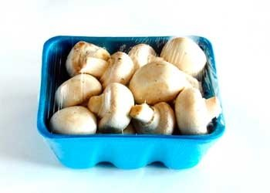
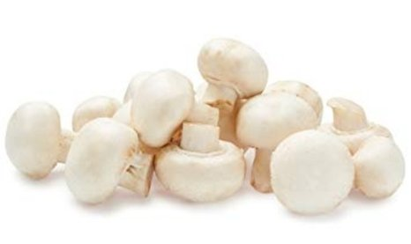
Packaged (fixed weight) versus random weight
While both down, fixed weight did better than random weight
4 w.e. 6/16/2024 | Share of total mushroom sales and sales growth %
 | Fixed weight | Random weight
Dollar growth | -3.0% | -7.0%
Share of mushroom $ sales | 96.0% | 4.0%
Volume growth | -4.3% | -7.7%
Share of mushroom lbs sales | 96.4% | 3.6%
Source: Circana, Integrated Fresh, MULO, 4 weeks ending 6/16/2024

Slide 23
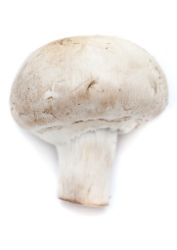
Organic versus conventional mushrooms sales
Organic mushrooms increased volume sales with a shift to larger pack sizes
4 w.e. 6/16/2024 | Share of total mushroom sales and sales growth %
Market
size
$85.1M
$ growth
-4.5%
Unit growth
-4.4%
Volume
growth
-6.1%
Conventional
Market size
$13.1M
$ growth
+6.9%
Unit growth
+2.7%
Volume
growth
+12.9%
Organic
10.5%
of pound sales
Source: Circana, Integrated Fresh, MULO, 4 weeks ending 6/16/2024 compared with year ago

Slide 24
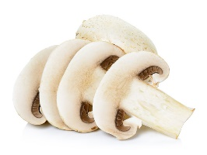
Cut/prepared versus whole mushrooms
Hardly any difference in performance for whole versus sliced
4 w.e. 6/16/2024 | Share of total mushroom sales and sales growth %
Market
size
$53.5M
$ growth
-2.5%
Unit growth
-1.4%
Volume
growth
-3.2%
No preparation
Market size
$39.4M
$ growth
-5.7%
Unit growth
-7.6%
Volume
growth
-8.4%
Cut/Sliced
Source: Circana, Integrated Fresh, MULO, 4 weeks ending 6/16/2024 compared with year ago

