Slide 1
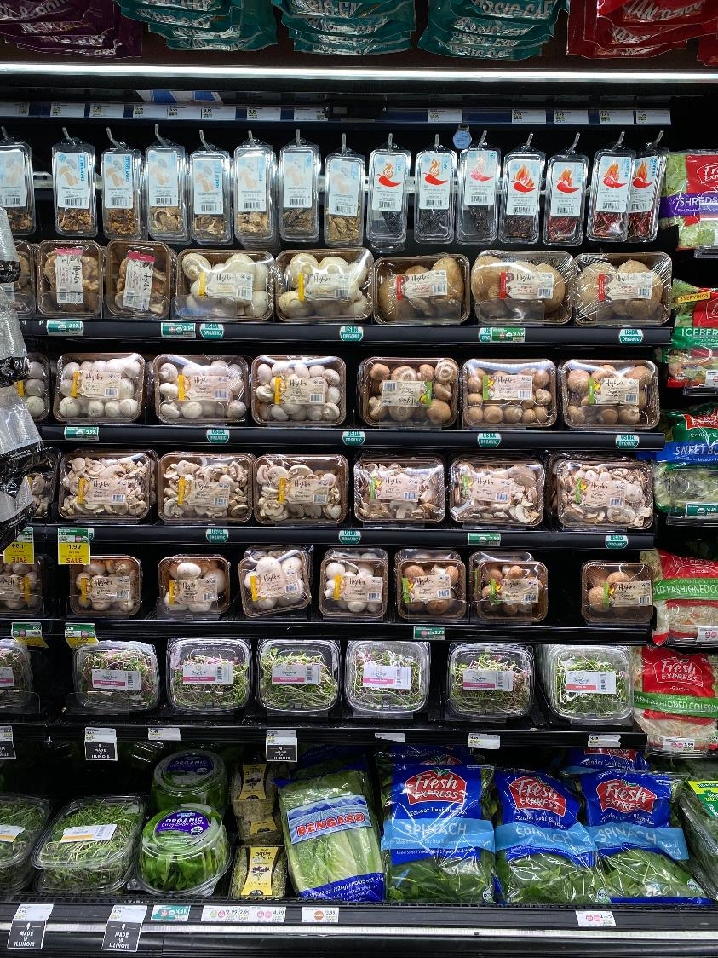

$92.77
Total ring if fresh mushrooms are purchased
Total trip spend by mushroom type:
$92.53 White mushrooms
$105.98 Crimini (baby bella) mushrooms
Source: IRI, Integrated Fresh, Household Panel data, All outlets, mushrooms, 52 weeks ending 6/12/2022
Notes:
When shoppers buy mushrooms, they spend an average of $93 on the trip. This means fresh mushrooms tend to be bought during the stock up trip, with meals in mind. Mushrooms’ versatility makes it an ideal candidate for all meal occasions and cuisines. When shoppers purchase crimini mushrooms, often referred to as baby bellas, the average trip basket is even higher, at an average of $105.98. Crimini mushroom shoppers, along with people who purchase specialty mushrooms, such as shiitake and oyster mushrooms, are higher on the foodie scale. This means recipes involving these types of mushrooms can be a bit more adventurous. For more insights and merchandising inspiration, visit www.mushroomcouncil.org!

Slide 2
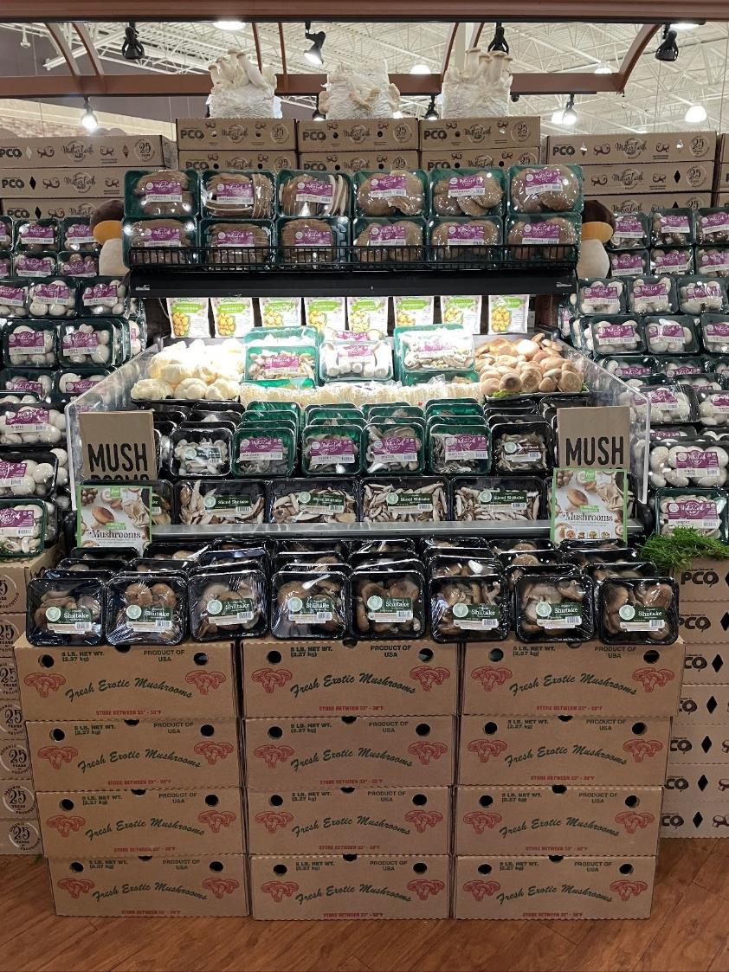
$22.90
Average annual spend per fresh mushroom buyer
Around 63 million households in the U.S. purchase fresh mushrooms, spending nearly $23 a year.
Source: IRI, Integrated Fresh, Household Panel data, All outlets, mushrooms, 52 weeks ending 1/1/2023
Notes:
About half of all U.S. households purchase mushrooms at retail at least once a year. That equates to some 63 million households being engaged in the category. Mushroom sales peak in the winter and the holiday months, with the average shopping spending nearly $23 on fresh mushrooms per year. Add to that the mushrooms on pizzas, burgers, salads and more bought from restaurants, and the nation’s love for the mushroom is clear! For more insights and merchandising inspiration, visit www.mushroomcouncil.org!

Slide 3
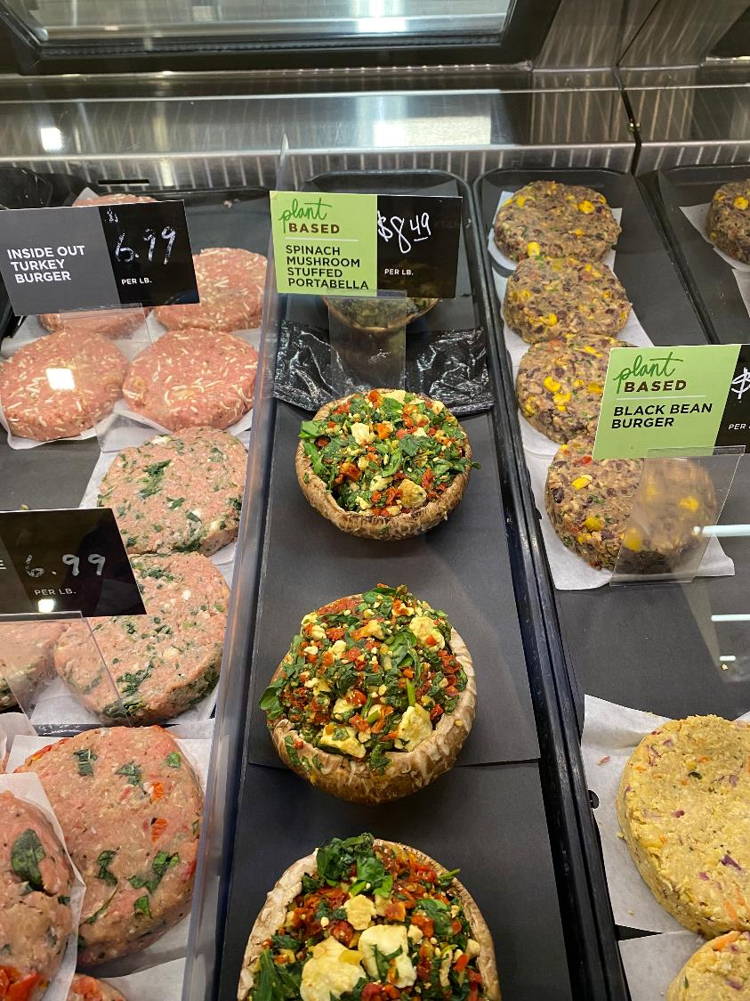
$69M
2022 dollar sales for stuffed and stuffer mushrooms
Consumers are enjoying stuffed mushrooms, whether creating their own at home or buying them already made.
Up from $50 million in 2017, combined sales for stuffed and stuffer mushrooms reached $69M in 2022.
This is up 29% from 2019, the pre-pandemic normal
Source: IRI, Integrated Fresh, Household Panel data, All outlets, mushrooms, 52 weeks ending 1/1/2023
Notes:
Consumers are enjoying stuffed mushrooms, whether creating their own at home or buying them already made. Stuffed portabellas span the range of flavors and ingredients — sometimes going vegetarian and plant-based, such as these beauties at Heinen’s Foods in Chicago and other times including items such as Italian sausage, cream cheese, etc. Ready-to-cook stuffed mushrooms can be found in many places around the store. Some retailers keep the stuffed and stuffer mushrooms in a more traditional produce department merchandising set. Other retailers, as showcased in the picture, have brought stuffed mushrooms into the meat department. Yet others are also offering ready-to-cook stuffed mushrooms into the deli department — taking advantage of oven, air fryer and microwave-ready trays. Sales of stuffed and stuffer mushrooms have increased tremendously over the past few years, underscoring the popularity of the stuffed mushroom. For more insights and merchandising inspiration, visit www.mushroomcouncil.org!

Slide 4
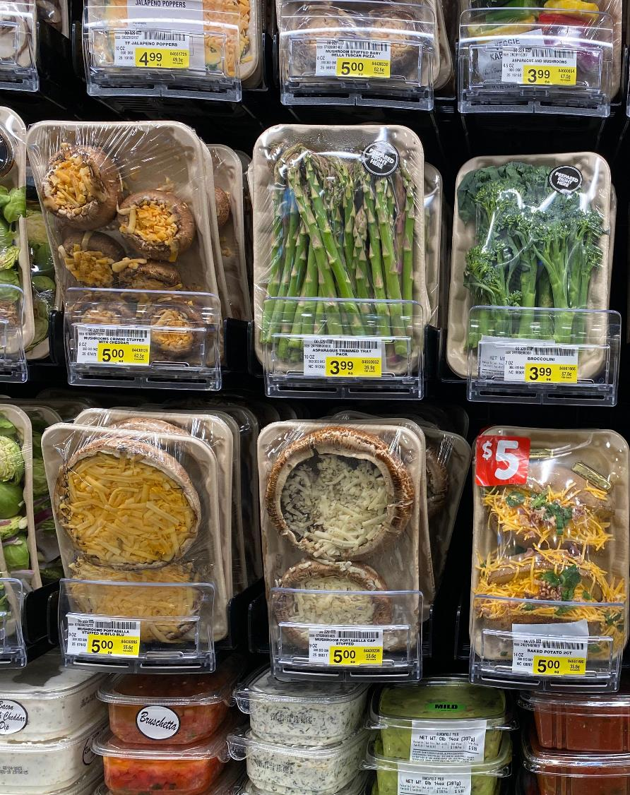
+192%
2017-2022 dollar sales increase for stuffed mushrooms sold in the produce department
Stuffed mushrooms are a hit, whether sold in the produce, meat or deli departments.
Stuffed mushrooms sold in the produce department alone reached $49M in sales in 2022.
This was up from $17M in 2017
Source: IRI, Integrated Fresh, Household Panel data, All outlets, mushrooms, 52 weeks ending 1/1/2023
Notes:
Addressing the ever-growing important intersection of health, convenience and great flavor, stuffed mushrooms are a hit with consumers. Looking at stuffed mushroom sales in the produce department only, shows an enormous 192% increase in dollar sales between 2017 and 2022. Sales of ready-to-cook stuffed mushrooms increased from $17M in 2017 to $49M in 2022. Offerings range from smaller stuffed bellas providing some options for bite-sized dishes or appetizers to center-of-plate stuffed portabellas. Likewise, items range from vegetarian to vegan options and increasingly meat departments are offering items stuffed with Italian sausage and other grinds. For more insights and merchandising inspiration, visit www.mushroomcouncil.org!

Slide 5
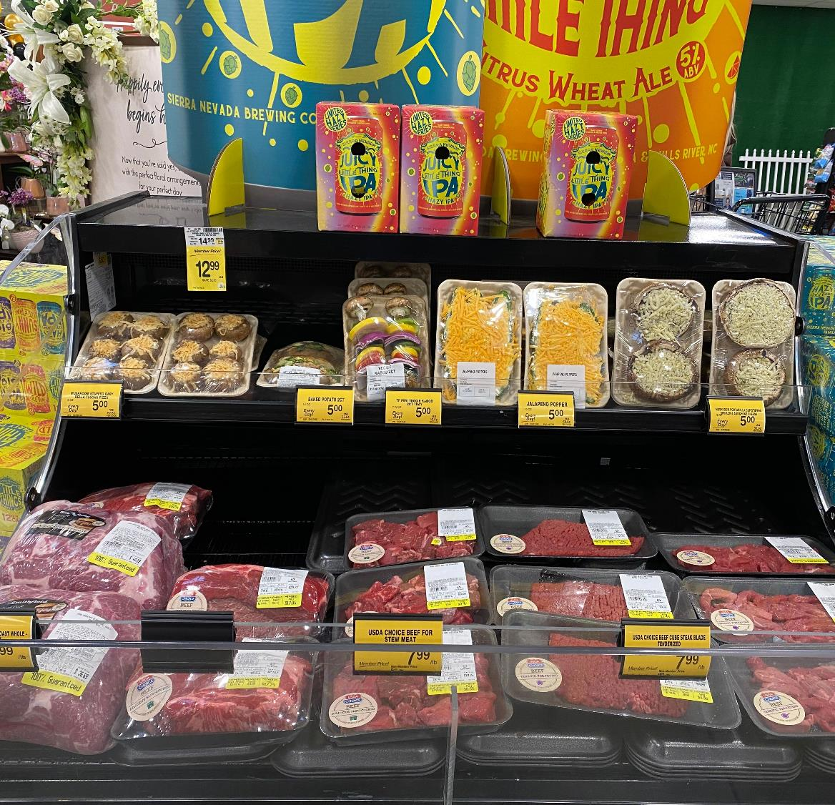
+135%
2017-2022 unit sales increase vs. YA for stuffed mushrooms sold in the produce department
This checkout secondary display at Safeway in El Dorado Hills, CA is showcasing mushrooms’ incredible versatility, including veggie kabobs and stuffed crimini and portabella mushrooms.
Source: IRI, Integrated Fresh, Household Panel data, All outlets, mushrooms, 52 weeks ending 1/1/2023
Notes:
In today’s marketplace, consumers’ money-saving measures are putting enormous pressure on units and volume in departments around the store. But there are still pockets of growth and stuffed mushrooms are one of them. In the produce department alone, retailers are selling nearly 10M stuffed mushroom units, which is up 65% versus the pre-pandemic normal level of 2019 and an astounding 135% over the past five years. More retailers are selling them and the offering is expanding. Stuffed mushrooms make for great bite-sized appetizers or center-of-plate meat alternatives. For more insights and merchandising inspiration, visit www.mushroomcouncil.org!

Slide 6
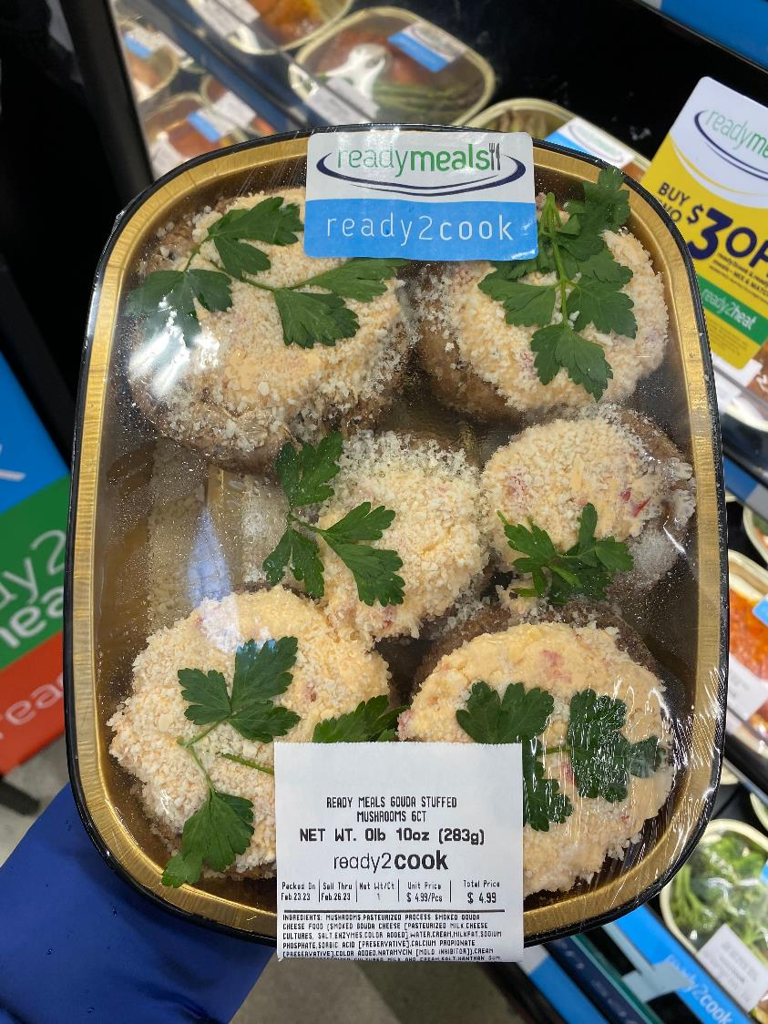
+12.5%
52-week deli prepared entrees sales growth vs. YA
Deli prepared entrees have seen tremendous growth over the past year as a cost-effective way to save time and money. Additionally, growth is seen in:
+2.5% Deli-prepared appetizers
+7.2% Deli-prepared side dishes
Source: IRI, Integrated Fresh, Total US, MULO, 52 w.e. 2/26/2023
Notes:
Deli-prepared foods were a growth engine prior to the pandemic and continue to generate growing consumer engagement today. Deli-prepared entrees reached $5.9 billion in sales, which was up 12.5% in dollars and 3.7% in unit sales — underscoring that growth is fueled by higher prices and greater demand. Additionally, growth can be seen in deli-prepared appetizers and side dishes. These are all great areas to highlight the versatile mushroom, whether as a topping on deli-prepared pizza, slices mushrooms on the salad bar or stuffed and oven-ready mushrooms in the grab-and-go set as demonstrated by these beauties in the El Dorado Hills, CA Safeway. For more insights and merchandising inspiration, visit www.mushroomcouncil.org!

Slide 7
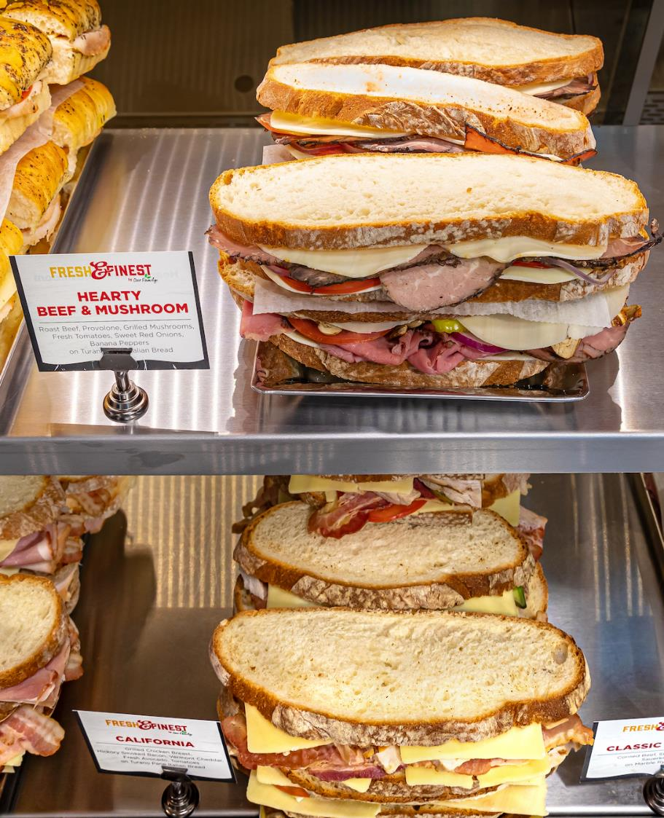
$3.3B
52-week deli prepared sandwich sales, growing 11.5% year-on-year
Deli prepared sandwiches have seen tremendous growth over the past year as a cost-effective way to save time and money. Appetizers and side dishes are other powerhouses.
$1.8B | +2.5% Deli-prepared appetizers
$1.4B | +7.2% Deli-prepared side dishes
Source: IRI, Integrated Fresh, Total US, MULO, 52 w.e. 2/26/2023
Notes:
Retail deli sales are nearing $45 billion over the past year, with the vast majority, $23.8 billion, generated by deli-prepared foods. Pizzas, rotisserie chicken, sushi, salads and sandwiches are a sales powerhouses. Deli-prepared sandwiches generated $3.3 billion in the 52-week period. This is up 11.5% versus year ago levels. Deli-prepared foods offer consumers a helping hand on preparation time and ease, but also tend to be a cost-effective alternative to restaurant meals. This hearty beef & mushroom sandwich looks like a winner for lunch or dinner! For more insights and merchandising inspiration, visit www.mushroomcouncil.org!

Slide 8
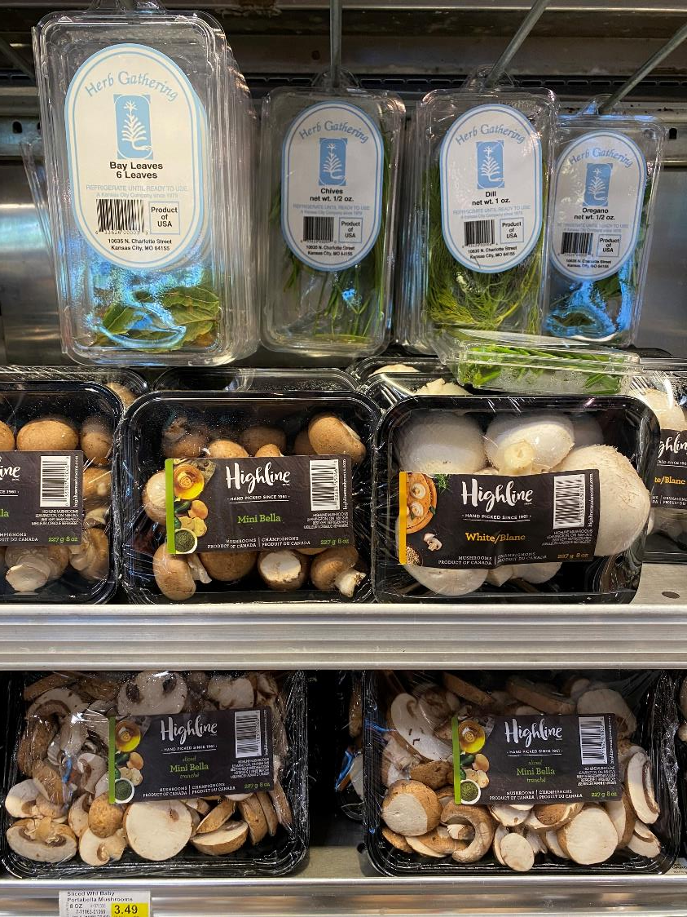
128
Fresh mushroom cross-purchase index with fresh herbs
Fresh mushroom consumers love fresh herbs as well:
While 35.8% of the total population bought fresh herbs in the past year, 45.7% of fresh mushroom consumers did, resulting in a 128 cross-purchase index.
Source: IRI, Integrated Fresh, MULO, Cross-Purchase Index for the 52 w.e. 6-12-2022
Notes:
The cross-purchase index shows what types of other items a mushroom household may be purchasing at a greater rate than the general population. Fresh mushroom consumers love fresh herbs as well. While 35.8% of the total population bought fresh herbs in the past year, 45.7% of fresh mushroom consumers did, resulting in a 128 cross-purchase index. Co-merchandising, as done here by Price Chopper, may be a way to drive a bigger basket. The index is even higher for crimini mushrooms, also called baby bellas, at 143. For more insights and merchandising inspiration, visit www.mushroomcouncil.org!

Slide 9
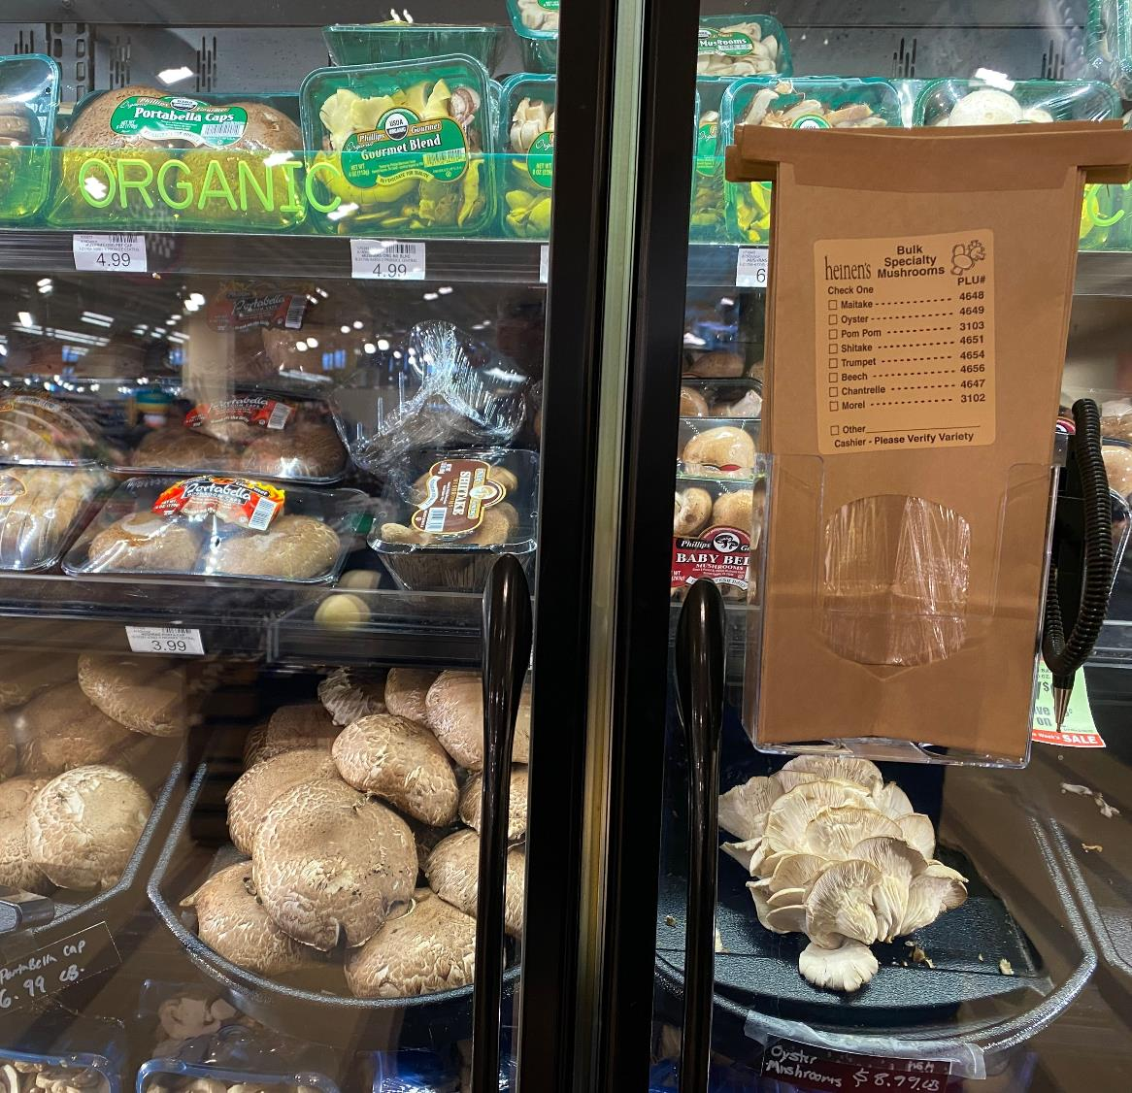
+2.4%
Organic mushroom sales
versus YA
While conventional mushrooms make up the bulk of sales, organic mushroom dollars sales are growing at an above average rate.
Organic mushroom sales reached $166M in the past year
Specialty organic mushroom sales have increased 17.5% over the past year
Source: IRI, Integrated Fresh, MULO, 52 w.e. 3-26-2023
Notes:
Organic mushrooms made up 13% of total fresh mushroom dollar sales in the past year. Despite inflation taking a big bite out of people’s food budgets, organic mushroom sales remained strong. Sales reached $166 million over the past year, which was up 2.4% versus year ago. Not all retailers carry organic mushrooms, but distribution is growing and now up to 62.2%. Criminis and portabellas are the most common organic variety available at retail, with distribution of 58% of total stores, but year-on-year sales growth is highest for organic specialty mushrooms. One-third (33%) of all specialty mushroom sales are organic and sales increased 17.5% over the past year. This is hand-in-hand with an increase in unit sales of 6.5% and an increase in pound sales of 5.8%.
For more insights and merchandising inspiration, visit www.mushroomcouncil.org!

Slide 10
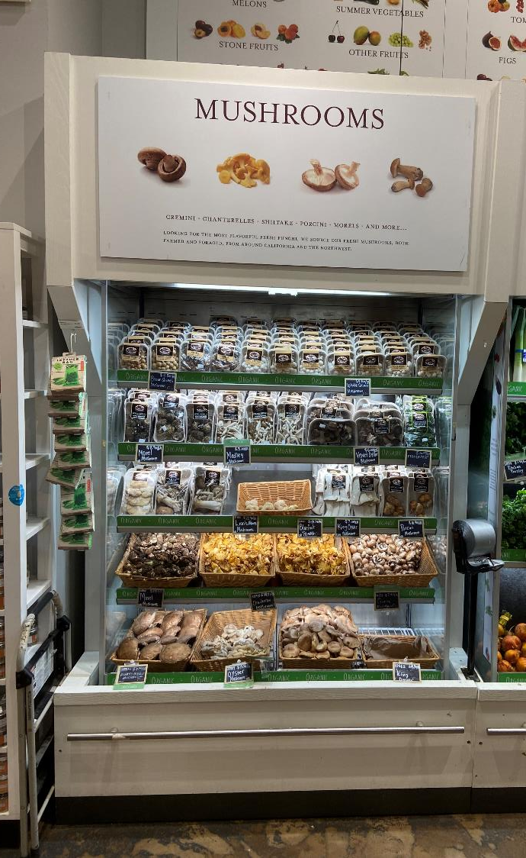
4.6%
Bulk mushroom’s share of total mushroom sales
With fewer retailers carrying bulk mushrooms, their share of dollars hovers around 5%. Retailers often leverage bulk to merchandise specialty mushrooms.
Bulk displays share of sales by mushroom type:
4.8% White mushrooms
4.1% Brown mushrooms (combined crimini and portabellas)
7.2% Specialty mushrooms, such as shiitake, oyster or lion’s mane
Source: IRI, Integrated Fresh, MULO, YTD weeks ending 3-26-2023
Notes:
With fewer retailers carrying bulk mushrooms, their share of dollars hovers around 5%. Retailers often leverage bulk to merchandise specialty mushrooms as evidenced by an above-average 7.2% of specialty mushrooms being generated by bulk. Bulk displays…
Can be of interest to drive trial as consumers can buy a limited amount to see if they are up for more
Can be useful for smaller households that may not need a full 8 or 16 ounces and want to prevent food waste
Bulk can also be an answer to inflationary pressure on the food budget to still purchase some mushrooms but adapt the purchase size
For more insights and merchandising inspiration, visit www.mushroomcouncil.org!

Slide 11
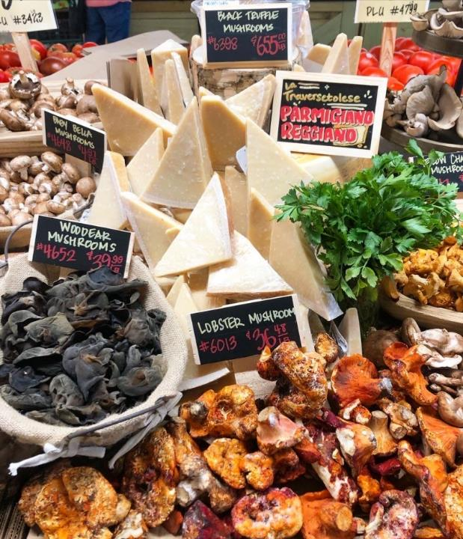
Co-purchase
Items bought during the same grocery trip as fresh mushrooms
Top 10 categories by rank:
Cooking vegetables
Snacking/salad vegetables
Cruciferous vegetables
Salads and leafy greens
Tropical & specialty fruit
Citrus fruit
Deli specialty cheese
Chicken
Frozen vegetables
Shelf-stable pasta
Source: IRI, Integrated Fresh, Household Panel data, All outlets, mushrooms, 52 weeks ending 6/12/2022
Notes:
With mushrooms home being the produce department, it comes as no surprise that many other fruits and vegetables land in the same shopping basket as fresh mushrooms. These include cooking vegetables such as onions, snacking and salad vegetables such as tomatoes and cucumbers and various fruit. But also in the top 10 items are specialty cheeses and with the great popularity of charcuterie boards, cross-merchandising mushrooms and deli cheeses is the solution for the foodies’ heart, as shown beautifully here at Central Market in Texas. For more insights and merchandising inspiration, visit www.mushroomcouncil.org!

Slide 12
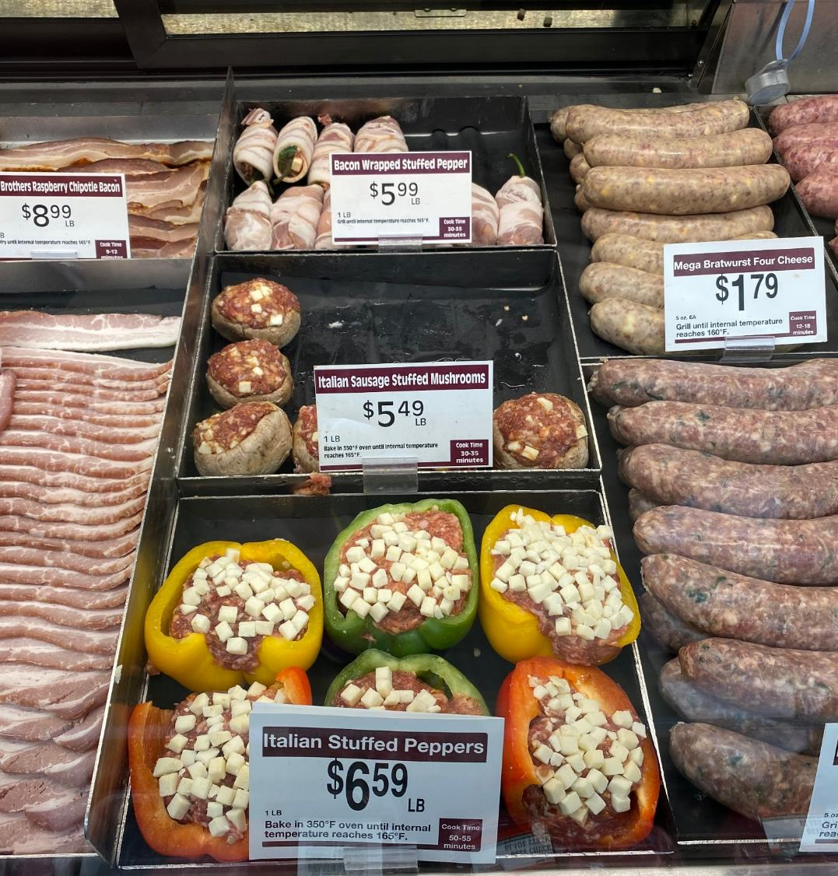
+82.9%
Dollar sales increase for stuffed mushrooms in the meat department
Retailers are increasingly adding stuffed mushrooms in secondary locations, including the full-service meat department. Sales of stuffed mushrooms in the meat department reached $6.6 million, up 82.9% versus year ago levels.
Source: IRI, Integrated Fresh, MULO, YTD weeks ending 4-15-2023
Notes:
As shoppers carefully navigate the balancing act between budget, time and health, ready-to-cook stuffed #mushrooms are a winner. In the 52 weeks ending mid-April, stuffed mushrooms sold in the #meat department generated $6.6 million, up 82.9% versus their year ago levels. While this is a fraction of the sales sold in fresh mushrooms out the produce department, the high growth rate signals that shoppers are increasingly enjoying stuffed mushrooms as a true plant-based meat alternative or blended meat/produce item whether as the center-of-plate protein or a little appetizer. These mushrooms stuffed with Italian sausage as seen at Cubs in Minneapolis are clearly moving fast! For more insights and merchandising inspiration, visit www.mushroomcouncil.org!

Slide 13
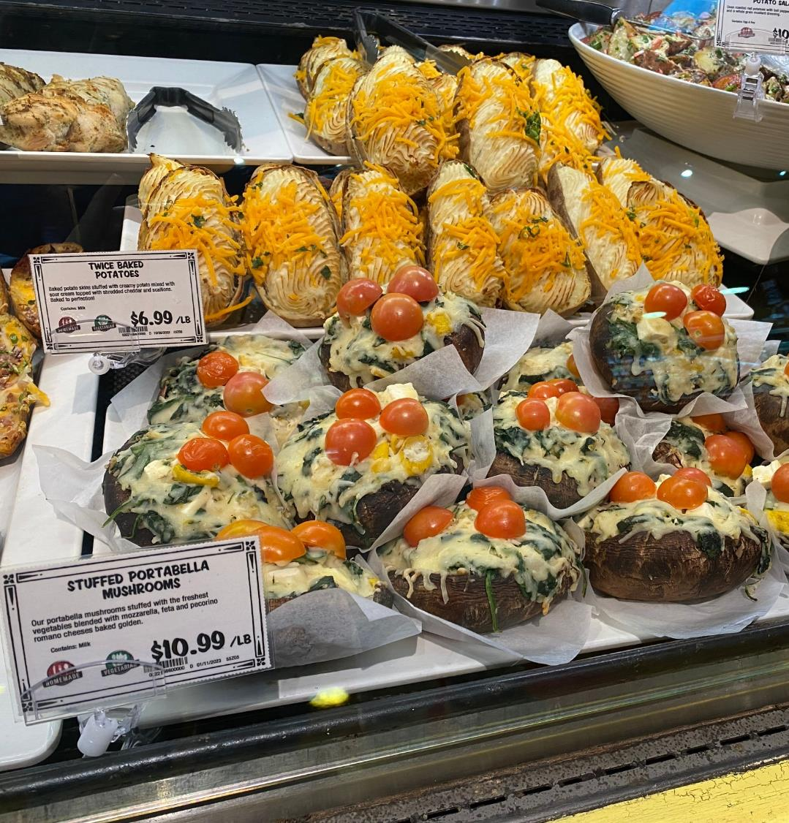
+63.8%
Dollar sales increase for stuffed mushrooms in the deli department
Retailers are increasingly adding stuffed mushrooms in secondary locations, including the deli-prepared area of the store.
Sales of stuffed mushrooms in the deli department reached $4.4 million, up 63.8% versus year ago levels.
Source: IRI, Integrated Fresh, MULO, YTD weeks ending 4-15-2023
Notes:
Deli-prepared foods were a growth engine prior to the pandemic and after a brief slump in sales have picked up where they left off. Very few areas of the store have accomplished true unit or volume growth over the past year but prepared foods are one of them. Retailers are investing in grab-and-go items in particular in addition to the more traditional offerings of rotisserie and fried chicken, pizza and sandwiches. Stuffed mushrooms are increasingly making it into the deli department and with great success. Sales, while small, are growing rapidly. Retailers are taking advantage of new packaging technology that is oven, air fryer or microwave ready, for easy preparation and cleanup, as seen with this wonderful @Nugget Market offering. For more insights and merchandising inspiration, visit www.mushroomcouncil.org!

Slide 14
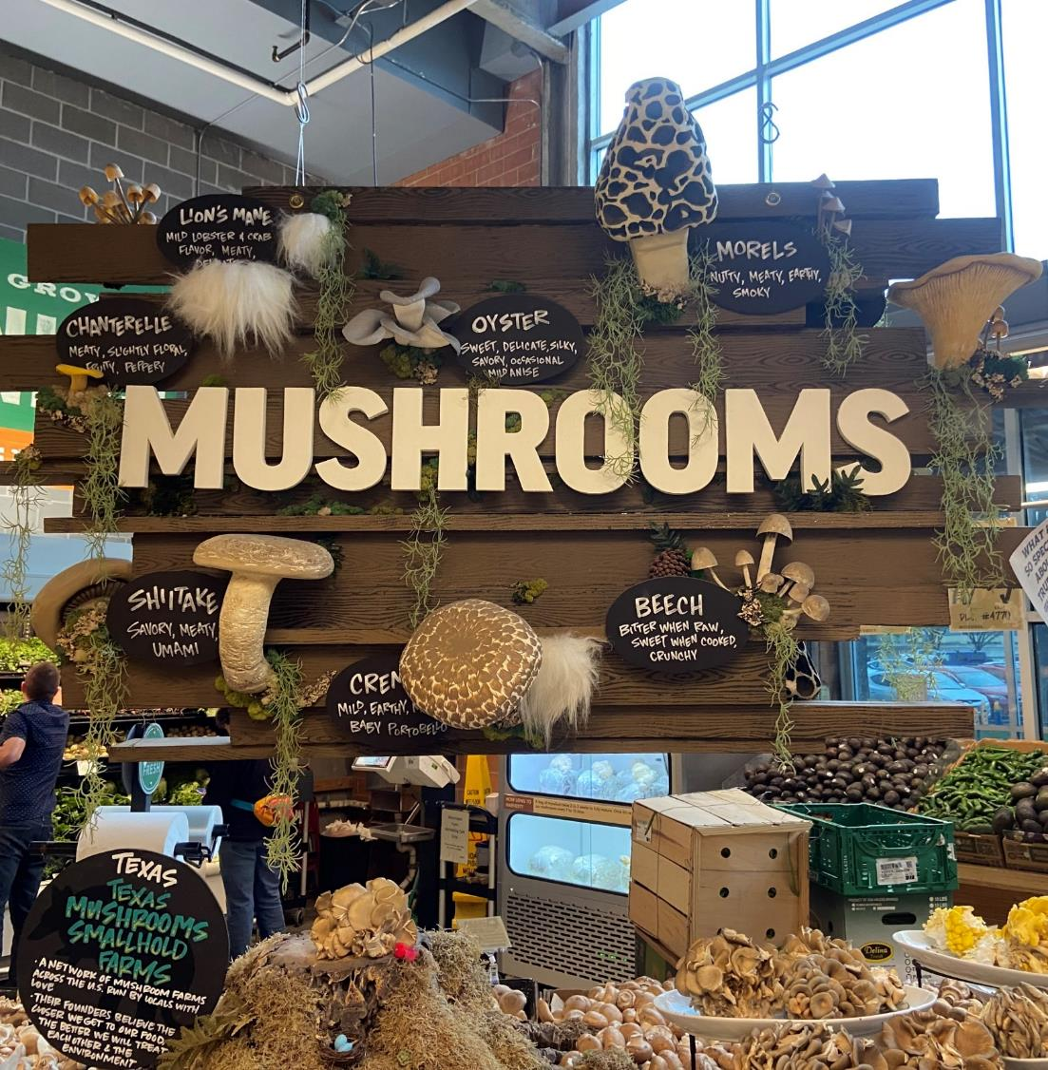
42%
Of consumers can be encouraged to make unplanned produce purchases by eye-catching displays
Eye-catching displays are the second-most powerful way to drive unplanned purchases, behind highlighting seasonal items but ahead of locally-grown items.
Source: Power of Produce 2023
Notes:
While making a grocery list and sticking to it is among the top money-saving measures in these times of high #inflation, there is still ample room for impulse purchases. Produce’s visual beauty can create eye-catching displays that prompt unplanned purchases among 46% of Americans. This beautiful and elaborate mushroom display at @Central Market in Austin certainly caught our eye. The investment in education along with the wide variety of exotic mushrooms is sure to drive some incremental purchases. For more insights and merchandising inspiration, visit www.mushroomcouncil.org!

Slide 15
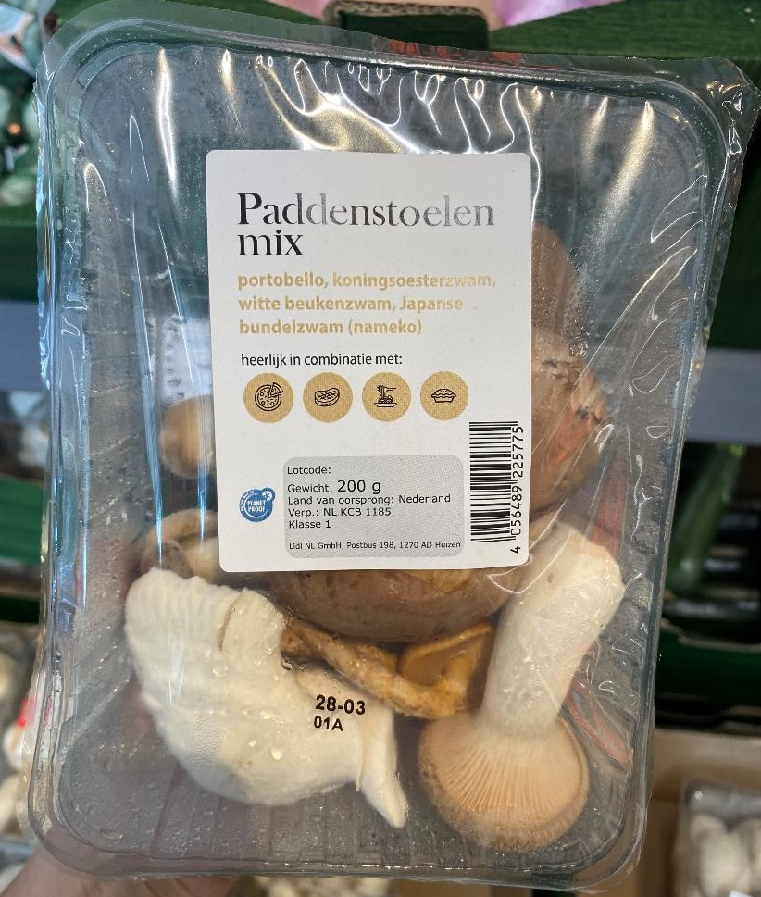
38%
Of consumers can be encouraged to make unplanned produce purchases by an inspiring recipe idea
Mushroom’s versatility means they play a role in virtually all consumption occasions, from a breakfast omelet to being one of the most popular pizza toppings.
Source: Power of Produce 2023
Notes:
Routine meals are out and shoppers browse YouTube, Instagram, Pinterest and more to figure out what’s for dinner. Other times, they walk around the store, looking for meal inspiration. Mushroom’s versatility can help spark that meal idea, selling not just mushrooms but an entire meal’s worth. Inspiration can be as simple as meal icons as done here by @Lidl in the Netherlands, showing icons of pizza, steak, pasta and casseroles. After all, when mushrooms are in the basket, the total trip spend averages nearly $94. Consider secondary locations with frequent co-purchases that include salad fixings, all ingredients for spaghetti as well as omelet fixings such as eggs, shredded cheese and bacon. For more insights and merchandising inspiration, visit www.mushroomcouncil.org!

Slide 16
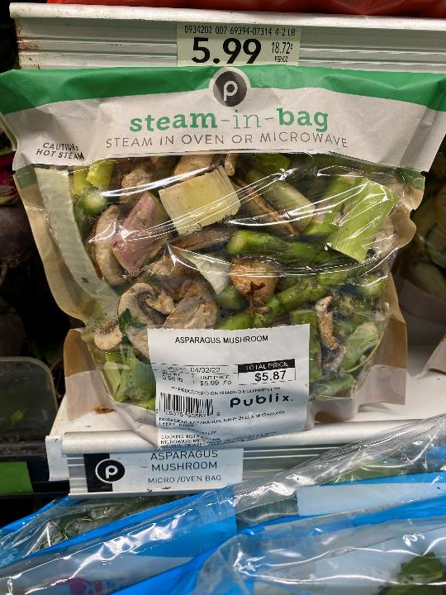
176
Fresh mushroom cross-purchase index with fresh asparagus
Fresh mushroom consumers also love asparagus!
While 18.8% of the total population bought fresh asparagus in the past year, 31.8% of fresh mushroom consumers did, resulting in a 170 cross-purchase index; the highest of all items around the store.
Source: IRI, Integrated Fresh, MULO, Cross-Purchase Index for the 52 w.e. 6-12-2022
Notes:
The cross-purchase index shows what types of other items a mushroom household may be purchasing at a greater rate than the general population. Fresh mushroom consumers love fresh fresh asparagus as well. While 18.8% of the total population bought fresh herbs in the past year, 31.8% of fresh mushroom consumers did, resulting in a 170 cross-purchase index. Creating a mushroom with asparagus mix, as done here by @Publix supermarkets, is just the way to catch these shoppers’ eyes! For more insights and merchandising inspiration, visit www.mushroomcouncil.org! For more insights and merchandising inspiration, visit www.mushroomcouncil.org!

Slide 17
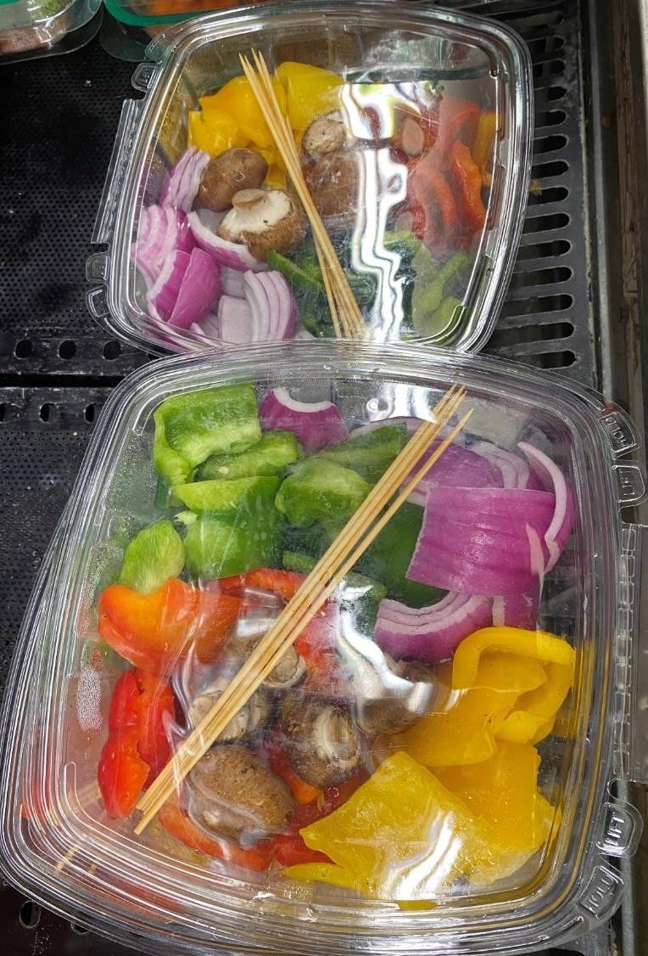
88%
Of shoppers own a grill (including both indoor or outdoor grills)
Produce departments have long provided grill-ready vegetable solutions for items such as peppers and corn on the cob. But this innovative item caught our eyes: a kebab kit complete with skewers, fresh mushrooms and pre-cut vegetables — providing shoppers with maximum flexibility to create the kebab of their dreams.
Source: Power of Meat 2023
Notes:
Grilling remains popular but is no longer just for meat and poultry. Produce departments have taken a cue from restaurant chefs experimenting with nontraditional foods on the grill, from lemons to lettuce and pound cake to doughnuts. We found this innovative kebab kit at Marriano’s in Chicago. With pre-cut and washed mushrooms, peppers and onions, shoppers have maximum flexibility to create their favorite kebab configurations, with or without pre-cubed meat and poultry sourced from the meat department. Adding fruits and veggies to the grilling lineup is encouraged by many grocery retailers and manufacturers. Pittsburgh-based Giant Eagle shares recipes on its website for making fruits and desserts on the grill, such as a grilled banana split. On Brandt Beef’s recipe pages, Chef Rodgers provides a recipe for grilled romaine lettuce. Rochester-based Wegmans also encourages shoppers to put veggies on the grill with in-store recipes and merchandising. For more insights and merchandising inspiration, visit www.mushroomcouncil.org!

Slide 18
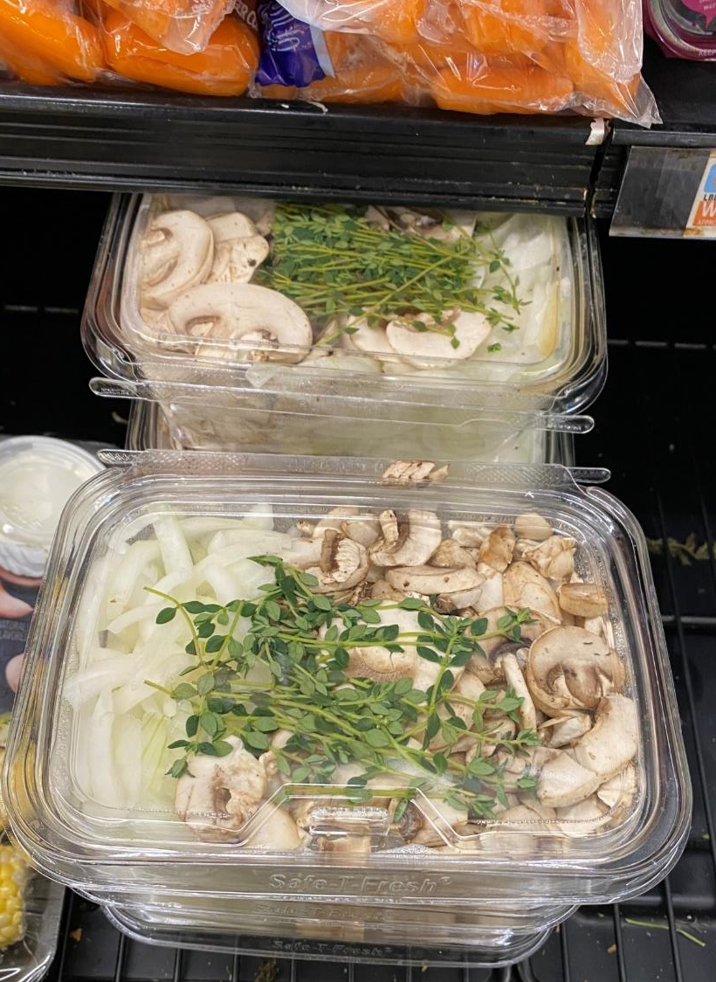
126
Fresh mushroom cross-purchase index with fresh herbs
The number one produce item bought during the same shopping trip as fresh mushrooms are onions.
Additionally, mushroom shoppers also love fresh herbs. While 35.8% of the total population bought fresh herbs in the past year, 45.7% of fresh mushroom consumers did, resulting in a 126 cross-purchase index.
Source: Circana, Integrated Fresh, MULO, Cross-Purchase Index for the 52 w.e. 6-12-2022
Notes:
The cross-purchase index shows what types of other items a mushroom household may be purchasing at a greater rate than the general population. Fresh mushroom consumers love onions and fresh herbs as well. For instance, while 35.8% of the total population bought fresh herbs in the past year, 45.7% of fresh mushroom consumers did, resulting in a 126 cross-purchase index. And onions are the single most common produce item that is purchased in the same shopping trip as fresh mushrooms. Creating a mushroom with onions and fresh herb mix, as done here by @Marriano’s is just the way to catch these shoppers’ eyes! For more insights and merchandising inspiration, visit www.mushroomcouncil.org!

Slide 19
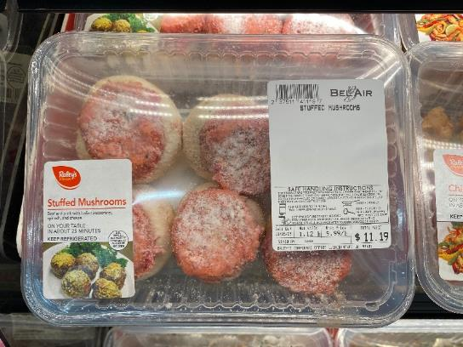
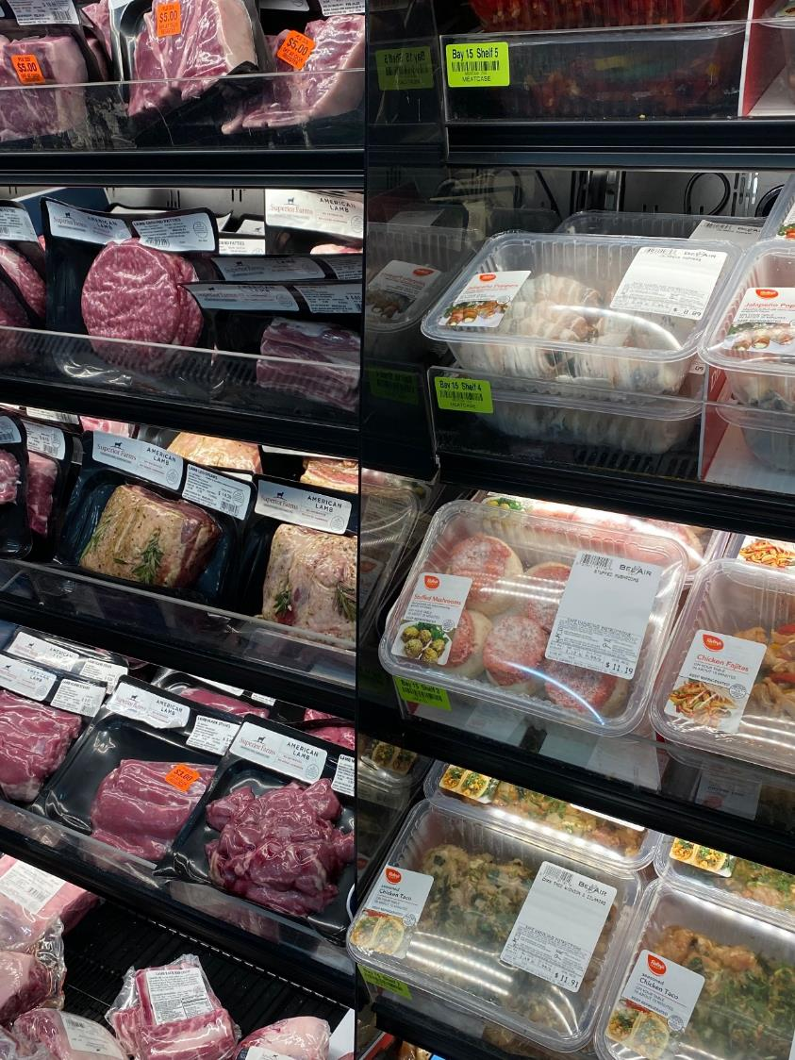
122
Fresh mushroom cross-purchase index with Italian sausage
Stuffed mushrooms provide endless possibilities, from vegan and vegetarian options to this sausage pairing found at Bel Air (Raley’s) in Sacramento, CA.
While 13.3% of the total population bought random weight Italian sausage in the past year, 16.2% of fresh mushroom consumers did, resulting in a 122 cross-purchase index.
Source: Circana, Integrated Fresh, MULO, Cross-Purchase Index for the 52 w.e. 6-12-2022
Notes:
Oven or air fryer-ready stuffed mushrooms are a fast-growing offering in the produce, deli and meat departments. Stuffed mushrooms are incredibly versatile and can be made into a center-of-plate protein alternative for vegans, vegetarians or those looking for some protein variety. But combined with ground meat or sausage, stuffed mushrooms can also combine the best of both worlds, such as seen here at Bel Air, a Raley’s banner, in the Sacramento, California area.
The cross-purchase index shows what types of other items a mushroom household may be purchasing at a greater rate than the general population. Fresh mushroom consumers are more likely to purchase ground sausage: while 13.3% of the total population bought random weight Italian sausage in the past year, 16.2% of fresh mushroom consumers did, resulting in a 122 cross-purchase index. For more insights and merchandising inspiration, visit www.mushroomcouncil.org!

Slide 20
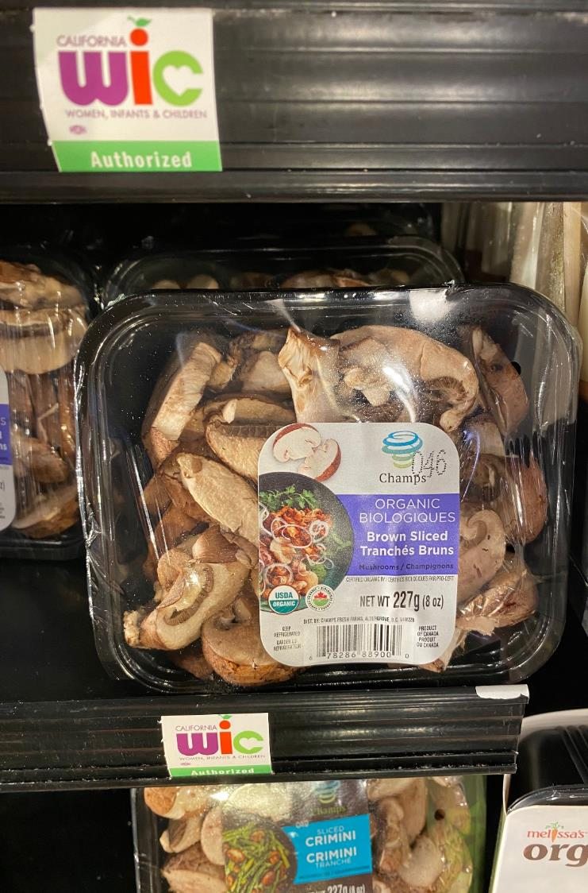

6.5 million
People in the U.S. are certified to receive WIC benefits as of February 2023
The WIC program aims to safeguard the health of low-income women, infants, and children up to age 5 who are at nutrition risk by providing nutritious foods to supplement diets, information on healthy eating, and referrals to health care.
As shown by Nugget Markets in California, fresh mushrooms are WIC eligible and a nutritious and delicious edition to the diet.
Source: USDA, WIC Data Tables, Summary of Major Programs for Latest Available Month
Notes:
Averaging nearly $55 per person, WIC, the Special Supplemental Nutrition Program for Women, Infants, and Children (WIC) provides federal grants to states for supplemental foods, health care referrals, and nutrition education to safeguard the health of low-income women, infants and children up to age five. WIC serves about half of all infants born in the United States, according to USDA. Fresh mushrooms, both organic and conventional types, are WIC-eligible items. Mushrooms are a great way to add key vitamins and nutrients to the diet. For more nutrition insights and merchandising inspiration, visit www.mushroomcouncil.org!

Slide 21
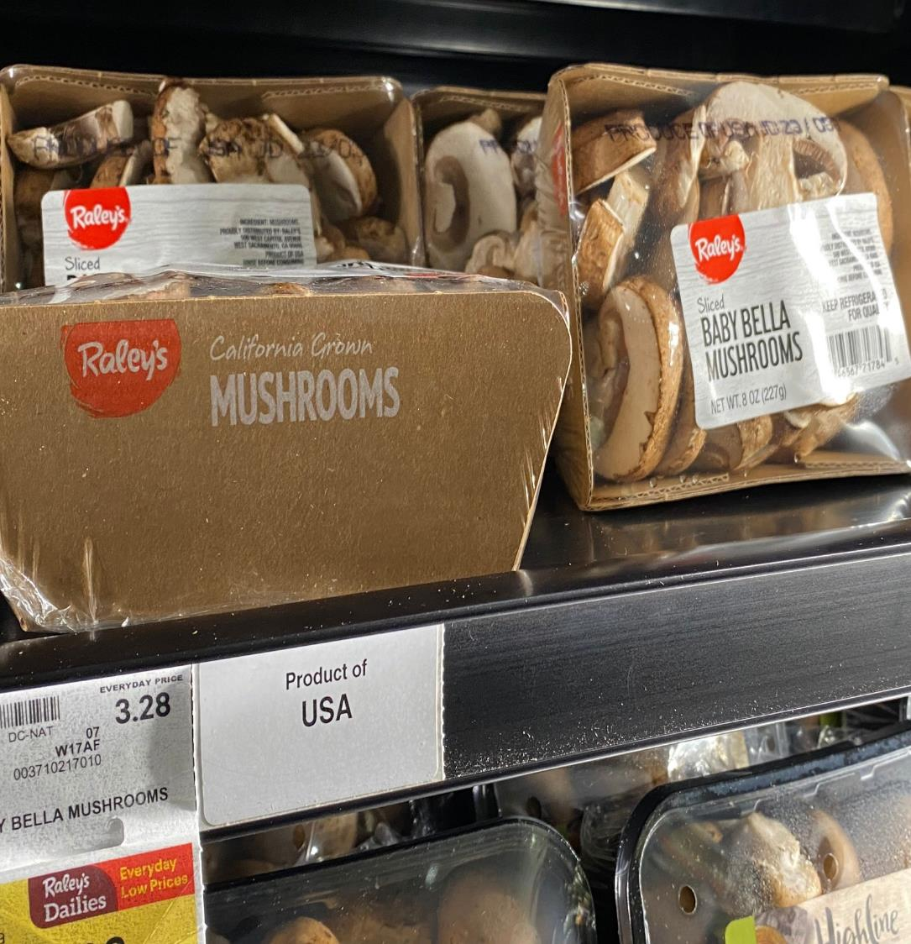
+19.1%
Dollar sales increase for private-brand fresh mushrooms in the latest 52 weeks
One-third of grocery shoppers say they are purchasing store-brand or private-label items more often with an eye on inflation.
Dollar sales for private-label fresh mushrooms increased 19.1% over the past year, compared with an increase of 8.4% for total vegetables.
Source: Circana, Integrated Fresh, MULO, 52 w.e. 5-21-2023
Notes:
The pressure on America’s pocket books is real. Between continued inflation, the expiration of the additional SNAP dollars and a host of other economic indicators pointing to higher debt and eroded savings, 85% of grocery shoppers are applying one or more money-saving measures. Following looking for sales specials and avoiding nonessentials, buying store-brand items more often ranks in third in the list of popular ways to save. This has resulted in above-average performances of private-brand items across the store and mushrooms are no exception. In the latest 52 weeks ending mid-May, sales of private brand mushrooms have increased 19.1%. Mushrooms can also help stretch the meat dollar by blending eight ounces of mushrooms with a pound of ground beef or pork. For more insights and merchandising inspiration, visit www.mushroomcouncil.org!

Slide 22
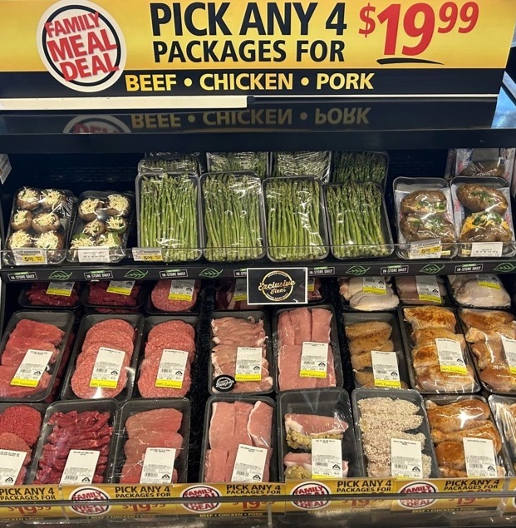
85%
Of grocery shoppers are applying one or more money-saving measure
With sustained high levels of food inflation, 53% of Americans are looking for sales or deals more often. Mix-and-match family deals combining protein, sides and veg options are popular with consumers.
Source: Circana, Primary Grocery Shopper Survey, April 2023
Notes:
‘What’s for dinner?’ is the age-old question. Between pressure on time and budget in today’s challenging marketplace, this is not always an easy one to answer. @Safeway is coming to the rescue by combining various meal components into one easy-to-shop display and providing mix-and-match discounts featuring four items for $19.99. This includes various animal protein options, asparagus, baked potatoes and stuffed mushrooms that can serve as an appetizer, side or center-of-plate protein replacement. For more insights and merchandising inspiration, visit www.mushroomcouncil.org!

Slide 23
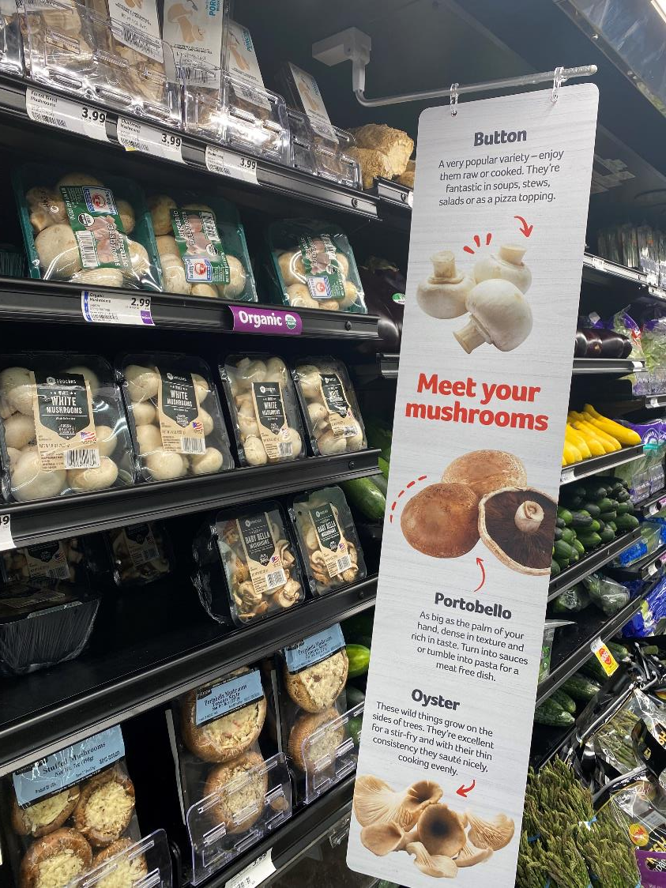
53.6%
Of total mushroom dollar sales are generated by white (button) mushrooms
 | Share of $ sales | Share of pound sales
White (button) mushrooms | 53.6% | 60.8%
Crimini & portabella mushrooms | 40.8% | 67.3%
Specialty mushrooms | 5.7% | 1.9%
Source: Circana, Integrated Fresh, Total US, MULO, 52 weeks ending 6/18/2023
Notes:
White or button mushrooms have long been the majority sales driver in grocery retailing. They account for 60.8% of pounds, but given their slightly lower price point, account for 53.6% of dollars. However, there has been a distinct shift toward more crimini mushrooms, also referred to as baby bellas, along with portabellas. They now represent 40.8% of total mushrooms sold at retail. Specialty mushrooms make up less than 2% of pounds, but given their far above average price point, they represent nearly 6% of dollar sales. Specialty mushrooms are a favorite among foodies but new and light mushrooms buyers tend to stick to white button mushrooms. Having point-of-sales materials explaining the flavor profile along with some usage ideas can be a great way to have these consumers explore something different. @Winn Dixie is doing a great job educating consumers on button, portobello and oyster mushrooms in the picture. For more insights and merchandising inspiration, visit www.mushroomcouncil.org!

Slide 24
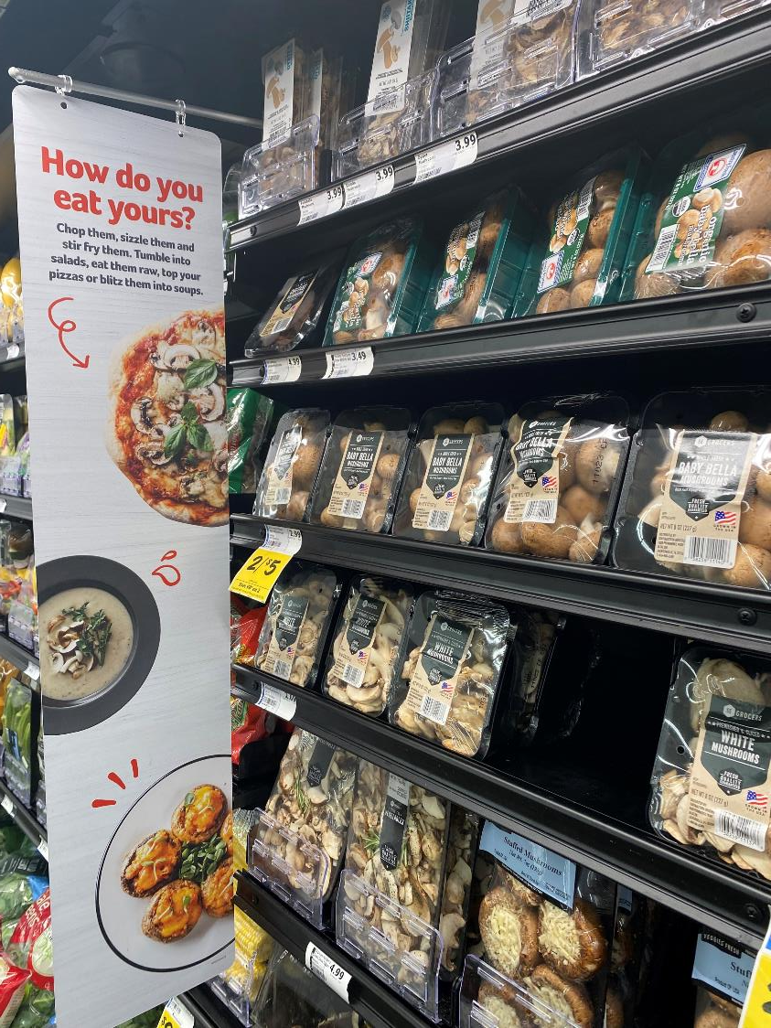


Versatility
How do you eat yours?
Chop them, sizzle them and stir fry them. Tumble into salads, eat them raw, top your pizzas or blitz them into soups.
Source: Circana, Integrated Fresh, MULO, Cross-Purchase Index for the 52 w.e. 6-12-2022
Notes:
Mushrooms are incredibly versatile and a great way to add nutrients and flavor to #pizza, #soup and more. @Winn Dixie reminds shoppers of the many usage occasions and cuisines that are a perfect match for the mighty mushroom and we can think of a few more: a breakfast omelet, a hearty spaghetti sauce, a veggie or meat kabob when firing up the grill or, increasingly popular, stuffed mushrooms served as appetizers or center of plate. For more insights and merchandising inspiration, visit www.mushroomcouncil.org!

Slide 25
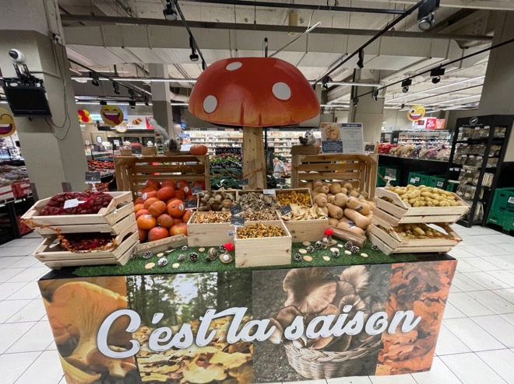
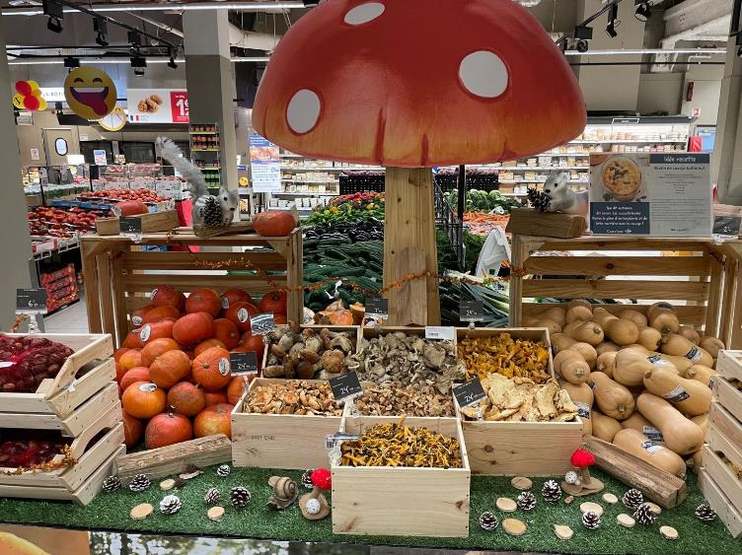
42%
Of consumers can be encouraged to make unplanned produce purchases by eye-catching displays
Eye-catching displays are the second-most powerful way to drive unplanned purchases, behind highlighting seasonal items but ahead of locally-grown items.
Source: Power of Produce 2023
Notes:
It’s the season! Fall means everything from pies to lattes becomes pumpkin flavored. But the fall and winter months bring so many more opportunities. Check out these displays focused on a variety of fall and winter favorites, including mushrooms. The eye-catching display inspires and educates with recipes included. For more nutrition insights and merchandising inspiration, visit www.mushroomcouncil.org!

Slide 26
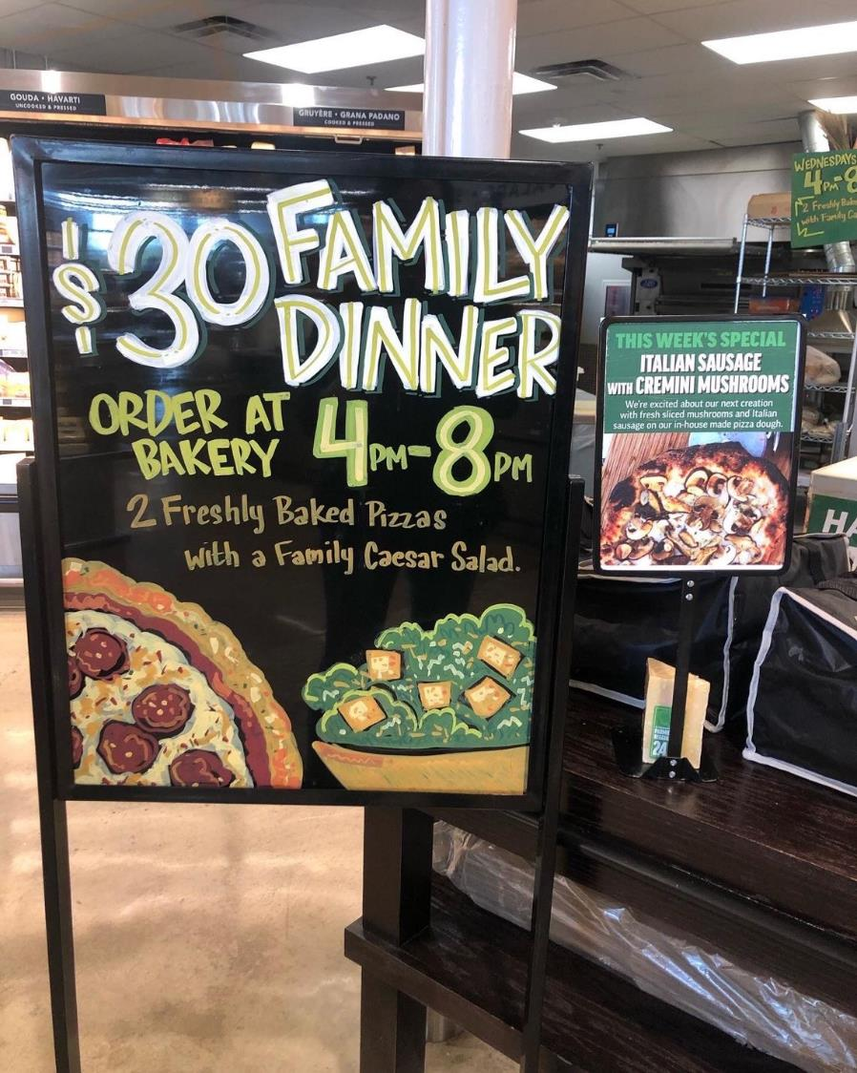
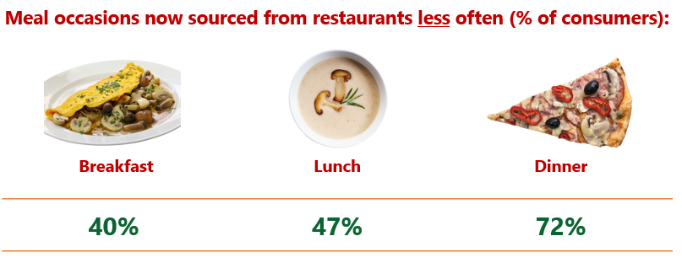
39%
Of shoppers eat out at or order in from restaurants less often
Source: IDDBA, What’s In Store 2023
Notes:
While the rate of inflation has decelerated to single digits in the past few months, consumers are paying 27.1% more for food and beverages now than they did pre-pandemic. With life significantly more expensive, 39% of consumers are putting the brakes on restaurant spending to balance their budgets. Dinner is most often on the chopping block, but also the biggest meal occasion for restaurants. Many retailers have expanded their deli prepared offerings in the past few years, with additional focus on cost-effective family dinners. Check out this $30 family dinner, featuring two freshly baked pizzas and a family Caesar salad. And of course we love this week’s special: Italian sausage with crimini mushrooms! Mushrooms are among the most popular toppings in foodservice. For more insights and merchandising inspiration, visit www.mushroomcouncil.org!

Slide 27
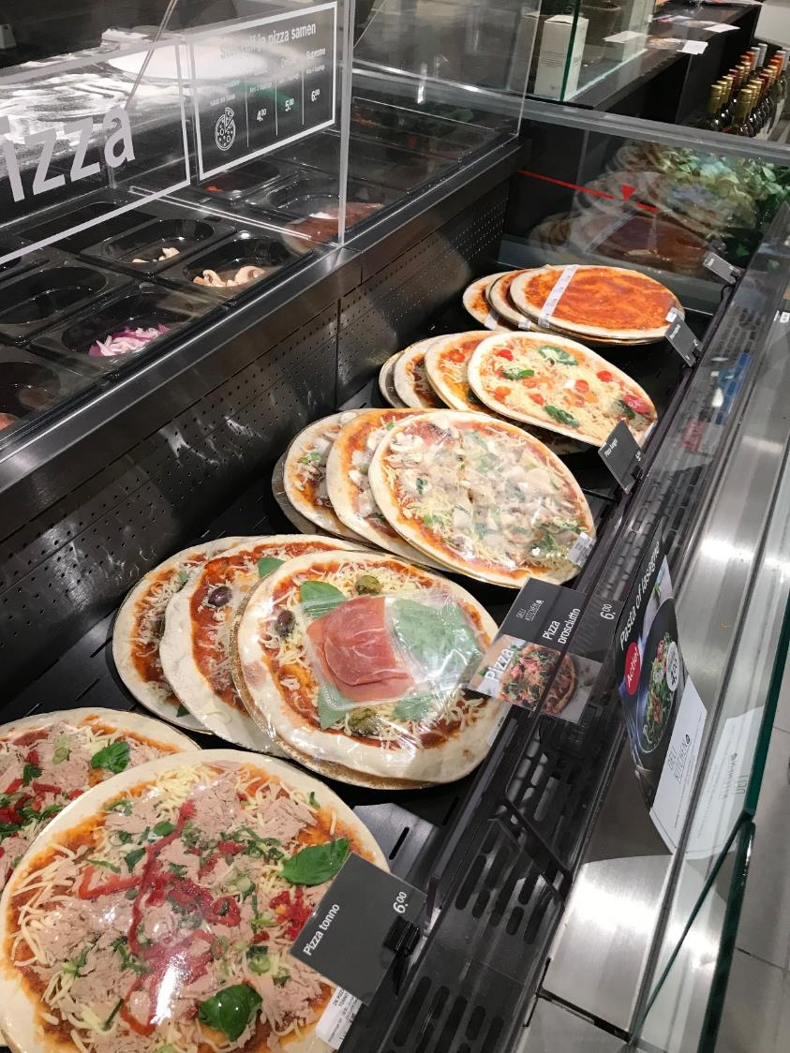
+8.9%
Growth in mushrooms appearing as toppings on pizzas
According to the 2023 Slice of the Union report from Slice, mushrooms were the “Topping of the Year” in 2022, appearing on 8.9% more pizzas than in 2021.
Source: 2023 Slice of the Union Report
Notes:
Slice, the technology platform powering America’s largest network of pizzerias, named mushrooms the “topping of the year.” Slice crunched the data from millions of orders across nearly 19,000 independent pizza shops and found that mushrooms appeared on nearly 9% more pizzas in 2022 — becoming the fastest growing topping. Want a piece of the pie? According to Slice, pizza and football go hand-in-hand: more people ordered pizza on game days than during any other major league sporting events. For more insights and merchandising inspiration, visit www.mushroomcouncil.org!

Slide 28
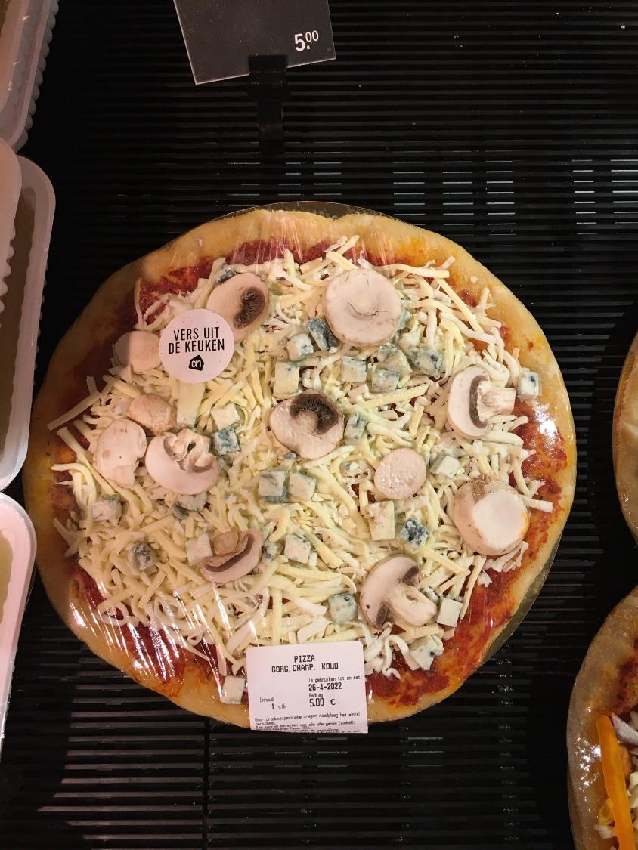
+20.7%
Dollar growth of grocery deli-prepared pizzas
Grocery deli-prepared pizzas have grown to a $854 million business.
Dollar sales have increased 20.7% over the latest 52 weeks
Unit sales were up 10.4%
Source: Circana, Integrated Fresh, MULO, 52 weeks ending 7/2/2023
Notes:
“Amid widespread unit and volume pressure in departments and categories across the entire grocery store, the deli prepared aisle is largely holding its own,” said Jonna Parker, Team Lead, Fresh at Circana (formerly IRI). Deli-prepared foods generated $24.4 billion in the past year and only had mild unit pressure of -0.9%, according to Circana. One of the standout performers within grocery deli prepared are pizzas. Whether sold hot by the slice or the whole pie, or ready to be baked, grocery deli prepared pizzas have grown to become a $854 million business that is growing in both dollars and units. In fact, unit sales increased 10.4% over the past year — ahead of all other categories. Ride the growth train, but don’t forget the mushrooms! For more insights and merchandising inspiration, visit www.mushroomcouncil.org!

Slide 29
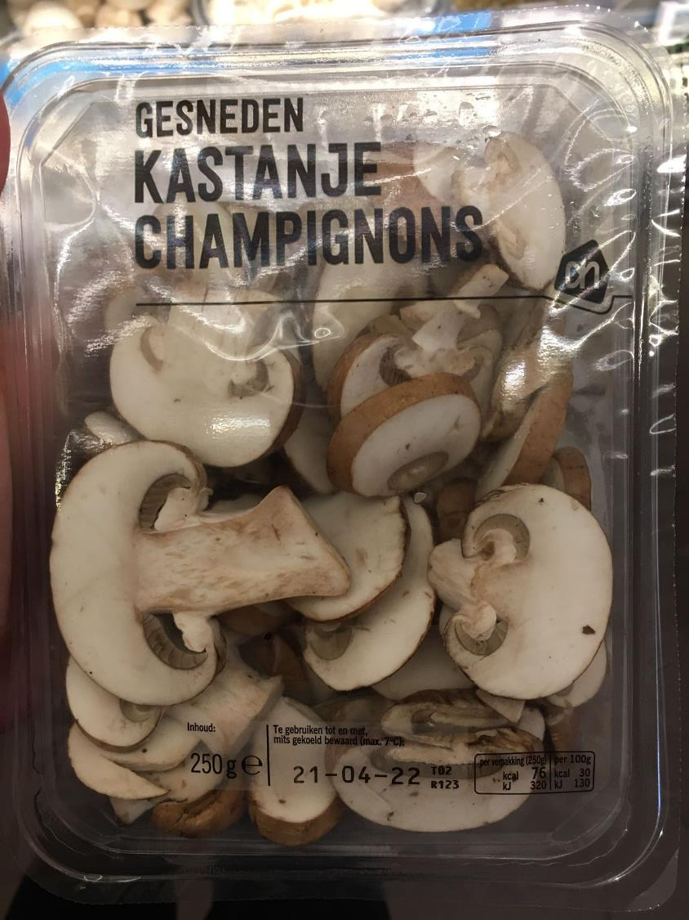
+12.6%
Dollar growth in shelf-stable pizza products, such as crusts/dough, crust mixes and sauce
The love for pizzas comes in many forms, including make-your-own. According to Circana, shelf-stable pizza ingredients reached $228 million in sales, up 12.6% in dollars and 0.6% in units.
Source: Circana, Integrated Fresh, Total US, MULO, 52 weeks ending 7/2/2023
Notes:
By the slice or a whole pie; from the deli or pizzeria; frozen or fresh, pizzas are popular. Consumers are also making their own as evidenced by ingredient sales numbers, according to Circana (formerly IRI):
Shelf-stable crust mixes reached $18 million in sales, up 18.2% in dollars and 1.4% in units
Shelf-stable pizza sauce reached $180 million over the past year, up 14.0% in dollars and 1.0% in units
And we may be a bit tainted, but what’s a pizza without mushrooms — named the ingredient of the year by Slice. For more nutrition insights and merchandising inspiration, visit www.mushroomcouncil.org!

Slide 30
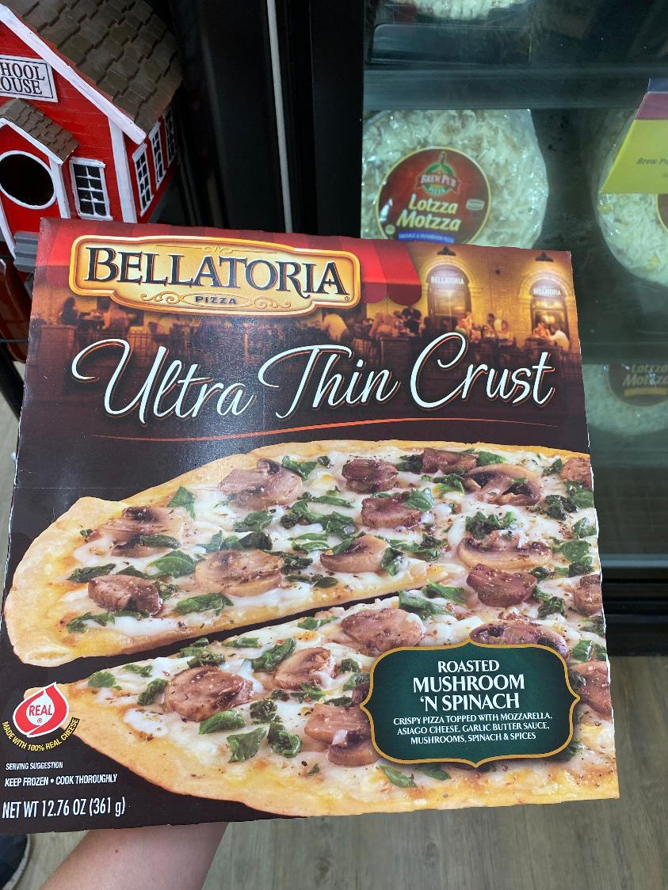
$6.7 billion
Sales of frozen pizzas
The love for pizzas comes in many forms, including the ever-convenient standby, frozen pizza. According to Circana, frozen pizza sales reached $6.7 billion, up 10.4% in dollars, though down 3.0% in units.
Source: Circana, Integrated Fresh, Total US, MULO, 52 weeks ending 7/2/2023
Notes:
Out of time to cook from scratch? Not in the mood to cook from scratch? For many of us, frozen pizza is the loyal standby when life gets in the way of best laid plans. Frozen pizzas are a $6.7 billion business, according to Circana, formerly IRI. Much like the vast majority of categories in the frozen food aisle, pizzas have experienced robust dollar gains over the past year, of 10.4% but there is some unit pressure. Frozen pizza units decreased by 3.0% over the past year. Mushrooms were the fastest-growing topping among independent pizzerias in 2022, according to Slice. And mushrooms are the number three topping behind sausage and pepperoni — holding the top honors across all produce toppings,, according to Domino’s. Sliced mushrooms make for an ideal combination with frozen pizzas, to add some extra nutrition and flavor. For more insights and merchandising inspiration, visit www.mushroomcouncil.org!

Slide 31
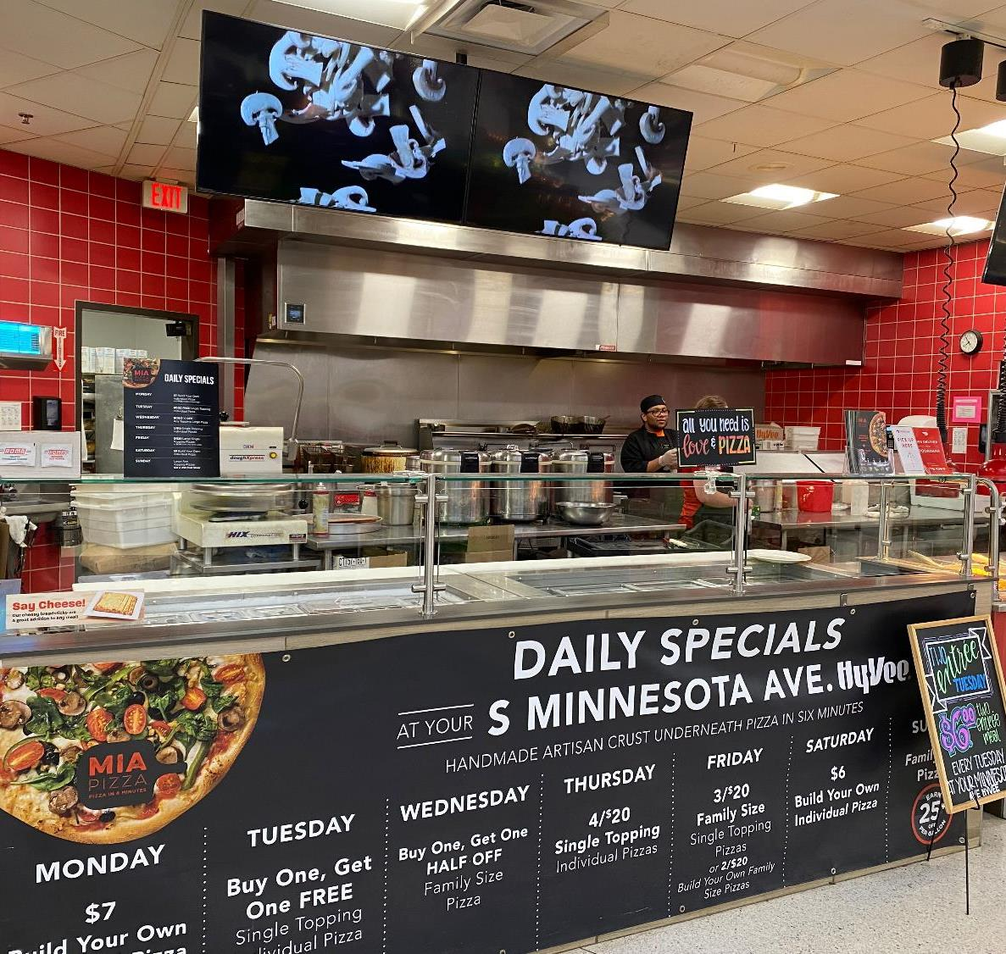
+24.0%
Dollar growth in whole deli-prepared pizzas
Grocery deli-prepared pizzas have grown to a $854 million business.
Whole pizzas: $648 million
Slices: $99 million
Calzones: $47 million
Ingredient sales: $35 million
Source: Circana, Integrated Fresh, Total US, MULO, 52 weeks ending 7/2/2023
Notes:
Many channels compete to answer America’s love for pizza. From pizza restaurant chains and independents, to frozen, make-your-own and of course grocery deli-prepared pizzas. According to Circana (formerly IRI), grocery deli-prepared pizzas have grown to a $854 million business. The vast majority of sales comes from whole pizzas, accounting for $648 million. They are also the fastest growing side of the business. Dollar sales for whole deli pizza increased 24% over the past year, while units increased 14.7%. Pizza by the slice is the next largest part of the business, accounting for nearly $100 million. Pizza by the slice also increased dollar and unit sales, at +11.4% and 5.4%, respectively. Hot, ready-to-eat pizza does especially well in urban areas. Make sure you highlight mushrooms — the fastest growing topping in 2022 according to Slice. For more insights and merchandising inspiration, visit www.mushroomcouncil.org!

Slide 32
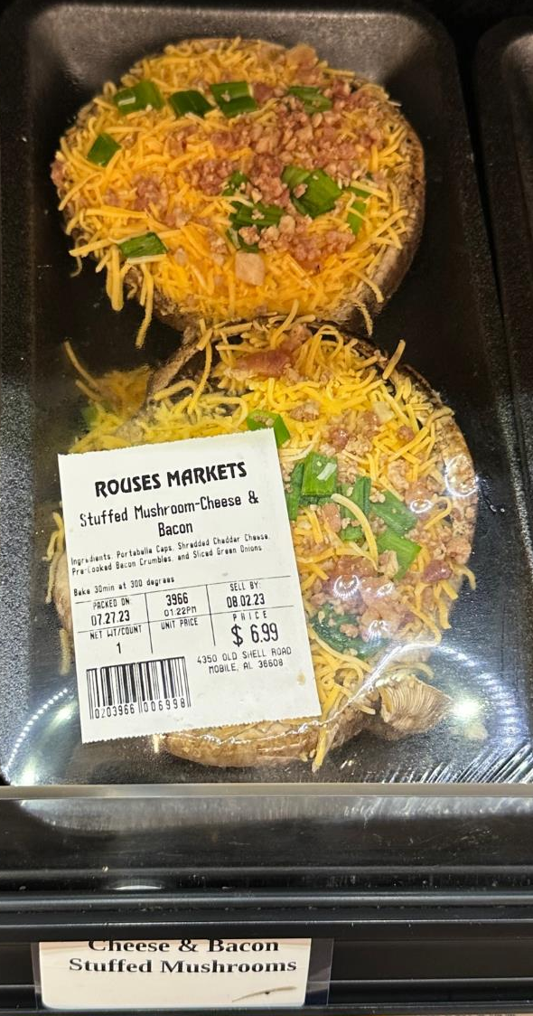
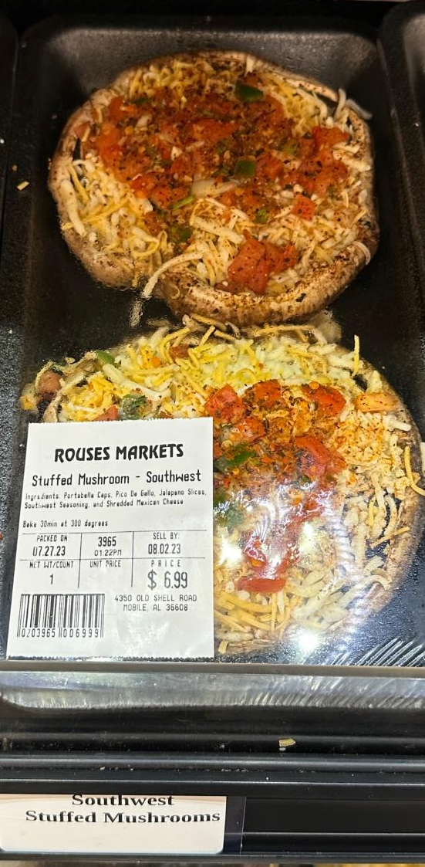
+39.3%
Dollar growth in stuffed mushrooms deli appetizers
Interest in plant-based eating remains high and stuffed mushrooms are delivering big in the produce, meat and deli departments of the grocery store.
Source: Circana, MULO, 52 weeks ending 7/16/2023
Notes:
Growth continues for stuffed mushrooms — a convenient way to serve up a nutritious and delicious appetizer or center of plate solution. According to data insights firm Circana, stuffed mushroom dollar sales in the deli department grew 39.3% over the past year. Additionally, unit sales increased 47.9%, signaling deflation for the first time in many months. Keep interest strong with an ever-rotating variety of mushrooms as shown here with some best-in-class examples by @Rouses Markets in New Orleans, LA! From Southwest style to stuffed mushrooms with cheese and bacon, variety is the spice of life. Everything is better with #bacon, well, and #mushrooms. For more insights and merchandising inspiration, visit www.mushroomcouncil.org!

Slide 33
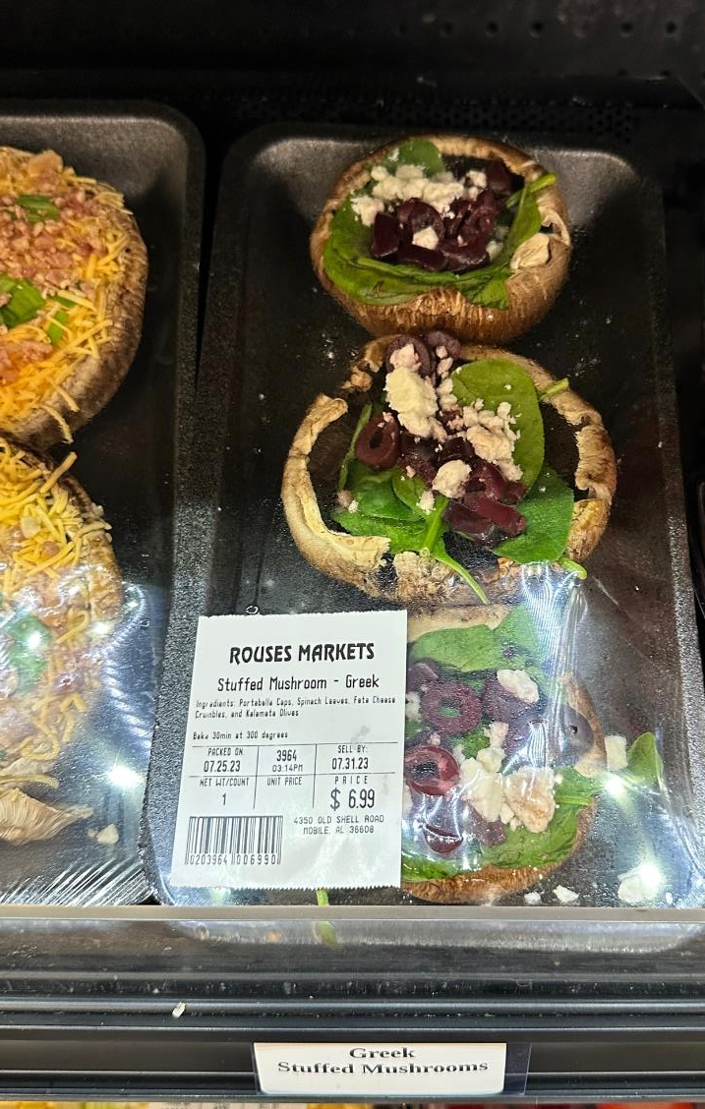
+4.7%
Average number of weekly items in grocery deli-prepared
Retailers are investing in deli-prepared space and items. According to data insights firm Circana, the average grocery deli carries 169 items, up 4.7% over year ago levels. Don’t miss out on a hot seller: stuffed mushrooms.
Source: Circana, Integrated Fresh, Total US, MULO, 52 weeks ending 7/16/2023
Notes:
Despite a lot of pressure on income, shoppers still heavily lean on convenient solutions that help them save time, while trying something different. Grocery deli prepared remains one of the strongest performers across the store. Over the past 52 weeks, sales reached $24.4 billion, according to data insights firm Circana (formerly IRI). That makes it the biggest of the four deli areas that include deli meat and cheese and it continues to grow. Dollar sales are up 8.4% over year-ago levels and innovation is a big driver. The average number of items increased by 4.7% over the past year, whereas most areas of the store have streamlined the assortment ever since the start of the pandemic. Don’t miss out on a fast-riser: stuffed mushrooms! Over the past year, stuffed mushrooms increased 39.3% in dollars and 47.9% in units. For more nutrition insights and merchandising inspiration, visit www.mushroomcouncil.org!

Slide 34
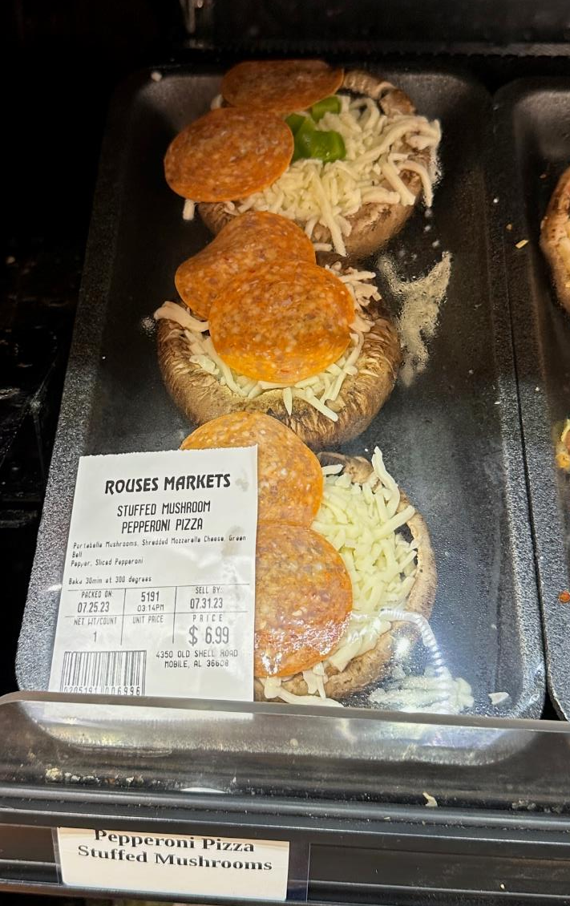
+20.7%
Dollar growth of grocery deli-prepared pizzas
Pizza is hot! Deli pizza slices, whole pizzas, ingredients to make your own pizza, you name it, it is growing. Stuffed mushrooms can be an excellent way to enjoy pizza while watching carbs
Source: Circana, Integrated Fresh, MULO, 52 weeks ending 7/2/2023
Notes:
#Pizza is delivering big for grocery retailers, whether by the slice or a whole pie from the deli or make your own using crusts and sauce from center store. Over the past year, dollar sales increased 20.7% for grocery deli prepared pizza and pizza crust mixes increased by 18.2%. For those watching carbs, cauliflower crusts have been the stand-in. At the Mushroom Council, we believe we can do even better! Using portabella #mushrooms as the base, you can make an excellent pizza complete with mozzarella, basil and pepperoni as shown by this best-in-class example by @Rouses Markets in New Orleans, LA. For more insights and merchandising inspiration, visit www.mushroomcouncil.org!

Slide 35
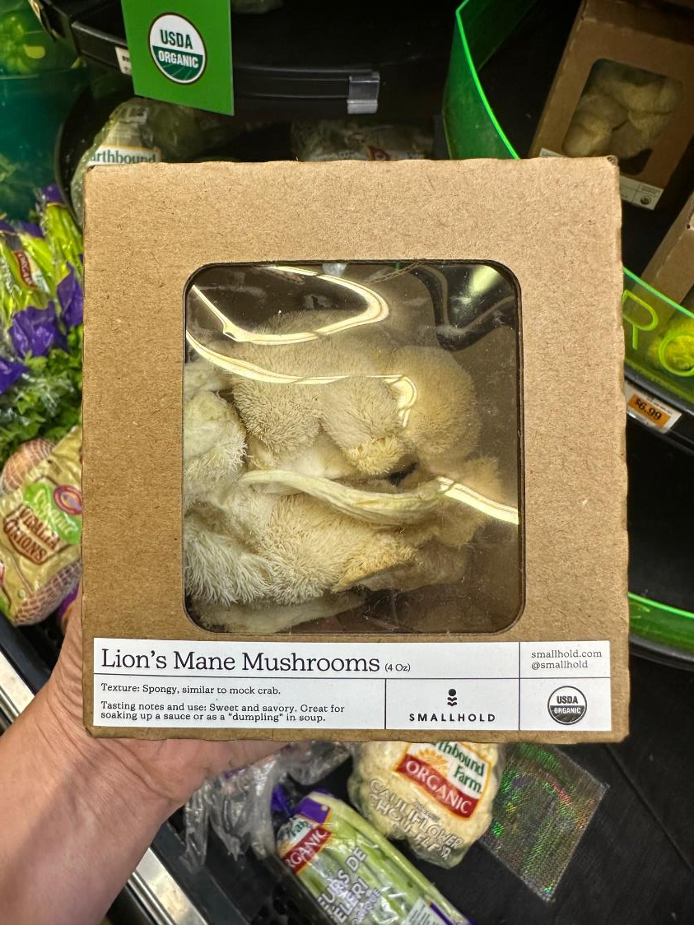
$73 million
Sales of specialty mushrooms at retail in the past year
Source: Circana, Integrated Fresh, Total US, MULO, 52 weeks ending 7/16/2023
Specialty mushrooms are trending and sales are growing. Growth is quickly accelerating in the past few weeks:
Dollars: +7.0%
Units: +4.6%
Volume: +9.7%
Source: Circana, Integrated Fresh, Total US, MULO, 4 weeks ending 7/16/2023
Notes:
Consumers may not be eating out as much but they are not giving up the gourmet touch to their meals. While white and crimini mushrooms make up the bulk of sales, specialty mushrooms like Lion’s Mane, Shiitake and Oyster mushrooms are making inroads in distribution and sales. Over the past year, sales of combined specialty mushrooms reached $73 million across packaged and bulk sales — making it one of the few areas within produce that experienced growth in dollars, units and volume! Restaurant chefs have used mushrooms to premiumize meals for years, don’t miss out on the opportunity to upscale the shoppers’ basket! For more insights and merchandising inspiration, visit www.mushroomcouncil.org!

Slide 36
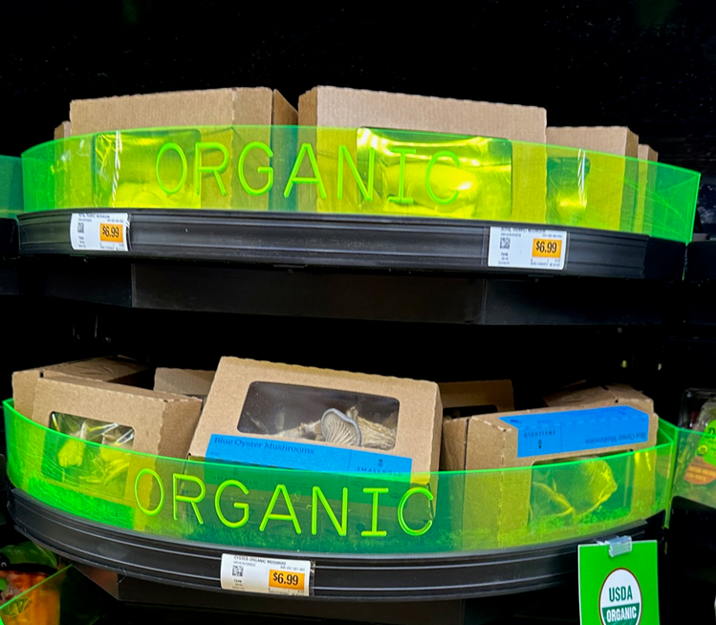
+3.3%
Growth of organic mushrooms at retail.
Organic mushrooms are showing all around growth in the second quarter of 2023:
Dollar sales reached $40 million and increased 3.3%
Unit sales reached 11.6 million, up 2.8%
Pound sales now exceed 6.6 million, an increase of 2.1%
Source: Circana, Integrated Fresh, Total US, MULO, 13 weeks ending 7/16/2023
Notes:
Organic mushrooms are making inroads with annual sales reaching $168 million, according to data insights firm Circana (formerly IRI). The performance for organic mushrooms is showing promise with strong second quarter 2023 sales growth in all three areas of dollars, units and pounds. Organic mushrooms are outperforming the total organic produce category that experienced flat unit and pound sales during the second quarter of the year. For more insights and merchandising inspiration, visit www.mushroomcouncil.org!

Slide 37
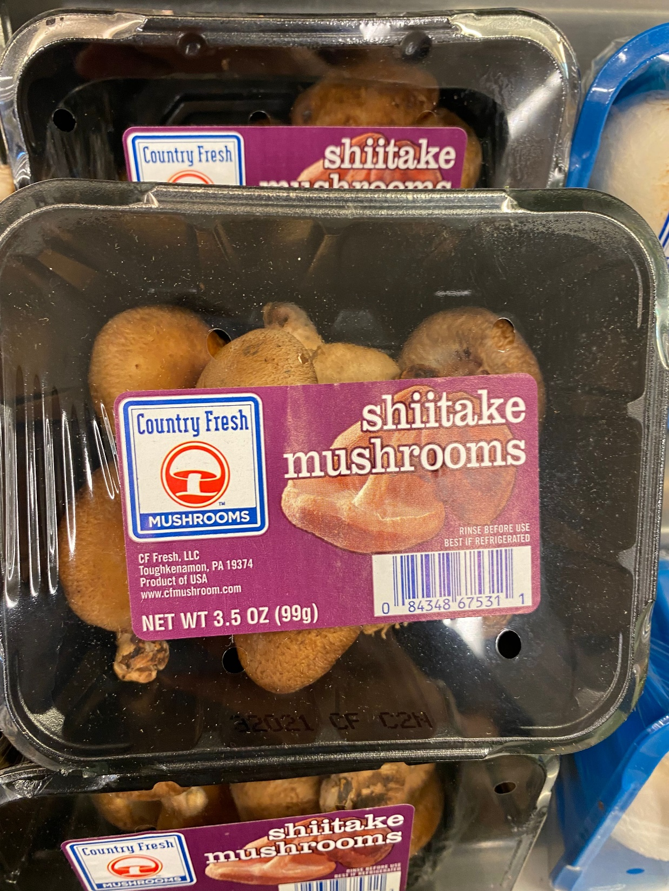

+4.5%
Dollar growth in shiitake mushrooms sold at retail (fixed and random weight)
Shiitake mushrooms have experienced all around growth in the past year.
Dollars: $56M, up 4.5%
Units: 11.3M, up 0.6%
Pounds: 3.5M, up 3.2%
Source: Circana, Integrated Fresh, MULO, 52 weeks ending 8/3/2023
Notes:
White and crimini mushrooms represent the bulk of sales, but specialty is expanding its share, led by shiitake. Retailed in bulk, packaged and often featured in specialty blends, shiitake mushrooms are making inroads, now accounting for nearly 5% of total mushroom sales. About 43% of retailers carry shiitake mushrooms in their stores today and they are especially loved by foodies. For more insights and merchandising inspiration, visit www.mushroomcouncil.org!

Slide 38
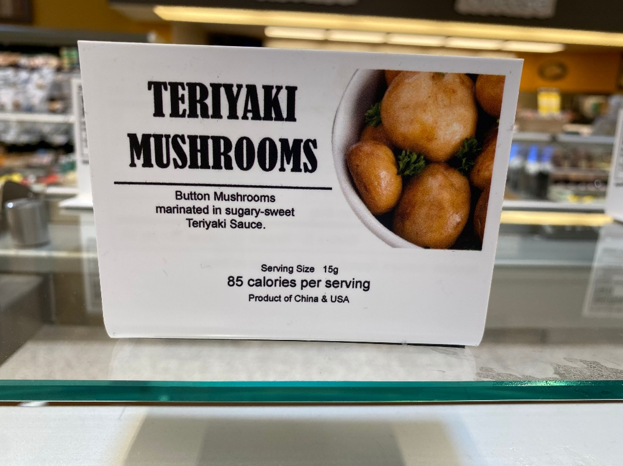

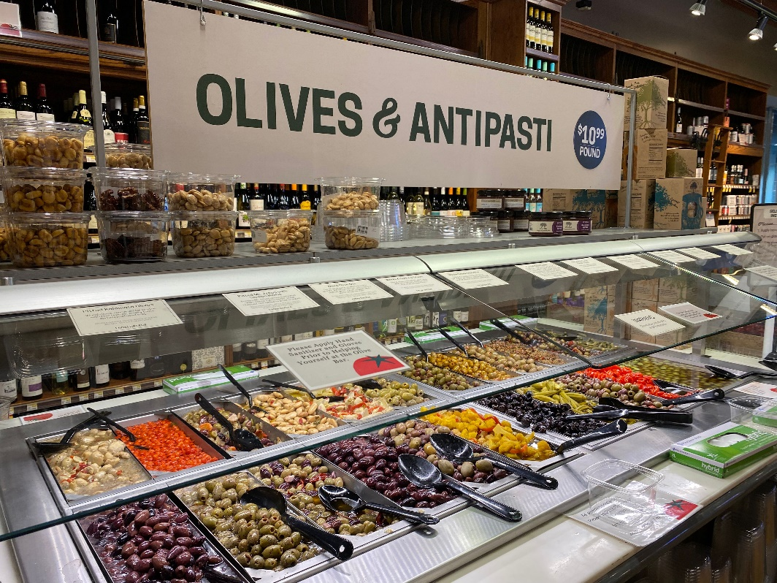

The salad bar at the Southern California-based Barons Market remains one of the most exciting and popular areas in the store, according to Rachel Shemirani, Senior VP.
Side dishes and salads that are available in
our olive bar rarely change with the season too. For example, if we ever remove our Teriyaki Marinated Mushrooms, we’d have a riot on our hands.
Ingles, NC
Source: https://www.thepacker.com/news/foodservice/top-produce-trends-restaurant-retail-foodservice-salads-juices-fresh-cut
Earth Fare, NC
Notes:
Baron’s Market is a Southern California-based independent grocer with nine stores featuring a curated selection of grab-and-go fruit and vegetables, produce-rich prepared foods and an attention-grabbing salad bar. Best-in-class deli departments tend to be known for something, much like the specialty item at restaurants. For Baron’s Market, Teriyaki Marinated Mushrooms is a customer favorite – underscoring the versatile nature of mushrooms. Mushroom purchases in one area of the store can drive above-average engagement with fresh mushrooms in the produce department as well. For more insights and merchandising inspiration, visit www.mushroomcouncil.org!

Slide 39
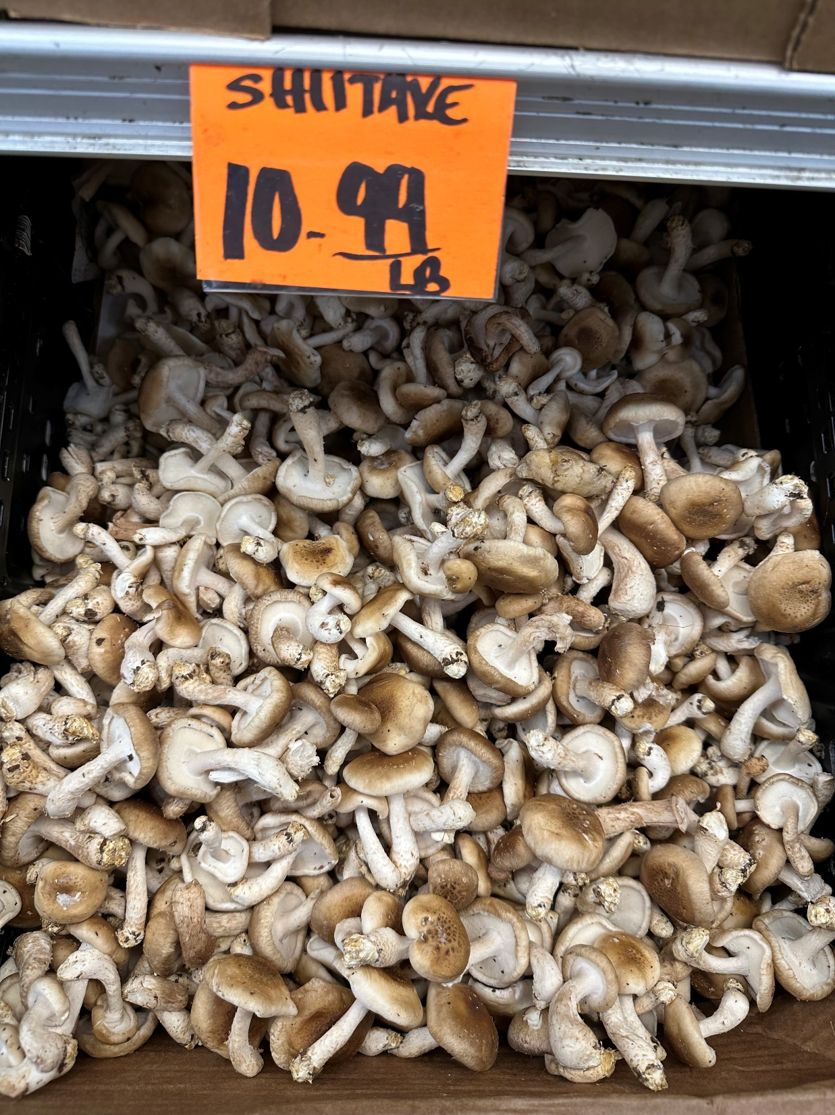
$73.7 million
Sales of specialty mushrooms at retail in the past year
Source: Circana, Integrated Fresh, Total US, MULO, 52 weeks ending 7/16/2023
Specialty mushrooms are trending and sales are growing. Growth is quickly accelerating in the past quarter:
Dollars: +4.9%
Units: +2.9%
Volume: +6.9%
Source: Circana, Integrated Fresh, Total US, MULO, 13 weeks ending 8/13/2023
Notes:
Consumers may not be eating out as much but they are not giving up the gourmet touch to their meals. While white and crimini mushrooms make up the bulk of sales, specialty mushrooms like Shiitake and Oyster mushrooms are making inroads in distribution and sales. Over the past year, sales of combined specialty mushrooms reached $73 million across packaged and bulk sales — making it one of the few areas within produce that experienced growth in dollars, units and volume! Restaurant chefs have used mushrooms to premiumize meals for years, don’t miss out on the opportunity to upscale the shoppers’ basket! For more insights and merchandising inspiration, visit www.mushroomcouncil.org!

Slide 40
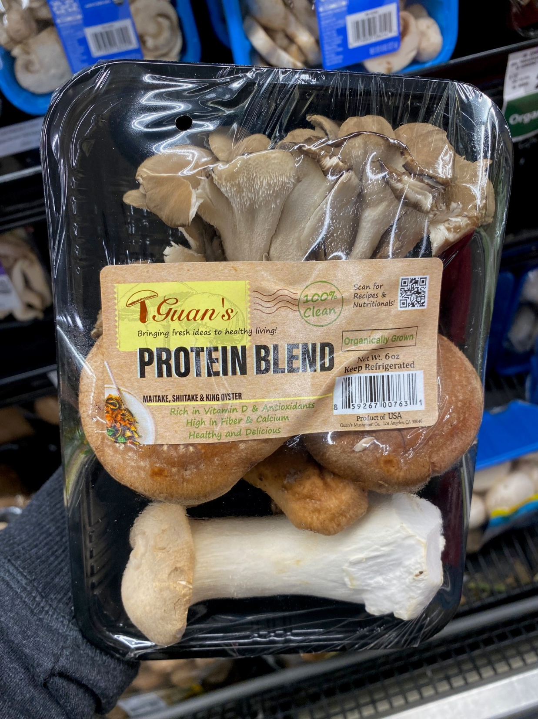
76%
Purchase fruits and vegetables specifically for their known nutrients.
Consumers strongly associate fruit and vegetables with nutritious, healthful eating overall. But there is also opportunity in calling out specific nutrients to prompt unplanned purchases.
Source: Southeast Produce Council (SEPC) What’s New? 2023
Notes:
According to SEPC’s What’s New? 2023 research, the relationship between health and fresh produce is as strong as ever. The study also found that there is an opportunity to go a step further as 76% of consumers will purchase fruits and/or vegetables because of their specific known nutrients. Common examples, according to the study, are oranges for Vitamin C and spinach for iron. Importantly, heavy buyers, who consumer fresh produce virtually every day, are much more likely to purchase fruits and vegetables specifically for their nutrients. They are more educated about nutrition to start, seek out information online and leverage the package label to learn more. For more nutrition insights and merchandising inspiration, visit www.mushroomcouncil.org!

Slide 41
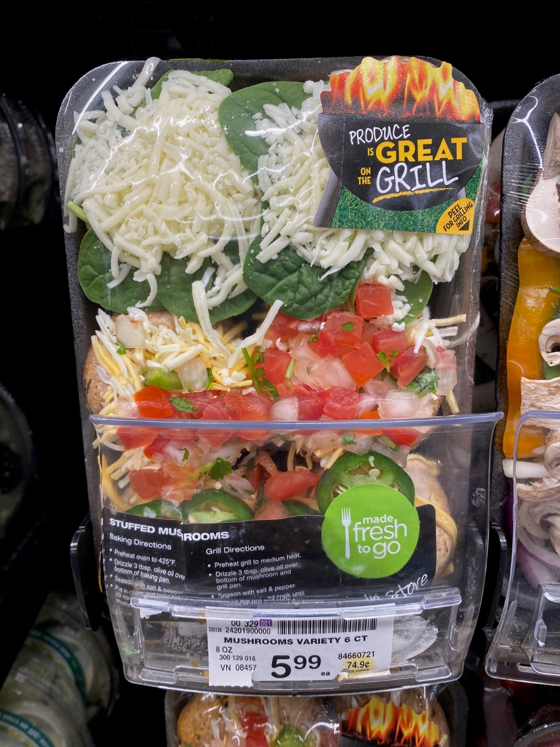
$2.8 billion
Estimated size of the American barbecue grill market in 2021
According to Statista, 68% of Americans say do not wait for a special occasion to fire up their barbecue, but July Fourth is the most popular day of the year to grill out. The vast majority of grilling occasions takes place between late spring to early fall.
Source: Statista: https://www.statista.com/topics/4620/grill-and-barbecue-market-in-the-us/#topicOverview
Notes:
Grilling has been meat-centric for many years, but produce is making inroads. Look at these beautiful stuffed mushrooms by @Vons in California with an on-pack callout that “produce is great on the grill.” The versatility of stuffed mushrooms means that they can be consumed as an appetizer, a side or a true plant-based meat altenative. The label folds open for more tips about produce on the grill to encourage consumers to make their own creations for future occasions. For more insights and merchandising inspiration, visit www.mushroomcouncil.org!

