Slide 1
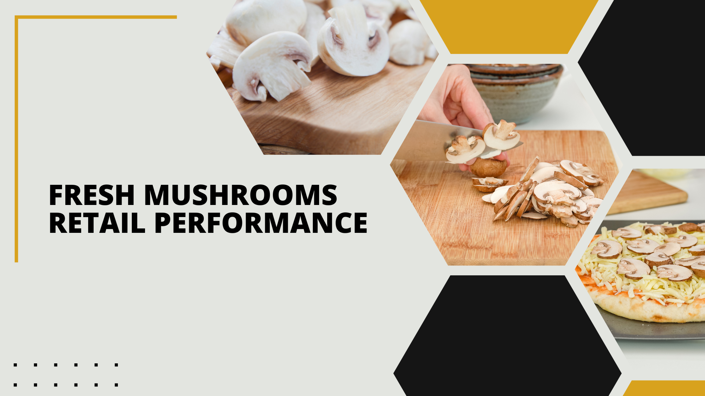

Period ending
September 10, 2023

Slide 2
Methodology
The report covers the four weeks ending 10 September, 2023 with week endings:
  August 20, 2023
  August 27, 2023
  September 3, 2023
  September 10, 2023
Dollar references are the retail value, volume is reflected in pounds and units (packages)
Data is based on the Circana total multi-outlet (MULO) universe, which includes supermarkets, supercenters, club, commissaries, etc.
  It excludes specialty stores (Whole Foods, Sprouts, etc.), ALDI and Costco
Package size, organic, fixed/random weight and value-added have been updated to reflect the total market rather than being SKU-based
Source: Circana, Integrated Fresh, MULO, 4 weeks ending 9/10/2023

Slide 3
Four-year dollar sales trend
Sales trended below year-ago levels in the shorter- and longer-term views but are starting to level off
Source: Circana, Integrated Fresh, MULO, 4 weeks and 52 w.e. 9/10/2023 versus same periods the past four years

Slide 4
Four-year unit sales trend
The shorter- and longer-term unit trends reflect the market pressure, being behind prior year levels
Source: Circana, Integrated Fresh, MULO, 4 weeks and 52 w.e. ending 9/10/2023 versus same periods the past four years

Slide 5
Four-year volume (pound) sales trend
In the YTD and the quad-week view, pounds continued to trend behind last year’s and prior years’ levels but the gaps are narrowing
Source: Circana, Integrated Fresh, MULO, 4 weeks and 52 w.e. ending 9/10/2023 versus same periods the past four years

Slide 6
Mushroom contribution to the department and category
The mushroom share of total produce and vegetables remains below average but has held stable in the past few months
4 w.e. 9/10/2023 Mushroom $ share | Share of total produce | Share of total vegetables
3YA | 1.9% | 3.8%
2YA | 1.7% | 3.6%
YA | 1.6% | 3.3%
4 w.e. 9/10/2023 | 1.5% | 3.3%
L-52 w.e. 9/10/2023 Mushroom $ share | Share of total produce | Share of total vegetables
3YA | 2.0% | 3.8%
2YA | 1.9% | 3.8%
YA | 1.7% | 3.6%
52 w.e. 9/10/2023 | 1.7% | 3.4%
Source: Circana, Integrated Fresh, MULO, 4 weeks and 52 w.e. ending 9/10/2023

Slide 7
Mushrooms price per unit
On a per unit basis, mushroom prices were virtually unchanged from year-ago levels, with inflation below that of total produce and vegetables.
4 w.e. 9/10/2023 Average price/unit | Total produce | Total vegetables | Mushrooms
3YA | $2.26 | $2.00 | $2.66
2YA | $2.37 | $2.05 | $2.71
YA | $2.61 | $2.27 | $2.93
4 w.e. 9/10/2023 | $2.64 | +1.1% | $2.30 | +1.4% | $2.95 | +0.8%
Source: Circana, Integrated Fresh, MULO, YTD weeks ending 9/10/2023

Slide 8
Mushroom price per volume (pound)
On a pound basis, mushroom inflation was below average, with total vegetables increasing 1.7% in the four-week period versus -0.3% for fresh mushrooms
4 w.e. 9/10/2023 Average price/pound | Total produce | Total vegetables | Mushrooms
3YA | $1.54 | $1.76 | $4.25
2YA | $1.63 | $1.82 | $4.32
YA | $1.81 | $2.01 | $4.70
4 w.e. 9/10/2023 | $1.80 | -0.6% | $2.02 | +0.4% | $4.71 | +0.3%
Source: Circana, Integrated Fresh, MULO, YTD weeks ending 9/10/2023

Slide 9
Price per volume by quarter/month
The rate of inflation on a per pound basis peaked in the middle of 2022
Source: Circana, Integrated Fresh, MULO, 2019-w.e. 9/10/2023

Slide 10
Price per volume and unit by type
4 w.e.9/10/2023 | Price per pound | % change vs.’22 | % change vs.’21
Total mushrooms | $4.71 | +0.3% | +9.2%
White mushrooms | $4.16 | +0.8% | +9.6%
Brown mushrooms | $5.12 | -0.9% | +7.5%
Specialty mushrooms | $13.71 | -0.4% | +7.8%
4 w.e. 9/10/2023 | Price per unit | % change vs.’22 | % change vs.’21
Total mushrooms | $2.95 | +0.8% | +9.1%
White mushrooms | $2.68 | +1.2% | +8.8%
Brown mushrooms | $3.20 | -0.3% | +8.5%
Specialty mushrooms | $4.77 | +2.5% | +11.6%
Brown mushrooms include crimini and portabella
Specialty mushrooms include shiitake, oyster, enoki, chanterelle, morel, wood ear, porcini, black forest, lion’s mane and other
Source: Circana, Integrated Fresh, MULO, 4 w.e. 9/10/2023

Slide 11

Mushroom dollar, unit, volume sales
Double-digit pressure for a number of years
4 w.e. 9/10/2023 dollars
$88.4M
volume (lbs)
18.8M
-4.5%
-5.2%
-4.8%
Dollar
growth vs. YA
Unit
growth vs. YA
Volume
growth vs. YA
-6.2% vs. ’21
-12.7% vs. ’20
-14.0% vs. ’21
-21.5% vs. ’20
-14.1% vs. ’21
-21.3% vs. ’20
Source: Circana, Integrated Fresh, MULO, 4 weeks ending 9/10/2023

Slide 12
Vegetables and mushroom dollar sales vs. YA
The gap between mushrooms and vegetables remained wide
Source: Circana, Integrated Fresh, MULO, 2019-w.e. 9/10/2023

Slide 13
Vegetables and mushroom pound sales vs. YA
While both vegetable and mushroom pounds trended below year-ago levels, the volume pressure on mushroom sales is greater
Source: Circana, Integrated Fresh, MULO, 2019-w.e. 9/10/2023

Slide 14
Share of dollars sold on merchandising
Promotions are gearing up fast in mushrooms and most areas of the store. In some cases, promotions are now exceeding 2019 levels. In the latest 52 weeks, 16.4% of dollars were sold on promotion, up 12.9% from year ago
Fresh mushrooms | 4 w.e. 9/10/2023 | Vs. 2022 | Latest 52 w.e. 9/10/2023 | Vs. 2022
Share of dollars sold on promotion | 16.4% | +12.9% | 16.9% | +16.0%
* Any merchandising, including feature, display, feature & display and temporary price reductions
Source: Circana, Integrated Fresh, MULO, YTD through weeks ending 9/10/2023

Slide 15
Base and incremental sales
Incremental sales remain a very small part of the business
Source: Circana, Integrated Fresh, MULO, 4 weeks ending 9/10/2023

Slide 16
Over indexing versus under indexing regions
The Mid-South and Southeast remain interesting areas for growth, as is the West, which has above-average sales and a strong growth performance
Use as comparison to understand importance/size of mushrooms
L-52 w.e. 9/10/2023 | Share of veg. $ | Share of mushrooms $ | $ sales growth vs. YA
Total US | 100.0% | 100.0% | -1.6%
California | 11.4% | 12.4% | -2.0%
Great Lakes | 13.2% | 15.0% | -2.1%
Mid-South | 13.2% | 11.9% | -0.6%
Northeast | 18.0% | 18.0% | -2.3%
Plains | 6.6% | 6.3% | -2.2%
South Central | 9.2% | 7.2% | -2.2%
Southeast | 15.7% | 13.6% | -1.0%
West | 12.8% | 15.5% | -0.5%
WEST
PLAINS
GREAT LAKES
NORTHEAST
MID SOUTH
CALIFORNIA
SOUTHEAST
SOUTH CENTRAL
= Above-average share vs. veg
= Above-average
performance vs. total US
Source: Circana, Integrated Fresh, MULO, YTD through 9/10/2023 | Total fresh vegetables and total fresh mushrooms

Slide 17
Performance summary whites, browns and specialty
Specialty mushrooms are outperforming white and brown mushrooms in dollars and volume
4 weeks ending 9/10/2023 | Dollars | Dollar share | $ sales vs. 2022 | $ sales vs. 2020 | Volume (lbs) | Lbs share | Lbs vs. 2022 | Lbs vs. 2020
Total fresh mushrooms | $88.4M | 100.0% | -4.5% | -12.7% | 18.8M | 100.0% | -4.8% | -21.3%
White mushrooms | $46.5M | 52.7% | -4.6% | -16.1% | 11.2M | 59.7% | -5.4% | -23.9%
Brown mushrooms | $36.9M | 41.7% | -4.7% | -8.5% | 7.2M | 38.4% | -3.9% | -17.1%
Specialty mushrooms | $5.0M | 5.6% | -1.5% | -9.1% | 0.4M | 1.9% | -1.1% | -17.9%
Source: Circana, Integrated Fresh, MULO, 4 weeks ending 9/10/2023

Slide 18
White button mushrooms dollar performance
Dollars L-52
w.e. 9/10/2023
$665.5M
-3.2% vs. YA
Average price/unit
$2.67
+3.4% vs. YA
Source: Circana, Integrated Fresh, MULO, 2021 plus 4 weeks ending 9/10/2023

Slide 19
White button mushrooms volume performance
Pounds L-52
w.e. 9/10/2023
162.1M
-6.3% vs YA
Average price/pound
$4.11
+3.3% vs. YA
Source: Circana, Integrated Fresh, MULO, 2021 plus 4 weeks ending 9/10/2023

Slide 20
Crimini mushrooms dollar performance
Dollars L-52
w.e. 9/10/2023
$429.3M
+6.7% vs. YA
Average price/unit
$3.22
+4.4% vs. YA
Source: Circana, Integrated Fresh, MULO, 2021 plus 4 weeks ending 9/10/2023

Slide 21
Crimini mushrooms volume performance
Pounds L-52
w.e. 9/10/2023
87.6M
+1.8% vs. YA
Average price/pound
$4.90
+4.8% vs. YA
Source: Circana, Integrated Fresh, MULO, 2021 plus 4 weeks ending 9/10/2023

Slide 22

Other insights
Packaged (fixed weight) versus random weight
Package-size analysis
Organic versus conventional
Value-added versus whole/uncut

Slide 23
Package size analysis
8 and 16 ounces drive the bulk of sales, with 8-ounce packages outperforming 16-ounces in the latest four weeks
Package size (per UPC) | Dollars | $ vs. YA | $ vs. 2YA | Pounds | lbs vs. YA | lbs vs. 2YA
8 OZ | $46.9M | -5.1% | -5.3% | 9.5M | -4.6% | -11.4%
16 OZ | $16.4M | -6.8% | -11.6% | 4.2M | -10.6% | -23.5%
Source: Circana, Integrated Fresh, MULO, 4 weeks ending 9/10/2023

Slide 24
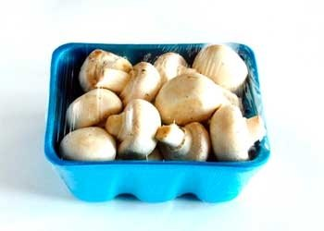
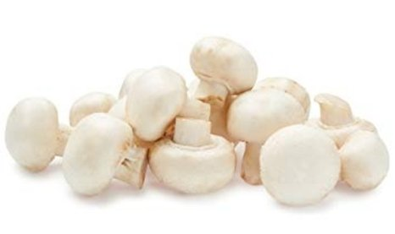
Packaged (fixed weight) versus random weight
While both down, fixed weight did better than random weight
4 W.E. 9/10/2023 | Share of total mushroom sales and sales growth %
 | Fixed weight | Random weight
Dollar growth | -4.5% | -5.2%
Share of mushroom $ sales | 95.7% | 4.3%
Volume growth | -4.9% | -0.3%
Share of mushroom lbs sales | 96.0% | 4.0%
Source: Circana, Integrated Fresh, MULO, 4 weeks ending 9/10/2023

Slide 25
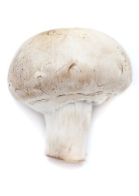
Organic versus conventional mushrooms sales
Organic mushrooms increased in dollar, unit and volume sales
4 w.e. 9/10/2023 | Share of total mushroom sales and sales growth %
Market
size
$76.7M
$ growth
-5.1%
Unit growth
-5.8%
Volume
growth
-5.1%
Conventional
Market size
$11.7M
$ growth
-0.3%
Unit growth
-0.5%
Volume
growth
-1.3%
Organic
10.1%
of pound sales
Source: Circana, Integrated Fresh, MULO, 4 weeks ending 9/10/2023 compared with year ago

Slide 26
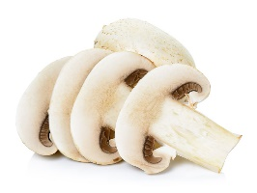
Cut/prepared versus whole mushrooms
No preparation (whole) had the better performance
4 w.e. 9/10/2023 | Share of total mushroom sales and sales growth %
Market
size
$43.5M
$ growth
-2.4%
Unit growth
-3.4%
Volume
growth
-1.3%
No preparation
Market size
$44.9M
$ growth
-6.5%
Unit growth
-6.9%
Volume
growth
-8.3%
Cut/Sliced
47.4%
of lbs sales
Source: Circana, Integrated Fresh, MULO, 4 weeks ending 9/10/2023 compared with year ago

