Slide 1
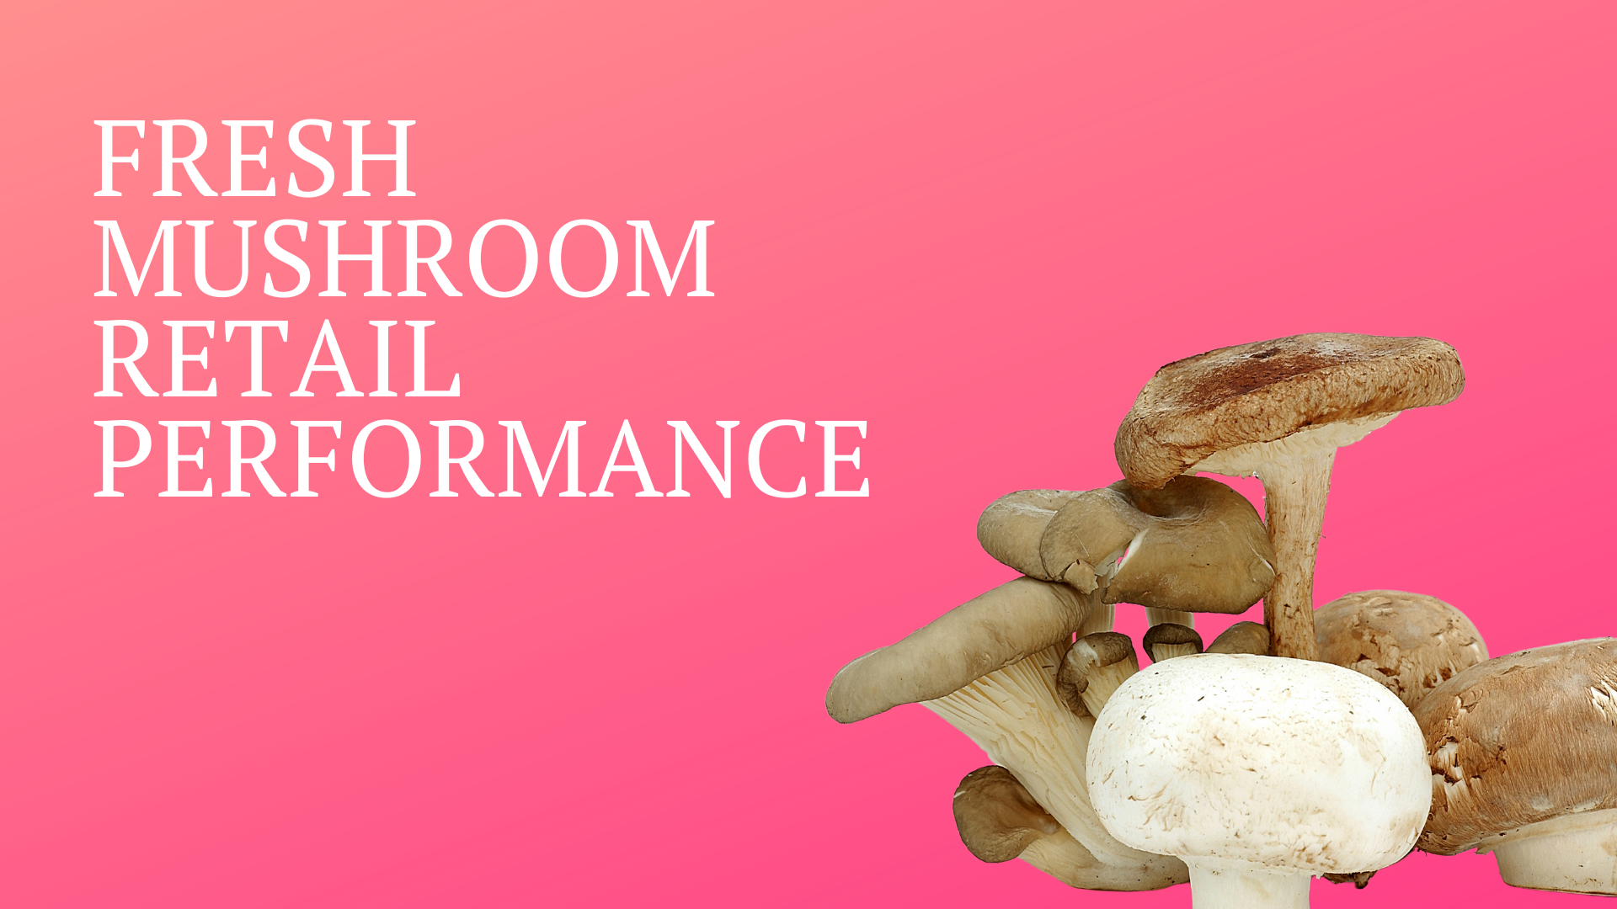
Period ending
May 21, 2023

Slide 2
Methodology
The report covers the four weeks ending 21 May, 2023 with week endings:
April 30, 2023
May 7, 2023
May 14, 2023
May 21, 2023
This data reflects the updated supercenter UPCs that were coded incorrectly previously.
Dollar references are the retail value, volume is reflected in pounds
Data is based on the Circana total multi-outlet universe, which includes supermarkets, supercenters, club, commissaries, etc. It excludes specialty stores (Whole Foods, Sprouts, etc.)
Package size is the last tab left that is derived from SKU analysis. This means Walmart private brand, H-E-B, Hy-Vee and others are not included, which causes the gap between total market and SKU-level data
Source: Circana, Integrated Fresh, MULO, 4 weeks ending 5/21/2023

Slide 3
Four-year dollar sales trend Sales trended below year ago levels in the shorter- and longer-term views
Source: Circana, Integrated Fresh, MULO, 4 weeks and 52 w.e. 5/21/2023 versus same periods the past four years

Slide 4
Four-year unit sales trend Unit sales were below 2020 levels in the quad week and 52 w.e. views
Source: Circana, Integrated Fresh, MULO, 4 weeks and 52 w.e. ending 5/21/2023 versus same periods the past four years

Slide 5
Four-year volume (pound) sales trend In the YTD and the quad-week view, pounds dipped below pre-pandemic levels
Source: Circana, Integrated Fresh, MULO, 4 weeks and 52 w.e. ending 5/21/2023 versus same periods the past four years

Slide 6
Mushroom contribution to the department and category The mushroom share of total produce and vegetables remains below average but is holding stable in the past few months
4 w.e. 5/21/2023 Mushroom $ share | Share of total produce | Share of total vegetables
3YA | 2.0% | 4.0%
2YA | 1.8% | 3.7%
YA | 1.6% | 3.5%
4 w.e. 5/21/2023 | 1.6% | 3.3%
L-52 w.e. 5/21/2023 Mushroom $ share | Share of total produce | Share of total vegetables
3YA | 1.9% | 3.8%
2YA | 2.0% | 3.9%
YA | 1.8% | 3.6%
52 w.e. 5/21/2023 | 1.7% | 3.4%
Source: Circana, Integrated Fresh, MULO, 4 weeks and 52 w.e. ending 5/21/2023

Slide 7
Mushrooms price per unit Price increases for mushrooms were above those of total produce but below total vegetables. This is due to substantial deflation in fruit.
4 w.e. 5/21/2023 Average price/unit | Total produce | Total vegetables | Mushrooms
3YA | $2.27 | $2.00 | $2.68
2YA | $2.41 | $2.07 | $2.70
YA | $2.63 | $2.25 | $2.84
4 w.e. 5/21/2023 | $2.64 | +0.2% | $2.32 | +3.0% | $2.90 | +1.8%
Source: Circana, Integrated Fresh, MULO, YTD weeks ending 5/21/2023

Slide 8
Mushroom price per volume (pound) On a pound basis, mushroom inflation was also ahead of total produce but behind vegetables.
4 w.e. 5/21/2023 Average price/pound | Total produce | Total vegetables | Mushrooms
2020 | $1.55 | $1.75 | $4.25
2021 | $1.71 | $1.87 | $4.27
2022 | $1.87 | $2.02 | $4.55
2023 | $1.88 | +0.2% | $2.08 | +2.9% | $4.61 | +1.3%
Source: Circana, Integrated Fresh, MULO, YTD weeks ending 5/21/2023

Slide 9
Price per volume by quarter/month The rate of inflation on a per pound basis accelerated after coming down in Q3 and Q4
Source: Circana, Integrated Fresh, MULO, 2019-w.e. 5/21/2023

Slide 10
Price per volume and unit by type
4 w.e.5/21/2023 | Price per pound | % change vs.’22 | % change vs.’21
Total mushrooms | $4.61 | +1.3% | +7.8%
White mushrooms | $4.00 | +0.5% | +6.3%
Brown mushrooms | $5.13 | +1.8% | +10.3%
Specialty mushrooms | $13.68 | +2.6% | +13.5%
4 w.e. 5/21/2023 | Price per unit | % change vs.’22 | % change vs.’21
Total mushrooms | $2.90 | +1.8% | +7.2%
White mushrooms | $2.58 | +0.6% | +5.0%
Brown mushrooms | $3.22 | +3.2% | +10.0%
Specialty mushrooms | $4.67 | +1.5% | +12.9%
Brown mushrooms include crimini and portabella
Specialty mushrooms include shiitake, oyster, enoki, chanterelle, morel, wood ear, porcini, black forest and other
Source: Circana, Integrated Fresh, MULO, 4 w.e. 5/21/2023

Slide 11
Mushroom dollar, unit, volume sales Double-digit pressure for a number of years
4 w.e. 5/21/2023 dollars
$95.2M
volume (lbs)
20.7M
-1.7%
-3.4%
-2.9%
Dollar growth vs. YA
Unit
growth vs. YA
Volume growth vs. YA
-5.6% vs. ’21
-19.9% vs. ’20
-11.9% vs. ’21
-25.8% vs. ’20
-12.4% vs. ’21
-26.0% vs. ’20
Source: Circana, Integrated Fresh, MULO, 4 weeks ending 5/21/2023

Slide 12
Vegetables and mushroom dollar sales vs. YA and 3YA Now going up against the April 2020 spikes, sales drop behind the 3YA levels
Source: Circana, Integrated Fresh, MULO, 2019-w.e. 5/21/2023

Slide 13
Vegetables and mushroom pound sales vs. YA and 2019 Vs. 3YA levels shows just how high the pandemic spikes were
Source: Circana, Integrated Fresh, MULO, 2019-w.e. 5/21/2023

Slide 14
Share of dollars sold on merchandising While still low, at 18%, more dollars were sold on promotion
Fresh mushrooms | 4 w.e. 5/21/2023 | Vs. 2022 | Latest 52 w.e. 5/21/2023 | Vs. 2022
Share of dollars sold on promotion | 18.1% | +13.7% | 16.2% | +9.7%
* Any merchandising, including feature, display, feature & display and temporary price reductions
Source: Circana, Integrated Fresh, MULO, YTD through weeks ending 5/21/2023

Slide 15
Base and incremental sales Volume incrementality increased slightly in the latest 4 weeks
Source: Circana, Integrated Fresh, MULO, 4 weeks ending 5/21/2023

Slide 16
Over indexing versus under indexing regions The Mid-South and West regions had a strong 5/21 performance
Use as comparison to understand importance/size of mushrooms
L-52 w.e. 5/21/2023 | Share of veg. $ | Share of mushrooms $ | $ sales growth vs. YA
Total US | 100.0% | 100.0% | -1.1%
California | 11.4% | 12.4% | -1.2%
Great Lakes | 13.2% | 15.1% | -1.1%
Mid-South | 13.2% | 11.9% | +0.4%
Northeast | 18.0% | 17.9% | -3.1%
Plains | 6.6% | 6.3% | -2.3%
South Central | 9.1% | 7.3% | -2.0%
Southeast | 15.6% | 13.6% | -1.0%
West | 12.8% | 15.5% | +1.0%
WEST
PLAINS
GREAT LAKES
NORTHEAST
MID SOUTH
CALIFORNIA
SOUTHEAST
SOUTH CENTRAL
= Above-average share
= Above-average performance
Source: Circana, Integrated Fresh, MULO, YTD through 5/21/2023 | Total fresh vegetables and total fresh mushrooms

Slide 17
Performance summary whites, browns and exotics Brown (combination of crimini and ports) continues to pull away from whites
4 weeks ending 5/21/2023 | Dollars | Dollar share | $ sales vs. 2022 | $ sales vs. 2020 | Volume (lbs) | Lbs share | Lbs vs. 2022 | Lbs vs. 2020
Total fresh mushrooms | $95.2M | 100.0% | -1.7% | -19.9% | 20.7M | 100.0% | -2.9% | -26.0%
White mushrooms | $50.2M | 53.2% | -2.7% | -24.9% | 12.5M | 60.8% | -3.1% | -28.6%
Brown mushrooms | $39.8M | 41.4% | -0.9% | -13.8% | 7.8M | 37.4% | -2.6% | -21.6%
Specialty mushrooms | $5.3M | 5.4% | +1.6% | -12.4% | 0.4M | 1.8% | -1.0% | -23.8%
Source: Circana, Integrated Fresh, MULO, 4 weeks ending 5/21/2023

Slide 18
White button mushrooms dollar performance
Dollars L-52 w.e. 5/21/2023
$674.2M
-2.6% vs. YA
Average price/unit
$2.66
+5.4% vs. YA
Source: Circana, Integrated Fresh, MULO, 2021 plus 4 weeks ending 5/21/2023

Slide 19
White button mushrooms volume performance
Pounds L-52 w.e. 5/21/2023
164.3M
-7.7% vs YA
Average price/pound
$4.10
+5.6% vs. YA
Source: Circana, Integrated Fresh, MULO, 2021 plus 4 weeks ending 5/21/2023

Slide 20
Crimini mushrooms dollar performance
Dollars L-52 w.e. 5/21/2023
$426.4M
+7.7% vs. YA
Average price/unit
$3.23
+7.1% vs. YA
Source: Circana, Integrated Fresh, MULO, 2021 plus 4 weeks ending 5/21/2023

Slide 21
Crimini mushrooms volume performance
Pounds L-52 w.e. 5/21/2023
87.0M
-0.2% vs. YA
Average price/pound
$4.90
+7.9% vs. YA
Source: Circana, Integrated Fresh, MULO, 2021 plus 4 weeks ending 5/21/2023

Slide 22
other insights
Packaged (fixed weight) versus random weight
Package-size analysis
Organic versus conventional
Value-added versus whole/uncut

Slide 23
Package size analysis 8 and 16 ounces drive the bulk of sales; 8 ounce had another strong performance
Package size (per UPC) | Dollars | $ vs. YA | $ vs. 2YA | Pounds | lbs vs. YA | lbs vs. 2YA
8 OZ | $50.2M | -2.9% | -4.4% | 10.4M | -3.7% | -14.5%
16 OZ | $18.4M | +1.3% | -6.6% | 4.9M | -3.1% | -9.4%
Source: Circana, Integrated Fresh, MULO, 4 weeks ending 5/21/2023

Slide 24
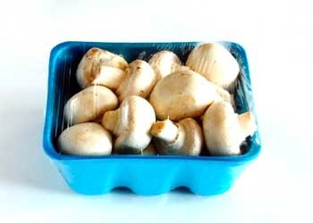
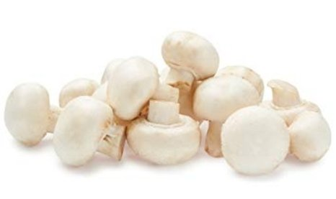
Packaged (fixed weight) versus random weight While both down, fixed weight did better than random weight
4 W.E. 5/21/2023 | Share of total mushroom sales and sales growth %
 | Fixed weight | Random weight
Dollar growth | -1.3% | -9.2%
Share of mushroom $ sales | 95.7% | 4.3%
Volume growth | -2.8% | -6.7%
Share of mushroom lbs sales | 96.4% | 3.6%
Source: Circana, Integrated Fresh, MULO, 4 weeks ending 5/21/2023

Slide 25
Organic versus conventional mushrooms sales Organic sales outperform conventional
4 w.e. 5/21/2023 | Share of total mushroom sales and sales growth %
Market size
$82.6M
$ growth
-2.6%
Unit growth
-4.3%
Volume growth
-3.5%
Conventional
Market size
$12.1M
$ growth
+4.6%
Unit growth
+3.5%
Volume growth
+2.8%
Organic
10.4%
of pound sales
Source: Circana, Integrated Fresh, MULO, 4 weeks ending 5/21/2023 compared with year ago

Slide 26
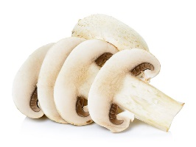
Cut/prepared versus whole mushrooms No preparation (whole) had the better performance
4 w.e. 5/21/2023 | Share of total mushroom sales and sales growth %
Market size
$46.9M
$ growth
+1.2%
Unit growth
-0.2%
Volume growth
0.0%
No preparation
Market size
$M
$ growth
-4.4%
Unit growth -6.3%
Volume growth
-5.9%
Cut/Sliced
47.9%
of lbs sales
Source: Circana, Integrated Fresh, MULO, 4 weeks ending 5/21/2023 compared with year ago

