Slide 1
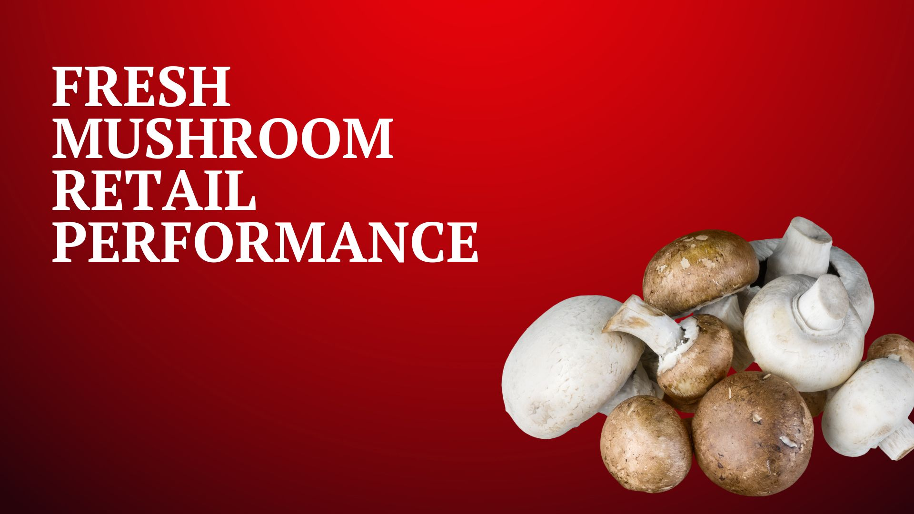

Four weeks ending
April 23, 2023

Slide 2
Please note
In the process of understanding the root cause of the sustained volume pressure, Anne-Marie Roerink, our retail channel consultant, discovered a substantial data problem in the Circana/IRI system. Upon noticing that the Walmart loss of households and trips more than tripled that of grocery stores, she launched an investigation into whether these numbers could be correct. Based on her other category work in meat, candy, deli and other areas of the store, Walmart has been an above-average performer in the past two years virtually all categories, which red-flagged the mushroom finding. Knowing that Walmart had required all grower/shippers to switch to private brands focused the investigation on those 10 Walmart private brand SKUs. Walmart does not allow SKU level access to their private brand items, but collaborated with us and IRI to dig into the issue. It turns out that the two biggest Walmart SKUs have not been captured as they are coded incorrectly as cereal. With grower/shippers having started to change branded SKUs to Walmart brand SKUs in the fall of 2022 into February of 2023, this means a large amount of volume/dollars has not been captured in the past nine months, in particular. Given Walmart’s size, this improves the national averages by some 7 percentage points and likely more in Walmart-centric Midwest markets. Here is an estimate for how Total US reported trends would adjust (based on last 13 weeks):
The SKU recode is in process but will not hit the data platform until 5/29. Rather than holding up the quad week data distribution, please be aware of the undercounting of Walmart sales in the 4/23/23 report and all reports going back. The minute the updated information is available, Anne-Marie will re-pull all data endings going back 52 weeks to ensure everyone can correct internal spreadsheets.

Slide 3
Methodology
The report covers the four weeks ending 23 April, 2023 with week endings:
  April 2, 2023
  April 9, 2023
  April 16, 2023
  April 23, 2023
Comparisons to year ago (YA) refer to 2022; comparisons to two years ago (2YA) refer to 2021 and 3YA to 2020
Dollar references are the retail value, volume is reflected in pounds
Data is based on the Circana total multi-outlet universe, which includes supermarkets, supercenters, club, commissaries, etc. It excludes specialty stores (Whole Foods, Sprouts, etc.)
Package size is the last tab left that is derived from SKU analysis. This means Walmart private brand, H-E-B, Hy-Vee and others are not included, which causes the gap between total market and SKU-level data
Source: Circana, Integrated Fresh, MULO, 4 weeks ending 4/23/2023

Slide 4
Four-year dollar sales trend
In the 4-week view, March 2023 sales are below that of the past four years
Source: Circana, Integrated Fresh, MULO, 4 weeks and year-to-date ending 4/23/2023 versus same periods the past four years

Slide 5
Four-year unit sales trend
Unit sales were below 2020 levels in the quad week and year-to-date views
Source: Circana, Integrated Fresh, MULO, 4 weeks and year-to-date ending 4/23/2023 versus same periods the past four years

Slide 6
Four-year volume (pound) sales trend
In the YTD and the quad-week view, pounds dipped below pre-pandemic levels
Source: Circana, Integrated Fresh, MULO, 4 weeks and year-to-date ending 4/23/2023 versus same periods the past four years

Slide 7
Mushroom contribution to the department and category
The mushroom share of total produce and vegetables is below prior year levels
4 w.e. 4/23/2023 Mushroom $ share | Share of total produce | Share of total vegetables
2020 | 2.1% | 3.9%
2021 | 1.9% | 3.8%
2022 | 1.7% | 3.5%
2023 | 1.6% | 3.2%
L-52 w.e. 4/23/2023 Mushroom $ share | Share of total produce | Share of total vegetables
2020 | 1.9% | 3.7%
2021 | 2.0% | 3.9%
2022 | 1.8% | 3.6%
2023 | 1.6% | 3.3%
Source: Circana, Integrated Fresh, MULO, 4 weeks and year-to-date ending 4/23/2023

Slide 8
Mushrooms price per unit
Price increases for mushrooms were above those of total produce and total vegetables. This was driven by white button mushrooms (slide 10)
4 w.e. 4/23/2023 Average price/unit | Total produce | Total vegetables | Mushrooms
2020 | $2.29 | $2.06 | $2.66
2021 | $2.37 | $2.08 | $2.70
2022 | $2.60 | $2.26 | $2.85
2023 | $2.60 | +0.2% | $2.32 | +2.6% | $3.04 | +6.6%
Source: Circana, Integrated Fresh, MULO, YTD weeks ending 4/23/2023

Slide 9
Mushroom price per volume (pound)
On a pound basis, mushroom inflation was also ahead of vegetables. Other vegetables apply shrinkflation measures to offset volume inflation
4 w.e. 4/23/2023 Average price/pound | Total produce | Total vegetables | Mushrooms
2020 | $1.59 | $1.70 | $4.24
2021 | $1.72 | $1.84 | $4.24
2022 | $1.89 | $1.96 | $4.54
2023 | $1.89 | -0.1% | $2.00 | +2.1% | $4.69 | +3.2%
Source: Circana, Integrated Fresh, MULO, YTD weeks ending 4/23/2023

Slide 10
Price per volume by quarter/month
The rate of inflation on a per pound basis accelerated after coming down in Q3 and Q4
Source: Circana, Integrated Fresh, MULO, 2019-w.e. 4/23/2023

Slide 11
Price per volume and unit by type
4 w.e.4/23/2023 | Price per pound | % change vs.’22 | % change vs.’21
Total mushrooms | $4.69 | +3.2% | +10.5%
White mushrooms | $4.05 | +1.6% | +8.6%
Brown mushrooms | $5.12 | +2.4% | +10.8%
Specialty mushrooms | $13.87 | +3.5% | +12.6%
4 w.e. 4/23/2023 | Price per unit | % change vs.’22 | % change vs.’21
Total mushrooms | $3.04 | +6.6% | +12.7%
White mushrooms | $2.76 | +6.7% | +12.6%
Brown mushrooms | $3.24 | +4.6% | +10.9%
Specialty mushrooms | $4.68 | +3.2% | +12.7%
Brown mushrooms include crimini and portabella
Specialty mushrooms include shiitake, oyster, enoki, chanterelle, morel, wood ear, porcini, black forest and other
Source: Circana, Integrated Fresh, MULO, 4 w.e. 4/23/2023

Slide 12

Mushroom dollar, unit, volume sales
Double-digit pressure for a number of years
4 w.e. 4/23/2023 dollars
$91.8M
volume (lbs)
19.6M
-7.8%
-13.5%
-10.6%
Dollar
growth vs. YA
Unit
growth vs. YA
Volume
growth vs. YA
-11.8% vs. ’21
-21.8% vs. ’20
-21.7% vs. ’21
-31.6% vs. ’20
-20.2% vs. ’21
-29.3% vs. ’20
Source: Circana, Integrated Fresh, MULO, 4 weeks ending 4/23/2023

Slide 13
Vegetables and mushroom dollar sales vs. YA and 3YA
Now going up against the March 2020 spikes, sales drop behind the 3YA levels
Source: Circana, Integrated Fresh, MULO, 2019-w.e. 4/23/2023

Slide 14
Vegetables and mushroom pound sales vs. YA and 2019
Vs. 3YA levels shows just how high the pandemic spikes were
Source: Circana, Integrated Fresh, MULO, 2019-w.e. 4/23/2023

Slide 15
Share of dollars sold on merchandising
While still low, at 19%, more pounds were sold on promotion, but it did not boost dollar growth equally in the quad-week
Fresh mushrooms | 4 w.e. 4/23/2023 | Vs. 2022 | Latest 52 w.e. 4/23/2023 | Vs. 2022
Share of dollars sold on promotion | 19.2% | +23.9% | 16.6% | +12.0%
* Any merchandising, including feature, display, feature & display and temporary price reductions
Source: Circana, Integrated Fresh, MULO, YTD through weeks ending 4/23/2023

Slide 16
Base and incremental sales
Volume incrementality increased slightly in the latest 4 weeks
Source: Circana, Integrated Fresh, MULO, 4 weeks ending 4/23/2023

Slide 17
Over indexing versus under indexing regions
The Northeast had a strong April performance
Use as comparison to understand importance/size of mushrooms
L-52 w.e. 4/23/2023 | Share of veg. $ | Share of mushrooms $ | $ sales growth vs. YA
Total US | 100.0% | 100.0% | -4.8%
California | 11.5% | 12.8% | -4.7%
Great Lakes | 13.2% | 15.1% | -4.8%
Mid-South | 13.2% | 11.7% | -5.9%
Northeast | 18.0% | 18.3% | -2.7%
Plains | 6.6% | 6.3% | -4.3%
South Central | 9.1% | 7.0% | -3.9%
Southeast | 15.6% | 13.2% | -7.0%
West | 12.8% | 15.7% | -4.7%
WEST
PLAINS
GREAT LAKES
NORTHEAST
MID SOUTH
CALIFORNIA
SOUTHEAST
SOUTH CENTRAL
= Above-average share
= Above-average performance
Source: Circana, Integrated Fresh, MULO, YTD through 4/23/2023 | Total fresh vegetables and total fresh mushrooms

Slide 18
Performance summary whites, browns and exotics
Brown (combination of crimini and ports) continues to pull away from whites
4 weeks ending 4/23/2023 | Dollars | Dollar share | $ sales vs. 2022 | $ sales vs. 2020 | Volume (lbs) | Lbs share | Lbs vs. 2022 | Lbs vs. 2020
Total fresh mushrooms | $91.8M | 100.0% | -7.8% | -21.8% | 19.6M | 100.0% | -10.6% | -29.3%
White mushrooms | $45.6M | 53.4% | -14.2% | -31.9% | 11.3M | 60.8% | -15.6% | -36.4%
Brown mushrooms | $40.6M | 41.1% | -0.6% | -8.7% | 7.9M | 37.3% | -2.9% | -16.9%
Specialty mushrooms | $5.6M | 5.6% | +1.0% | -4.9% | 0.4M | 1.9% | -2.3% | -13.0%
Source: Circana, Integrated Fresh, MULO, 4 weeks ending 4/23/2023

Slide 19
White button mushrooms dollar performance
Dollars L-52
w.e. 4/23/2023
$626.1M
-9.2% vs. YA
Average price/unit
$2.74
+8.4% vs. YA
Source: Circana, Integrated Fresh, MULO, 2021 plus 4 weeks ending 4/23/2023

Slide 20
White button mushrooms volume performance
Pounds L-52
w.e. 4/23/2023
152.2M
-14.6% vs YA
Average price/pound
$4.11
+6.3% vs. YA
Source: Circana, Integrated Fresh, MULO, 2021 plus 4 weeks ending 4/23/2023

Slide 21
Crimini mushrooms dollar performance
Dollars L-52
w.e. 4/23/2023
$424.2M
+7.3% vs. YA
Average price/unit
$3.22
+7.5% vs. YA
Source: Circana, Integrated Fresh, MULO, 2021 plus 4 weeks ending 4/23/2023

Slide 22
Crimini mushrooms volume performance
Pounds L-52
w.e. 4/23/2023
86.7M
-1.2% vs. YA
Average price/pound
$4.89
+8.5% vs. YA
Source: Circana, Integrated Fresh, MULO, 2021 plus 4 weeks ending 4/23/2023

Slide 23
other insights
Packaged (fixed weight) versus random weight
Package-size analysis
Organic versus conventional
Value-added versus whole/uncut

Slide 24
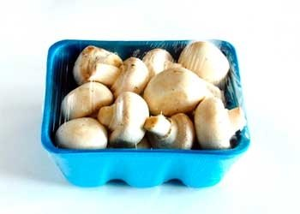
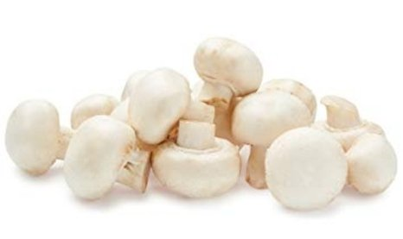
Packaged (fixed weight) versus random weight
While both down, fixed weight did better than random weight
4 W.E. 4/23/2023 | Share of total mushroom sales and sales growth %
 | Fixed weight | Random weight
Dollar growth | -7.7% | -9.0%
Share of mushroom $ sales | 95.4% | 4.6%
Volume growth | -10.8% | -6.3%
Share of mushroom lbs sales | 96.0% | 4.0%
Source: Circana, Integrated Fresh, MULO, 4 weeks ending 4/23/2023
UPC-level analysis which excludes certain items due to Circana/retailer agreements

Slide 25
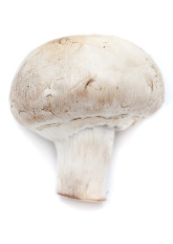
Organic versus conventional mushrooms sales
Organic sales outperform conventional
4 w.e. 4/23/2023 | Share of total mushroom sales and sales growth %
Market
size
$79.0M
$ growth
-9.4%
Unit growth
-15.0%
Volume
growth
-11.7%
Conventional
Market size
$12.8M
$ growth
+3.1%
Unit growth
-0.8%
Volume
growth
-1.1%
Organic
10.7%
of pound sales
Source: Circana, Integrated Fresh, MULO, 4 weeks ending 4/23/2023 compared with year ago
UPC-level analysis which excludes certain items due to Circana/retailer agreements

Slide 26
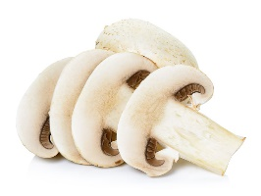
Cut/prepared versus whole mushrooms
No preparation (whole) had the better performance
4 w.e. 4/23/2023 | Share of total mushroom sales and sales growth %
Market
size
$46.3M
$ growth
-3.8%
Unit growth
-9.4%
Volume
growth
-6.8%
No preparation
Market size
$45.5M
$ growth
-11.5%
Unit growth
-17.3%
Volume
growth
-14.7%
Cut/prepped
46.2%
of lbs sales
Source: Circana, Integrated Fresh, MULO, 4 weeks ending 4/23/2023 compared with year ago
UPC-level analysis which excludes certain items due to Circana/retailer agreements

