Slide 1
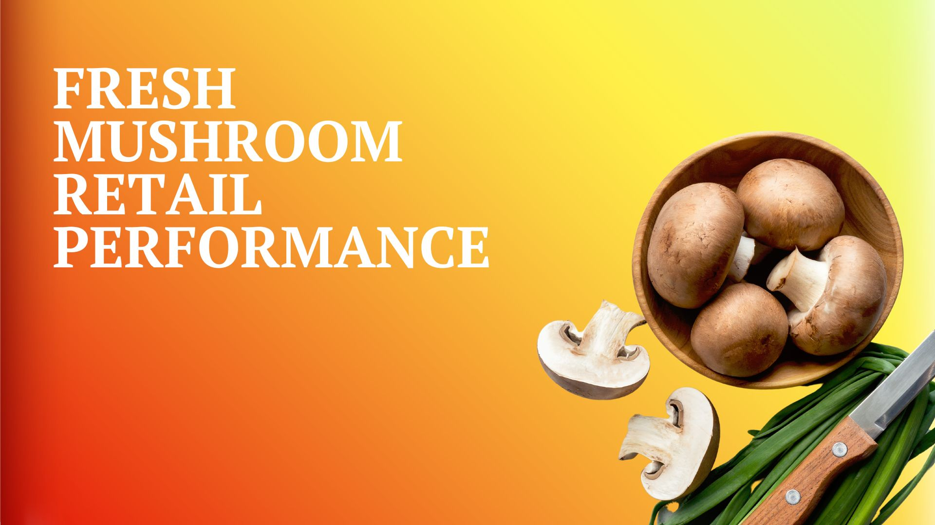

Four weeks ending
March 26, 2023

Slide 2
Methodology
The report covers the four weeks ending 26 March, 2023 with week endings:
  March 5, 2023
  March 12, 2023
  March 19, 2023
  March 26, 2023
Comparisons to year ago (YA) refer to 2022; comparisons to two years ago (2YA) refer to 2021 and 3YA to 2020
Dollar references are the retail value, volume is reflected in pounds
IRI data underwent its annual restatement in October 2022, which included a realignment of the quad-weeks. The periods jumped back by one week. The 52-week view in the database has been adjusted to see all the back quad-week periods using this restatement.
Data is based on the IRI total multi-outlet universe, which includes supermarkets, supercenters, club, commissaries, etc. It excludes specialty stores (Whole Foods, Sprouts, etc.)
Organic, cut/whole, package size, etc. are derived from SKU analysis. This means Walmart private brand, H-E-B, Hy-Vee and others are not included, which causes the gap between total market and SKU-level data
Source: IRI, Integrated Fresh, MULO, 4 weeks ending 3/26/2023

Slide 3
Four-year dollar sales trend
In the 4-week view, March 2023 sales are below that of the past four years
Source: IRI, Integrated Fresh, MULO, 4 weeks and year-to-date ending 3/26/2023 versus same periods the past four years

Slide 4
Four-year unit sales trend
Unit sales were below 2020 levels in the quad week and year-to-date views
Source: IRI, Integrated Fresh, MULO, 4 weeks and year-to-date ending 3/26/2023 versus same periods the past four years

Slide 5
Four-year volume (pound) sales trend
In the YTD and the quad-week view, pounds dipped below pre-pandemic levels
Source: IRI, Integrated Fresh, MULO, 4 weeks and year-to-date ending 3/26/2023 versus same periods the past four years

Slide 6
Mushroom contribution to the department and category
The mushroom share of total produce and vegetables is below prior year levels
4 w.e. 3/26/2023 Mushroom $ share | Share of total produce | Share of total vegetables
2020 | 1.9% | 3.7%
2021 | 2.0% | 3.9%
2022 | 1.8% | 3.6%
2023 | 1.7% | 3.3%
L-52 w.e. 3/26/2023 Mushroom $ share | Share of total produce | Share of total vegetables
2020 | 1.9% | 3.7%
2021 | 2.0% | 3.9%
2022 | 1.8% | 3.7%
2023 | 1.6% | 3.3%
Source: IRI, Integrated Fresh, MULO, 4 weeks and year-to-date ending 3/26/2023

Slide 7
Mushrooms price per unit
Price increases for mushrooms were above those of total produce and total vegetables. This was driven by white button mushrooms (slide 10)
4 w.e. 3/26/2023 Average price/unit | Total produce | Total vegetables | Mushrooms
2020 | $2.28 | $2.08 | $2.62
2021 | $2.33 | $2.08 | $2.69
2022 | $2.58 | $2.26 | $2.79
2023 | $2.59 | +0.3% | $2.36 | +4.3% | $3.02 | +8.2%
Source: IRI, Integrated Fresh, MULO, YTD weeks ending 3/26/2023

Slide 8
Mushroom price per volume (pound)
On a pound basis, mushroom inflation was also ahead of vegetables. Other vegetables apply shrinkflation measures to offset volume inflation
4 w.e. 3/26/2023 Average price/pound | Total produce | Total vegetables | Mushrooms
2020 | $1.58 | $1.66 | $4.22
2021 | $1.72 | $1.81 | $4.25
2022 | $1.89 | $1.94 | $4.44
2023 | $1.90 | +0.6% | $2.00 | +3.4% | $4.72 | +6.2%
Source: IRI, Integrated Fresh, MULO, YTD weeks ending 3/26/2023

Slide 9
Price per volume by quarter/month
The rate of inflation on a per pound basis accelerated after coming down in Q3 and Q4
Source: IRI, Integrated Fresh, MULO, 2019-w.e. 3/26/2023

Slide 10
Price per volume and unit by type
4 w.e.3/26/2023 | Price per pound | % change vs.’22 | % change vs.’21
Total mushrooms | $4.72 | +6.2% | +11.0%
White mushrooms | $4.10 | +4.7% | +9.4%
Brown mushrooms | $5.09 | +5.4% | +10.5%
Specialty mushrooms | $14.00 | +2.8% | +15.6%
4 w.e. 3/26/2023 | Price per unit | % change vs.’22 | % change vs.’21
Total mushrooms | $3.02 | +8.2% | +12.2%
White mushrooms | $2.75 | +9.0% | +12.3%
Brown mushrooms | $3.20 | +5.5% | +9.8%
Specialty mushrooms | $4.68 | +3.2% | +14.2%
Brown mushrooms include crimini and portabella
Specialty mushrooms include shiitake, oyster, enoki, chanterelle, morel, wood ear, porcini, black forest and other
Source: IRI, Integrated Fresh, MULO, 4 w.e. 3/26/2023

Slide 11

Mushroom dollar, unit, volume sales
Double-digit pressure for a number of years
4 w.e. 3/26/2023 dollars
$94.4M
volume (lbs)
20.0M
-6.8%
-13.9%
-12.2%
Dollar
growth vs. YA
Unit
growth vs. YA
Volume
growth vs. YA
-10.7% vs. ’21
-15.7% vs. ’20
-20.4% vs. ’21
-26.7% vs. ’20
-19.6% vs. ’21
-24.7% vs. ’20
Source: IRI, Integrated Fresh, MULO, 4 weeks ending 3/26/2023

Slide 12
Vegetables and mushroom dollar sales vs. YA and 3YA
Now going up against the March 2020 spikes, sales drop behind the 3YA levels
Source: IRI, Integrated Fresh, MULO, 2019-w.e. 3/26/2023

Slide 13
Vegetables and mushroom pound sales vs. YA and 2019
Vs. 3YA levels shows just how high the pandemic spikes were
Source: IRI, Integrated Fresh, MULO, 2019-w.e. 3/26/2023

Slide 14
Share of dollars and pounds sold on merchandising
While still low, at 19%, more pounds were sold on promotion, but it did not boost dollar growth equally in the quad-week
Fresh mushrooms | 4 w.e. 3/26/2023 | Vs. 2022 | Latest 52 w.e. 3/26/2023 | Vs. 2022
Share of dollars sold on promotion | 19.9% | +13.2% | 16.3% | +9.9%
Share of pounds sold on promotion | 23.2% | +10.8% | 19.6% | +12.3%
* Any merchandising, including feature, display, feature & display and temporary price reductions
Source: IRI, Integrated Fresh, MULO, YTD through weeks ending 3/26/2023

Slide 15
Base and incremental sales
Volume incrementality increased slightly in the latest 4 weeks
Source: IRI, Integrated Fresh, MULO, 4 weeks ending 3/26/2023

Slide 16
Over indexing versus under indexing regions
Under indexing regions are catching up
Use as comparison to understand importance/size of mushrooms
L-52 w.e. 3/26/2023 | Share of veg. $ | Share of mushrooms $ | $ sales growth vs. YA
Total US | 100.0% | 100.0% | -4.5%
California | 11.5% | 12.7% | -2.8%
Great Lakes | 13.2% | 15.1% | -5.1%
Mid-South | 13.2% | 11.7% | -3.5%
Northeast | 18.0% | 18.2% | -5.1%
Plains | 6.6% | 6.3% | -6.5%
South Central | 9.1% | 7.1% | -7.4%
Southeast | 15.6% | 13.2% | -6.5%
West | 12.8% | 15.7% | -1.6%
WEST
PLAINS
GREAT LAKES
NORTHEAST
MID SOUTH
CALIFORNIA
SOUTHEAST
SOUTH CENTRAL
= Above-average share
= Above-average performance
Source: IRI, Integrated Fresh, MULO, YTD through 3/26/2023 | Total fresh vegetables and total fresh mushrooms

Slide 17
Performance summary whites, browns and exotics
Brown (combination of crimini and ports) continues to pull away from whites
4 weeks ending 3/26/2023 | Dollars | Dollar share | $ sales vs. 2022 | $ sales vs. 2020 | Volume (lbs) | Lbs share | Lbs vs. 2022 | Lbs vs. 2020
Total fresh mushrooms | $94.4M | 100.0% | -6.8% | -15.7% | 20.0M | 100.0% | -12.2% | -24.7%
White mushrooms | $46.1M | 48.9% | -14.2% | -26.8% | 11.3M | 56.3% | -18.0% | -32.8%
Brown mushrooms | $42.4M | 44.9% | +1.8% | -1.1% | 8.3M | 41.6% | -3.4% | -10.6%
Specialty mushrooms | $5.9M | 6.2% | -0.8% | -2.2% | 0.4M | 2.1% | -3.5% | -14.6%
Source: IRI, Integrated Fresh, MULO, 4 weeks ending 3/26/2023

Slide 18
White button mushrooms dollar performance
Dollars L-52
w.e. 3/26/2023
$633.8M
-8.5% vs. YA
Average price/unit
$2.72
+8.3% vs. YA
Source: IRI, Integrated Fresh, MULO, 2021 plus 4 weeks ending 3/26/2023

Slide 19
White button mushrooms volume performance
Pounds L-52
w.e. 3/26/2023
154.2M
-14.2% vs YA
Average price/pound
$4.11
+6.7% vs. YA
Source: IRI, Integrated Fresh, MULO, 2021 plus 4 weeks ending 3/26/2023

Slide 20
Crimini mushrooms dollar performance
Dollars L-52
w.e. 3/26/2023
$421.9M
+6.8% vs. YA
Average price/unit
$3.21
+7.8% vs. YA
Source: IRI, Integrated Fresh, MULO, 2021 plus 4 weeks ending 3/26/2023

Slide 21
Crimini mushrooms volume performance
Pounds L-52
w.e. 3/26/2023
86.4M
-2.1% vs. YA
Average price/pound
$4.88
+9.1% vs. YA
Source: IRI, Integrated Fresh, MULO, 2021 plus 4 weeks ending 3/26/2023

Slide 22
other insights
Packaged (fixed weight) versus random weight
Package-size analysis
Organic versus conventional
Value-added versus whole/uncut

Slide 23
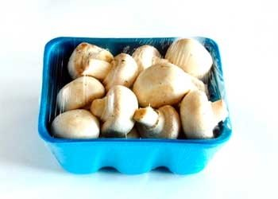
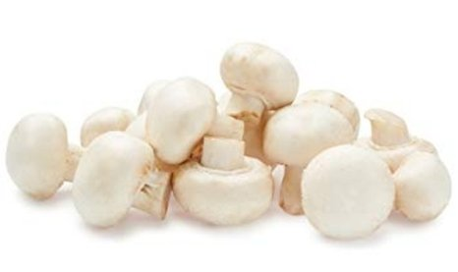
Packaged (fixed weight) versus random weight
While both down, fixed weight did better than random weight
4 W.E. 3/26/2023 | Share of total mushroom sales and sales growth %
 | Fixed weight | Random weight
Dollar growth | -6.8% | -7.0%
Share of mushroom $ sales | 95.5% | 4.5%
Volume growth | -12.5% | -4.6%
Share of mushroom lbs sales | 96.0% | 4.0%
Source: IRI, Integrated Fresh, MULO, 4 weeks ending 3/26/2023
UPC-level analysis which excludes certain items due to IRI/retailer agreements

Slide 24
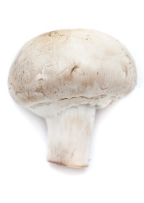
Organic versus conventional mushrooms sales
Organic sales outperform conventional
4 w.e. 3/26/2023 | Share of total mushroom sales and sales growth %
Market
size
$81.1M
$ growth
-8.5%
Unit growth
-15.0%
Volume
growth
-12.7%
Conventional
Market size
$13.3M
$ growth
+5.1%
Unit growth
-4.9%
Volume
growth
-8.1%
Organic
10.6%
of pound sales
Source: IRI, Integrated Fresh, MULO, 4 weeks ending 3/26/2023 compared with year ago
UPC-level analysis which excludes certain items due to IRI/retailer agreements

Slide 25
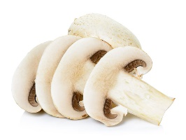
Cut/prepared versus whole mushrooms
No preparation (whole) had the better performance
4 w.e. 3/26/2023 | Share of total mushroom sales and sales growth %
Market
size
$46.5M
$ growth
-3.1%
Unit growth
-10.3%
Volume
growth
-9.0%
No preparation
Market size
$47.9M
$ growth
-10.2%
Unit growth
-17.1%
Volume
growth
-15.5%
Cut/prepped
47.7%
of lbs sales
Source: IRI, Integrated Fresh, MULO, 4 weeks ending 3/26/2023 compared with year ago
UPC-level analysis which excludes certain items due to IRI/retailer agreements

