Slide 1




Slide 2



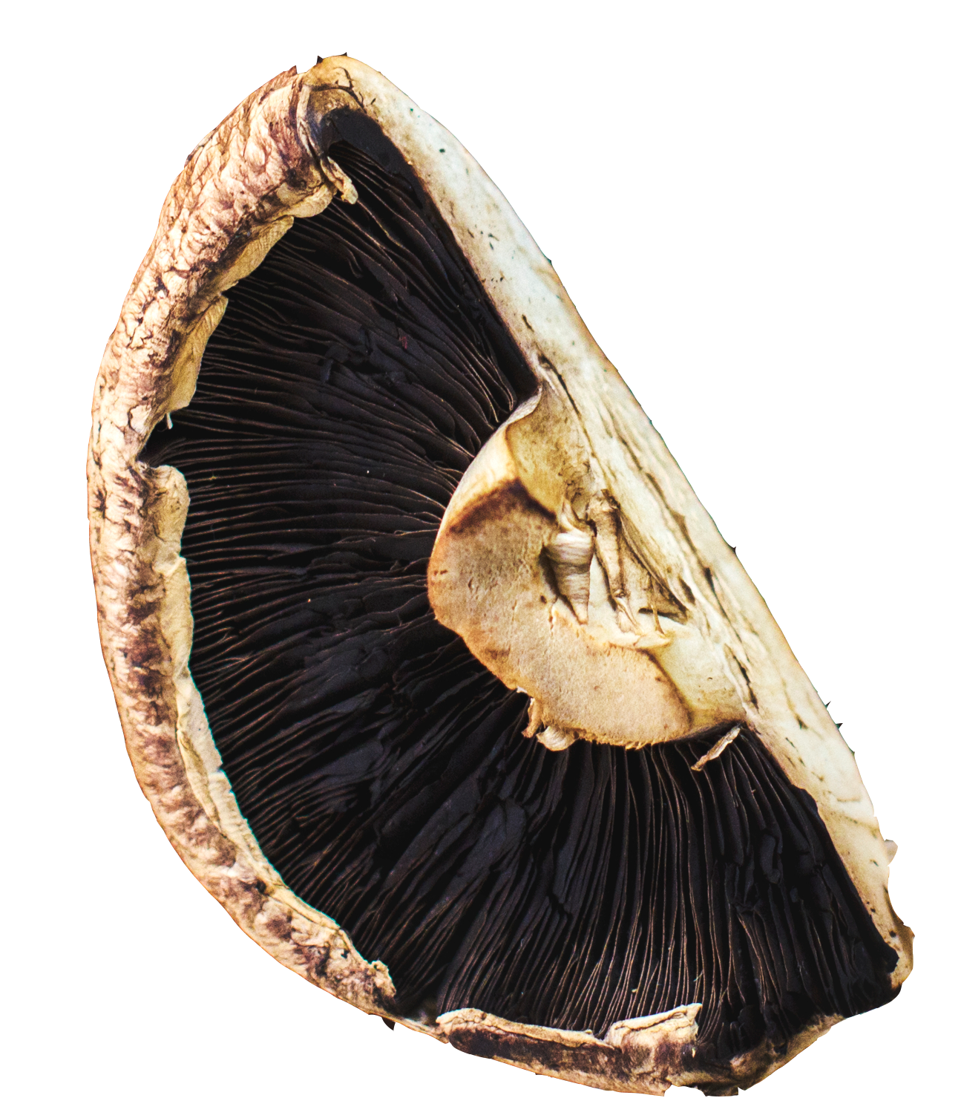
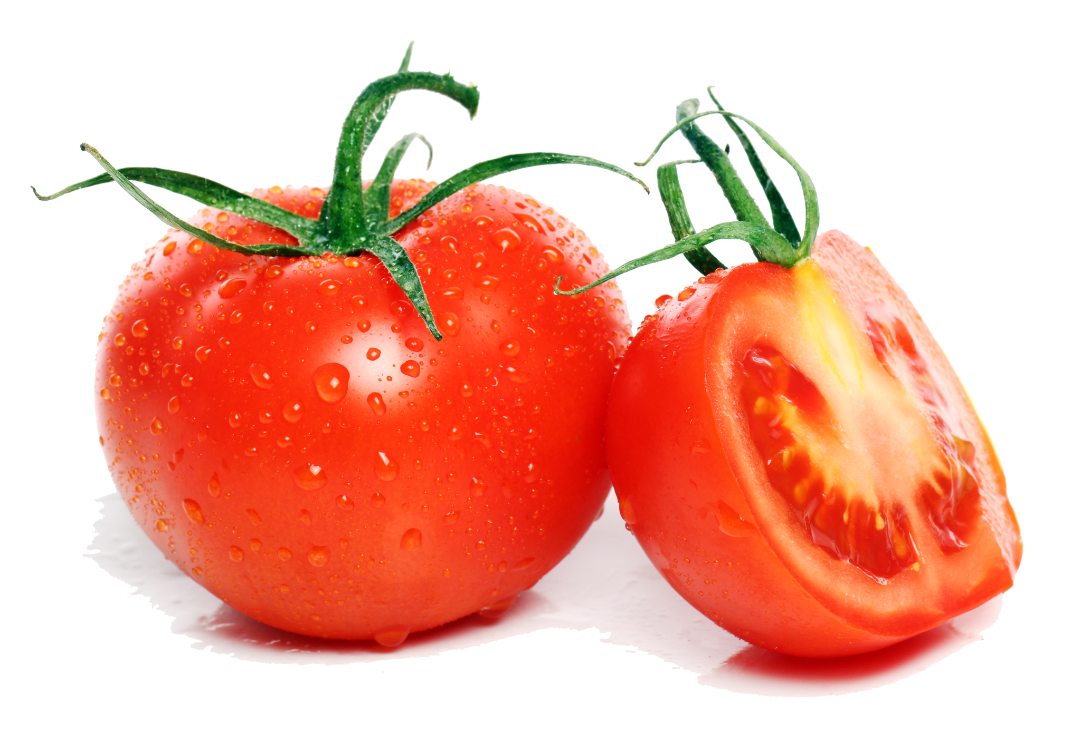
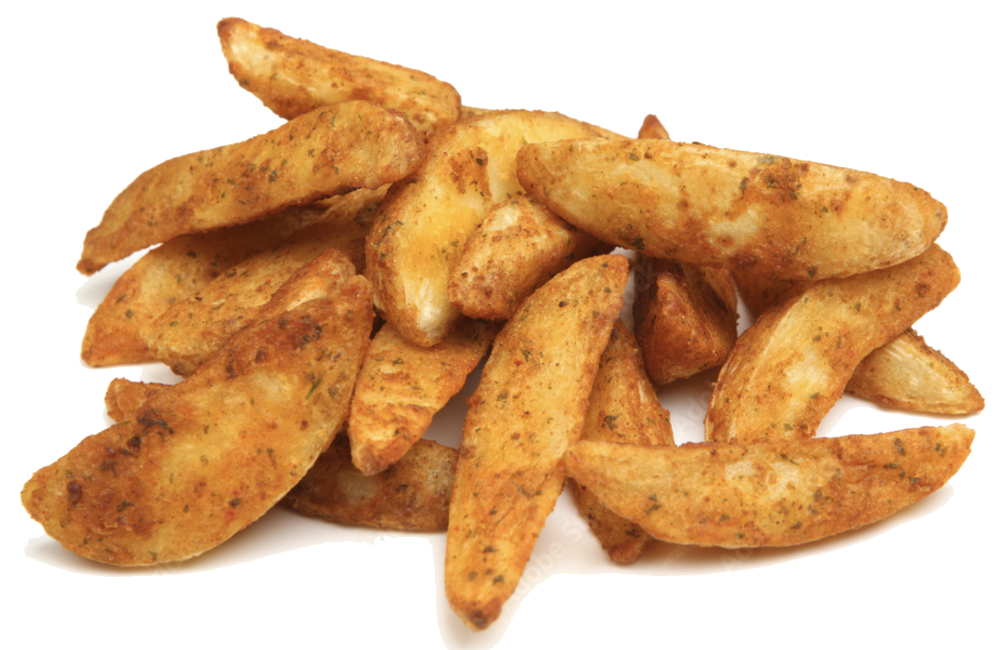
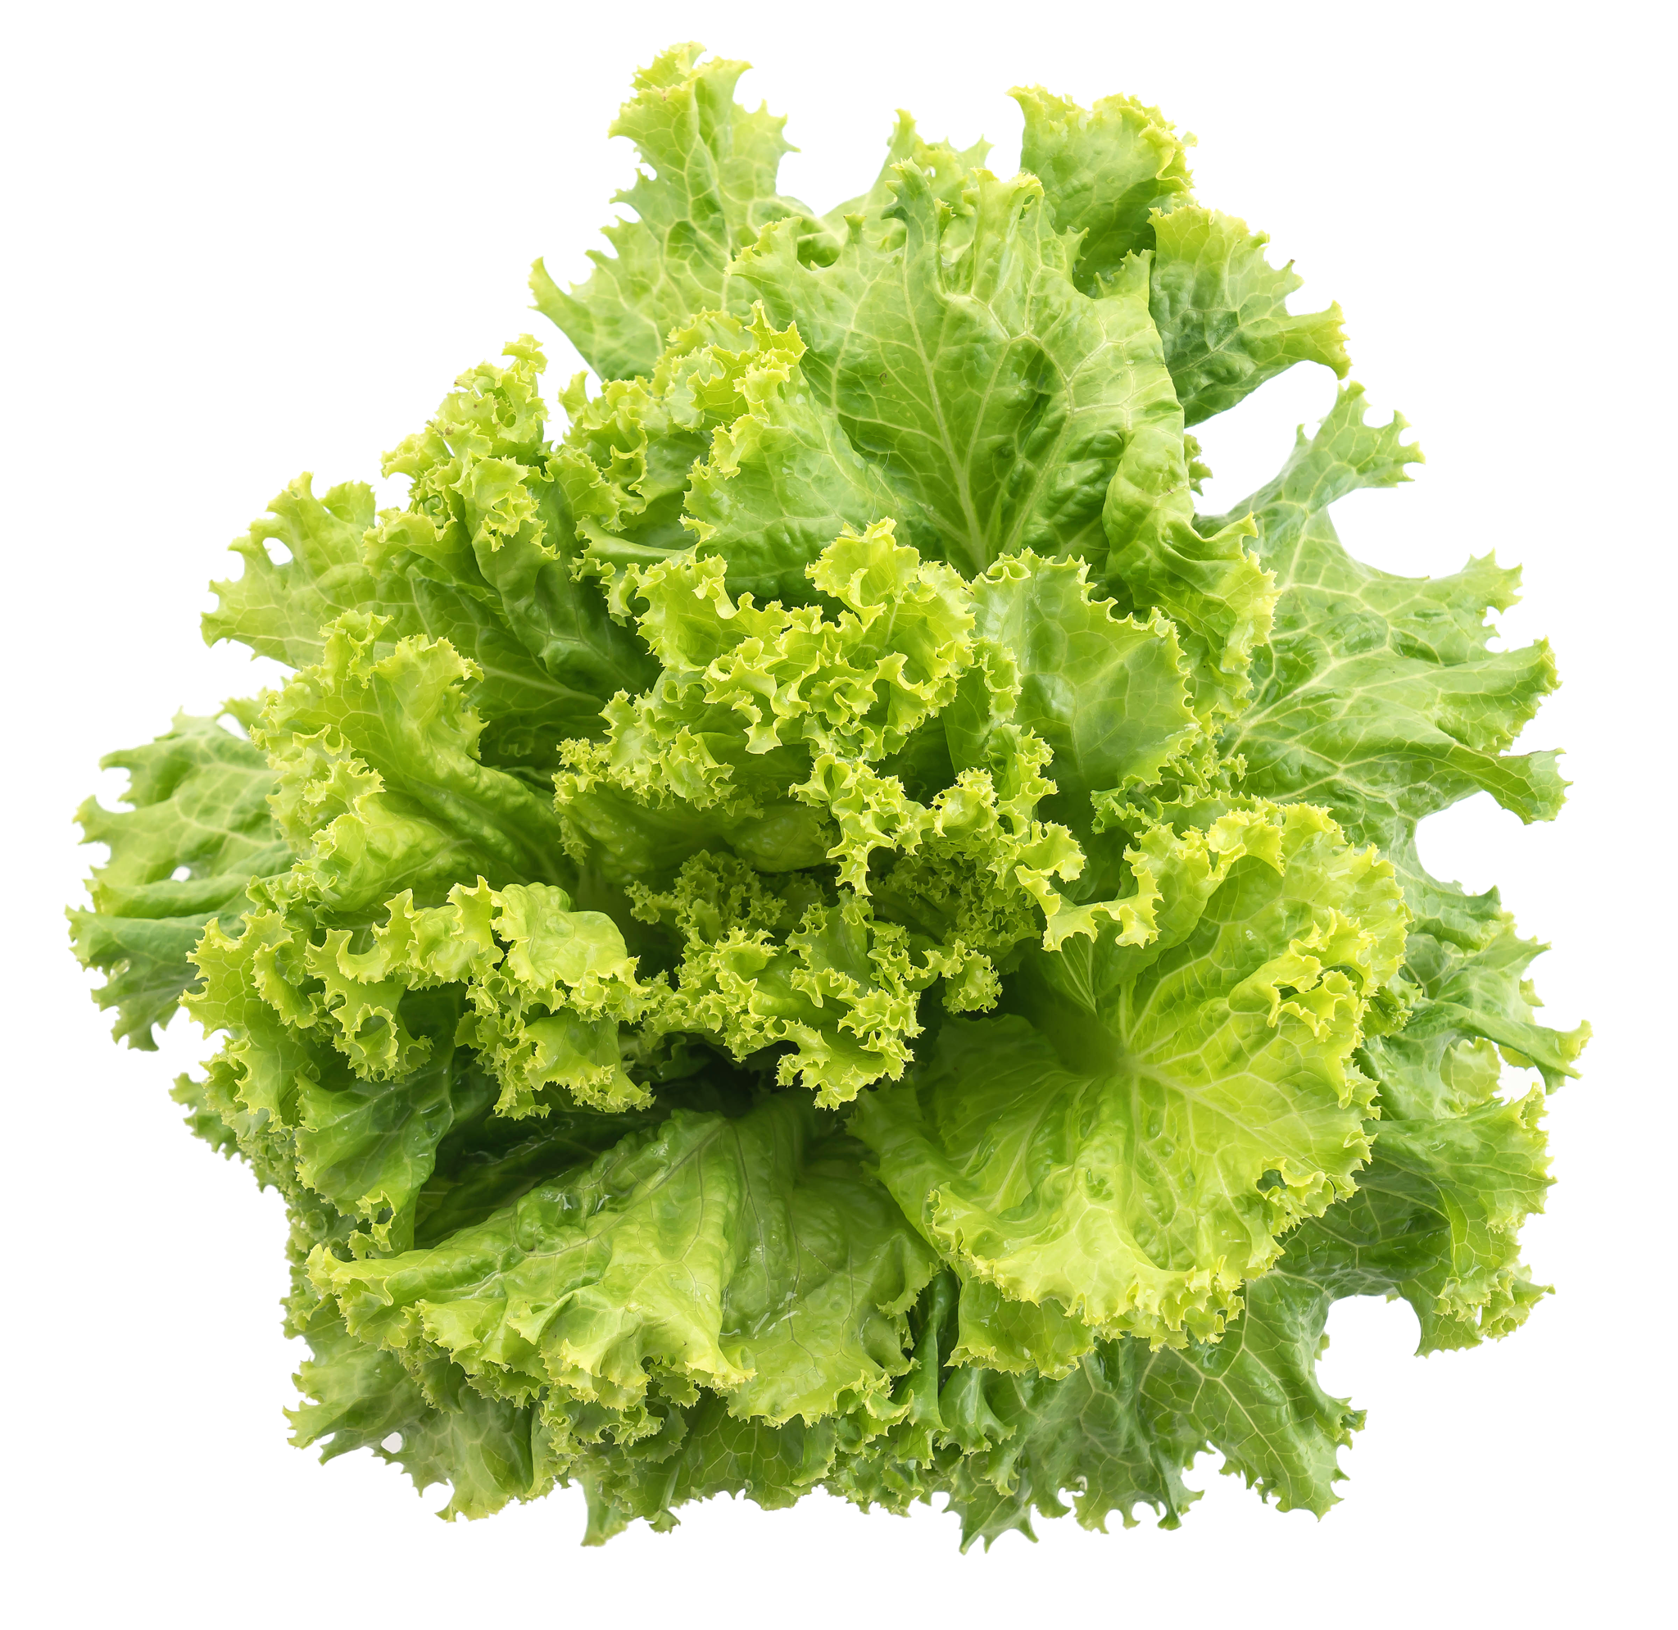
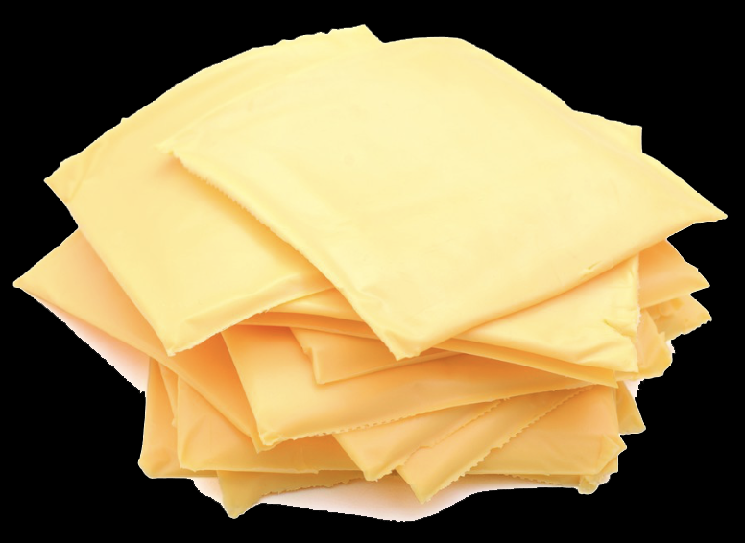

All-American Portabella Burger
With
French Fries
Grapes
Choice of Milk

Slide 3




Portabella mushrooms have tons of flavor and many key nutrients like B vitamins, potassium, and minerals.

Slide 4
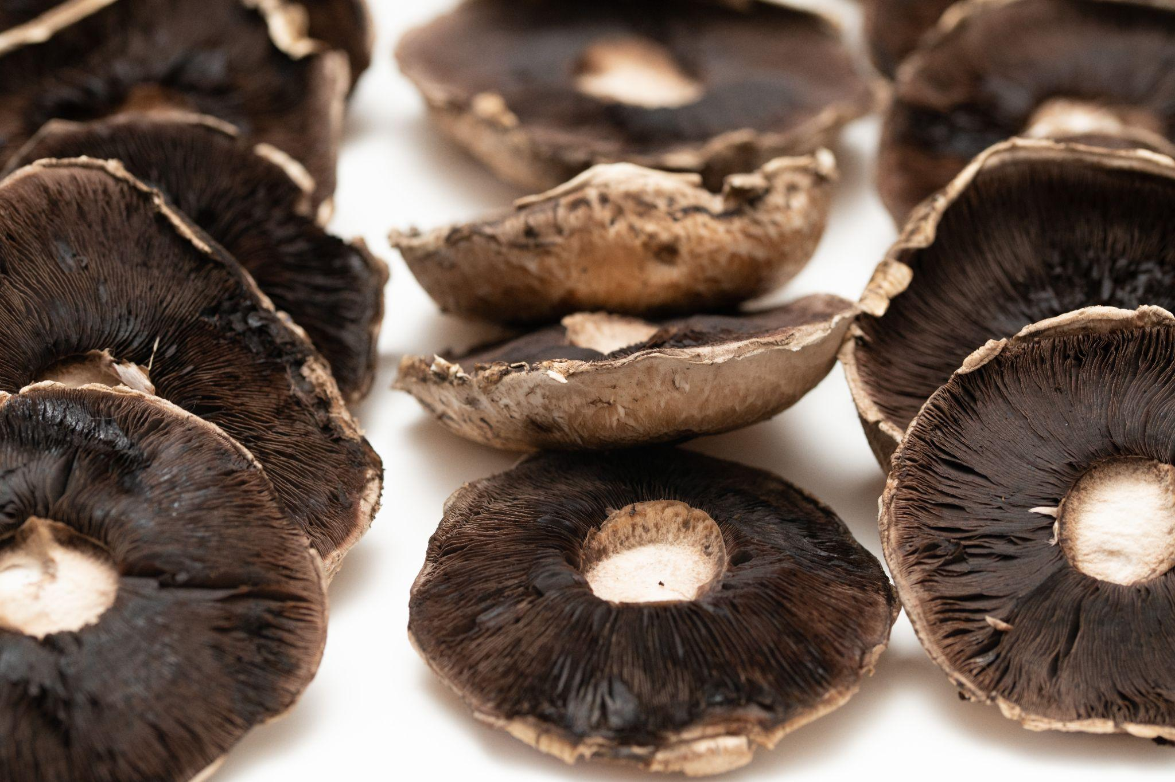
Portabella caps can measure up to 6 inches in diameter.

Slide 5
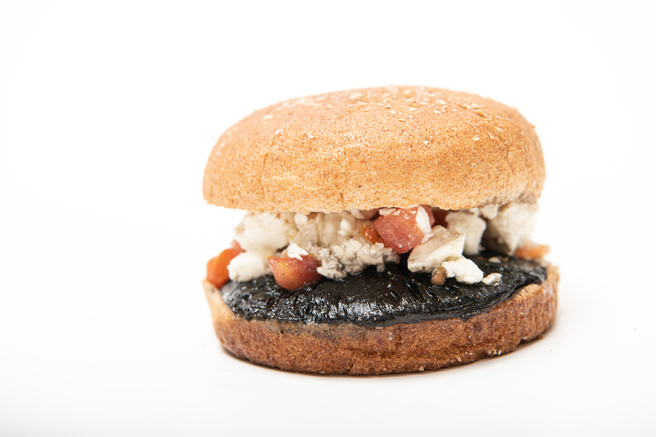
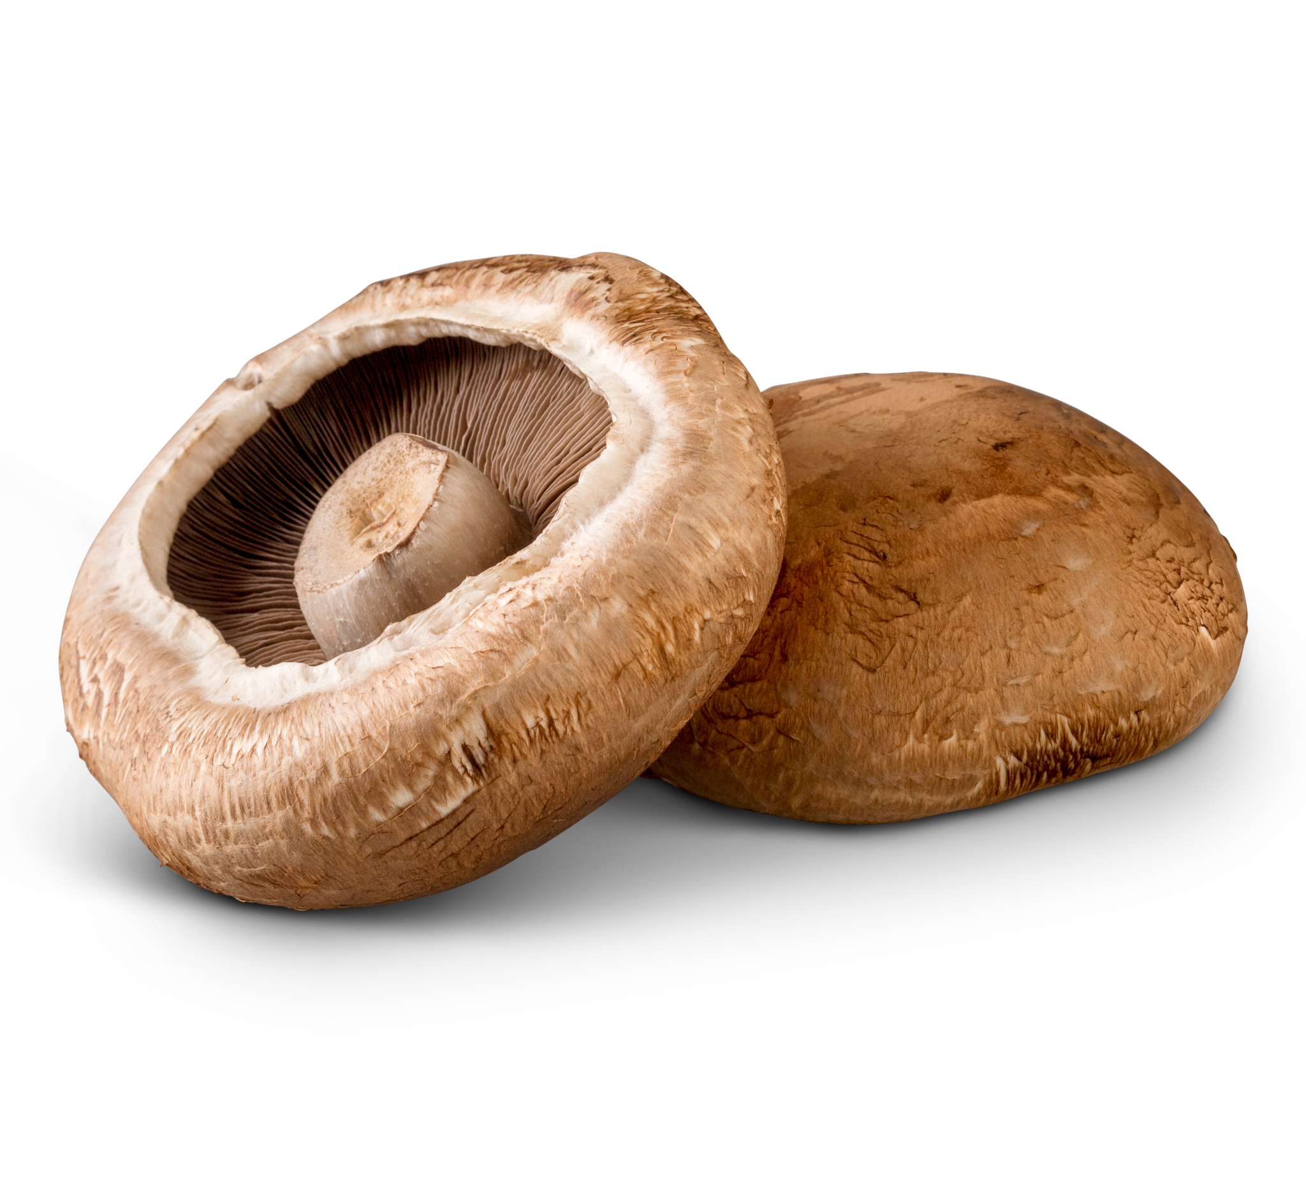
The botanical name for the portabella mushroom is Agaricus Bisporus.

Slide 6

What’s for Lunch?

