Slide 1
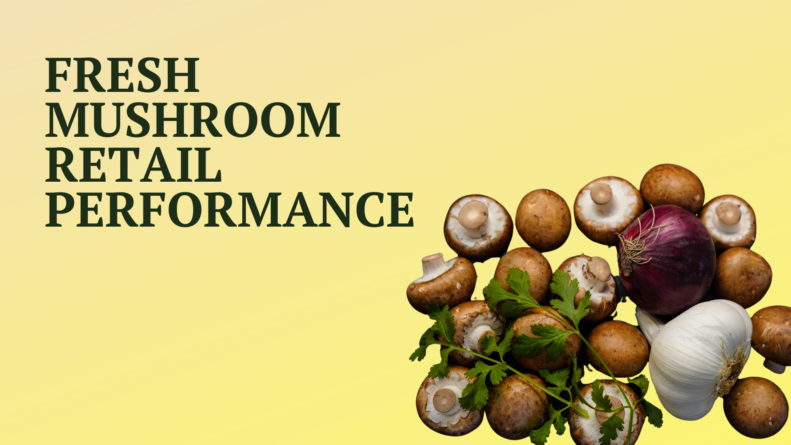

Four weeks ending
January 1, 2023

Slide 2
Methodology
NEW: Coding for organic and fixed weight versus random weight has been finalized. These attributes are now pulled at the full market versus SKU level. For the time being, preparation and package size is still at the SKU level until coding has been completed
The report covers the four weeks ending January 1, 2023 with week endings:
  December 11, 2022
  December 18, 2022
  December 25, 2022
  January 1, 2023
Comparisons to year ago (YA) refer to 2021; comparisons to two years ago (2YA) refer to 2020 and 3YA to 2019
Dollar references are the retail value, volume is reflected in pounds
Data is based on the IRI total multi-outlet universe, which includes supermarkets, supercenters, club, commissaries, etc. It excludes specialty stores (Whole Foods, Sprouts, etc)
Source: IRI, Integrated Fresh, MULO, 4 weeks ending 1/1/2023

Slide 3
Four-year dollar sales trend
2022 dollar sales were down but remained ahead of 2019
Source: IRI, Integrated Fresh, MULO, 4 weeks and 2022 ending 1/1/2023 versus same periods the past four years

Slide 4
Four-year unit sales trend
Unit sales were below 2019 levels in the quad week and year-to-date views
Source: IRI, Integrated Fresh, MULO, 4 weeks and 2022 ending 1/1/2023 versus same periods the past four years

Slide 5
Four-year volume (pound) sales trend
In the YTD and the quad-week view, pounds dipped below 2019
Source: IRI, Integrated Fresh, MULO, 4 weeks and 2022 ending 1/1/2023 versus same periods the past four years

Slide 6
Mushroom contribution to the department and category
The mushroom share of total produce and vegetables is below prior year levels
4 w.e. 1/1/2023 Mushroom $ share | Share of total produce | Share of total vegetables
2019 | 2.2% | 4.1%
2020 | 2.3% | 4.2%
2021 | 2.0% | 3.9%
2022 | 1.8% | 3.4%
2022 through w.e. 1/1/2023 Mushroom $ share | Share of total produce | Share of total vegetables
2019 | 1.9% | 3.7%
2020 | 2.0% | 3.9%
2021 | 1.8% | 3.7%
2022 | 1.7% | 3.4%
Source: IRI, Integrated Fresh, MULO, 4 weeks and year-to-date ending 1/1/2023

Slide 7
Mushrooms price per unit
Price increases for mushrooms were above those of total produce and total vegetables. This was driven by white button mushrooms (slide 10)
4 w.e. 1/1/2023 Average price/unit | Total produce | Total vegetables | Mushrooms
2019 | $2.25 | $2.03 | $2.61
2020 | $2.26 | $2.07 | $2.75
2021 | $2.48 | $2.21 | $2.86
2022 | $2.60 | +4.8% | $2.39 | +8.4% | $3.11 | +8.8%
Source: IRI, Integrated Fresh, MULO, 2022 weeks ending 1/1/2023

Slide 8
Mushroom price per volume (pound)
On a pound basis, mushroom inflation was below vegetables.
4 w.e. 1/1/2023 Average price/pound | Total produce | Total vegetables | Mushrooms
2019 | $1.63 | $1.69 | $4.15
2020 | $1.65 | $1.73 | $4.28
2021 | $1.83 | $1.85 | $4.46
2022 | $1.91 | +4.4% | $1.98 | +7.0% | $4.72 | +5.8%
Source: IRI, Integrated Fresh, MULO, 2022 weeks ending 1/1/2023

Slide 9
Price per volume by quarter/month
The rate of inflation versus YA on a per pound basis peaked in the third quarter
Source: IRI, Integrated Fresh, MULO, 2019-1/1/2023

Slide 10
Price per volume and unit by type
4 w.e.1/1/2023 | Price per pound | % change vs.’21 | % change vs.’20
Total mushrooms | $4.72 | +5.8% | +10.2%
White mushrooms | $4.12 | +4.6% | +9.1%
Brown mushrooms | $5.13 | +6.5% | +11.4%
Specialty mushrooms | $13.44 | -2.3% | +9.0%
4 w.e. 1/1/2023 | Price per unit | % change vs.’21 | % change vs.’20
Total mushrooms | $3.11 | +8.8% | +13.2%
White mushrooms | $2.87 | +9.4% | +14.0%
Brown mushrooms | $3.29 | +7.5% | +11.6%
Specialty mushrooms | $4.62 | +1.8% | +10.3%
Brown mushrooms include crimini and portabella
Specialty mushrooms include shiitake, oyster, enoki, chanterelle, morel, wood ear, porcini, black forest and other
Source: IRI, Integrated Fresh, MULO, 4 w.e. 1/1/2023

Slide 11

Mushroom dollar, unit, volume sales
Mushroom dollars still exceed the 2019 levels, but units/lbs are now double-digits below
4 w.e. 1/1/2023 dollars
$100M
volume (lbs)
21.2M
-6.8%
-14.4%
-11.9%
Dollar
growth vs. YA
Unit
growth vs. YA
Volume
growth vs. YA
-12.7% vs. ’20
+2.0% vs. ’19
-22.9% vs. ’20
-14.4% vs. ’19
-20.8% vs. ’20
-10.4% vs. ’19
Source: IRI, Integrated Fresh, MULO, 4 weeks ending 1/1/2023

Slide 12
Vegetables and mushroom dollar sales vs. YA and 2019
Both mushrooms and vegetables continued to trend above pre-pandemic levels
Source: IRI, Integrated Fresh, MULO, 2019-w.e. 1/1/2023

Slide 13
Vegetables and mushroom pound sales vs. YA and 2019
Vegetable pounds are now far outpacing fresh mushroom pounds when compared to 2019 and YA
Source: IRI, Integrated Fresh, MULO, 2019-w.e. 12/4/2022

Slide 14
Share of dollars and pounds sold on merchandising
While still low, at 19%, December saw a much higher level of promotions than last year
Fresh mushrooms | 4 w.e. 1/1/2023 | Vs. 2021 | 2022 | Vs. 2021
Share of dollars sold on promotion | 15.5% | +62.7% | 15.6% | +4.6%
Share of pounds sold on promotion | 19.3% | +84.4% | 18.7% | +8.1%
* Any merchandising, including feature, display, feature & display and temporary price reductions
Source: IRI, Integrated Fresh, MULO, 2022 through weeks ending 1/1/2023

Slide 15
Base and incremental sales
The increased level of promotions is driving 6.1% incrementality
Source: IRI, Integrated Fresh, MULO, 4 weeks ending 1/1/2023

Slide 16
Over indexing versus under indexing regions
Under indexing regions are catching up
Use as comparison to understand importance/size of mushrooms
2022 w.e. 1/1/2023 | Share of veg. $ | Share of mushrooms $ | $ sales growth vs. YA
Total US | 100.0% | 100.0% | -4.2%
California | 11.5% | 12.6% | -4.2%
Great Lakes | 13.2% | 15.2% | -5.0%
Mid-South | 13.0% | 11.5% | -2.7%
Northeast | 18.5% | 18.4% | -4.9%
Plains | 6.6% | 6.4% | -4.6%
South Central | 9.3% | 7.3% | -5.4%
Southeast | 15.1% | 13.4% | -5.5%
West | 12.8% | 15.2% | -1.8%
WEST
PLAINS
GREAT LAKES
NORTHEAST
MID SOUTH
CALIFORNIA
SOUTHEAST
SOUTH CENTRAL
= Above-average share
= Above-average performance
Source: IRI, Integrated Fresh, MULO, 2022 through 1/1/2023 | Total fresh vegetables and total fresh mushrooms

Slide 17
Performance summary whites, browns and exotics
Dollar sales for browns up 18.9% versus pre-pandemic levels and specialty is going strong also
4 weeks ending 1/1/2023 | Dollars | Dollar share | $ sales vs. 2021 | $ sales vs. 2019 | Volume (lbs) | Lbs share | Lbs vs. 2021 | Lbs vs. 2019
Total fresh mushrooms | $100.2M | 100.0% | -6.8% | +2.0% | 21.2M | 100.0% | -11.9% | -10.4%
White mushrooms | $50.5M | 50.4% | -12.4% | -9.2% | 12.3M | 57.7% | -16.2% | -19.0%
Brown mushrooms | $43.9M | 43.8% | +1.0% | +18.9% | 8.5M | 40.3% | -5.2% | +5.8%
Specialty mushrooms | $5.8M | 5.8% | -9.6% | +1.1% | 0.4M | 2.0% | +7.5% | -10.7%
Source: IRI, Integrated Fresh, MULO, 4 weeks ending 1/1/2023

Slide 18
White button mushrooms dollar performance
Dollars 2022 through
1/1/2023
$657.6M
-6.6% vs YA
Average price/unit
$2.66
+6.9% vs YA
Source: IRI, Integrated Fresh, MULO, 2021 plus 4 weeks ending 1/1/2023

Slide 19
White button mushrooms volume performance
Pounds 2022 through
w.e. 1/1/2023
162.0M
-12.4% vs YA
Average price/pound
$4.06
+6.6% vs. YA
Source: IRI, Integrated Fresh, MULO, 2021 plus 4 weeks ending 1/1/2023

Slide 20
Crimini mushrooms dollar performance
Dollars 2022 through
w.e. 1/1/2023
$414.1M
+4.1% vs. YA
Average price/unit
$3.16
+7.5% vs. YA
Source: IRI, Integrated Fresh, MULO, 2021 plus 4 weeks ending 1/1/2023

Slide 21
Crimini mushrooms volume performance
Pounds 2022 through
w.e. 1/1/2023
86.3M
-4.1% vs. YA
Average price/pound
$4.80
+8.6% vs. YA
Source: IRI, Integrated Fresh, MULO, 2021 plus 4 weeks ending 1/1/2023

Slide 22
other insights
Packaged (fixed weight) versus random weight
Package-size analysis
Organic versus conventional
Value-added versus whole/uncut

Slide 23
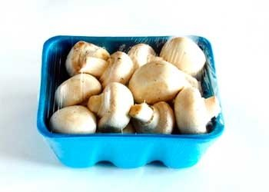
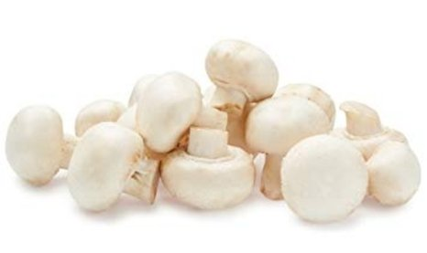
Packaged (fixed weight) versus random weight
Fixed weight represents the vast majority of
4 W.E. 1/1/2023 | Share of total mushroom sales and sales growth %
 | Fixed weight | Random weight
Dollar growth | -6.9% | -5.3%
Share of mushroom $ sales | 95.3% | 4.7%
Volume growth | -12.2% | -6.9%
Share of mushroom lbs sales | 95.9% | 4.1%
Source: IRI, Integrated Fresh, MULO, 4 weeks ending 1/1/2023
UPC-level analysis which excludes certain items due to IRI/retailer agreements

Slide 24
Package size analysis
8 and 16 ounces, the big sellers, both saw big declines*
Package size (per UPC) | Dollars | $ vs. YA | $ vs. 2YA | Pounds | lbs vs. YA | lbs vs. 2YA
<8 OZ | $8.1M | -14.7% | -21.1% | 0.6M | -19.6% | -30.4%
8 OZ | $44.8M | -18.3% | -23.2% | 8.6M | -25.6% | -31.9%
>8 OZ < 16 OZ | $6.3M | -8.0% | -15.1% | 1.3M | -11.6% | -27.2%
16 OZ | $14.0M | -32.6% | -34.0% | 3.6M | -36.8% | -41.3%
>16 OZ | $11.0M | +11.6% | +13.4% | 3.4M | -0.2% | -6.7%
Random weight | $4.4M | -2.1% | -20.2% | 0.8M | -3.3% | -25.1%
* Package size is still at the SKU level, which means certain private brand SKUs and retailers are not included in this
Source: IRI, Integrated Fresh, MULO, 4 weeks ending 1/1/2023
UPC-level analysis which excludes certain items due to IRI/retailer agreements

Slide 25
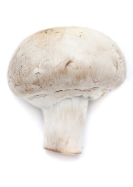
Organic versus conventional mushrooms sales
Organic continued to outperform conventional
4 w.e. 1/1/2023 | Share of total mushroom sales and sales growth %
Market
size
$86.4M
$ growth
-7.7%
Unit growth
-15.0%
Volume
growth
-12.1%
Conventional
Market size
$13.9M
$ growth
-1.2%
Unit growth
-9.5%
Volume
growth
-10.9%
Organic
10.7%
of pound sales
Source: IRI, Integrated Fresh, MULO, 4 weeks ending 1/1/2023 compared with year ago
UPC-level analysis which excludes certain items due to IRI/retailer agreements

Slide 26
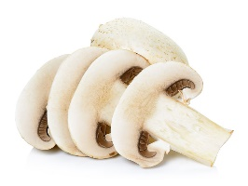
Cut/prepared versus whole mushrooms
No preparation (whole) had the better performance
4 w.e. 1/1/2023 | Share of total mushroom sales and sales growth %
Market
size
$45.8M
$ growth
-11.7%
Unit growth
-19.2%
Volume
growth
-18.8%
No preparation
Market size
$42.9M
$ growth
-21.4%
Unit growth
-27.3%
Volume
growth
-27.2%
Cut/prepped
45.3%
of lbs sales
Source: IRI, Integrated Fresh, MULO, 4 weeks ending 1/1/2023 compared with year ago
UPC-level analysis which excludes certain items due to IRI/retailer agreements

