Slide 1
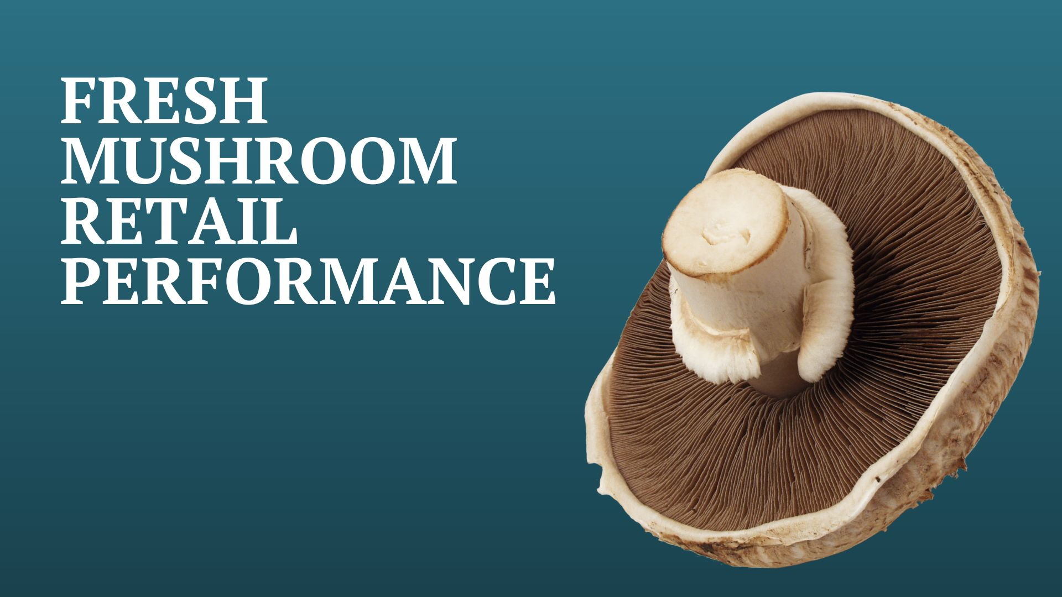

Four weeks ending
July 10, 2022

Slide 2
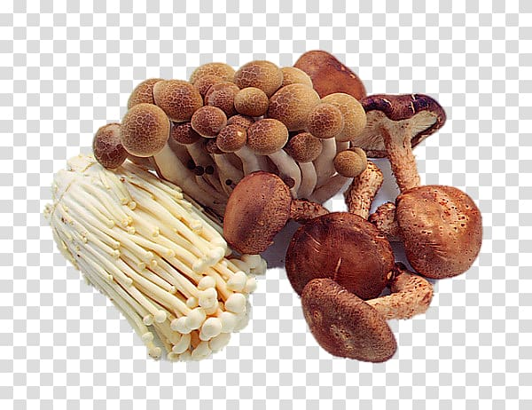
Methodology
The report covers the four weeks ending July 10, 2022 with week endings:
  June 19, 2022
  June 26, 2022
  July 3, 2022
  July 10, 2022
Comparisons to year ago (YA) refer to 2021; comparisons
to two years ago (2YA) refer to 2020 and 3YA to 2019
Dollar references are the retail value, volume is reflected in pounds
Data is based on the IRI total multi-outlet universe, which
includes supermarkets, supercenters, club, commissaries, etc.
It does not include the specialty stores, such as Whole Foods or Sprouts
Source: IRI, Integrated Fresh, MULO, 4 weeks ending 7/10/2022

Slide 3
Four-year dollar sales trend
Dollar sales fell below YA and 2YA levels, but remained well above 2019
Source: IRI, Integrated Fresh, MULO, 4 weeks and year-to-date ending 7/10/2022 versus same periods the past four years

Slide 4
Four-year unit sales trend
Unit sales were below 2019 levels in the quad week and year-to-date views
Source: IRI, Integrated Fresh, MULO, 4 weeks and year-to-date ending 7/10/2022 versus same periods the past four years

Slide 5
Four-year volume (pound) sales trend
YTD and the quad-week view, pounds were virtually even with 2019 levels
Source: IRI, Integrated Fresh, MULO, 4 weeks and year-to-date ending 7/10/2022 versus same periods the past four years

Slide 6
Mushroom contribution to the department and category
The mushroom share of total produce and vegetables is below prior year levels
4 w.e. 7/10/2022 Mushroom $ share | Share of total produce | Share of total vegetables
2019 | 1.6% | 3.4%
2020 | 1.8% | 3.7%
2021 | 1.6% | 3.4%
2022 | 1.5% | 3.2%
YTD through w.e. 7/10/2022 Mushroom $ share | Share of total produce | Share of total vegetables
2019 | 1.8% | 3.7%
2020 | 2.0% | 3.9%
2021 | 1.9% | 3.8%
2022 | 1.7% | 3.6%
Source: IRI, Integrated Fresh, MULO, 4 weeks and year-to-date ending 7/10/2022

Slide 7
Mushrooms price per unit
Price increases for mushrooms were below average — which automatically deflates the share
4 w.e. 7/10/2022 Average price/unit | Total produce | Total vegetables | Mushrooms
2019 | $2.27 | $1.91 | $2.56
2020 | $2.30 | $2.00 | $2.68
2021 | $2.38 | $1.99 | $2.72
2022 | $2.58 | +8.2% | $2.18 | 9.5% | $2.93 | +7.9%
Source: IRI, Integrated Fresh, MULO, YTD weeks ending 7/10/2022

Slide 8
Mushroom price per volume (pound)
On a pound basis, mushroom inflation exceeded total vegetables and produce for the first time since the start of the pandemic
4 w.e. 7/10/2022 Average price/pound | Total produce | Total vegetables | Mushrooms
2019 | $1.44 | $1.72 | $4.15
2020 | $1.50 | $1.80 | $4.28
2021 | $1.55 | $1.80 | $4.29
2022 | $1.67 | +7.4% | $1.96 | +8.8% | $4.68 | +9.1%
Source: IRI, Integrated Fresh, MULO, YTD weeks ending 7/10/2022

Slide 9
Price per volume by quarter/month
The rate of inflation for mushrooms reached its fastest acceleration yet, at +9.1%
Source: IRI, Integrated Fresh, MULO, 2019-7/10/2022

Slide 10
Price per volume and unit by type
YTD through w.e. 7/10/2022 | Price per pound | % change vs.’21 | % change vs.’20
Total mushrooms | $4.54 | +6.3% | +7.5%
White mushrooms | $4.00 | +6.1% | +6.2%
Brown mushrooms | $4.96 | +7.2% | +7.1%
Specialty mushrooms | $13.61 | +11.1% | +11.0%
YTD through w.e. 7/10/2022 | Price per unit | % change vs.’21 | % change vs.’20
Total mushrooms | $2.85 | +5.3% | +8.2%
White mushrooms | $2.59 | +5.0% | +6.9%
Brown mushrooms | $3.09 | +5.6% | +8.4%
Specialty mushrooms | $4.57 | +10.3% | +11.6%
Brown mushrooms include crimini and portabella
Specialty mushrooms include shiitake, oyster, enoki, chanterelle, morel, wood ear, porcini, black forest and other
Source: IRI, Integrated Fresh, MULO, YTD through weeks ending 7/10/2022

Slide 11
Share of dollars and pounds sold on merchandising
For the first time this year, more mushrooms were sold on promotion than during the same period a year ago
Fresh mushrooms | 4 w.e. 7/10/2022 |  | Vs. 2021 | Building CY thru 7/10/2022 | Vs. 2021
Share of dollars sold on promotion |  | 17.5% | +15.5% | 15.2% | -2.8%
Share of pounds sold on promotion |  | 21.3% | +23.0% | 17.9% | -0.3%
* Any merchandising, including feature, display, feature & display and temporary price reductions
Source: IRI, Integrated Fresh, MULO, YTD through weeks ending 7/10/2022

Slide 12

Mushroom dollar, unit, volume sales
Mushroom dollars still exceed the 2019 levels, but units and volume fell below
4 w.e. 7/10/2022 dollars
$91.8M
volume (lbs)
20M
-2.7%
-9.8%
-10.8%
Dollar
growth vs. YA
Unit
growth vs. YA
Volume
growth vs. YA
-15.7% vs. ’20
+3.7% vs. ’19
-21.0% vs. ’20
-4.0% vs. ’19
-21.1% vs. ’20
-2.3% vs. ’19
Source: IRI, Integrated Fresh, MULO, 4 weeks ending 7/10/2022

Slide 13
Vegetables and mushroom dollar sales vs. YA and 2019
Both mushrooms and vegetables continued to trend above pre-pandemic levels
Source: IRI, Integrated Fresh, MULO, 2019-w.e. 7/10/2022

Slide 14
Vegetables and mushroom pound sales vs. YA and 2019
Vegetables had a strong quad week with two holidays in this quad-week period
Source: IRI, Integrated Fresh, MULO, 2019-w.e. 7/10/2022

Slide 15
Base and incremental sales
Slightly higher incremental dollars in the last four weeks
Source: IRI, Integrated Fresh, MULO, 4 weeks ending 7/10/2022

Slide 16
Over indexing versus under indexing regions
Under indexing regions are catching up
Use as comparison to understand importance/size of mushrooms
YTD w.e. 7/10/2022 | Share of veg. $ | Share of mushrooms $ | $ sales growth vs. YA
Total US | 100.0% | 100.0% | -4.8%
California | 11.4% | 12.3% | -6.4%
Great Lakes | 13.4% | 15.2% | -6.0%
Mid-South | 13.1% | 11.8% | -2.4%
Northeast | 18.3% | 18.1% | -5.7%
Plains | 6.7% | 6.5% | -4.6%
South Central | 9.0% | 7.4% | -5.5%
Southeast | 15.3% | 13.4% | -3.8%
West | 12.8% | 15.3% | -4.0%
WEST
PLAINS
GREAT LAKES
NORTHEAST
MID SOUTH
CALIFORNIA
SOUTHEAST
SOUTH CENTRAL
= Above-average share
= Above-average performance
Source: IRI, Integrated Fresh, MULO, YTD through 7/10/2022 | Total fresh vegetables and total fresh mushrooms

Slide 17
Performance summary whites, browns and exotics
Dollar sales for browns up 17.8% versus pre-pandemic levels
4 weeks ending 7/10/2022 | Dollars | Dollar share | $ sales vs. 2021 | $ sales vs. 2019 | Volume (lbs) | Lbs share | Lbs vs. 2021 | Lbs vs. 2019
Total fresh mushrooms | $91.8M | 100.0% | -2.7% | +10.0% | 19.6M | 100.0% | -10.8% | -2.3%
White mushrooms | $49.2M | 53.6% | -1.9% | +3.7% | 12.0M | 60.9% | -9.9% | -6.8%
Brown mushrooms | $38.0M | 41.4% | -2.3% | +17.8% | 7.3M | 37.4% | -11.6% | +5.7%
Specialty mushrooms | $4.6M | 5.0% | -13.3% | +22.7% | 0.3M | 1.7% | -23.2% | +3.5%
Source: IRI, Integrated Fresh, MULO, 4 weeks ending 7/10/2022

Slide 18
White button mushrooms dollar performance
Dollars YTD through
7/10/2022
$373M
-5.1% vs YA
Average price/unit
$2.59
+5.0% vs YA
Source: IRI, Integrated Fresh, MULO, 2021 plus 4 weeks ending 7/10/2022

Slide 19
White button mushrooms volume performance
Pounds YTD through
w.e. 7/10/2022
93.3M
-10.5% vs YA
Average price/pound
$4.00
+6.1% vs. YA
Source: IRI, Integrated Fresh, MULO, 2021 plus 4 weeks ending 7/10/2022

Slide 20
Crimini mushrooms dollar performance
Dollars YTD through
w.e. 7/10/2022
$218M
-1.7% vs. YA
Average price/unit
$3.09
+6.4% vs. YA
Source: IRI, Integrated Fresh, MULO, 2021 plus 4 weeks ending 7/10/2022

Slide 21
Crimini mushrooms volume performance
Pounds YTD through
w.e. 7/10/2022
46.4M
-8.8% vs. YA
Average price/pound
$4.70
+7.8% vs. YA
Source: IRI, Integrated Fresh, MULO, 2021 plus 4 weeks ending 7/10/2022

Slide 22
other insights
Packaged (fixed weight) versus random weight
Package-size analysis
Organic versus conventional
Value-added versus whole/uncut

Slide 23
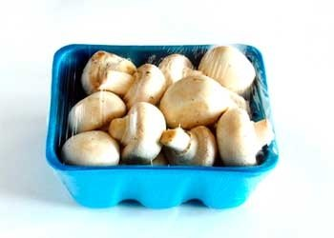
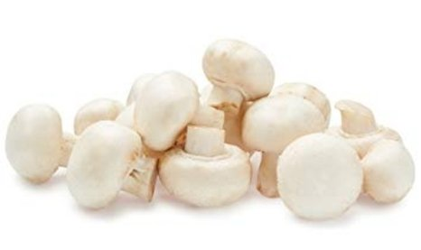
Packaged (fixed weight) versus random weight
While both down, fixed weight did better than random weight
4 W.E. 7/10/2022 | Share of total mushroom sales and sales growth %
 | Fixed weight | Random weight
Dollar growth | -5.0% | -12.8%
Share of mushroom $ sales | 94.9% | 5.1%
Volume growth | -13.3% | -24.5%
Share of mushroom lbs sales | 95.5% | 4.5%
Source: IRI, Integrated Fresh, MULO, 4 weeks ending 7/10/2022

Slide 24
Package size analysis
8 and 16 ounces drive the bulk of sales; 8 ounce had another strong performance
Package size (per UPC) | Dollars | $ vs. YA | $ vs. 2YA | Pounds | lbs vs. YA | lbs vs. 2YA
<8 OZ | $7.8M | -6.7% | -11.1% | 662,238 | -14.3% | -17.7%
8 OZ | $48M | -1.2% | -16.2% | 9,715,652 | -8.4% | -22.8%
>8 OZ < 16 OZ | $5.1M | -10.6% | -25.6% | 1,078,147 | -19.2% | -31.7%
16 OZ | $16.8M | -6.4% | -14.0% | 4,490,667 | -13.7% | -20.5%
>16 OZ | $4.9M | -24.0% | -29.4% | 1,520,783 | -35.5% | -41.6%
Random weight | $4.2M | -11.1% | -20.5% | 773,949 | -15.7% | -27.6%
Source: IRI, Integrated Fresh, MULO, 4 weeks ending 7/10/2022

Slide 25
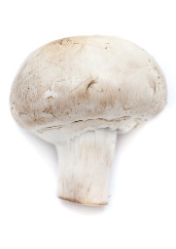
Organic versus conventional mushrooms sales
The organic share of mushroom dollar sales reached 12.7%
4 WE 7/10/2022 | Share of total mushroom sales and sales growth %
Market
size
$75.7M
$ growth
-6.5%
Unit growth
-11.8%
Volume
growth
-13.9%
Conventional
Market size
$11.2M
$ growth
+2.6%
Unit growth
-8.9%
Volume
growth
-13.7%
Organic
9.7%
of pound sales
Source: IRI, Integrated Fresh, MULO, 4 weeks ending 7/10/2022 compared with year ago

Slide 26
Organic by type
Brown mushrooms had the highest organic share, specialty drove growth
Dollars 4 w.e. 7/10/2022 | Organic $ | % change vs.’21 | Conventional $ | % change vs. 21
Total mushrooms | $11,223,705 | +2.6% | $75,738,646 | -6.5%
White mushrooms | $4,117,220 | +0.6% | $42,348,690 | -4.6%
Brown mushrooms | $5,820,384 | -0.9% | $30,123,399 | -6.8%
Specialty mushrooms | $1,286,101 | +32.0% | $3,266,496 | -23.9%
Volume 4 w.e. 7/10/2022 | Organic lbs | % change vs.’21 | Conventional lbs | % change vs. 21
Total mushrooms | 1,777,211 | -13.7% | 16,464,536 | -13.9%
White mushrooms | 761,155 | -5.9% | 10,327,084 | -12.7%
Brown mushrooms | 916,707 | -21.0% | 5,903,892 | -14.9%
Specialty mushrooms | 99,348 | 12.7% | 233,554 | -32.6%
Source: IRI, Integrated Fresh, MULO, 4 weeks ending 7/10/2022

Slide 27
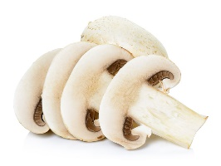
Cut/prepared versus whole mushrooms
No preparation (whole) had the better performance
4 w.e. 7/10/2022 | Share of total mushroom sales and sales growth %
Market
size
$40.8M
$ growth
-3.4%
Unit growth
-9.6%
Volume
growth
-14.0%
No preparation
Market size
$46.2M
$ growth
-7.2%
Unit growth
-13.1%
Volume
growth
-13.7%
Cut/prepped
51.2%
of lbs sales
Source: IRI, Integrated Fresh, MULO, 4 weeks ending 7/10/2022 compared with year ago

Slide 28
Cut/prepared by type
Brown mushrooms represented the largest share but white had the better dollar performance
Dollars 4 w.e. 7/10/2022 | Cut/prepared $ | % change vs.’21 | Whole $ | % change vs. 21
Total mushrooms | $46,203,288 | -3.4% | $40,759,063 | -7.2%
White mushrooms | $23,599,461 | -0.8% | $22,866,449 | -7.2%
Brown mushrooms | $19,569,274 | -5.1% | $16,374,509 | -6.6%
Specialty mushrooms | $3,034,553 | -18.7% | $1,518,105 | -10.9%
Pounds 4 w.e. 7/10/2022 | Cut/prepared lbs | % change vs.’21 | Whole lbs | % change vs. 21
Total mushrooms | 9,332,099 | -13.7% | 8,909,648 | -14.0%
White mushrooms | 5,682,281 | -13.5% | 5,405,959 | -10.9%
Brown mushrooms | 3,438,015 | -13.5% | 3,382,584 | -18.0%
Specialty mushrooms | 211,803 | -20.6% | 121,104 | -28.0%
Source: IRI, Integrated Fresh, MULO, 4 weeks ending 7/10/2022

