Slide 1
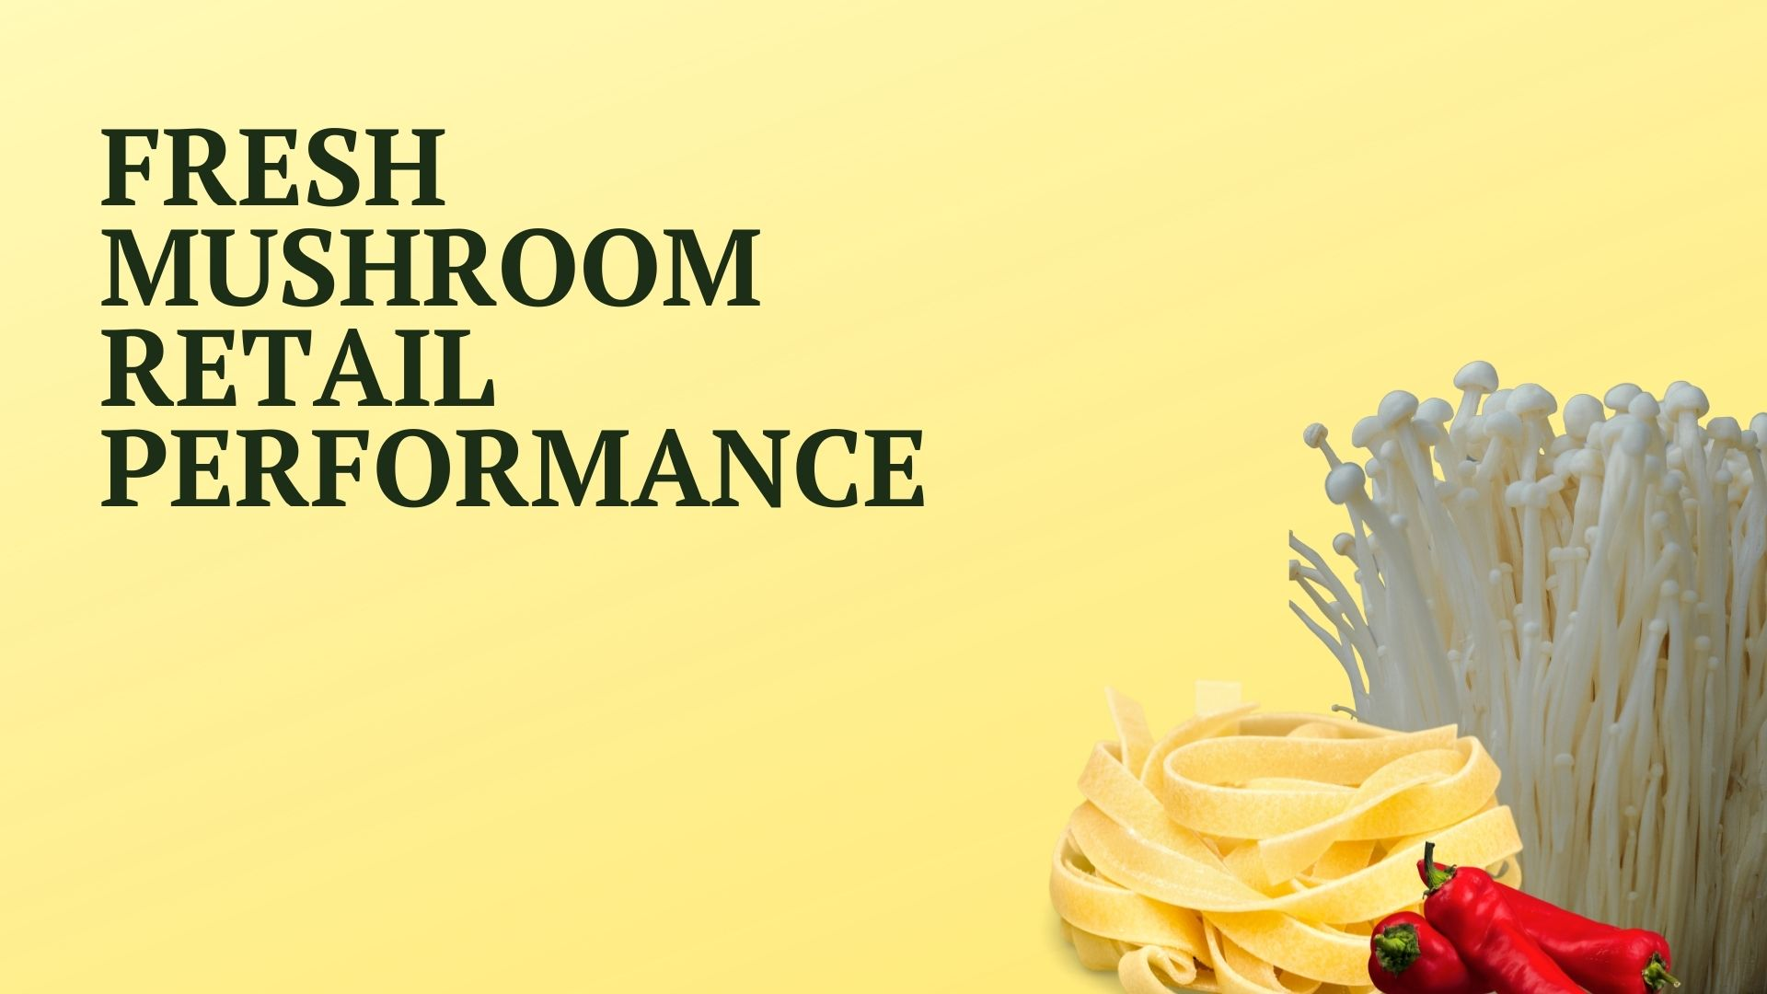

Four weeks ending
June 12, 2022

Slide 2
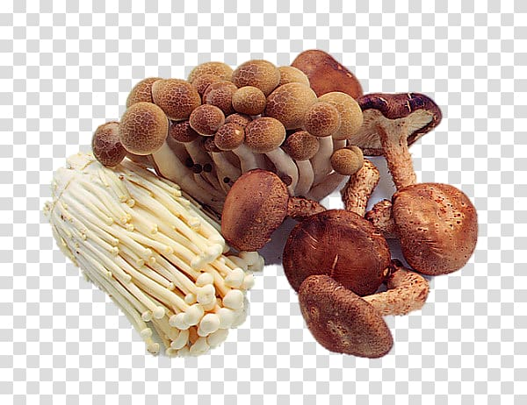
Methodology
The report covers the four weeks ending June 12, 2022 with week endings:
May 22, 2022
May 29, 2022
June 5, 2022
June 12, 2022
Comparisons to year ago (YA) refer to 2021; comparisons to two years ago (2YA) refer to 2020 and 3YA to 2019
Dollar references are the retail value, volume is reflected in pounds
Data is based on the IRI total multi-outlet universe, which includes supermarkets, supercenters, club, commissaries, etc.
It does not include the specialty stores, such as Whole Foods or Sprouts
Source: IRI, Integrated Fresh, MULO, 4 weeks ending 6/12/22

Slide 3
Four-year dollar sales trend Dollar sales fell below YA and 2YA levels as the quad-week period now laps the start of the pandemic, but remained well above 2019
Source: IRI, Integrated Fresh, MULO, 4 weeks and year-to-date ending 6/12/22 versus same periods the past four years

Slide 4
Four-year unit sales trend Unit sales were below 2019 levels in the quad week and year-to-date views
Source: IRI, Integrated Fresh, MULO, 4 weeks and year-to-date ending 6/12/22 versus same periods the past four years

Slide 5
Four-year volume (pound) sales trend YTD, pounds were virtually even with 2019. In the quad-week performance, pounds fell behind by about 0.7M
Source: IRI, Integrated Fresh, MULO, 4 weeks and year-to-date ending 6/12/22 versus same periods the past four years

Slide 6
Mushroom contribution to the department and category The mushroom share of pounds versus total produce and total vegetables was the same as 2019. The share of dollars is lower due the difference in inflation.
4 w.e. 6/12/2022 Mushroom $ share | Share of total produce | Share of total vegetables
2019 | 1.9% | 3.8%
2020 | 2.0% | 3.9%
2021 | 1.9% | 3.9%
2022 | 1.8% | 3.6%
YTD through w.e. 6/12/2022 Mushroom $ share | Share of total produce | Share of total vegetables
2019 | 0.7% | 1.6%
2020 | 0.8% | 1.6%
2021 | 0.8% | 1.7%
2022 | 0.7% | 1.6%
Source: IRI, Integrated Fresh, MULO, 4 weeks and year-to-date ending 6/12/22

Slide 7
Mushrooms price per unit YTD Inflation for mushrooms, at +4.9%, was much lower than total produce and total vegetables — which automatically deflates the share
YTD w.e. 6/12/2022 Average price/unit | Total produce | Total vegetables | Mushrooms
2019 | $2.31 | $2.04 | $2.52
2020 | $2.28 | $2.05 | $2.62
2021 | $2.36 | $2.07 | $2.70
2022 | $2.58 | +9.6% | $2.24 | +8.0% | $2.83 | +4.9%
Source: IRI, Integrated Fresh, MULO, YTD weeks ending 6/12/22

Slide 8
Mushroom price per volume (pound) On a pound basis, mushroom inflation was also below average. However, the price per volume is much higher than many other vegetables
YTD w.e. 6/12/2022 Average price/pound | Total produce | Total vegetables | Mushrooms
2019 | $1.63 | $1.78 | $4.10
2020 | $1.60 | $1.75 | $4.22
2021 | $1.70 | $1.83 | $4.27
2022 | $1.86 | +9.6% | $1.96 | +6.7% | $4.52 | +5.9%
Source: IRI, Integrated Fresh, MULO, YTD weeks ending 6/12/22

Slide 9
Price per volume by quarter/month The rate of inflation for mushrooms reached its fastest acceleration yet, at +8.3%
Source: IRI, Integrated Fresh, MULO, 2019-6/12/2022

Slide 10
Price per volume and unit by type
YTD through w.e. 6/12/2022 | Price per pound | % change vs.’21 | % change vs.’20
Total mushrooms | $4.65 | +8.3% | +9.3%
White mushrooms | $4.08 | +7.7% | +7.8%
Brown mushrooms | $5.13 | +10.5% | +10.0%
Specialty mushrooms | $13.60 | +12.2% | +11.2%
YTD through w.e. 6/12/2022 | Price per unit | % change vs.’21 | % change vs.’20
Total mushrooms | $2.91 | +7.4% | +8.5%
White mushrooms | $2.66 | +7.2% | +7.6%
Brown mushrooms | $3.15 | +7.9% | +8.5%
Specialty mushrooms | $4.64 | +12.3% | +11.2%
Brown mushrooms include crimini and portabella
Specialty mushrooms include shiitake, oyster, enoki, chanterelle, morel, wood ear, porcini, black forest and other
Source: IRI, Integrated Fresh, MULO, YTD through weeks ending 6/12/22

Slide 11
Share of dollars and pounds sold on merchandising In addition to higher prices, less was sold while on promotion. In contrast, about one-third of total produce dollars/pounds were sold on promotion
Share of sold on merchandising* | YTD through w.e. 6/12/2022 | Change vs. 2021
Share of total fresh mushroom dollars | 14.8% | -5.5%
Share of total fresh mushroom pounds | 17.4% | -3.7%
* Any merchandising, including feature, display, feature & display and temporary price reductions
Source: IRI, Integrated Fresh, MULO, YTD through weeks ending 6/12/22

Slide 12

Mushroom dollar, unit, volume sales Mushroom dollars still exceed the 2019 levels, but units and volume fell below
4 w.e. 6/12/2022 dollars
$93.6M
volume (lbs)
21M
-4.1%
-10.7%
-11.5%
Dollar growth vs. YA
Unit
growth vs. YA
Volume growth vs. YA
-15.9% vs. ’20
+8.6% vs. ’19
-22.5% vs. ’20
-5.1% vs. ’19
-23.1% vs. ’20
-3.3% vs. ’19
Source: IRI, Integrated Fresh, MULO, 4 weeks ending 6/12/22

Slide 13
Vegetables and mushroom dollar sales vs. YA and 2019 Both mushrooms and vegetables continued to trend above pre-pandemic levels
Source: IRI, Integrated Fresh, MULO, 2019-w.e. 5/15/2022

Slide 14
Vegetables and mushroom pound sales vs. YA and 2019 Vegetables dropped to 2019 levels and mushrooms dropped to -3.3% when regarding pounds
Source: IRI, Integrated Fresh, MULO, 2019-w.e. 6/12/2022

Slide 15
Base and incremental sales Slightly higher incremental dollars in the last four weeks
Source: IRI, Integrated Fresh, MULO, 4 weeks ending 6/12/22

Slide 16
Over indexing versus under indexing regions Under indexing regions are catching up
Use as comparison to understand importance/size of mushrooms
YTD w.e. 6/12/2022 | Share of veg. $ | Share of mushrooms $ | $ sales growth vs. YA
Total US | 100.0% | 100.0% | -5.2%
California | 11.4% | 12.3% | -7.4%
Great Lakes | 13.3% | 15.2% | -6.4%
Mid-South | 13.1% | 11.8% | -2.7%
Northeast | 18.2% | 18.1% | -5.8%
Plains | 6.7% | 6.4% | -4.8%
South Central | 9.0% | 7.4% | -5.3%
Southeast | 15.4% | 13.5% | -3.5%
West | 12.8% | 15.3% | -4.9%
WEST
PLAINS
GREAT LAKES
NORTHEAST
MID SOUTH
CALIFORNIA
SOUTHEAST
SOUTH CENTRAL
= Above-average share
= Above-average performance
Source: IRI, Integrated Fresh, MULO, YTD through 6/12/22 | Total fresh vegetables and total fresh mushrooms

Slide 17
Performance summary whites, browns and exotics Dollar sales for browns up 15.6% versus pre-pandemic levels
4 weeks ending 6/12/2022 | Dollars | Dollar share | $ sales vs. 2021 | $ sales vs. 2019 | Volume (lbs) | Lbs share | Lbs vs. 2021 | Lbs vs. 2019
Total fresh mushrooms | $93.6M | 100.0% | -4.1% | +8.6% | 20.1M | 100.0% | -11.5% | -3.3%
White mushrooms | $50M | 53.4% | -3.0% | +2.7% | 12.2M | 60.8% | -10.0% | -7.7%
Brown mushrooms | $38.7M | 41.3% | -3.9% | +15.6% | 7.5M | 37.4% | -13.1% | +4.7%
Specialty mushrooms | $4.9M | 5.2% | -14.9% | +21.8% | 0.3M | 1.8% | -24.2% | +2.7%
Source: IRI, Integrated Fresh, MULO, 4 weeks ending 6/12/22

Slide 18
White button mushrooms dollar performance
Dollars YTD through 6/12/2022
$324M
-5.5% vs YA
Average price/unit
$2.57
+4.6% vs YA
Source: IRI, Integrated Fresh, MULO, 2021 plus 4 weeks ending 6/12/22

Slide 19
White button mushrooms volume performance
Pounds YTD through w.e. 6/12/2022
81.4M
-10.6% vs YA
Average price/pound
$3.98
+5.7% vs. YA
Source: IRI, Integrated Fresh, MULO, 2021 plus 4 weeks ending 6/12/22

Slide 20
Crimini mushrooms dollar performance
Dollars YTD through w.e. 6/12/2022
$190M
-2.1% vs. 2019
Average price/unit
$3.08
+6.0% vs. YA
Source: IRI, Integrated Fresh, MULO, 2021 plus 4 weeks ending 6/12/22

Slide 21
Crimini mushrooms volume performance
Pounds YTD through w.e. 6/12/2022
40.7M
-8.7% vs. YA
Average price/pound
$4.35
+7.0% vs. YA
Source: IRI, Integrated Fresh, MULO, 2021 plus 4 weeks ending 6/12/22

Slide 22
other insights
Packaged (fixed weight) versus random weight
Package-size analysis
Organic versus conventional
Value-added versus whole/uncut

Slide 23
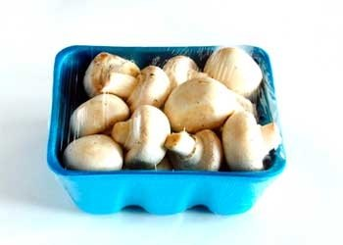
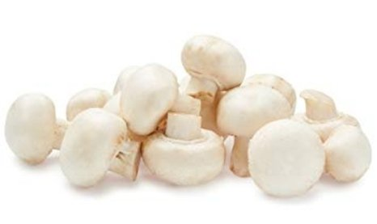
Packaged (fixed weight) versus random weight While both down, fixed weight did better than random weight
4 W.E. 6/12/2022 | Share of total mushroom sales and sales growth %
 | Fixed weight | Random weight
Dollar growth | -5.6% | -15.4%
Share of mushroom $ sales | 94.9% | 5.1%
Volume growth | -3.0% | -28.5%
Share of mushroom lbs sales | 95.7% | 4.3%
Source: IRI, Integrated Fresh, MULO, 4 weeks ending 6/12/22

Slide 24
Package size analysis 8 and 16 ounces drive the bulk of sales; 8 ounce had a strong quad weeks for the second time in a row. Could this point to trading down in size?
Package size (per UPC) | Dollars | $ vs. YA | $ vs. 2YA | Pounds | lbs vs. YA | lbs vs. 2YA
<8 OZ | $8.0M | -9.1% | -8.7% | 675,323 | -15.9% | -14.3%
8 OZ | $48M | -1.9% | -17.7% | 9,986,544 | -9.2% | -23.8%
>8 OZ < 16 OZ | $5.3M | -8.1% | -24.8% | 1,132,630 | -15.9% | -30.9%
16 OZ | $17.2M | -6.6% | -18.7% | 4,679,317 | -11.7% | -24.3%
>16 OZ | $5.0M | -25.6% | -31.7% | 1,587,716 | -35.2% | -42.2%
random weight | $4.3M | -13.6% | -20.7% | 772,116 | -19.7% | -29.7%
Source: IRI, Integrated Fresh, MULO, 4 weeks ending 6/12/22

Slide 25
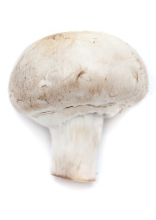
Organic versus conventional mushrooms sales The organic share of mushroom dollar sales reached 12.7%
4 WE 6/12/2022 | Share of total mushroom sales and sales growth %
Market size
$77.8M
$ growth
-7.2%
Unit growth
-12.1%
Volume growth
-13.8%
Conventional
Market size
$11.3M
$ growth
+1.7%
Unit growth
-8.9%
Volume growth
-13.9%
Organic
9.6%
of pound sales
Source: IRI, Integrated Fresh, MULO, 4 weeks ending 6/12/22 compared with year ago

Slide 26
Organic by type Brown mushrooms had the highest organic share, specialty drove growth
Dollars 4 w.e. 6/12/22 | Organic $ | % change vs.’21 | Conventional $ | % change vs. 21
Total mushrooms | $ 11,317,156 | +1.7% | $ 77,823,839 | -7.2%
White mushrooms | $ 4,092,567 | +2.5% | $ 43,288,188 | -5.5%
Brown mushrooms | $ 5,855,016 | -3.9% | $ 31,051,696 | -6.9%
Specialty mushrooms | $ 1,369,573 | +30.8% | $ 3,483,915 | -25.3%
Volume 4 w.e. 6/12/22 | Organic lbs | % change vs.’21 | Conventional lbs | % change vs. 21
Total mushrooms | 1,816,199 | -13.9% | 17,017,447 | -13.8%
White mushrooms | 771,730 | -2.4% | 10,626,919 | -12.6%
Brown mushrooms | 938,464 | -23.4% | 6,139,779 | -14.9%
Specialty mushrooms | 106,004 | 12.2% | 250,744 | -33.4%
Source: IRI, Integrated Fresh, MULO, 4 weeks ending 6/12/22

Slide 27
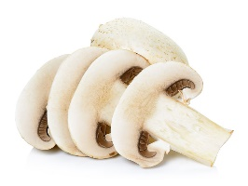
Cut/prepared versus whole mushrooms No preparation (whole) had the better performance
4 w.e. 6/12/2022 | Share of total mushroom sales and sales growth %
Market size
$41.7M
$ growth
-4.0%
Unit growth
-9.9%
Volume growth
-13.8%
No preparation
Market size
$47.5M
$ growth
-7.9%
Unit growth
-13.4%
Volume growth
-13.5%
Cut/prepped
51.8%
of lbs sales
Source: IRI, Integrated Fresh, MULO, 4 weeks ending 6/12/22 compared with year ago

Slide 28
Cut/prepared by type Brown mushrooms represented the largest share and the better performance
Dollars 4 w.e. 6/12/22 | Cut/prepared $ | % change vs.’21 | Whole $ | % change vs. 21
Total mushrooms | $ 58,398,523 | -7.9% | $ 51,279,878 | -4.0%
White mushrooms | $ 31,227,288 | -8.2% | $ 29,095,134 | -1.1%
Brown mushrooms | $ 23,649,621 | -6.6% | $ 20,229,450 | -6.2%
Specialty mushrooms | $ 3,521,614 | -13.5% | $ 1,955,295 | -18.0%
Pounds 4 w.e. 6/12/22 | Cut/prepared lbs | % change vs.’21 | Whole lbs | % change vs. 21
Total mushrooms | 9,649,901 | -13.5% | 9,183,745 | -14.1%
White mushrooms | 5,812,001 | -13.5% | 5,586,648 | -10.3%
Brown mushrooms | 3,611,586 | -13.1% | 3,466,657 | -19.1%
Specialty mushrooms | 226,314 | -21.6% | 130,440 | -28.6%
Source: IRI, Integrated Fresh, MULO, 4 weeks ending 6/12/22

