Slide 1
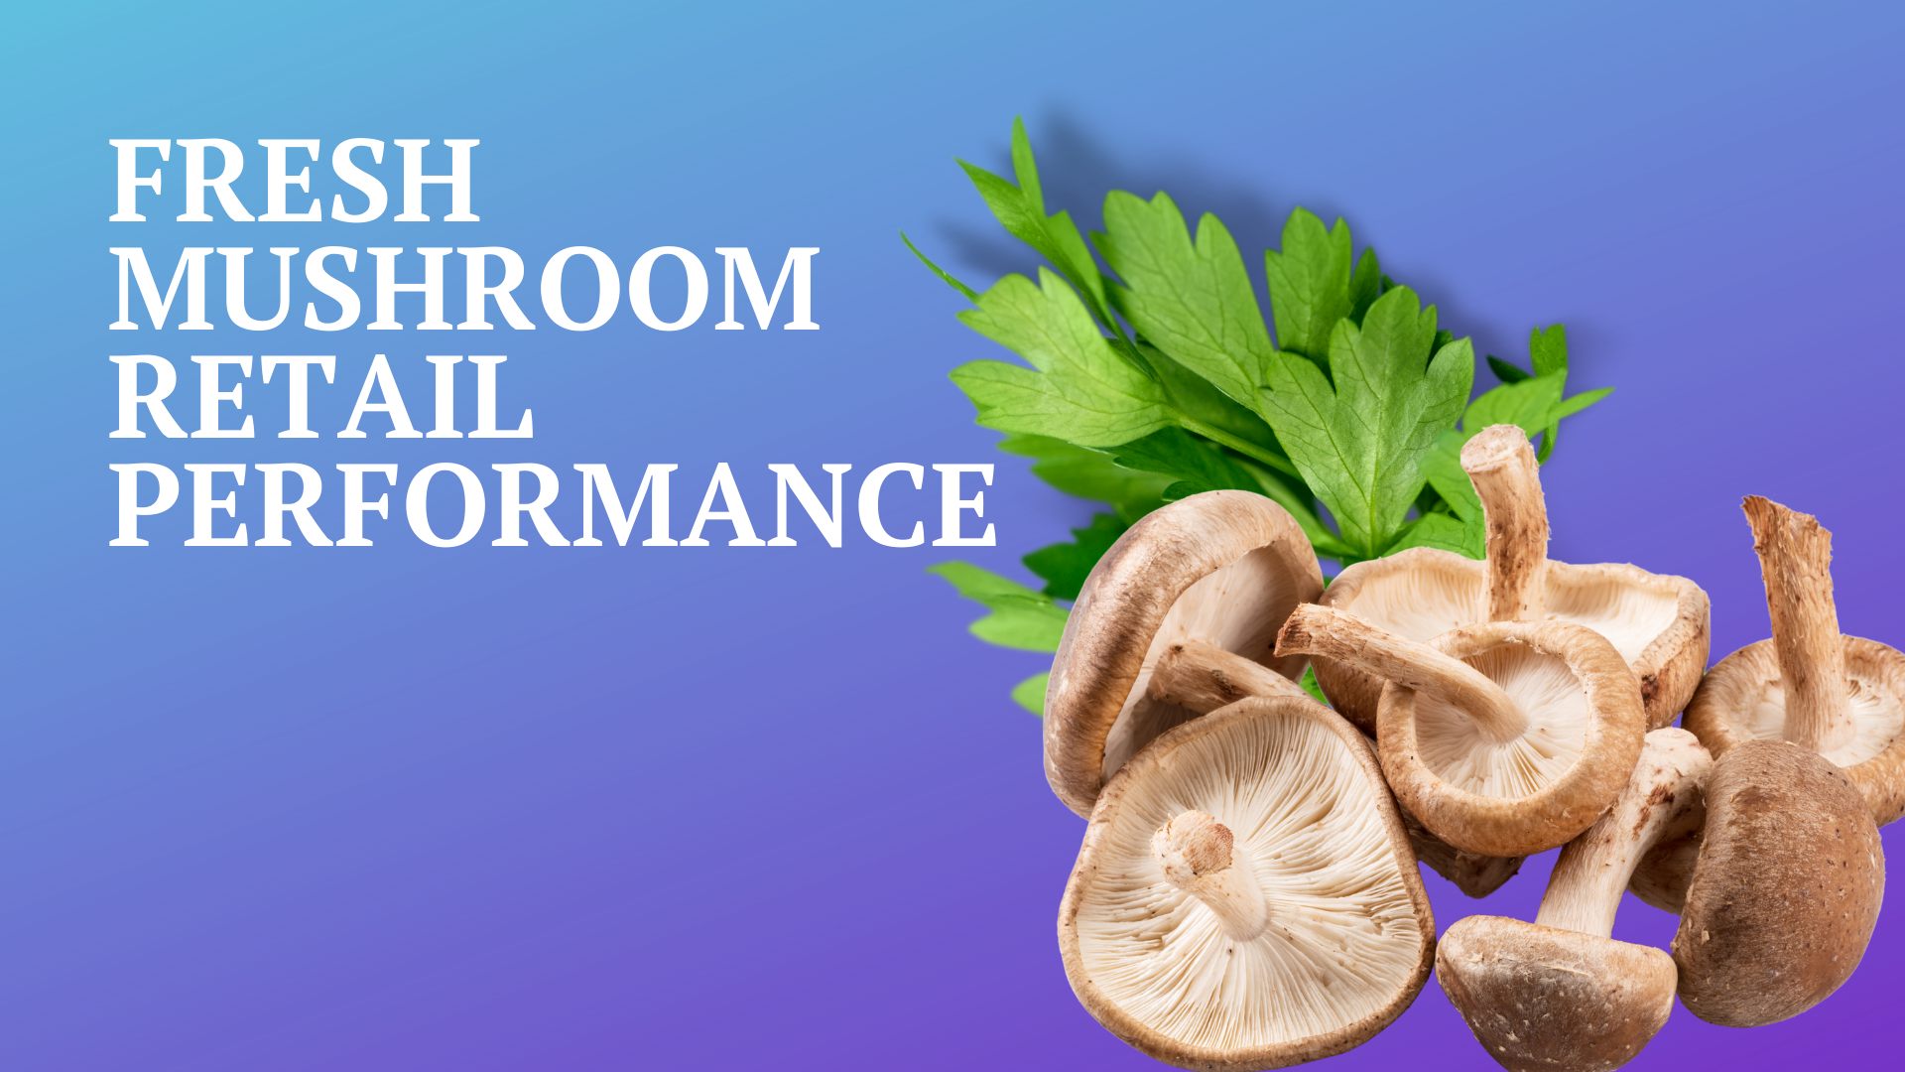

Four weeks ending
March 20, 2022

Slide 2
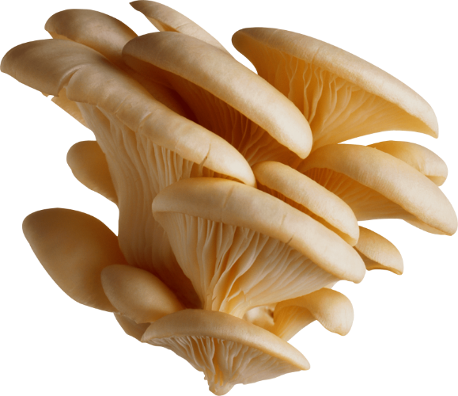
Methodology
The report covers the four weeks ending March 20, 2022 with week endings:
February 27, 2022
March 6, 2022
March 13, 2022
March 20, 2022
Comparisons to year ago (YA) refer to 2021; comparisons to two years ago (2YA) refer to 2020 and 3YA to 2019
Dollar references are the retail value, volume is reflected in pounds
Data is based on the IRI total multi-outlet universe, which includes supermarkets, supercenters, club, commissaries, etc.
It does not include the specialty stores, such as Whole Foods or Sprouts
Source: IRI, Integrated Fresh, MULO, 4 weeks ending 2/20/22

Slide 3
Four-year dollar sales trend Dollar sales fell below YA and 2YA levels as the quad-week period now laps the start of the pandemic in March 2020, but remained well above 2019
Source: IRI, Integrated Fresh, MULO, 4 weeks ending 3/20/22 and year-to-date through 3/20/2022 versus same periods the past four years

Slide 4
Four-year unit sales trend Unit sales were at its lowest point since 2020 in the quad week and below 2019 levels in the year-to-date view
Source: IRI, Integrated Fresh, MULO, 4 weeks ending 3/20/22 and year-to-date through 3/20/2022 versus same periods the past four years

Slide 5
Four-year volume (pound) sales trend Pounds dropped versus year ago, but are up slightly against 2019 levels Volume being steady, but units down points to buying larger pack sizes
Source: IRI, Integrated Fresh, MULO, 4 weeks ending 3/20/22 and year-to-date through 3/20/2022 versus same periods the past four years

Slide 6
Mushroom contribution to the department and category The mushroom share of dollars versus total produce and total vegetables was at a four-year low but mushroom’s below-average inflation plays a big role
4 w.e. 3/20/2022 Mushroom $ share | Share of total produce | Share of total vegetables
2019 | 1.9% | 3.8%
2020 | 1.9% | 3.7%
2021 | 2.0% | 3.9%
2022 | 1.8% | 3.7%
YTD through w.e. 3/20/2022 Mushroom $ share | Share of total produce | Share of total vegetables
2019 | 2.0% | 3.9%
2020 | 2.0% | 3.9%
2021 | 2.1% | 4.0%
2022 | 1.9% | 3.8%
Source: IRI, Integrated Fresh, MULO, 4 weeks ending 3/20/22 and year-to-date sales through w.e. 3/20/22

Slide 7
Mushrooms price per unit YTD Inflation for mushrooms, at +4.3%, was much lower than total produce and total vegetables — which automatically deflates the share
YTD w.e. 3/20/2022 Average price/unit | Total produce | Total vegetables | Mushrooms
2019 | $2.32 | $2.08 | $2.51
2020 | $2.27 | $2.06 | $2.57
2021 | $2.32 | $2.09 | $2.70
2022 | $2.54 | +9.8% | $2.22 | +6.6% | $2.81 | +4.3%
Source: IRI, Integrated Fresh, MULO, 4 weeks ending 3/20/22

Slide 8
Mushroom price per volume (pound) On a pound basis, mushroom inflation was also below average. However, the price per volume is much higher than many other vegetables
YTD w.e. 3/20/2022 Average price/pound | Total produce | Total vegetables | Mushrooms
2019 | $1.68 | $1.79 | $4.09
2020 | $1.65 | $1.77 | $4.19
2021 | $1.72 | $1.82 | $4.27
2022 | $1.89 | +10.0% | $1.92 | +5.7% | $4.48 | +5.0%
Source: IRI, Integrated Fresh, MULO, 4 weeks ending 3/20/22

Slide 9
Price per volume by quarter/month Inflation slowed down slightly in the latest quad weeks
Source: IRI, Integrated Fresh, MULO, 2019-3/20/2022

Slide 10
Price per volume and unit by type
4 w.e. 3/20/2022 | Price per pound | % change vs.’21 | % change vs.’20
Total mushrooms | $4.45 | +4.9% | +6.0%
White mushrooms | $3.93 | +5.2% | +5.1%
Brown mushrooms | $4.78 | +4.3% | +4.7%
Specialty mushrooms | $9.37 | +5.1% | +17.7%
4 w.e. 3/20/2022 | Price per unit | % change vs.’21 | % change vs.’20
Total mushrooms | $2.79 | +3.9% | +7.1%
White mushrooms | $2.55 | +3.6% | +5.4%
Brown mushrooms | $3.02 | +3.9% | +7.4%
Specialty mushrooms | $3.70 | +6.4% | +14.9%
Brown mushrooms include crimini and portabella
Specialty mushrooms include shiitake, oyster, enoki, chanterelle, morel, wood ear, porcini, black forest and other
Source: IRI, Integrated Fresh, MULO, 4 weeks ending 3/20/22

Slide 11
Share of dollars and pounds sold on merchandising In addition to higher prices, less was sold while on promotion
Share of sold on merchandising* | 4 w.e. 3/20/2022 | Change vs. 2021
Share of total fresh mushroom dollars | 14.8% | -4.2%
Share of total fresh mushroom pounds | 17.4% | -4.4%
* Any merchandising, including feature, display, feature & display and temporary price reductions
Source: IRI, Integrated Fresh, MULO, 4 weeks ending 3/20/22

Slide 12

Mushroom dollar, unit, volume sales Year-on-year, mushrooms couldn’t hold the line, but versus 2020 $ and pounds are up
4 w.e. 2/20/2022 dollars
$101.9M
volume (lbs)
22.9M
-4.7%
-8.3%
-9.1%
Dollar growth vs. YA
Unit
growth vs. YA
Volume growth vs. YA
-6.9% vs. ’20
+10.8% vs. ’19
-13.1% vs. ’20
-0.7% vs. ’19
-12.1% vs. ’20
+1.1% vs. ’19
Source: IRI, Integrated Fresh, MULO, 4 weeks ending 2/20/22

Slide 13
Vegetables and mushroom dollar sales vs. YA and 2YA Both mushrooms and vegetables continued to trend above pre-pandemic levels
Source: IRI, Integrated Fresh, MULO, 2019-w.e. 3/20/2022

Slide 14
Vegetables and mushroom pound sales vs. YA and 2YA Both mushrooms and veg experienced lowest volume gain versus two years ago, but still in the plus
Source: IRI, Integrated Fresh, MULO, 2019-w.e. 3/20/2022

Slide 15
Base and incremental sales Volume had a higher share of incremental sales Valentine’s Day week
Source: IRI, Integrated Fresh, MULO, 4 weeks ending 3/20/22

Slide 16
Over indexing versus under indexing regions Under indexing regions are catching up
Use as comparison to understand importance/size of mushrooms
4 w.e. 3/20/2022 | Share of veg. $ | Share of mushrooms $ | $ sales growth vs. YA
Total US | 100.0% | 100.0% | -5.1%
California | 11.4% | 12.3% | -7.8%
Great Lakes | 13.2% | 14.9% | -6.6%
Mid-South | 13.1% | 11.8% | -3.5%
Northeast | 18.2% | 18.0% | -6.3%
Plains | 6.6% | 6.4% | -4.1%
South Central | 8.9% | 7.3% | -3.9%
Southeast | 15.6% | 13.8% | -2.4%
West | 12.9% | 15.4% | -4.8%
WEST
PLAINS
GREAT LAKES
NORTHEAST
MID SOUTH
CALIFORNIA
SOUTHEAST
SOUTH CENTRAL
= Above-average share
= Above-average performance
Source: IRI, Integrated Fresh, MULO, 4 weeks ending 3/20/22 | Total fresh vegetables and total fresh mushrooms

Slide 17
Performance summary whites, browns and exotics In going up against the March 2020
4 weeks ending 3/20/2022 | Dollars | Dollar share | $ sales vs. 2021 | $ sales vs. 2020 | Volume (lbs) | Lbs share | Lbs vs. 2021 | Lbs vs. 2020
Total fresh mushrooms | $101.9M | 100.0% | -4.7% | -6.9% | 22.9M | 100.0% | -9.1% | -12.1%
White mushrooms | $52.8M | 51.8% | -5.6% | -11.2% | 13.4M | 58.7% | -10.2% | -15.5%
Brown mushrooms | $41.2M | 40.4% | -3.0% | -0.9% | 8.6M | 37.6% | -7.0% | -5.3%
Specialty mushrooms | $8.0M | 7.8% | -7.2% | -6.0% | 0.8M | 3.7% | -11.8% | -20.1%
Source: IRI, Integrated Fresh, MULO, 4 weeks ending 3/20/22

Slide 18
White button mushrooms dollar performance
Dollars YTD through 3/20/2022
$165M
Or 51.8% of total
Average price/unit
$2.56
+4.0%
Source: IRI, Integrated Fresh, MULO, 2021 plus 4 weeks ending 3/20/22

Slide 19
White button mushrooms volume performance
Pounds YTD through w.e. 3/20/2022
41.7M
-11.4% vs. YA
Average price/pound
$3.95
+5.0% vs. YA
Source: IRI, Integrated Fresh, MULO, 2021 plus 4 weeks ending 3/20/22

Slide 20
Crimini mushrooms dollar performance
Dollars YTD through w.e. 3/20/2022
$98.4M
-3.7% vs. YA
Average price/unit
$3.05
+5.1% vs. YA
Source: IRI, Integrated Fresh, MULO, 2021 plus 4 weeks ending 3/20/22

Slide 21
Crimini mushrooms volume performance
Pounds YTD through w.e. 2/20/2022
21.5M
-8.3% vs. YA
Average price/pound
$4.57
+5.0% vs. YA
Source: IRI, Integrated Fresh, MULO, 2021 plus 4 weeks ending 3/20/22

Slide 22
Insights by market No overlap in biggest in volume versus fastest growth
Top 5 in pound sales | 4 w.e. 2/20/2022 | Growth vs. YA
Total US | 22,880,112 | -9.1%
New York, YA | 1,133,075 | -14.7%
Los Angeles, CA | 1,023,392 | -10.1%
Baltimore, MD/ Washington DC | 643,394 | -7.9%
Chicago, IL | 616,561 | 3.5%
Miami/Ft. Lauderdale, FL | 488,018 | -9.0%
Top 5 in pound growth | 4 w.e. 2/20/2022 | Growth vs. YA
Total US | 22,880,112 | -9.1%
Chicago, IL | 616,561 | 3.5%
Dallas/Ft. Worth, TX | 476,369 | 2.0%
Louisville, KY | 90,647 | 1.8%
St. Louis, MO | 167,585 | -0.1%
Wichita, KS | 54,587 | -3.7%
Source: IRI, Integrated Fresh, MULO, 4 weeks ending 3/20/22 | Total mushrooms by market

Slide 23
other insights
Packaged (fixed weight) versus random weight
Package-size analysis
Organic versus conventional
Value-added versus whole/uncut
Source: IRI, Integrated Fresh, MULO, 4 weeks ending 2/20/22

Slide 24
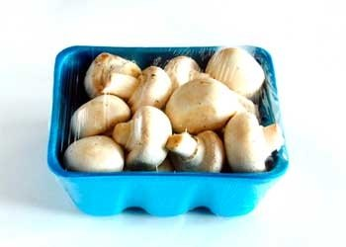
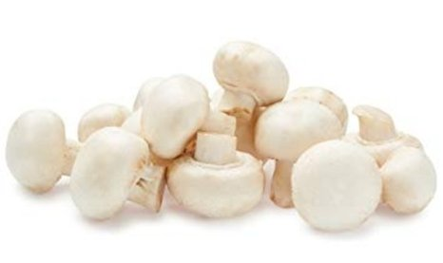
Packaged (fixed weight) versus random weight While both down, fixed weight did better than random weight
4 W.E. 3/20/2022 | Share of total mushroom sales and sales growth %
 | Fixed weight | Random weight
Dollar growth | -3.8% | -16.4%
Share of mushroom $ sales | 95.4% | 4.6%
Volume growth | -8.0% | -30.2%
Share of mushroom lbs sales | 94.7% | 5.3%
Source: IRI, Integrated Fresh, MULO, 4 weeks ending 3/20/22

Slide 25
Package size analysis 8 and 16 ounces drive the bulk of sales; smaller/larger had better growth Please note that package size shifts and RW influence affects YOY
Package size (per UPC) | Dollars | $ vs. YA | $ vs. 2YA | Volume | lbs vs. YA | lbs vs. 2YA
Less than 8 oz | $9.2M | -5.3% | 2.1% | 0.8M | -13.0% | -8.9%
8 oz | $54.2M | -2.5% | -9.9% | 11.5M | -6.1% | -14.7%
More than 8oz; less than 16 oz | $5.7M | -8.3% | -8.3% | 1.3M | -15.8% | -16.3%
16 oz | $18.9M | -5.3% | -5.2% | 5.2M | -11.1% | -11.8%
More than 16 oz | $7.2M | -4.5% | 7.9% | 2.5M | -8.6% | 2.5%
Random weight | $4.2M | -15.8% | -31.3% | 0.8M | -22.4% | -41.4%
Source: IRI, Integrated Fresh, MULO, 4 weeks ending 3/20/22

Slide 26
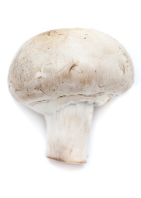
Organic versus conventional mushrooms sales The organic share of mushroom dollar sales reached 12%
4 WE 3/20/2022 | Share of total mushroom sales and sales growth %
Market size
$91.5M
$ growth
-5.2%
Unit growth
-8.6%
Volume growth
-9.7%
Conventional
Market size
$12.4M
$ growth
+0.9%
Unit growth
-2.4%
Volume growth
-3.4%
Organic
9.7%
of pound sales
Source: IRI, Integrated Fresh, MULO, 4 weeks ending 3/20/22 compared with year ago

Slide 27
Organic by type Brown mushrooms had the highest organic share
Dollars 4 w.e. 3/20/22 | Organic $ | % change vs.’21 | Conventional $ | % change vs. 21
Total mushrooms | $12.6M | +0.9% | $86.8M | -5.2%
White mushrooms | $4.5M | -1.0% | $46.8M | -5.5%
Brown mushrooms | $6.3M | -6.2% | $33.9M | -2.3%
Specialty mushrooms | $1.8M | +46.8% | $6.2M | -16.3%
Volume 4 w.e. 3/20/22 | Organic lbs | % change vs.’21 | Conventional lbs | % change vs. 21
Total mushrooms | 2.3M | +0.9% | 19.7M | -14.1%
White mushrooms | 0.9M | -1.0% | 12.0M | -16.8%
Brown mushrooms | 1.2M | -6.2% | 7.1M | -7.2%
Specialty mushrooms | 0.1M | +46.8% | 0.7M | -26.5%
Source: IRI, Integrated Fresh, MULO, 4 weeks ending 3/20/22

Slide 28
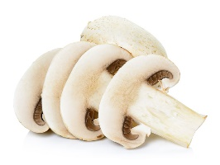
Cut/prepared versus whole mushrooms No preparation (whole) had the better performance
4 w.e. 3/20/2022 | Share of total mushroom sales and sales growth %
Market size
$45.9M
$ growth
-2.4%
Unit growth
-6.9%
Volume growth
-8.6%
No preparation
Market size
$53.4M
$ growth
-6.1%
Unit growth
-8.9%
Volume growth
-9.7%
Cut/prepped
51.4%
of lbs sales
Source: IRI, Integrated Fresh, MULO, 4 weeks ending 3/20/22 compared with year ago

Slide 29
Cut/prepared by type Brown mushrooms represented the largest share, but above-average declines
Dollars 4 w.e. 3/20/22 | Cut/prepared $ | % change vs.’21 | Whole $ | % change vs. 21
Total mushrooms | $53.4M | -6.1% | $45.9M | -2.4%
White mushrooms | $25.9M | -8.5% | $25.4M | -1.5%
Brown mushrooms | $21.7M | -3.1% | $18.4M | -2.7%
Specialty mushrooms | $5.8M | -5.7% | $2.2M | -10.1%
Pounds 4 w.e. 3/20/22 | Cut/prepared lbs | % change vs.’21 | Whole lbs | % change vs. 21
Total mushrooms | 11.3M | -9.7% | 10.8M | -8.6%
White mushrooms | 6.5M | -12.0% | 6.4M | -7.9%
Brown mushrooms | 4.1M | -5.8% | 4.2M | -8.8%
Specialty mushrooms | 0.7M | -7.6% | 0.2M | -22.8%
Source: IRI, Integrated Fresh, MULO, 4 weeks ending 3/20/22

