Slide 1
Four weeks ending
January 23, 2022
Prepared January 2022

Slide 2
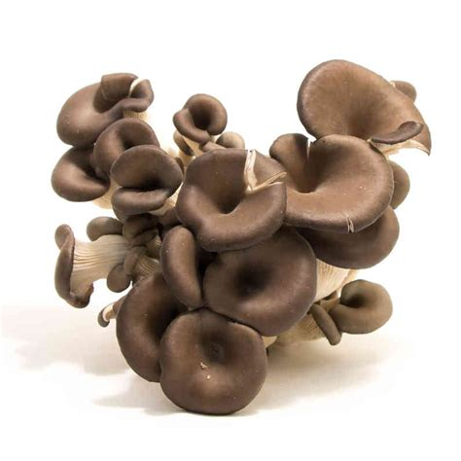
Methodology
All references to January 2022 include the four weeks ending January 23, 2022
January 2, 2022
January 9, 2022
January 16, 2022
January 23, 2022
Comparisons to year ago (YA) refer to 2021
Comparisons to two years ago (2YA) refer to 2020 and 3YA to 2019
Dollar references are the retail value, volume is reflected in pounds
Data is based on the IRI total multi-outlet universe, which includes supermarkets, supercenters, club, commissaries, etc.
It does not include the specialty stores, such as Whole Foods or Sprouts
Source: IRI, Integrated Fresh, MULO, 4 weeks ending 1/23/2022

Slide 3
Four-year January dollar sales trend Dollar sales fell below January 2021 levels, but remained well above 2019-2020
Source: IRI, Integrated Fresh, MULO, 4 weeks ending 1/23/2022

Slide 4
Four-year January unit sales trend Unit sales was at its lowest point since 2019, down about 1 million units versus pre-pandemic
Source: IRI, Integrated Fresh, MULO, 4 weeks ending 1/23/2022

Slide 5
Four-year January volume (pound) sales trend Volume dropped versus year ago, but sat right around 2019-2020 levels Volume being steady, but units down points to buying larger pack sizes
Source: IRI, Integrated Fresh, MULO, 4 weeks ending 1/23/2022

Slide 6
Mushroom contribution to the department and category Mushrooms make up a smaller share of dollars to total produce, vegetables and cooking vegetables but inflation plays a big role
January Mushroom $ share | Share of total produce | Share of total vegetables | Share of cooking vegetables
January 2019 | 2.1% | 4.0% | 22.9%
January 2020 | 2.1% | 4.1% | 23.4%
January 2021 | 2.2% | 4.2% | 23.3%
January 2022 | 2.0% | 3.9% | 21.8%
Source: IRI, Integrated Fresh, MULO, 4 weeks ending 1/23/2022

Slide 7
Mushrooms price per unit Inflation for mushrooms, at +4.7% in January 2021, trended below total produce and total vegetables
January average price/unit | Total produce | Total vegetables | Mushrooms
January 2019 | $2.32 | $2.08 | $2.50
January 2020 | $2.25 | $2.05 | $2.55
January 2021 | $2.29 | $2.09 | $2.71
January 2022 | $2.49 | +9.0% | $2.21 | +5.6% | $2.83 | +4.7%
Source: IRI, Integrated Fresh, MULO, 4 weeks ending 1/23/2022

Slide 8
Mushroom price per volume (pound) On a pound basis, mushroom inflation tracked above total vegetables in January 2022
January average price/pound | Total produce | Total vegetables | Mushrooms
January 2019 | $1.69 | $1.78 | $4.07
January 2020 | $1.66 | $1.77 | $4.18
January 2021 | $1.71 | $1.81 | $4.29
January 2022 | $1.86| +8.9% | $1.89 | +4.8% | $4.52 | +5.3%
Source: IRI, Integrated Fresh, MULO, 4 weeks ending 1/23/2022

Slide 9
Price per volume by quarter/month Inflation accelerated in January
Source: IRI, Integrated Fresh, MULO, 2019-January 2022

Slide 10
Price per volume by type
January 2022 | Price per pound | % change vs.’21 | % change vs.’20
Total mushrooms | $4.52 | +5.3% | +8.1%
White button | $3.98 | +5.4% | +7.9%
Cremini/brown | $4.60 | +5.0% | +5.0%
Portabella | $5.95 | +4.7% | +10.2%
Shiitake | $15.57 | +13.1% | +15.6%
Other | $5.76 | -3.2% | +6.7%
Oyster | $12.30 | +5.8% | +17.8%
Enoki | $16.94 | +62.0% | +58.2%
Chanterelle | $30.95 | +133.3% | +14.3%
Morel | $33.14 | +15.5% | +40.3%
Wood ear | $10.84 | -3.7% | +0.4%
Porcini | $42.61 | -8.8% | +3.7%
Black forest | $10.35 | +82.0% | +172.9%
Source: IRI, Integrated Fresh, MULO, 4 weeks ending 1/23/2022

Slide 11
Price per unit by type
January 2022 | Price per pound | % change vs.’21 | % change vs.’20
Total mushrooms | $2.83 | +4.7% | +11.1%
White button | $2.59 | +4.9% | +10.7%
Cremini/brown | $3.06 | +4.8% | +10.2%
Portabella | $3.04 | +2.0% | +7.7%
Shiitake | $4.76 | +6.7% | +10.9%
Other | $2.76 | +1.7% | +11.1%
Oyster | $3.69 | +1.5% | +6.3%
Enoki | $4.71 | +33.4% | +58.3%
Chanterelle | $10.65 | +161.8% | +9.0%
Morel | $20.37 | +39.2% | +81.0%
Wood ear | $4.86 | +0.3% | +9.5%
Porcini | $17.69 | -13.2% | +38.9%
Black forest | $13.22 | +10.9% | +62.9%
Source: IRI, Integrated Fresh, MULO, 4 weeks ending 1/23/2022

Slide 12
Share of dollars and pounds sold on merchandising In addition to higher prices, less was sold while on promotion
Share of sold on merchandising* | January 2022 | Change vs. 2021 | Change vs. 2020
Share of total fresh mushroom dollars | 11.0% | -25.7% | -48.5%
Share of total fresh mushroom pounds | 17.1% | -25.0% | -27.0%
* Any merchandising, including feature, display, feature & display and temporary price reductions
Source: IRI, Integrated Fresh, MULO, 4 weeks ending 1/23/2022

Slide 13
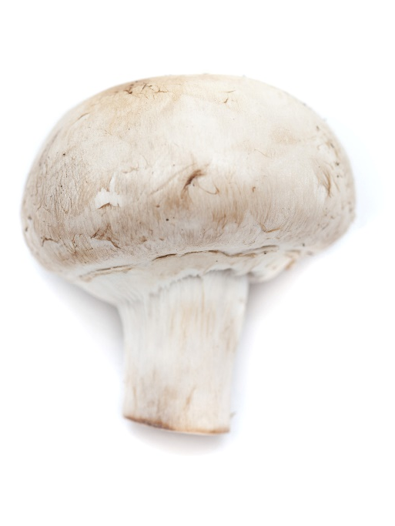
Mushroom dollar, unit, volume sales for January Year-on-year, mushrooms couldn’t hold the line, but versus 2020 $ and pounds are up
January dollars
$110.8M
January volume (lbs)
24.5M
-6.3%
-10.5%
-11.0%
Dollar growth vs. YA
Unit
growth vs. YA
Volume growth vs. YA
+8.3% vs. ’20
+9.8% vs. ’19
-2.5% vs. ’20
-3.3% vs. ’19
+0.2% vs. ’20
-1.1% vs. ’19
Source: IRI, Integrated Fresh, MULO, 4 weeks ending 1/23/2022

Slide 14
Vegetables and mushroom dollar sales 2019-January 2022 Both mushrooms and vegetables continued to trend above pre-pandemic levels
Source: IRI, Integrated Fresh, MULO, 2019-January 2022

Slide 15
Vegetables and mushroom pound sales 2019-January 2022 Both mushrooms and veg experienced lowest volume gain versus two years ago, but still in the plus
Source: IRI, Integrated Fresh, MULO, 2019-January 2022

Slide 16
Base and incremental sales Base drove mushroom dollars and volume each of the weeks
Source: IRI, Integrated Fresh, MULO, 4 weeks ending 1/23/2022

Slide 17
Over indexing versus under indexing regions Under indexing regions are catching up
Use as comparison to understand importance/size of mushrooms
January | Share of veg. $ | Share of mushrooms $ | $ sales growth vs. YA
Total US | 100.0% | 100.0% | -6.3%
California | 11.7% | 12.6% | -10.1%
Great Lakes | 13.1% | 15.0% | -8.5%
Mid-South | 13.3% | 12.0% | -1.5%
Northeast | 18.2% | 18.6% | -4.6%
Plains | 6.6% | 6.4% | -6.4%
South Central | 9.0% | 6.8% | -6.5%
Southeast | 15.6% | 13.6% | -3.7%
West | 12.6% | 15.0% | -8.8%
WEST
PLAINS
GREAT LAKES
NORTHEAST
MID SOUTH
CALIFORNIA
SOUTHEAST
SOUTH CENTRAL
= Above-average share
= Above-average performance
Source: IRI, Integrated Fresh, MULO, 4 weeks ending 1/23/2022 | Total fresh vegetables and total fresh mushrooms

Slide 18
Performance summary whites, browns and exotics Brown mushrooms were the top performers
 | Dollars | Vs. 2021 | Vs. 2020 | Volume | Vs. 2021 | Vs. 2020
Fresh mushrooms | $110.8M | -6.3% | +8.3% | 24.5M | -11.0% | +0.2%
White mushrooms | $57.2M | -7.5% | +3.3% | 14.4M | -12.0% | -4.3%
Brown mushrooms | $44.8M | -4.5% | +15.4% | 9.2M | -9.0% | +9.3%
Exotic mushrooms | $8.8M | -7.7% | +8.2% | 0.9M | -11.6% | -9.4%
Source: IRI, Integrated Fresh, MULO, 4 weeks ending 1/23/2022

Slide 19
Dollar performance by type
Dollars | January 2022 | % change vs.’21 | % change vs.’20
Total mushrooms | $110,752,526 | -6.3% | +8.3%
White button | $57,207,677 | -7.5% | +3.3%
Cremini/brown | $34,294,216 | -4.5% | +18.6%
Portabella | $10,477,922 | -4.2% | +6.1%
Shiitake | $5,035,359 | -3.6% | +28.3%
Other | $3,133,470 | -10.7% | -12.4%
Oyster | $541,452 | -16.2% | +5.6%
Enoki | $30,369 | 0.0% | -46.1%
Chanterelle | $22,286 | -72.8% | +1.3%
Morel | $5,532 | +18.1% | +27.1%
Wood ear | $2,656 | -28.4% | -44.9%
Porcini | $1,097 | -53.4% | -73.3%
Black forest | $490 | -38.4% | +29.2%
Source: IRI, Integrated Fresh, MULO, 4 weeks ending 1/23/2022

Slide 20
Volume performance by type
Pounds | January 2022 | % change vs.’21 | % change vs.’20
Total mushrooms | 24,498,091 | -11.0% | +0.2%
White button | 14,364,026 | -12.2% | -4.3%
Cremini/brown | 7,458,310 | -9.1% | +12.9%
Portabella | 1,761,003 | -8.6% | -3.7%
Shiitake | 323,310 | -14.8% | +10.9%
Other | 544,431 | -7.8% | -17.9%
Oyster | 44,013 | -20.8% | -10.3%
Enoki | 1,793 | -38.3% | -65.9%
Chanterelle | 720 | -88.4% | -11.3%
Morel | 167 | +2.2% | -9.4%
Wood ear | 245 | -25.7% | -45.2%
Porcini | 26 | -48.9% | -74.3%
Black forest | 47 | -66.2% | -52.7%
Source: IRI, Integrated Fresh, MULO, 4 weeks ending 1/23/2022

Slide 21
White button mushrooms dollar performance
Dollars January 2022
$57.2M
Or 51.7% of total
Average price/unit
$2.59
+4.9%
Source: IRI, Integrated Fresh, MULO, 2021 plus 4 weeks ending 1/23/2022

Slide 22
White button mushrooms volume performance
Pounds January 2022
14.4M
Or 58.6% of total
Average price/pound
$3.98
+5.4%
Source: IRI, Integrated Fresh, MULO, 2021 plus 4 weeks ending 1/23/2022

Slide 23
Brown/cremini mushrooms dollar performance
Dollars January 2022
$34.3M
31.0% of mushroom $
Average price/unit
$3.06
+4.8%
Source: IRI, Integrated Fresh, MULO, 2021 plus 4 weeks ending 1/23/2022

Slide 24
Brown/cremini mushrooms 2021 volume performance
Pounds January 2022
7.5M
30.4% of mushroom lbs
Average price/pound
$4.60
+5.0%
Source: IRI, Integrated Fresh, MULO, 2021 plus 4 weeks ending 1/23/2022

Slide 25
Insights by market No overlap in biggest in volume versus fastest growth
Top 5 in pound sales | January sales | January growth vs. YA
Total US | 24,498,091 | -11.0%
New York, YA | 1,242,909 | -13.3%
Los Angeles, CA | 1,130,254 | -12.1%
Baltimore, MD/ Washington DC | 724,179 | -6.3%
Chicago, IL | 621,712 | -10.2%
Philadelphia, PA | 542,051 | -13.2%
Top 5 in pound growth | January sales | January growth vs. YA
Total US | 24,498,091 | -11.0%
St. Louis, MO | 188,928 | -0.7%
Louisville, KY | 95,184 | -1.9%
Dallas/Ft. Worth, TX | 506,845 | -4.0%
Nashville, TN | 168,974 | -4.6%
New Orleans, LA/ Mobile, AL | 210,923 | -5.1%
Source: IRI, Integrated Fresh, MULO, 4 weeks ending 1/23/2022 | Total mushrooms by market

Slide 26
other insights
Packaged (fixed weight) made up the bulk of sales and performed better
8-ounce and 16-ounce represented largest share of sales
Organic performed slightly better than conventional and its share continued to grow
Value-added performed slightly better than non-cut and its share bounced back some
Source: IRI, Integrated Fresh, MULO, 4 weeks ending 1/23/2022

Slide 27
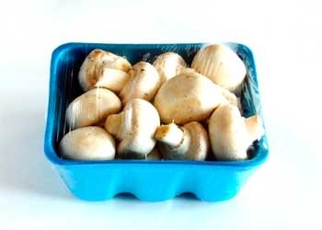
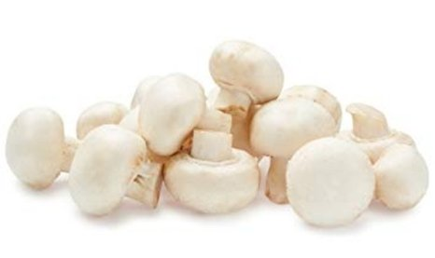
Packaged (fixed weight) versus random weight While both down, fixed weight did better than random weight in January 2022
January 2022 | Share of total mushroom sales and sales growth %
 | Fixed weight | Random weight
Dollar growth | -4.9% | -18.5%
Share of mushroom $ sales | 95.5% | 4.5%
Volume growth | -9.3% | -30.4%
Share of mushroom lbs sales | 96.1% | 3.9%
Source: IRI, Integrated Fresh, MULO, 4 weeks ending 1/23/2022

Slide 28
Package size analysis 8 and 16 ounces drive the bulk of sales; smaller/larger had better growth Please note that package size shifts and RW influence affects YOY
Package size (per UPC) | Dollars | $ vs. YA | Volume | lbs vs. YA | lbs vs. 2YA
Less than 8 oz | $10,244,566 | -5.2% | 865,578 | -12.7% | -4.7%
8 oz | $58,503,248 | -5.6% | 12,209,162 | -9.1% | 5.7%
More than 8oz; less than 16 oz | $6,889,361 | -5.0% | 1,489,775 | -21.2% | 1.3%
16 oz | $20,765,503 | -3.9% | 5,739,768 | -9.1% | -5.8%
More than 16 oz | $8,006,915 | -2.4% | 2,723,335 | -6.4% | -34.7%
Random weight | $4,460,057 | -17.7% | 839,187 | -30.4% | 35.0%
Source: IRI, Integrated Fresh, MULO, 4 weeks ending 1/23/2022

Slide 29
Organic versus conventional mushrooms sales Organic had the slightly better performance, but off a smaller base
January 2022 | Share of total mushroom sales and sales growth %
Market size
$94.1M
$ growth
-6.7%
Unit growth
-10.8%
Volume growth
-11.0%
Conventional
Market size
$14.7M
$ growth
+2.4%
Unit growth
-2.7%
Volume growth
-4.3%
Organic
10.8%
of pound sales
Source: IRI, Integrated Fresh, MULO, 4 weeks ending 1/23/2022

Slide 30
Organic by type Cremini/brown mushrooms had the highest organic share and best performance
Dollars | Organic $ | % change vs.’21 | Conventional $ | % change vs. 21
Total mushrooms | $14.7M | +2.4% | $94.1M | -6.7%
Cremini/brown | $5.7M | +3.7% | $27.9M | -5.3%
White button | $5.2M | -7.7% | $50.8M | -6.5%
Portabella | $1.8M | -6.0% | $8.7M | -2.9%
Volume | Organic lbs | % change vs.’21 | Conventional lbs | % change vs. 21
Total mushrooms | 2.6M | -4.3% | 21.3M | -11.0%
Cremini/brown | 1.2M | +0.1% | 6.1M | -10.0%
White button | 1.0M | -11.5% | 12.9M | -11.5%
Portabella | 0.2M | -10.0% | 1.5M | -7.6%
Source: IRI, Integrated Fresh, MULO, 4 weeks ending 1/23/2022

Slide 31
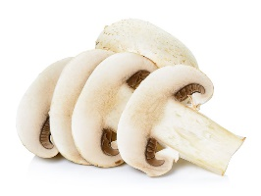
Cut/prepared versus whole mushrooms No preparation had the better performance in January 2022
January 2022 | Share of total mushroom sales and sales growth %
Market size
$50.9M
$ growth
-3.2%
Unit growth
-7.9%
Volume growth
-8.3%
No preparation
Market size
$58.0M
$ growth
-7.5%
Unit growth
-11.6%
Volume growth
-11.3%
Cut
50.6%
of lbs sales
Source: IRI, Integrated Fresh, MULO, 4 weeks ending 1/23/2022

Slide 32
Cut/prepared by type White button mushrooms represented nearly half of cut/prepared share
Dollars | Cut/prepared $ | % change vs.’20 | Whole $ | % change vs. 20
Total mushrooms | $58.0M | -7.5% | $50.9M | -3.2%
White button | $28.0M | -9.9% | $28.0M | -3.1%
Cremini/brown | $15.6M | -5.6% | $18.0M | -2.2%
Portabella | $8.1M | -2.8% | $2.3M | -5.5%
Pounds | Cut/prepared lbs | % change vs.’20 | Whole lbs | % change vs. 20
Total mushrooms | 12.1M | -11.3% | 11.8M | -9.3%
White button | 7.0M | -13.1% | 6.9M | -9.9%
Cremini/brown | 3.0M | -9.8% | 4.3M | -7.5%
Portabella | 1.4M | -6.2% | 0.4M | -13.2%
Source: IRI, Integrated Fresh, MULO, 4 weeks ending 1/23/2022

Slide 33
Cut/prepared by type Sliced is, by far, the biggest type
Row Labels | Dollars | $ vs. YA | Volume (lbs) | Volume versus YA
Sliced | $47,508,322 | -7.8% | 10,384,203 | -11.7%
Whole | $46,103,183 | -1.7% | 10,714,957 | -6.9%
Fresh | $4,884,858 | -18.6% | 921,287 | -30.4%
Baby | $3,144,877 | -10.8% | 616,697 | -17.7%
Caps | $2,381,183 | -8.0% | 301,422 | -12.1%
Baby sliced | $2,036,954 | 20.5% | 395,288 | 23.8%
Jumbo whole | $831,001 | -4.6% | 232,742 | -6.9%
Stuffed | $724,351 | 17.1% | 104,829 | 19.7%
Assorted form | $316,412 | 21.7% | 42,914 | 10.1%
Not stated on package | $281,673 | -35.7% | 51,657 | -46.8%
Stuffing | $254,329 | -9.9% | 36,656 | -26.2%
Steak cut | $159,276 | 63.3% | 23,910 | 55.6%
Petite | $78,637 | -63.4% | 14,650 | -62.7%
Stuffer | $72,575 | -41.5% | 13,188 | -34.8%
Slider | $53,228 | -7.6% | 8,901 | -7.6%
Jumbo | $20,449 | 21.5% | 1,516 | 7.9%
Source: IRI, Integrated Fresh, MULO, 4 weeks ending 1/23/2022

