Slide 1
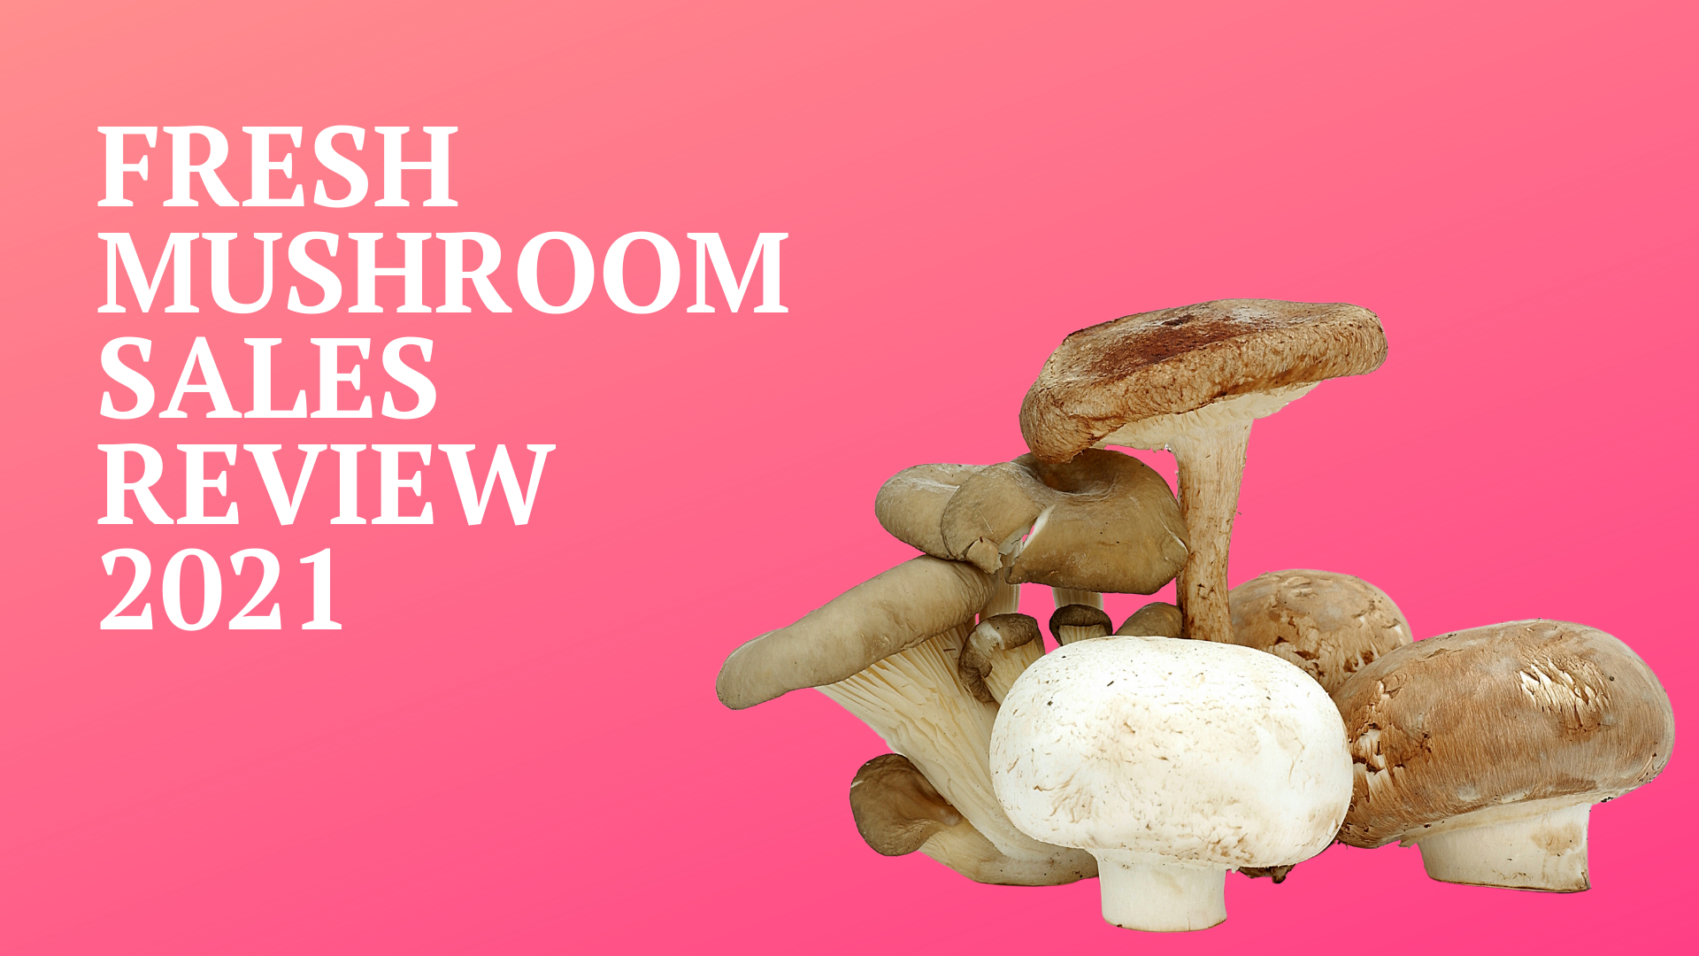

Prepared January 2022

Slide 2
Five-year trend shows second-best year since 2016 For both dollars and pound sales
Source: IRI, Integrated Fresh, MULO, 52 weeks ending 12/26/2021

Slide 3
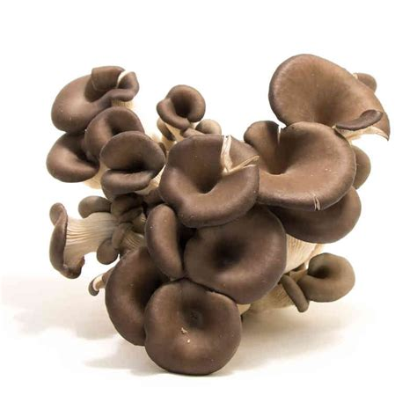
Mushrooms jumped to 7th largest within vegetables Success in salad kits/lettuce points to alignment opportunity with mushrooms
2021 | Dollar sales | Change vs. YA | Change vs. 2YA
Total fresh vegetables | $35.4B | -1.3% | +13.3%
Tomatoes | $3.9B | -2.9% | +15.0%
Potatoes | $3.3B | -7.3% | +12.2%
Salad kits | $3.2B | +11.5% | +27.9%
Lettuce | $2.7B | +1.9% | +14.2%
Peppers | $2.5B | -0.6% | +18.6%
Onions | $2.4B | -3.6% | +10.3%
Mushrooms | $1.3B | -5.1% | +13.6%
Source: IRI, Integrated Fresh, MULO, 52 weeks ending 12/26/2021

Slide 4
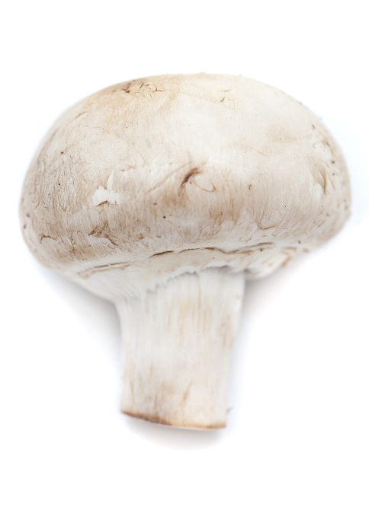

YOY, fresh mushroom sales couldn’t hold the line But all metrics look strong against 2019 and vegetable sales were down 1.3% also
Dollars
$1.317B
Volume (lbs)
306M
-5.1%
-7.7%
-6.8%
Dollar growth vs. YA
Unit
growth vs. YA
Volume growth vs. YA
+13.6%
Vs. ‘19
+6.0%
Vs. ‘19
+8.7%
Vs. ‘19
Source: IRI, Integrated Fresh, MULO, 52 weeks ending 12/26/2021

Slide 5
2020’s Q2 and Q3 were too tough to beat Mushroom’s performance trended far above total vegetables all of 2020
Source: IRI, Integrated Fresh, MULO, 52 weeks ending 12/26/2021

Slide 6
Mushroom volume growth outpaced vegetables For most of 2020 and Q1-Q3 in 2021. The lower inflation prompted lower $ increases
Source: IRI, Integrated Fresh, MULO, 52 weeks ending 12/26/2021

Slide 7




Fresh mushroom household engagement Unable to hold onto its 2020 growth in households and purchase frequency
Mushroom shopping trends 2021
HH penetration
Trips/yr
Spend/trip
Spend/buyer
46.5%
-1.7%
5.7x
-4.5%
$2.99
+1.4%
$17.05
-3.1%
Source: IRI, Integrated Fresh, MULO, 52 weeks ending 12/26/2021

Slide 8

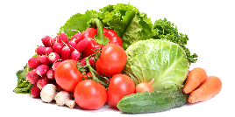
Opportunity in trip conversion Every one in seven trips includes a mushroom purchase
Vegetable vs. mushroom shopping trends 2021
HH penetration
Trips/yr
Spend/trip
Spend/buyer
46.5%
98.3%
5.7x
30.2x
$2.99
$5.98
$17
$180
Source: IRI, Integrated Fresh, MULO, 52 weeks ending 12/26/2021

Slide 9
Week-by-week sales shows holiday strength Mushroom sales do not have huge seasonality but definitely see holiday spikes
Week
Source: IRI, Integrated Fresh, MULO, 52 weeks ending 12/26/2021

Slide 10
Over indexing versus under indexing regions Above-average share and growth in the West
Use as comparison to understand importance/size of mushrooms
 | Share of food | Share of mushrooms $ | $ sales growth vs. YA
Total US | 100.0% | 100.0% | -5.1%
California | 9.9% | 12.6% | -7.2%
Great Lakes | 14.0% | 15.2% | -4.7%
Mid-South | 13.4% | 11.5% | -4.3%
Northeast | 16.6% | 18.4% | -5.7%
Plains | 6.7% | 6.4% | -6.0%
South Central | 12.0% | 7.3% | -5.1%
Southeast | 16.0% | 13.4% | -4.6%
West | 11.5% | 15.3% | -3.7%
WEST
PLAINS
GREAT LAKES
NORTHEAST
MID SOUTH
CALIFORNIA
SOUTHEAST
SOUTH CENTRAL
= Above-average share
= Above-average performance
Source: IRI, Integrated Fresh, MULO, 52 weeks ending 12/26/2021

Slide 11
Mushroom retail inflation was far below average Though up above-average in 2019 and 2020
Average price/pound | Total produce | Total vegetables | Mushrooms
2019 | $1.57 | +1.4% | $1.70 | +2.2% | $4.13 | +2.3%
2020 | $1.57 | +0.3% | $1.71 | +0.6% | $4.23 | +2.6%
2021 | $1.68 | +7.1% | $1.79 | +4.6% | $4.31 | +1.9%
Source: IRI, Integrated Fresh, MULO, 52 weeks ending 12/26/2021

Slide 12
Mushrooms remain an above-average per unit ring Though below average per unit inflation in 2021
Average price/unit | Total produce | Total vegetables | Mushrooms
2019 | $2.28 | +0.1% | $2.01 | +2.0% | $2.54 | +2.5%
2020 | $2.28 | -0.1% | $2.05 | +1.7% | $2.65 | +4.3%
2021 | $2.39 | 4.8% | $2.09 | +2.4% | $2.73 | +2.8%
Source: IRI, Integrated Fresh, MULO, 52 weeks ending 12/26/2021

Slide 13
Prices did start to rise come Q3-Q4 And ended the year $0.27 above the 2019 level
Source: IRI, Integrated Fresh, MULO, 52 weeks ending 12/26/2021

Slide 14
Additionally, fewer dollars and pounds were sold on promotion in 2020 and 2021
Share of sold on merchandising* | 2021 | Change vs. 2020 | Change vs. 2019
Share of total fresh mushroom dollars | 15.1% | -4.4% | -32.9%
Share of total fresh mushroom pounds | 17.5% | -4.9% | -31.7%
* Any merchandising, including feature, display, feature & display and temporary price reductions
Source: IRI, Integrated Fresh, MULO, 52 weeks ending 12/26/2021

Slide 15
Dollar performance by type
 | 2021 | % change vs.’20 | % change vs.’19
Total mushrooms | $1.3B | -5.1% | +13.6%
White button | $690.9M | -7.5% | +5.3%
Crimini/brown | $393.5M | -1.8% | +26.5%
Portabella | $132.6M | -3.0% | +10.2%
Shiitake | $54.5M | +3.9% | +42.0%
Other | $37.5M | -15.7% | +32.9%
Oyster | $7.3M | +10.9% | +41.5%
Chanterelle | $827K | +46.3% | +189.0%
Enoki | $369K | -24.3% | -30.0%
Morel | $171K | +16.2% | -18.7%
Wood ear | $34K | -35.4% | -32.9%
Porcini | $25K | -48.9% | -64.1%
Black forest | $8K | +14.4% | +45.3%
Source: IRI, Integrated Fresh, MULO, 52 weeks ending 12/26/2021

Slide 16
Volume performance by type
 | 2021 | % change vs.’20 | % change vs.’19
Total mushrooms | 305.7M | -6.8% | +8.7%
White button | 181.8M | -8.6% | +1.6%
Crimini/brown | 89.3M | -2.9% | +25.4%
Portabella | 23.4M | -5.0% | +3.0%
Shiitake | 3.8M | +0.8% | +31.3%
Other | 6.6M | -18.5% | +41.7%
Oyster | 647K | +8.2% | +23.3%
Chanterelle | 59K | +69.5% | +308.9%
Enoki | 32K | -63.5% | -39.3%
Morel | 5K | +15.3% | -14.5%
Wood ear | 3K | -40.6% | -36.3%
Porcini | 0.5K | -51.1% | -65.0%
Black forest | 1K | -16.4% | +18.2%
Source: IRI, Integrated Fresh, MULO, 52 weeks ending 12/26/2021

Slide 17
White button mushrooms 2021 dollar performance
Dollars 2021
$691M
Or 52.4% of total
Average price/unit
$2.50
+2.1%
Source: IRI, Integrated Fresh, MULO, 52 weeks ending 12/26/2021

Slide 18
White button mushrooms 2021 volume performance
Pounds 2021
182M
Or 59.5% of total
Average price/pound
$3.80
+1.6%
Source: IRI, Integrated Fresh, MULO, 52 weeks ending 12/26/2021

Slide 19
Brown/Crimini mushrooms 2021 dollar performance
Dollars 2021
$393M
-1.8%
Average price/unit
$2.94
+3.7%
Source: IRI, Integrated Fresh, MULO, 52 weeks ending 12/26/2021

Slide 20
Brown/Crimini mushrooms 2021 volume performance
Pounds 2021
89M
-2.9%
Average price/pound
$4.41
+1.1%
Source: IRI, Integrated Fresh, MULO, 52 weeks ending 12/26/2021

Slide 21
White button versus brown/crimini share of total But could not maintain the 2020 levels
% of total $ sales 2021 | Share of regular white button | Share of brown/Crimini
Total US | 52.4% | 29.9%
California | 52.2% | 32.8%
Great Lakes | 55.2% | 29.1%
Mid-South | 48.8% | 32.4%
Northeast | 47.9% | 29.9%
Plains | 49.4% | 34.3%
South Central | 57.6% | 27.5%
Southeast | 57.2% | 20.2%
West | 52.7% | 33.9%
WEST
PLAINS
GREAT LAKES
NORTHEAST
MID SOUTH
CALIFORNIA
SOUTHEAST
SOUTH CENTRAL
= Above-average share
Source: IRI, Integrated Fresh, MULO, 52 weeks ending 12/26/2021

Slide 22
The market is shifting toward brown/crimini Though white button remain the largest seller
Share of total mushrooms $ | Regular white button | Brown/ Crimini
2016 | 62.3% | 22.4%
2017 | 60.3% | 23.5%
2018 | 58.6% | 24.8%
2019 | 56.5% | 26.8%
2020 | 53.7% | 28.9%
2021 | 52.4% | 29.9%
Share of total mushrooms lbs | Regular white button | Brown/ Crimini
2016 | 68.7% | 20.6%
2017 | 67.2% | 21.6%
2018 | 65.8% | 23.0%
2019 | 63.7% | 25.3%
2020 | 60.6% | 28.0%
2021 | 59.5% | 29.2%
Source: IRI, Integrated Fresh, MULO, 52 weeks ending 12/26/2021

Slide 23
other insights
Packaged (fixed weight) made up the bulk of sales and performed better
8-ounce and 16-ounce represented largest share of sales
Organic performed slightly better than conventional and its share continued to grow
Value-added performed slightly better than non-cut and its share bounced back some
Source: IRI, Integrated Fresh, MULO, 52 weeks ending 12/26/2021

Slide 24
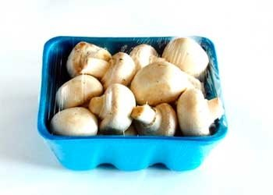
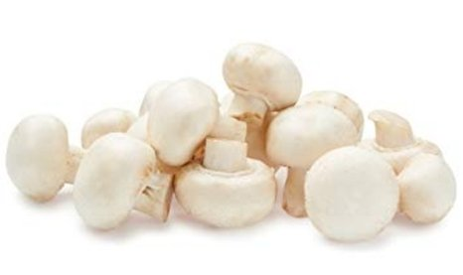
Packaged (fixed weight) versus random weight FW also outperformed RW for total produce, total veg and total cooking veg
2021 | Share of total mushroom sales and sales growth %
 | Fixed weight | Random weight
Dollar growth | -5.6% | -12.4%
Share of mushroom $ sales | 94.8% | 5.2%
Volume growth | -7.3% | -20.2%
Share of mushroom lbs sales | 95.3% | 4.7%
Source: IRI, Integrated Fresh, MULO, 52 weeks ending 12/26/2021

Slide 25
Package size analysis 8 and 16 ounces drive the bulk of sales; smaller/larger had better growth
Package size (per UPC) | Dollars | % vs YA | Pounds | % vs YA | Units | % vs YA
Less than 8 oz | $117M | +1.6% | 10M | -0.7% | 33M | -0.4%
8 oz | $685M | -8.8% | 149M | -11.0% | 297M | -10.5%
More than 8oz; less than 16 oz | $79M | -6.2% | 18M | -9.2% | 27M | -6.3%
16 oz | $249M | -2.7% | 72M | -4.4% | 72M | -4.4%
More than 16 oz | $94M | +2.8% | 33M | +1.2% | 22M | +1.2%
Random weight | $61M | -12.4% | 12M | -20.2% | 23M | -15.4%
Source: IRI, Integrated Fresh, MULO, 52 weeks ending 12/26/2021

Slide 26

Organic versus conventional mushrooms Organic had the slightly better performance, but off a smaller base
2021 | Share of total mushroom sales and sales growth %
Market size
$1.1B
$ growth
-6.1%
Unit growth
-8.5%
Volume growth
-8.0%
Conventional
Market size
$159M
$ growth
-5.4%
Unit growth
-8.2%
Volume growth
-8.0%
Organic
12.4%
of $ sales
Source: IRI, Integrated Fresh, MULO, 52 weeks ending 12/26/2021

Slide 27
Crimini by type Crimini/brown mushrooms had the highest dollar and volume shares
Dollars | Organic $ | % change vs.’20 | Conventional$ | % change vs. 20
Total mushrooms | $159M | -5.4% | $1.1B | -6.1%
Crimini/brown | $61M | -3.8% | $322M | -3.0%
White button | $58M | -12.4% | $612M | -8.0%
Portabella | $21M | -14.0% | $110M | -1.1%
Volume | Organic lbs | % change vs.’20 | Conventional lbs | % change vs. 20
Total mushrooms | 29M | -8.0% | 266M | -8.0%
Crimini/brown | 14M | -2.7% | 73M | -4.8%
White button | 11M | -13.8% | 163M | -9.5%
Portabella | 3M | -17.5% | 20M | -3.2%
Source: IRI, Integrated Fresh, MULO, 52 weeks ending 12/26/2021

Slide 28
Five-year trend organic dollar sales The organic sales share continued to grow
Share of total $
10.0% 10.8% 11.6% 12.3% 12.4%
Source: IRI, Integrated Fresh, MULO, 52 weeks ending 12/26/2021

Slide 29
Five-year trend organic volume sales Organic pounds closed in on 10% in 2021
Share of total
7.8% 8.4% 9.0% 9.9% 9.9%
Source: IRI, Integrated Fresh, MULO, 52 weeks ending 12/26/2021

Slide 30
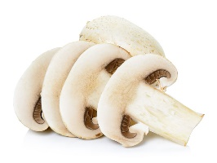
Cut/prepared versus whole mushrooms Cut/prepared fared slightly better in 2021
2021 | Share of total mushroom sales and sales growth %
Market size
$590M
$ growth
-6.4%
Unit growth
-8.6%
Volume growth
-8.3%
No preparation
Market size
$695M
$ growth
-5.7%
Unit growth
-8.4%
Volume growth
-7.8%
Cut
54.1%
of $ sales
Source: IRI, Integrated Fresh, MULO, 52 weeks ending 12/26/2021

Slide 31
Cut/prepared by type White button mushrooms represented nearly half of cut/prepared share
Dollars | Cut/prepared $ | % change vs.’20 | Whole $ | % change vs. 20
Total mushrooms | $695M | -5.7% | $590M | -6.4%
White button | $344M | -8.1% | $326M | -8.6%
Crimini/brown | $179M | -2.9% | $205M | -3.3%
Portabella | $101M | -2.4% | $31M | -6.9%
Pounds | Cut/prepared lbs | % change vs.’20 | Whole lbs | % change vs. 20
Total mushrooms | 151M | -7.8% | 144M | -8.3%
White button | 89M | -9.2% | 85M | -10.4%
Crimini/brown | 36M | -5.1% | 51M | -4.0%
Portabella | 18M | -2.7% | 6M | -12.6%
Source: IRI, Integrated Fresh, MULO, 52 weeks ending 12/26/2021

Slide 32
Five-year trend cut/prepared dollar sales The cut/prepared share bounced back a bit in 2021
Share of total $
54.9% 55.7% 55.2% 53.9% 54.1%
Source: IRI, Integrated Fresh, MULO, 52 weeks ending 12/26/2021

Slide 33
Five-year trend cut/prepared sales The 2021 volume was the second-largest in absolute pounds, its share 51.1%
Share of total
52.3% 53.0% 52.7% 50.9% 51.1%
Source: IRI, Integrated Fresh, MULO, 52 weeks ending 12/26/2021

Slide 34
Thank you
Questions? Comments? Contact the Mushroom Council at
info@mushroomcouncil.org
Visit MushroomCouncil.org for 24/7 access to additional data and reports.

